Slide 1

Introduction to computers
0750099 Pre-Computer Skills
Notes:
Hello, and welcome back!
Today we will talk about Computers, their main operations, and the most common types of computers.

Slide 2
Lecture outline
What is a computer?
Computer Usage
Data and Information
Computer Operations
Types of Computers
Notes:
In this lecture, we will talk about …

Slide 3
Learning outcomes
Learn about Computer definition and its usage.
Recognize the difference between data and information, and how they are related to main computer operations.
Recognize the main types of computers.
Notes:
After you attend this lecture, you should know the following:

Slide 4
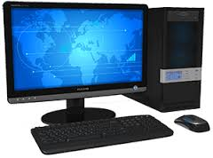
The Computer
Notes:
But, first: What is a Computer?
Computer : is an information processing machine used in different departments and organizations.
So, it is a machine, used to process data and information. Processing can be calculating formulas, merging data together in a way to make it understandable or to produce reports …etc.

Slide 5
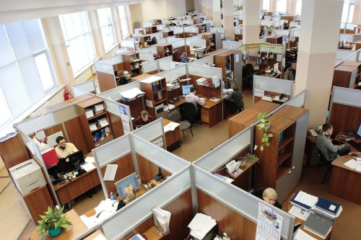
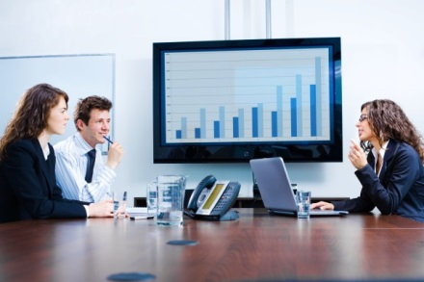
Computer Usage
Companies
Notes:
Where do we use computers?
Computers are used heavily in companies and organizations, not necessarily to produce programs, applications or computer games only, they also can be used to make work easier. Calculations are performed faster, Charts are drawn in more professional and proper manner, important information are stored in more secured way and retrieved easily.

Slide 6
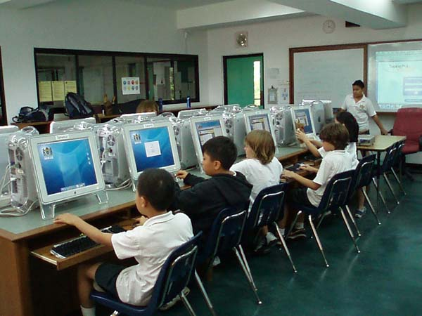
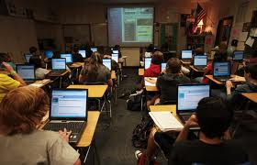
Computer Usage
Schools and Universities
Notes:
We also use computers in schools and universities.
As teachers, we use systems that display and print the names of class students, and we enter their marks through these systems. The averages of students are calculated, and statistical reports can be generated.
As students, computers are used to write an assignment, or a report demanded by their teachers.
Computers are also used for teaching, meaning that the teacher can display presentation slides with the lecture material on them, or students can watch online lectures, as you are doing right now!

Slide 7
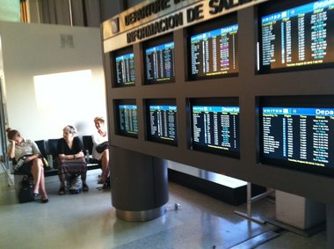
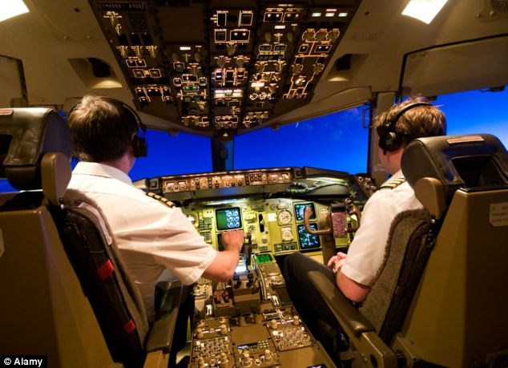
Computer Usage
Airports and Planes
Notes:
Have you ever been at Airports?
Most of you may have.
In Airports, Flights are managed and monitored using computers, flights departure and arrival times are displayed in large screens for passengers. These screens are connected to very complicated computer systems.
Planes have pilots. Human pilots who depend on computers to find the best flying path, and proper speed, proper altitude, …etc.

Slide 8
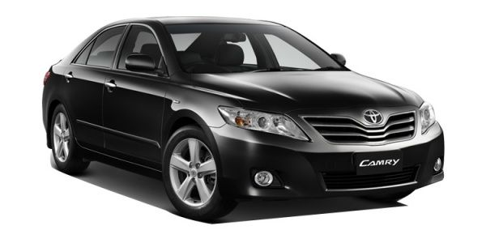
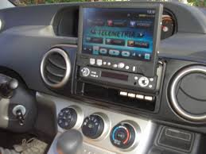
Computer Usage
Cars
Notes:
Modern cars use computers. The car engine is controlled by a computer program, managing the oil usage, the speed measuring, the security considerations regarding seat belts, doors, and give alarms for many problems that might happen to the car.

Slide 9
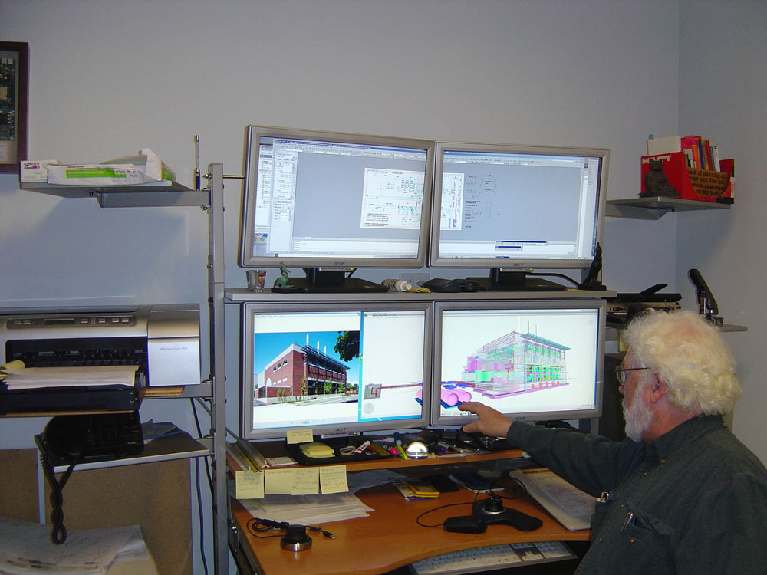
Computer Usage
Architecture Engineering
Notes:
Architecture Engineers use computers to design houses, building, roads, bridges, …etc. Also, computers help them in calculating the amounts and cost of material needed for any construction project.

Slide 10
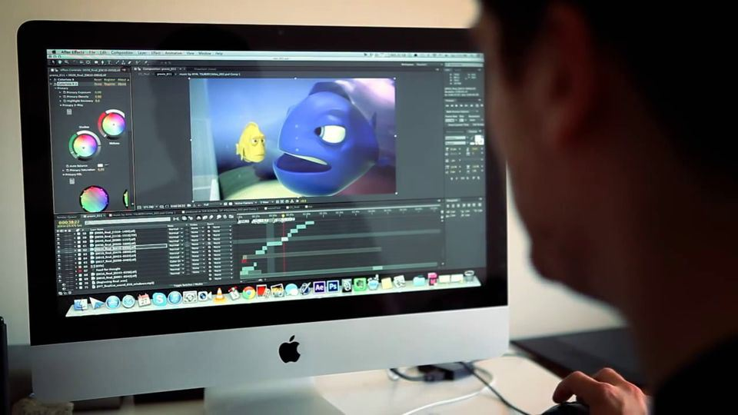
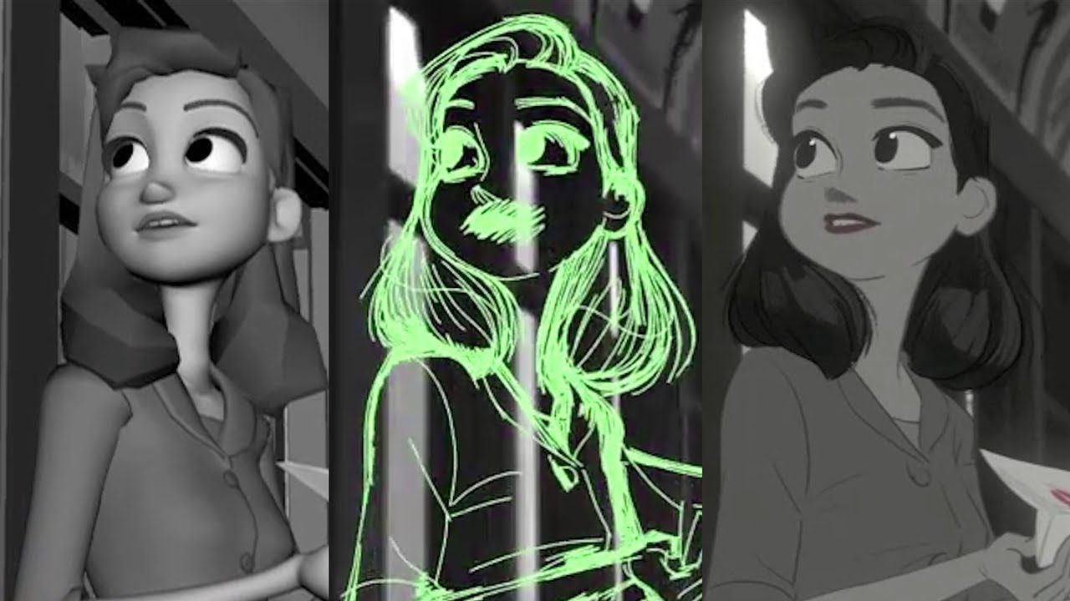
Computer Usage
Movie Industry
Notes:
Last, but not least, movie industry.
Animation movies are designed, drawn and animated using computer programs. Even movies performed by real actors are created using computer programs that design the backgrounds of the scenes, and even the dangerous scenes may be created by computers instead of human actors.

Slide 11
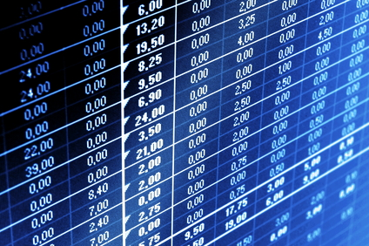
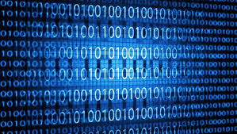
Data and Information
Notes:
Now, before talking about computer operations, we need to understand and distinguish between two concepts:
Data and Information
What is Data?
Data is the raw facts gathered about certain objects. For example, data about students and teachers in a university. Data about citizens in a country. Data about employees in a company.
These data may don’t have important meaning by itself. But, when they are gathered or merged in a proper manner, they produce information.
So, Information, are meaningful data, that can be used in a beneficiary manner.

Slide 12
Data and Information (Example)
Student Data: Number, Name, Major, Date of Birth…etc.
Course Data: Number, Name, Faculty…etc.
Teacher Data: Number, Name, Degree, Major, …etc.
Halls Data: Number, Location, Capacity,…etc.
Information: A Student Course Schedules
(Students, Courses, Teachers, Halls)
Notes:
Let’s have an example, that may make these concepts more clear.
In a university, we gather data about students, like their number, names, major, data of birth,…etc.
Also, coursed taught in the university, have important data such as, number, name, the faculty that teaches this courses, ..etc.
The same applies, for teachers, an halls.
If we looked at each of these data separately, they might not be that useful. I can retrieve student data alone, but I can’t connect them with the courses they study or the teachers that teach these courses!
So, I have to create this connection, by “Processing” data using computers and produce information.
In this example, information may be resembled by the Student Course Schedule.
Each one of you, try to check your course schedule report. You can find that it has certain data about you, the student, your name, number, Major. It has also the number and names of courses registered for this semester, the names of teachers assigned to these courses, and also the number of halls where to attend these courses.
See, This report has merged data in a way that gives use meaningful and useful information that you need as a student.

Slide 13

Computer Operations
Computer
INPUT
PROCESSING
OUTPUT
Receive Data
Produce Information
Notes:
So, that will lead us to the main Operations performed by a Computer System
1. Input: Which is receiving raw data from outside the computer using input devices such as keyboard and mouse. Who enters these data? Of course, the user. In later lectures we will discuss many types of input devices.
2. Processing: The computer has received the data, and it will start processing it, in a proper manner that suits the user needs. Processing may be merging data to product information report, as in the Student Course Schedule example. Or performing calculations on the data to produce certain results, or transforming data into useful charts.
3. Finally, Output: After computer has processed the data and transformed it into useful information, these information should be given to the user in a proper way, either by printing them using printers, or displaying them on monitors. Printers and monitors are called output devices. We will discuss them in details later.
So, The main three computer operations are: Input, Processing and Output.

Slide 14
Types of Computers
According to their capacity and performance, computers are classified into six categories:
Notes:
Now, we will discuss types of computers available for users. We have several types of computers, that differ according to their capacity (the size of data that can be stored in them) and performance (which is the speed of processing data and producing information).
Thus, we have 6 categories or types of computers.

Slide 15
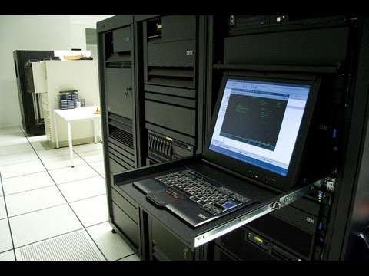
Types of Computers
Super Computers.
High capacity
Very expensive
Research
Notes:
Super Computers, as you can see, are large computers, with very high capacity and of course, very expensive.
Usually, they are used for research that need very large amount of data.

Slide 16
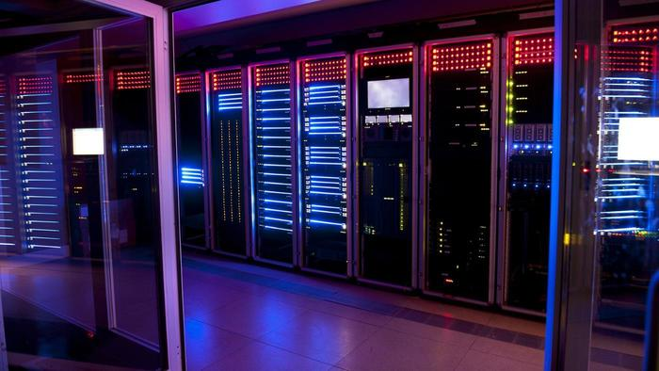
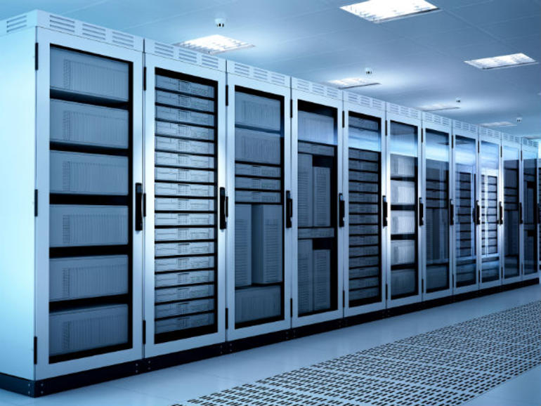
Types of Computers
2. Mainframes
Room-sized
Expensive
High speed
Large storage capacities
Large Organizations
Notes:
Mainframes, are also large sized computers. They usually occupy whole rooms in organizations. They are expensive, but with high processing speed and large storage capacities. Usually used in large organizations such as banks and government institutions.
Mainframes are used to store all data and programs needed in an organization operations, where user access the needed data by terminals (screens that display needed information) connected to the Mainframe.
Some of these terminals are considered dump-terminals (they only display information).
Others are considered intelligent-terminals, that allow users to process data or select the information needed to be displayed. Usually, such terminals work by user touch.

Slide 17
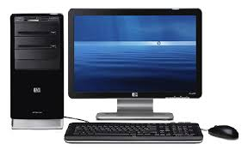

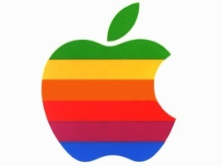
Types of Computers
3. Personal Computers (PCs)
Small computer with its own system.
Not expensive
Very popular
IBM compatible.
Apple Computers.
Notes:
Personal Computers, PCs.
They are small computers that has a full computer system, input devices, processor and output devices.
They are not expensive like the previous types of computers, and they are very popular. Most people own PCs in their homes. Employees in companies use PCs. Teachers and students in universities and schools use PCs. You may be watching this video, using a PC.
There are two types of PCs in computer markets:
IBM Compatible Computers: Which can run the same programs as computers made by IBM company. IBM, is a Large computer company, that produced one of the main operating systems called Windows. Compatible computers may be PCs that are not manufactured by IBM, but they can use its Windows and other programs.
Apple Computers: Apple is another large computer company, which can be considered the main competitor of IBM. They use their own operating system (named MAC), which needs special devices and software.

Slide 18
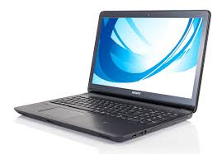
Types of Computers
4. Laptop Computers
Small
Briefcase-sized
Portable
As powerful as PC
More expensive than PC
Notes:
Laptop computers, are small, that you can hold it by a briefcase. Portable, you can use it at home, at university, at your friends house, wherever you go, you can take it with you.
It is as powerful as PCs, and also, you can find IBM compatible laptops and Apple laptops. But, it may be a little bit more expensive that a PC, because of its portability.

Slide 19
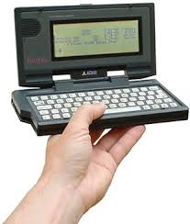
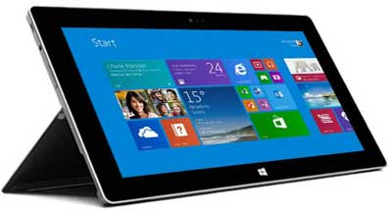
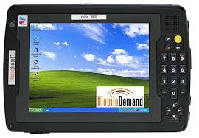
Types of Computers
5. Palmtop Computers
Notepads
Hand-held computer
Small
Less expensive than a laptop or a PC
Pens are used
Notes:
Palmtop computers, which are also called Notepads, are small computers that can be held with one hand.
They are less expensive than a laptop or a PC.
Some newer versions of Notepads (Such as iPad, or tablets), use pens or touch to perform their operations.

Slide 20
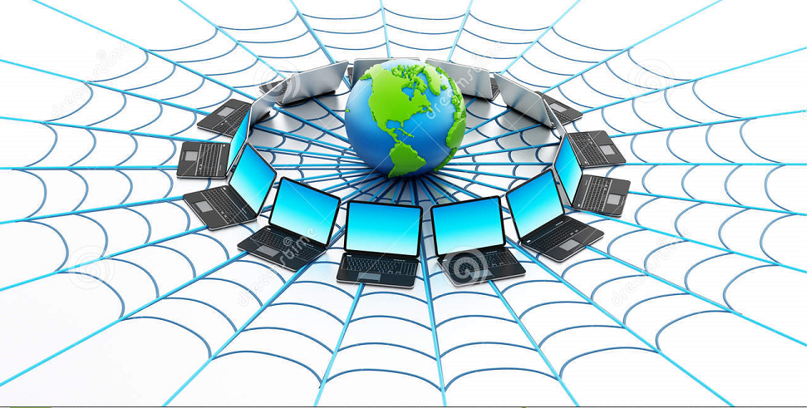
Types of Computers
6. Network Computers NC:
Notes:
Finally, Network Computers.
They are a set of computers that are connected together and share data and resources. They can be connected by hard wires in a certain company or institution, or connected in a wider range using the Internet.

Slide 21
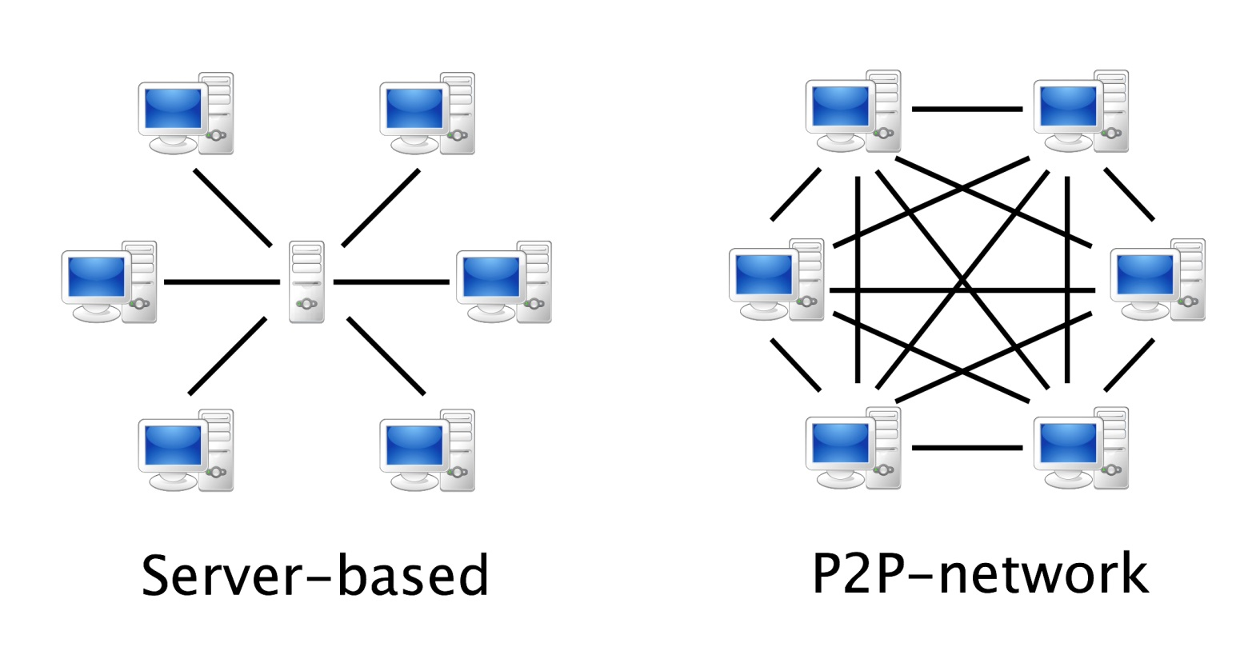
Types of Computers
7. Network Computers NC:
Client-Server Network
Peer-to-Peer Network
Notes:
For local networks (within an organization), there are two main types of Network computers:
1. Peer-to-Peer Network: which is a set of connected PCs that can be work independently and can share data and resources. Meaning that, each computer in the network, has its own system, programs and data, but they can be shared with other computers within the same network.
2. Client-Server Network: It has a large Computer which is called a (Server) that has the main needed programs and data in an organization, and it is connect to other computer that called (clients). A sever can share resources and data with the clients, but clients themselves can have their own programs and data that can work independently.
This is the main difference between a Client-Server Network and a Mainframe. Since, for mainframes, terminals totally depend on it for programs and data.

Slide 22
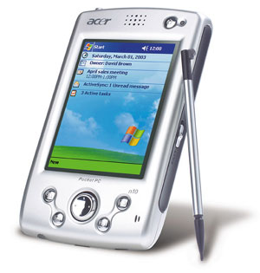
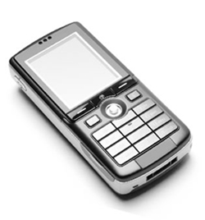
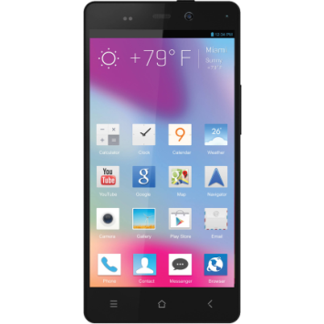
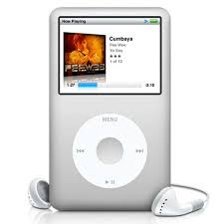
Hand-held portable Digital Devices
Personal Digital Assistant(PDA):
Mobile Phone
Smartphone
Multimedia player
iPod
Notes:
We have other types of devices that are considered as computers as well, but they are small and portable and easier to hold and use.
Personal Digital Assistant (PDA): Uses small pens to write commands, enter data and operate programs. It is usually used to send and receive emails and faxes, write memos, play games, and keep an appointment calendar.
Mobile Phone: it is an electronic telecommunication device, also called cellular phone, or cellphone. They are usually used to make phone calls, send and receive text messages, and some of them may have an internet connection that helps users to web browse and email check.
Smartphone: is a mobile phone that has a more PC-like functionality. Meaning that, you can use it for phone calls, text messages, multimedia messages, using the Internet, and also you can install applications that may be useful for study or work, or for entertainment like games.
Multimedia Player: is a special-purpose device, that is used mainly to run digital music and video files. A famous example that is used a lot by different types of people, is the iPod manufactured by Apple.

Slide 23
The end
Notes:
That’s all for today, thank you for watching and see you next lecture.

