Slide 1

Computer components, part i
0750099 Pre-Computer Skills
Notes:
Hello, and welcome back!

Slide 2
Lecture outline
Hardware Vs. Software
Hardware
Central Processing Unit (CPU)
Parts
Operations
Memory
Primary Memory
Secondary Memory
Notes:
In this lecture, we will talk about …

Slide 3
Learning outcomes
Be able to distinguish between Hardware and Software
Learn about Central Processing Unit, its components and main operations.
Be able to distinguish between types of Memory, and their characteristics.
Notes:
After you attend this lecture, you should know the following:

Slide 4
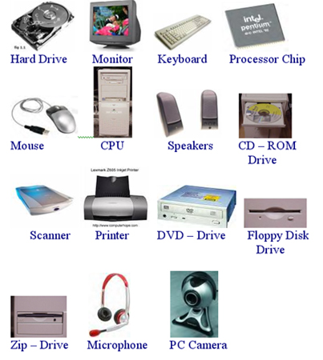
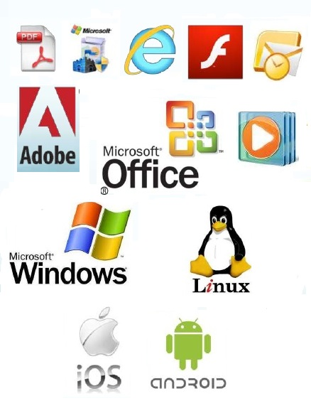
main computer system components
Hardware
Software
Notes:
The computer system components are divided into two main types: Hardware and Software.
Hardware: are the physical components in the computer system, for example, screen, cables, keyboard, printer, and the inner components hidden inside the computer case. They cannot work alone without software.
Software, on the other hand, is a set of programs, data and information. Programs that can be used to operate the computer system, and control the interaction between its hardware components together, or programs that can be used by different types of users.
We will talk in more details about software in coming lectures.

Slide 5
Hardware
System Unit: The hardware components that are used to process and store data.
a. CPU (Central Processing Unit)
b. Memory
Notes:
Let’s start talking about the hardware components of a computer system.
The Hardware is divided into three major components:
The System Unit, which includes components that are used to process and store data and information.
System unit consists mainly of the CPU and the Memory.
In today’s lecture we will talk in more details about system unit.

Slide 6
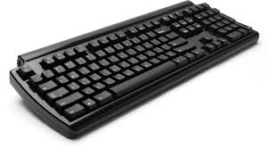
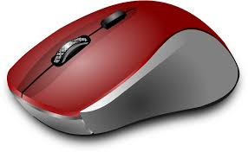
Hardware
Input Devices
Function: Insert Data
Notes:
2. The second group of Hardware components are Input devices.
Which are devices used to enable the computer to receive or insert data. Most famous examples of input devices are Keyboards, mouses and cameras.

Slide 7
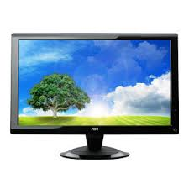
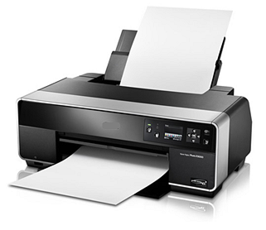
Hardware
Output Devices
Function: Display Information
Notes:
3. Output devices, are used to translate the information processed by the computer into a form that humans can understand, (display information). For example, screens, printers and speakers.
Input and Output devices will be discussed in more details in the next lecture.

Slide 8
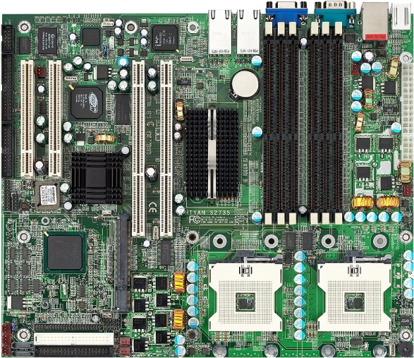
motherboard
Notes:
Now, we will start discussing the System unit, which its major component is Motherboard.
A motherboard: is a circuit board that is located in the computer case, where power, CPU, main memory and other computer hardware components are attached to.

Slide 9
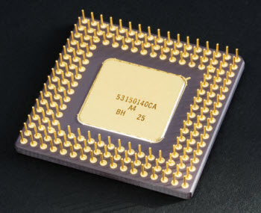
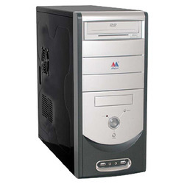
Central processing unit (cpu)
Definition: It is the central electronic chip that determines the processing power of the computer.
Notes:
The CPU or Central processing unit, is the central electronic chip that consumes and produces data and its power determines the processing power of the computer.
This small chip, is located into the computer case. Later, after we finish talking about hardware, I will show you a real computer system, and open its case to locate each of the components we talked about.

Slide 10

Central processing unit (cpu)
Brain of the Computer
Interpret (translate) and
Executes Instructions
MHz (Megahertz) or GHz (Gigahertz)
Notes:
The CPU, is considered the Brain of the computer.
As your brain as a human, translates the scenes you see and the voices you hear (which are considered input), into meaningful information (for example, this is a bird, this is a voice of a bird).. The CPU, does a similar job.
The CPU interprets or translates instructions in a certain program and executes them. i.e. it processes data inside the computer.
Since the CPU determines the speed of your computer, then the speed has to be measured. So, CPU speed is measured by Megahertz or Gigahertz.

Slide 11
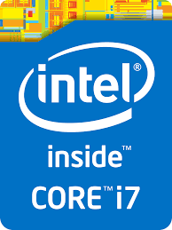
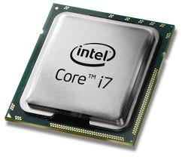
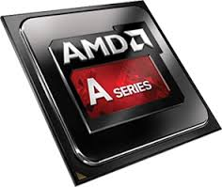
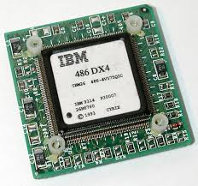
Central processing unit (cpu)
Intel
AMD
IBM
Notes:
CPUs are manufactured by several companies. Intel CPUs, are the most used in PCs and Laptops. AMD and IBM also are famous companies to produce CPUs.
Check your PC or laptop, you will find a sticker, like the one displayed, specifying the type of processor/CPU used. The displayed sticker indicates that a processor is manufactured by intel.

Slide 12
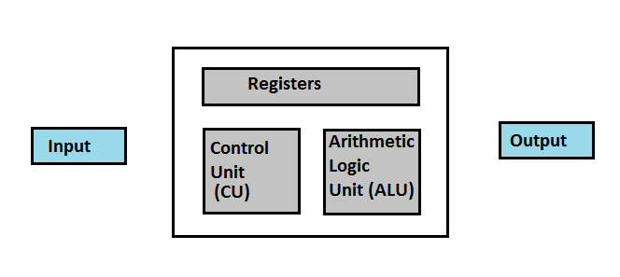
Cpu parts
CPU
Notes:
The CPU, consists of three main parts:
Arithmetic Logic Unit (ALU)
Control Unit (CU)
Registers or Immediate Access Memory.

Slide 13
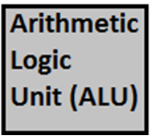




CPU parts
Directs Programs’ Instructions
Directs Electronic Signals
Arithmetic Operations
(+, -, *, /)
Logical Operations (>, <, =, <=, >=, <>)
Memory
ALU Data
Program Instructions
Buses
Wires
Transmits Data
Notes:
Arithmetic Logic Unit (ALU):
It performs arithmetic operations (addition, subtraction, multiplication and division).
Also, it performs logical operations (also called comparison operations, which are: greater than, less than, equal, less than or equal, greater than or equal and not equal).
In addition to performing these operations, ALU controls their speed.
2. Control Unit (CU):
1. Directs the rest of computer system how to carry out a program’s instruction.
2. Directs the movement of electronic signals between memory and ALU, and between memory and the input and output devices.
3. Registers or called Immediate Access Memory:
They are a high speed memory used to immediately store:
1. Data that is used by the ALU. (For example the numbers in an equation, or the result of sub equation).
2. Program instructions which are used by the Control Unit.
To connect between these three parts, Buses are used.
Buses are collection of wires that transmit data from one computer part to another, either within the CPU, or between the CPU, memory and Input/Output devices.

Slide 14
Memory
Also called Main Memory.
Definition: Special places in the computer system, where data and programs are stored (temporarily) until they are no longer needed.
Memory Main Types:
Primary Memory
Secondary Memory
Notes:
Now, we are going to discuss the second important part of the System Unit, which is the Memory.
The computer system stores data and information, like photos, slides and other types of files, into special places named Memory.
Memory, enables the user to get (retrieve) data whenever needed.
There are two main types of memory, which we will describe in detail in the coming slides:
Primary memory (which is a type of memory that must exist in any computer system)
and secondary memory (which are extra storage spaces, that does not have to exist in a computer system).

Slide 15
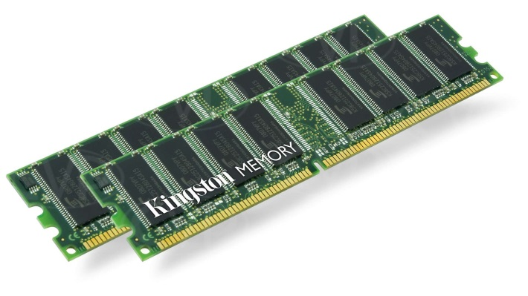
Primary Memory
Forms of Primary Memory (Storage) are:
RAM (Random Access Memory).
Chip attached to motherboard.
Stores data and programs temporarily
Windows and other programs.
Volatile
Speed measured in MHz and GHz.
Size 64, 128, 256, 512 Megabytes.
Notes:
There are several forms of Primary Memory:
RAM (Random Access Memory)
- It is a chip attached to motherboard.
RAM, stores data and programs instructions temporarily in a way that enables rapid data processing.
When you switch on your computer, Operating system, for example windows, is loaded into it. Also, when you start an application it is copied there to obtain quick access.
It is a volatile memory, meaning that the data contained in the RAM is lost when the power is turned off.
RAM speed is measured in Megahertz and Gigahertz.
Since it is a memory, so it has a size. Sizes of RAM differs from a computer system to another. RAM is attached to motherboard as several pieces, as you can see in the picture. The largest piece manufactured till the moment of this lecture, is 32 Gigabytes. You can attach more than one piece to motherboard to increase the size of RAM, till for example 1 terabyte. Surely, the size of RAM determines its speed.

Slide 16
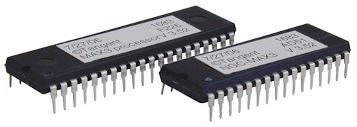
PRIMARY MEMORY
ROM (Read Only Memory).
Stores program (booting) instructions.
Cannot be written on it.
Not volatile.
Very small capacity.
Notes:
Another form of Primary Memory is ROM.
Read Only Memory.
This type of memory is used for storing the main program instructions needed to start up the computer system, which are called the booting-up instructions.
These instructions are vital, and if they are deleted, the computer won’t be able to start. Thus, it is a Read Only Memory, cannot be written on.
Also, for the importance of the instructions stored in it, ROM, is not volatile, meaning that it keeps the stored data and prevent its loss, even when the computer is turned off.
But, it has a very small capacity because of its limited job.

Slide 17
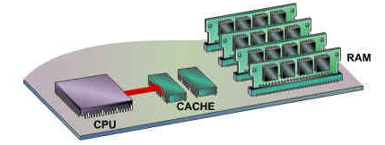
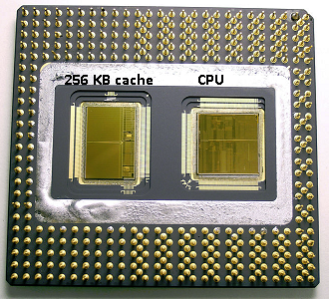
PRIMARY MEMORY
Cache Memory
Linked to CPU.
Very fast chips
Keeps frequent programs and data.
Reduce gap between CPU and RAM.
Size up to 512 Kilobytes (KB).
Notes:
Cache Memory, is another form of Primary memory.
It is usually it is attached to the motherboard next to CPU and it is linked to it.
It has very fast chips, and it helps in increasing the speed of a computer.
It keeps frequently used programs and data.
CPU can access cache memory more quickly than it can access RAM.
So, when CPU needs data, it first looks in cache memory.
Usually size of cache memory is 512 KB, but you may find smaller sizes down to 64 KB for older machines. And may find larger-sized cache memory up to 1 or 2 Megabytes.

Slide 18
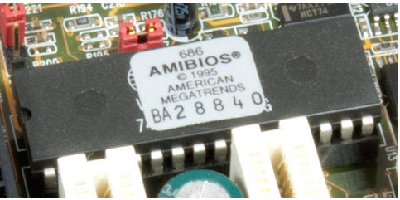
PRIMARY MEMORY
ROM-BIOS Memory
BIOS: Basic Input/Output System.
Special small capacity chip.
Read Only Memory
Non-volatile
Stores the software that defines Input/Output Devices.
Notes:
ROM-BIOS Memory
BIOS Stands for, Basic Input/Output System.
It is a special small capacity chip held to the motherboard.
It is a Read Only Memory, that is Non-Volatile, meaning it keeps its contents even if the power is off.
Since, it stores important software that defines the Input and Output devices connected to the computer system.

Slide 19
Secondary MEMORY
Storage Devices
External Storage
Definition: It is any memory devices that save the result of the processed data permanently for later retrieval.
Notes:
The other main type of memory, is the secondary memory.
It is also called Storage devices or External Storage.
There are several types of storage devices that are used in a computer system.

Slide 20
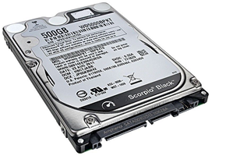
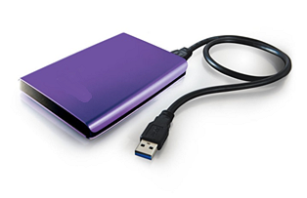
Secondary MEMORY
Hard Disks
Internal Hard Disks
Located inside the computer case.
Not-portable
High capacity (GB, TB)
High speed.
External Hard Disks
Same capacity range.
Slower
More Expensive
USB Port
Notes:
We will start with Hard disks.
The internal hard disks, are located within the computer system, in the computer case, and it is non-portable. You can’t move it freely out of the system.
It is used to store programs and large files.
It has a high capacity, that is measured in gigabytes. Some hard disk may be up to 500 gigabytes, or even 1 terabyte.
And they are very fast, information can be retrieved easily from them. But, they are slower than the primary memory.
Other type of hard disks, is External hard disks.
Usually used for backups, they also have high capacity, but a little bit slower than internal hard disk.
It is more expensive than internal hard disks.
It is usually connected to the computer system by a USB port.

Slide 21
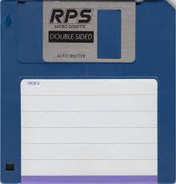
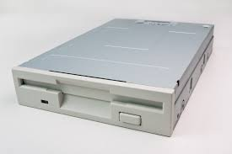
Secondary MEMORY
Floppy Disks
Small disk
Special Drive
Low speed
Capacity 1.4 MB
Portable
Notes:
Floppy disks, are old versions of storage devices, that maybe not used nowadays. But, back then, they were the most important storage devices.
They small in size, physically
They had special drives in the computer case.
They are lower in speed than the hard disk, and other storage devices.
Limited capacity of 1.4 Megabytes only, of course can’t store large files.
It is portable, so that used to transfer data from one computer to another
By the way, in most programs, as you can see in later lectures, in Microsoft office for example, the Save icon is the image of a floppy disk.
This is a toolbar in PowerPoint program, see here, this button looks like a floppy disk, when you press on it in the program, the new changes in the slides are saved.

Slide 22
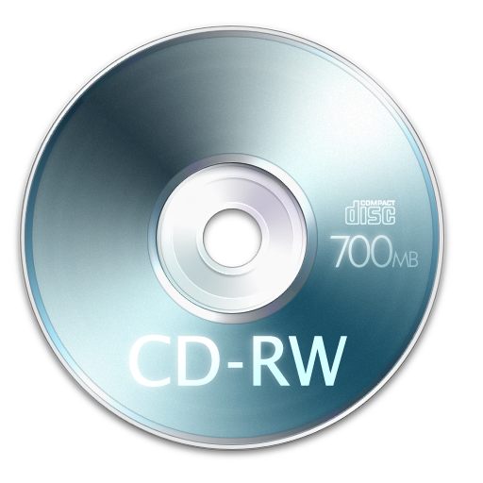
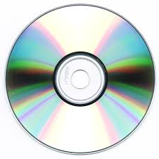
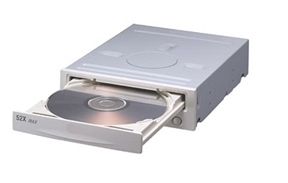
Secondary MEMORY
CD-ROM (Compact Disk - Read Only Memory)
Optical disk
Special Drive
High Speed
Capacity 700 MB
Portable
ROM / RW
Fragile
Notes:
CD-ROM (Stands for Compact Disk – Read Only Memory)
It is an optical disk, meaning, it uses laser to read information.
It also has its own drive attached to the computer case.
It is a high speed memory, but still slower than a hard disk.
It has a limited capacity of 700 MB.
And of course it is portable.
Usually it is a read only memory, some types of them are re-writeable.
THEY HAD A MAJOR PROBLEM OF BEING VERY FRAGILE, THEY ARE VERY THIN (AROUND 2MM), SO THEY BREAK EASILY, AND THEY CAN BE SCRATCHED EASILY AS WELL.

Slide 23
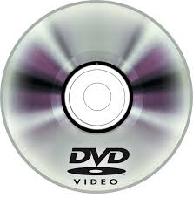
Secondary MEMORY
DVD (Digital Versatile Disk)
Development of CD
High Capacity (Over 4 GB)
High Speed
Store Videos
Notes:
DVD stands for Digital Versatile Disk
It is a development in CDs , with higher capacity over 4 GBs.
It is of high speed, and used to store high quality video files.

Slide 24
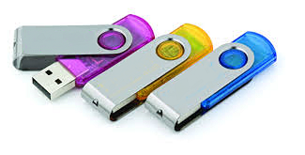
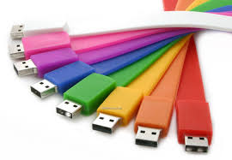
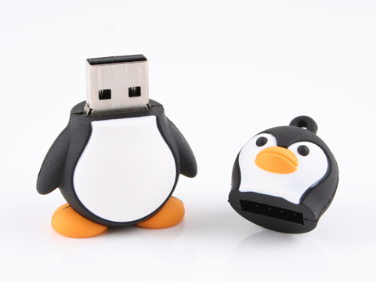
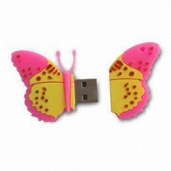
Secondary MEMORY
USB Flash Drives
Small storage devices
Come with different colors and shapes.
Easy-to-use
Portable
High capacities, over 64 MB.
Notes:
USB Flash Drive
They are small storage devices, come with different colors and shapes. Sometimes cute shapes…
They are easy-to-use, since they are portable, and can be held in your packet, bag, even with your keys.
It has high capacities, 16, 32, 64 and more MB.

Slide 25
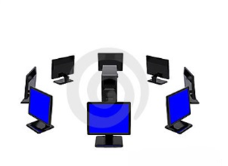
Secondary MEMORY
Network Drive
Is the hard disk of a remote computer that is connected to yours by a network.
Notes:
Network Drive
A hard disk of a remote computer that is connected to yours by a network.
You can share space in the hard disk of that computer to save your files, or to retrieve files already stored there.

Slide 26



Secondary MEMORY
Online File Storage
Internet Hosting Service
Store Files
Share Files
Famous Hosts
Notes:
Online File Storage.
It is an internet hosting service, that allows you to store large files are not web pages, for example, videos, images and any type of files.
This type of Storage, help users to access large storage data, and share files with other users through the internet
Some famous hosts used for this storage are, google drive, drop box and icloud.

Slide 27
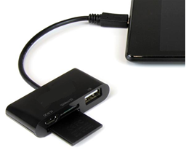
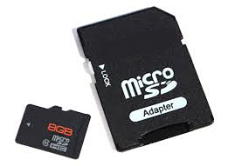
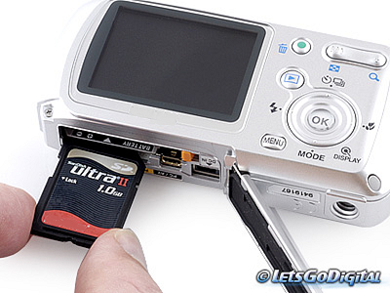
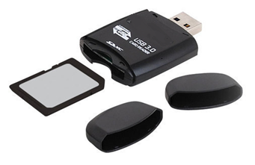
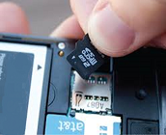
Secondary MEMORY
Memory Cards
Electronic Data Storage Device
Used in:
Digital Cameras
Smartphones
Can be attached:
Inside the device
Card Reader
Notes:
Memory Cards

Slide 28
Memory speed – in order
Registers (in CPU)
Cache memory
RAM
Hard disk
Internal
External
Rest of storage devices
Notes:
The different types of memory we talked about earlier, differ in their speed.
The fastest memory, are the registers, that are located in the CPU, since they are used in the processing, and thus this needs a very high speed.
Then comes, the cache memory, and after it the RAM.
Remember when I mentioned that the CPU checks the cache memory first when access of data is needed, since it is faster than RAM.
Then comes the hard disk, the internal hard disk of course, then comes the external hard disk.
And finally comes the other secondary storage devices, such as USB flash.

Slide 29
The end
Notes:
Let’s wrap everything up,…
Today, we distinguished between hardware and software
Then, we talked about some Hardware components, Motherboard, CPU, and memory.
We divided memory into two groups, primary and secondary.
And then described several types of each group.
And finally, ordered the speed of the most used types of memory.
That’s all for today, thank you for watching and see you next lecture.

