Slide 1

Computer components, part ii
0750099 Pre-Computer Skills
Notes:
Hello, and welcome back!

Slide 2

Lecture outline
Input/Output Devices
Types of Input/Output Devices
Monitors and their characteristics
Printers, job and types
Factors affecting computer performance.
Data representation in Memory.
Memory capacity measurement.
Notes:
In this lecture, we will talk about …

Slide 3
Learning outcomes
Gain knowledge about the different types of input and output devices and their usage.
Gain deeper information about monitors and printers.
Know the factors that affect the computer performance.
Understand the way data is represented in memory.
Learn the memory capacity measuring units.
Notes:
At the end of the lecture, you will learn the following:

Slide 4
Input/output devices
Input Devices: Hardware devices that allow you to input (insert) data into the computer system.
Output Devices: Hardware devices that allow you to output (display or print) information from the computer system.
Notes:
Let’s review the definitions of input and output devices
Input devices are: ….
Output devices are: ….
Today, I will show you several examples of such devices.

Slide 5
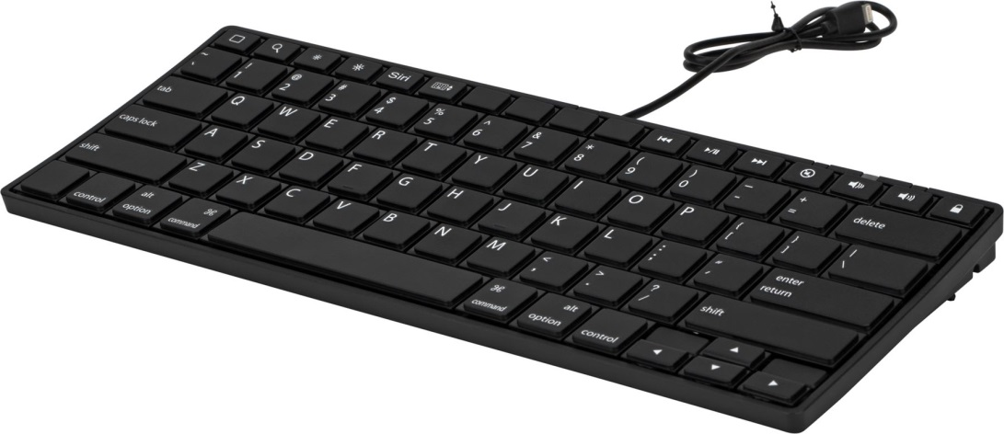
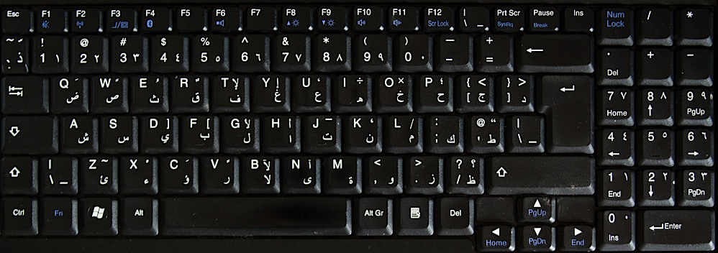
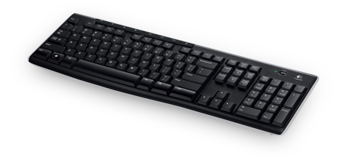
Input devices
Keyboards
Notes:
One of the most used input devices, used to enter written data into computer system, is the Keyboard.
Keyboard, contains the standard typewriter keys, which are the alphabets and numbers. Alphabets are used to write words and paragraphs.
It also contains specialized keys, such as functional keys labeled F1, F2, …etc. Enter and delete keys are other examples.
The displayed keyboard has English alphabets on its keys, but keyboards manufactured for Arab countries, have Arabic keys as well, and you can switch between English and Arabic keys, we will explain this later when we talk about word processing using Microsoft word.
Keyboards can be connected to the computer system using wires, or they can be wireless and send special signals to the CPU.

Slide 6
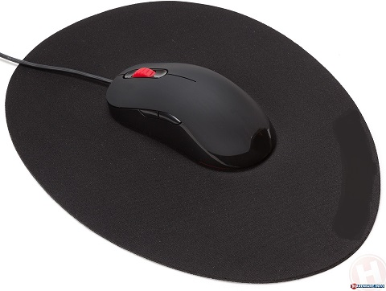
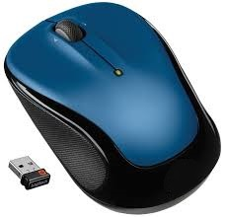
Input devices
Mouse
Notes:
Mouse: is a small hand-held device, that is shaped like a mouse.
It rolls over a special mouse pad to move the cursor on the screen.
It has buttons that performs certain operations when pressing on them.
It can be connected to the PC by a wire, or it can be wireless.
Wireless mouse, has a special USB part, that is attached to a USB port in your device, and you can use the mouse freely in a reasonable far distance of the device, according to the signal power of the mouse.
Mouse and its operations will be discussed in more detail in coming lectures.

Slide 7
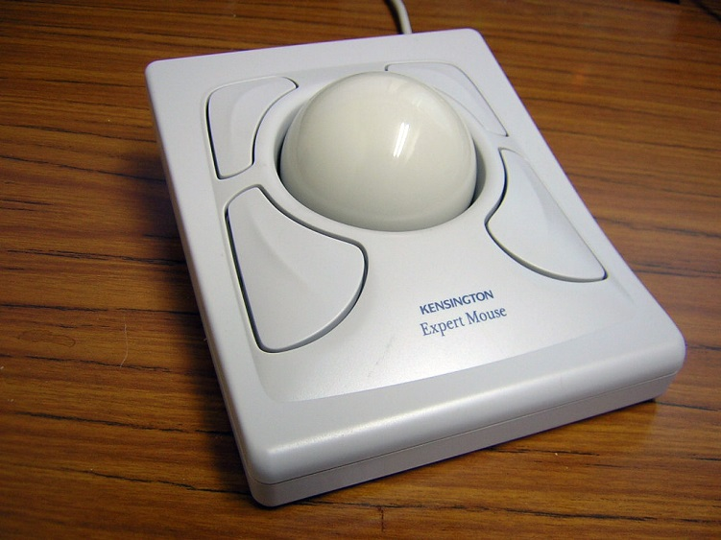
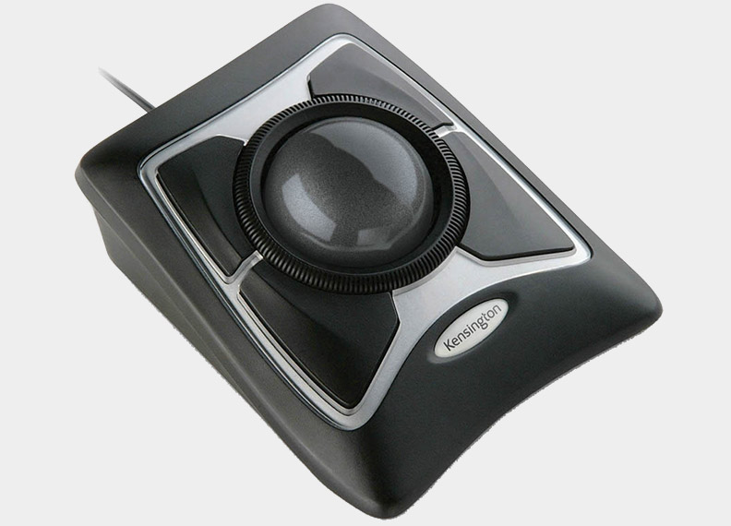
Input devices
Trackball
Notes:
Trackballs, is a special type of a mouse.
To move the cursor on the screen, just roll the ball with your finger.
It saves space on the disk, since you don’t need to move the whole device as you are doing with the mouse.
Sometimes, it is used for programs that needs more accurate movement on the screen.

Slide 8
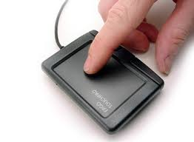
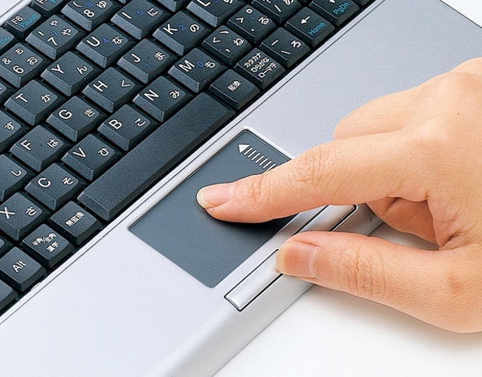
Input devices
Touch Pad
Notes:
A Touch pad, is also a type of a mouse, used to move the cursor on the screen.
So it is a touch sensitive device. When you move your finger on the surface, the cursor is moved on the screen.
It is mainly used in laptops as a replacement of a mouse.

Slide 9
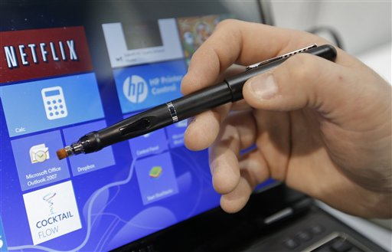
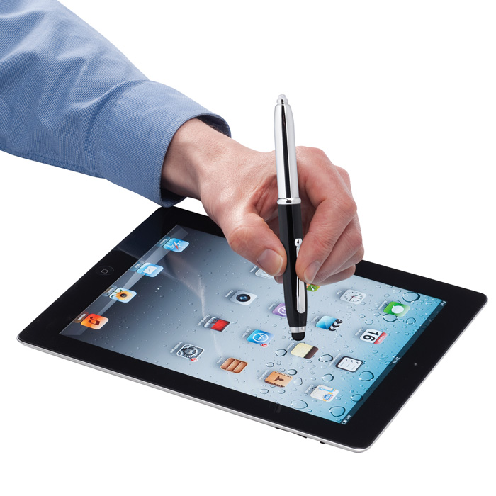
Input devices
Light Pen
Notes:
A light pen, is a device used to point on certain objects on the screen.
Surely, special screens are used to interact with this pen to take any touch or pointing done by the pen.
It can be used on separate screens, laptop screens and mostly used on modern tablets.

Slide 10
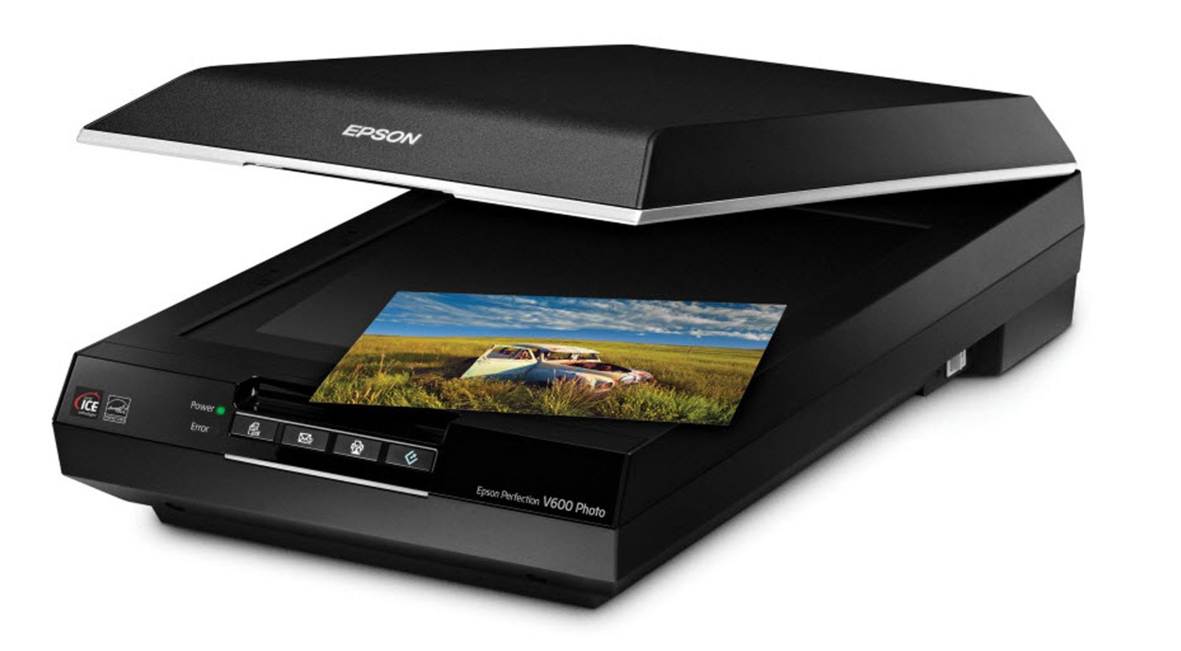
Input devices
Scanners
Notes:
A scanner, is a device used to transform a hard data into soft data.
Meaning that, it converts a photo, into a digital image that can be saved on a computer.
Or convert a paper document to a soft document also saved on a computer.
Of course, a special software should be installed separately, or with the operating system, so that you can use this scanner for this purpose.
The resulted files, images or documents, can be manipulated later when they become digital using special software programs.

Slide 11
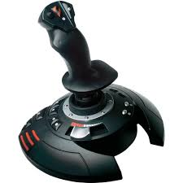
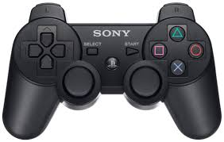
Input devices
Joystick
Notes:
A joystick is a small hand-held device, that is held and used by user hands. It may have a stick that by moving it, a certain object is moved on the screen. Also, it has buttons that when pressing them, certain operations can be done.
Usually, joysticks are used in Computer games to move the characters or objects in a game.

Slide 12
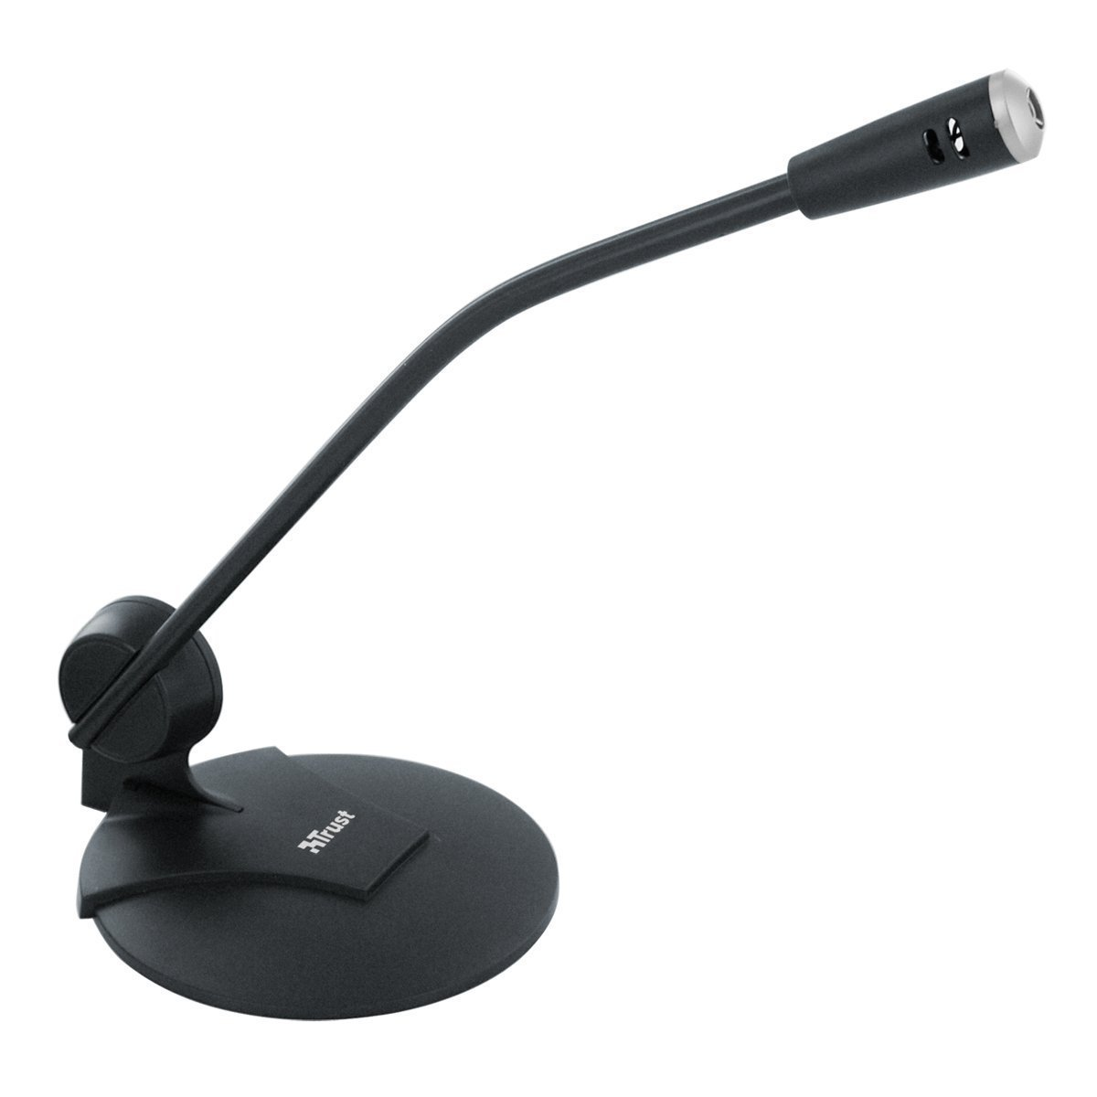
Input devices
Microphone
Notes:
A microphone is used to input your voice, music, or any type of voices, into an audio file, than can be recorded and played again whenever you like.
Microphones can be a separate device, as you can see in the picture, connected to the computer, either by wire, or wireless.
But, may computers, specially laptops, has a built-in microphone, which can be used for the same purpose.

Slide 13
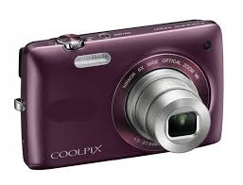
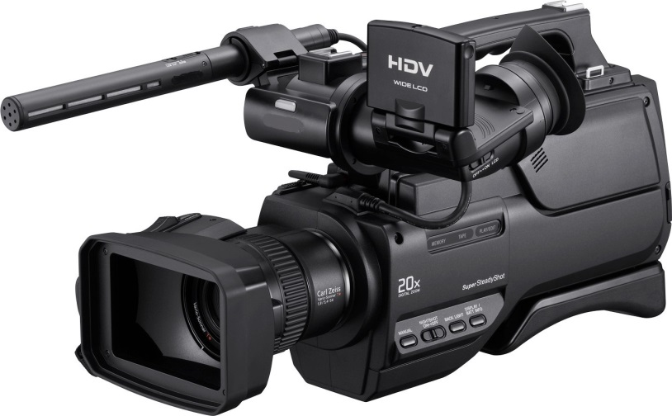
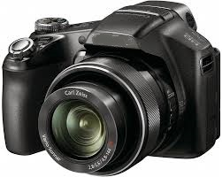
Input devices
Digital Camera
Notes:
A digital camera, is like an ordinary camera, it takes photos and videos. But, it uses a flash memory to save these photos and videos into digital files that can be transmitted to a computer.
Digital cameras differ in their options, according to the required usage. Professional photographers use more complex types of cameras that have developed options that control the brightness, the contrast, the zooming and other aspects of photos.

Slide 14
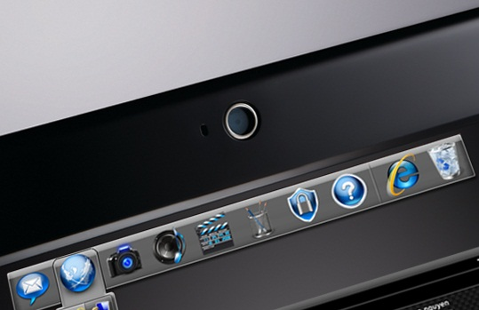
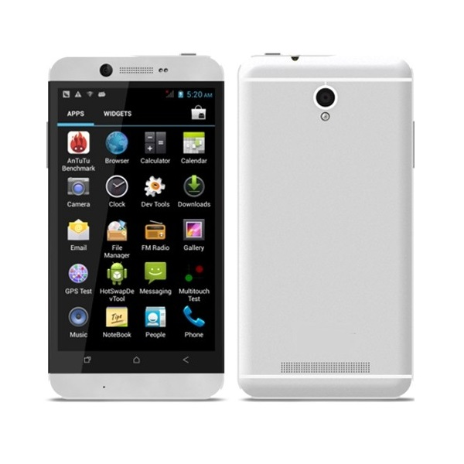
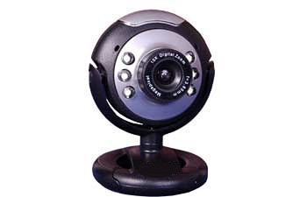

Input devices
Web Cameras
Notes:
A web camera
Is a digital camera connected to a PC or a laptop using a special wire. It is usually used in live chats conducted over the internet.
Laptops, usually have their own built-in web cameras, and also smart phones.
Note that Smart phones usually have two cameras, one to shoot ordinary photos and pages, and one in front to shoot selfie photos.

Slide 15
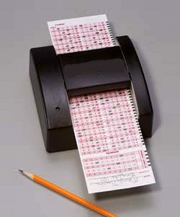
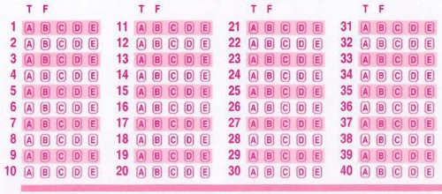
Input devices
Optical Mark Reader (OMR)
Notes:
Optical Mark Reader or OMR
Is a special-purpose input device, that is used to read the answer sheet of an exam. The answer sheet is designed in a special form, and it is usually used for Multiple choice questions.

Slide 16
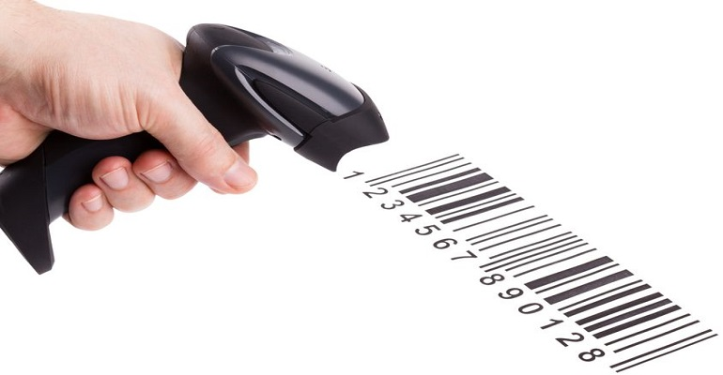
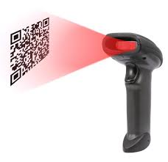
Input devices
Barcode Readers
Notes:
Barcode Readers, are also special-purpose input devices, and they are considered a type of scanners, that scan special images, called barcodes. Barcodes are images that are designed to hide special data about items in a certain store. And whenever it is scanned using this reader, the data are inserted into the computer.

Slide 17
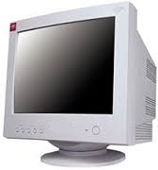
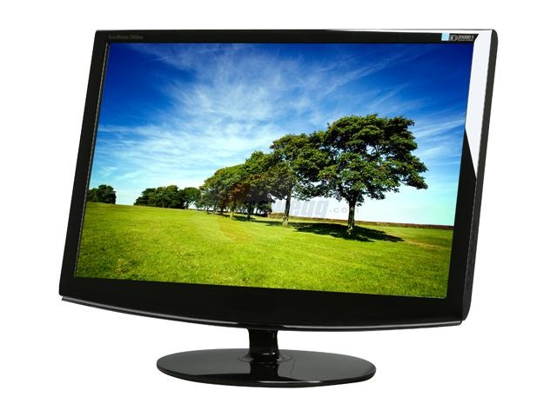
Output devices
Monitors (Screens)
Notes:
Now, let’s start with the output devices.
Monitors or screens are considered the most famous output device used in a computer system, to display photos, videos, documents and all programs in the computer.
There are several types and shapes of screens, which will be discussed in more detail, later in this lecture.

Slide 18
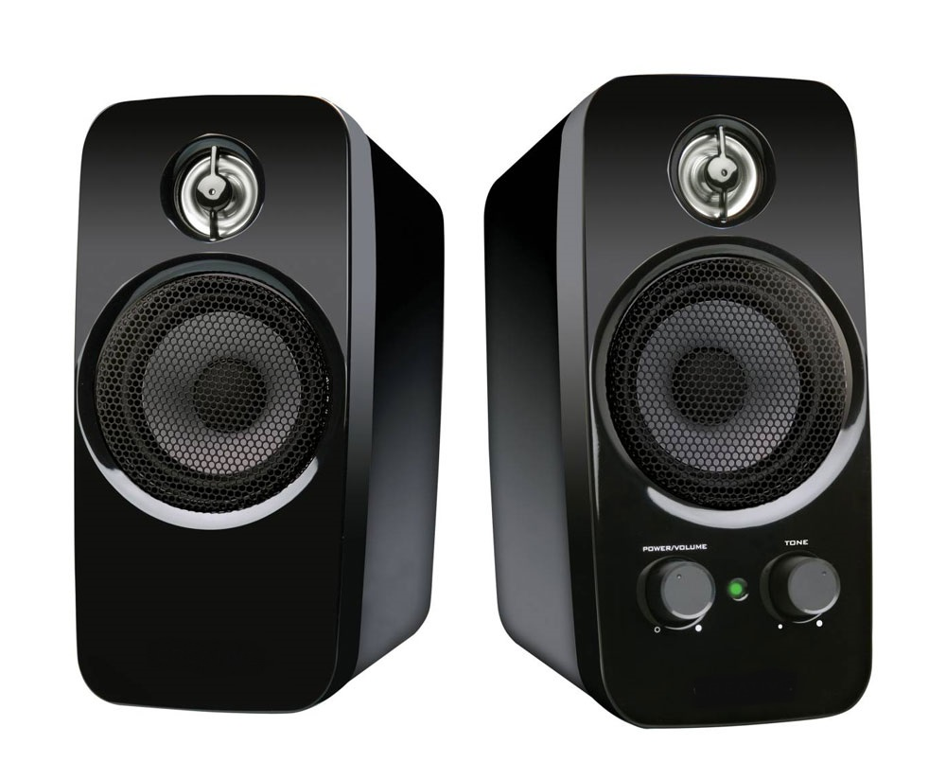
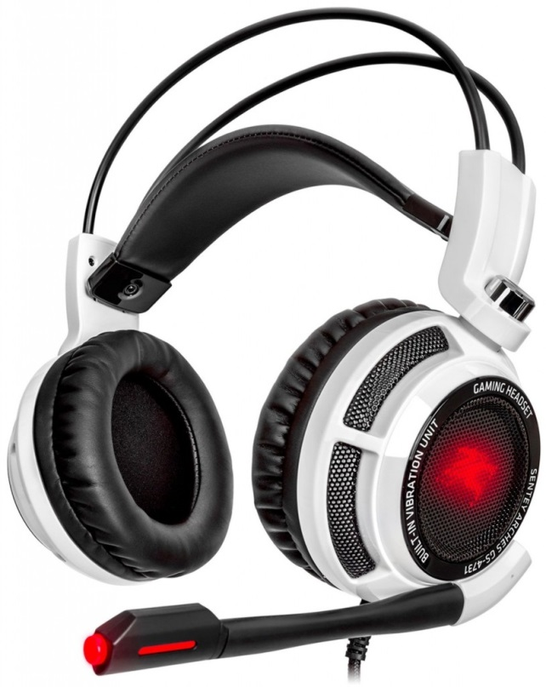
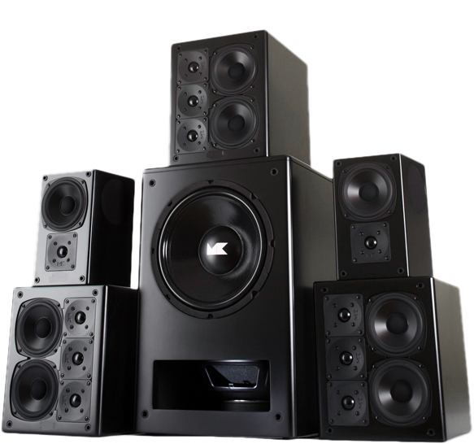
Output devices
Speakers
Notes:
Speakers are output devices used for sound files. You can play music, lectures and any types of sound files, and display them using speakers.
Speakers are connected to the computer system. Nevertheless, a built-in speakers are already exist in a PC or a laptop.
Speakers differ in shapes and sizes. Large sound system with several speakers can be used in large lecture rooms or conferences.
There is also, headsets, that are used by individuals, that contain both a speaker that is directly attached to a person’s ears, along with microphones. These are easily used in video chats.

Slide 19
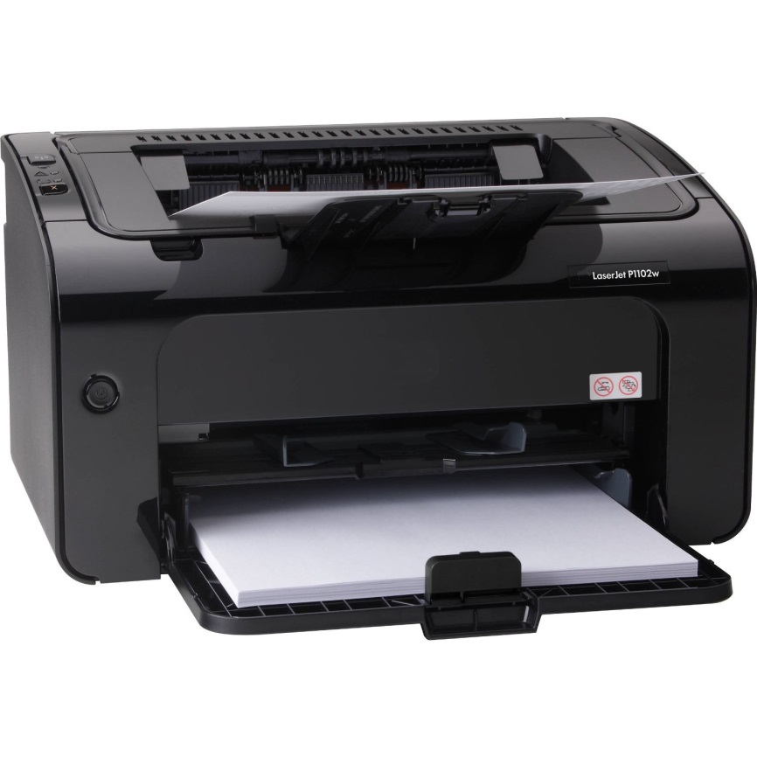
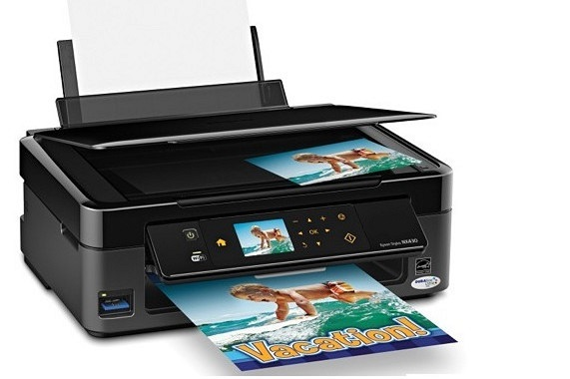
Output devices
Printers
Notes:
Printers, are output devices that convert digital photos or documents into hard paper. Which is actually the opposite job of a scanner.
When we use the term, Hard copy: it refers to printed output.
Soft copy, referred to computer files.
We will talk in more detail about printers shortly.
Some printers come with a scanner as well, so that this device actually contains input and output devices.

Slide 20
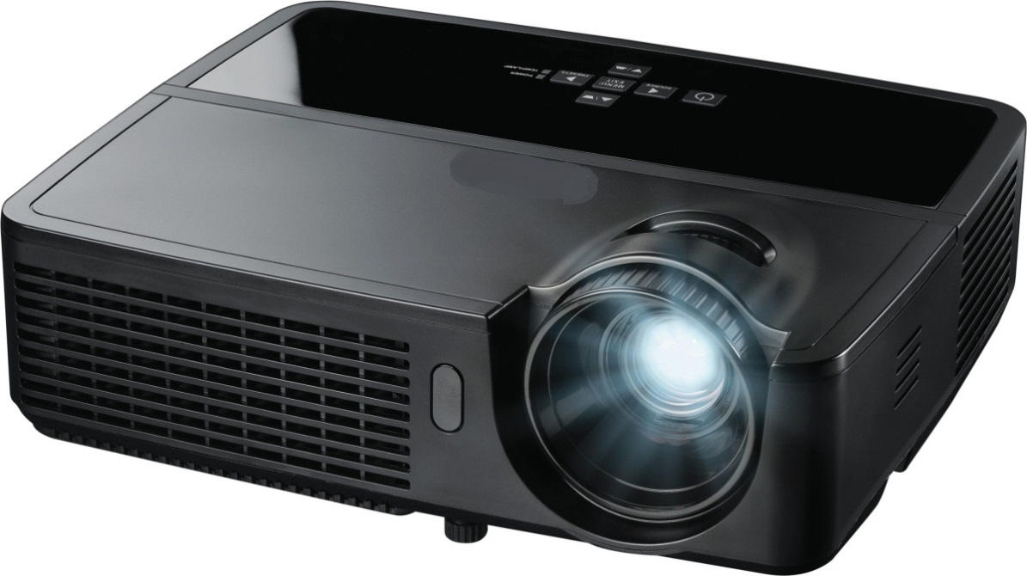
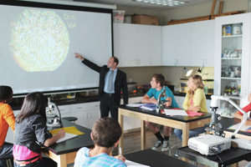
Output devices
Projectors
Notes:
Projectors, are output devices connected to the computer system, and display what should be displayed on a screen, on a large sheet spread on the wall in front of it.
Projectors are usually used in classrooms or in conferences.

Slide 21
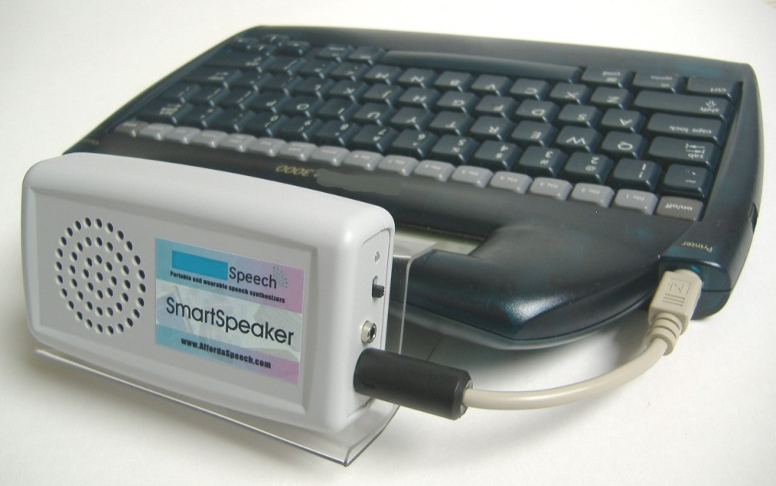
Output devices
Speech Synthesizers
Notes:
Speech Synthesizers, they are a special purpose output device, that converts data into sound. But, not as speaker.
Speakers display audio files. But, speech synthesizers, convert written documents into a sound, an electronic sound. This can be used from blind people to help them in reading.

Slide 22
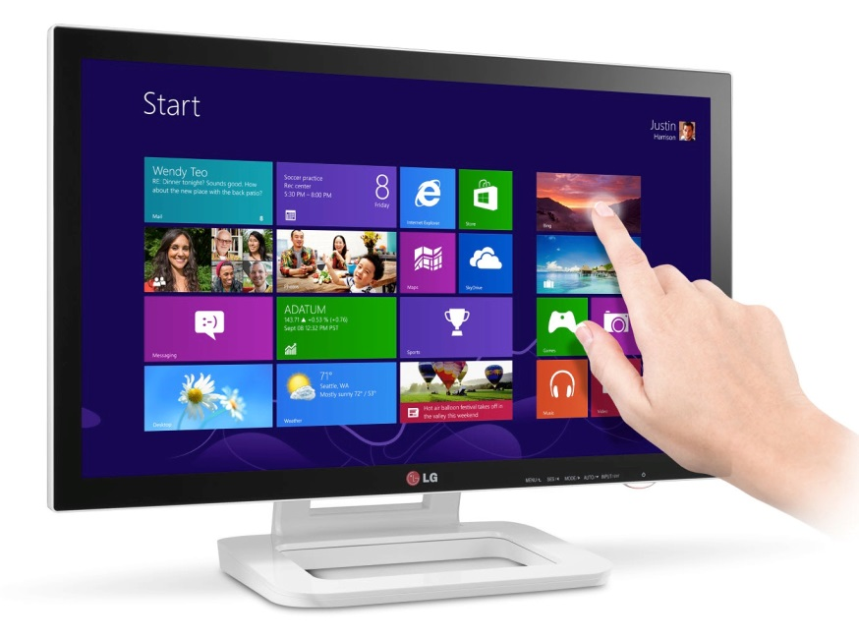
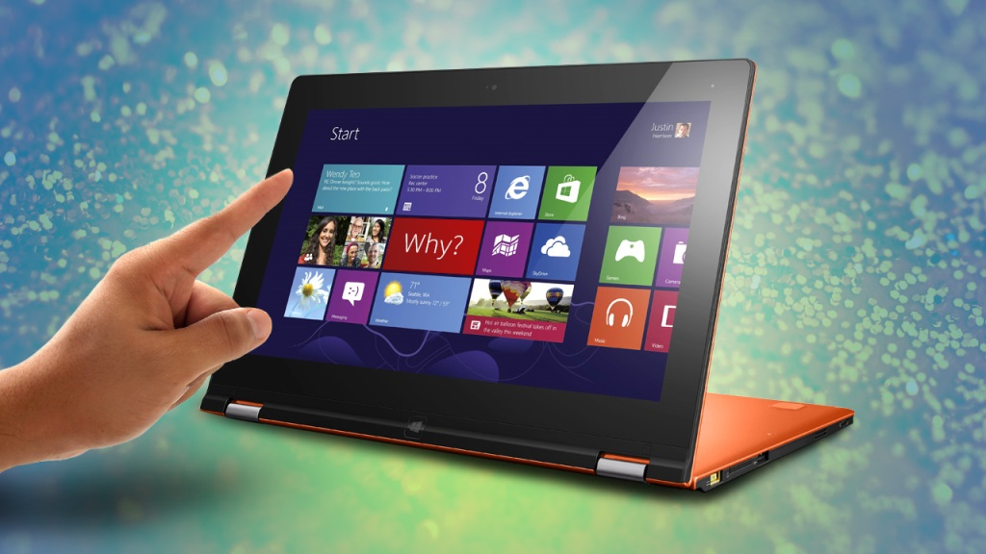
Input/output devices
Touch screen
Notes:
Some devices are considered both input and output devices, since they are used either way… for example: touch screens.
Touch screens can be screens connected to a PC or any computer system, and use finger to touch icons and commands (and this is considered input), and in the same time the screen display videos, files, images as an output.
Most modern smartphones and tablets use touch screens to become more user friendly.

Slide 23
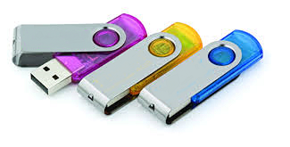
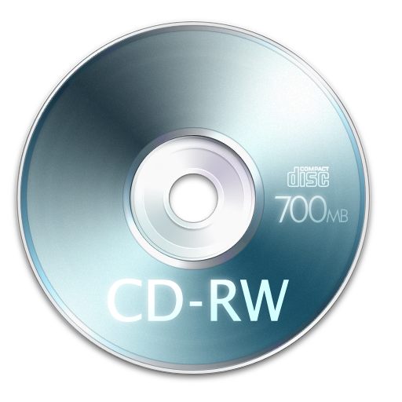
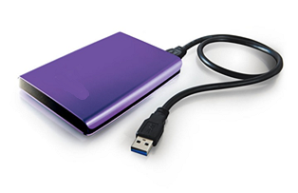
Input/output devices
Storage Devices
Notes:
All types of storage devices we have discussed in the previous lecture, are considered input/output devices.
Since, when you save files from your PC into a USB flash, for example, you are outputting information into this flash. And when you get saved information from a USB flash, to your computer, actually you are inputting data or information into your computer.

Slide 24
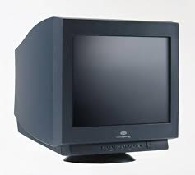
Types of monitors
Traditional Computer Monitor
CRT (Cathode Ray Tube)
Similar to televisions in size and shape.
Clear Image.
Low cost.
Not safe
Occupy space.
Notes:
We mentioned earlier in this lecture that monitors are the most common output devices used in computer systems.
They have two main types.
The traditional computer monitor, which are also called CRTs, Cathode Ray Tube, referring to its working technique.
it looks the same as an ordinary TV, with different sizes, but it displays a clearer image than a TV.
Its cost is less than the other type of monitors, but it is considered not safe, because of its large size and heavy weight.
Also, it occupies large space on a disk where the rest of the computer system resides.

Slide 25
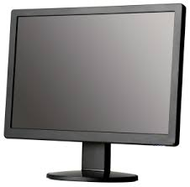
Types of monitors
Flat-Panel Screens
It is also called LCDs (Liquid Crystal Display)
More expensive
More Safe
Less space.
Notes:
The other type of monitors, is the flat-panel screens.
They are also called LCDs, and they are more common nowadays that the traditional one.
It is more expensive, but guarantees more safety.
And it takes much less space than the traditional ones. Some LCDs, even can be held on the wall against the user.

Slide 26
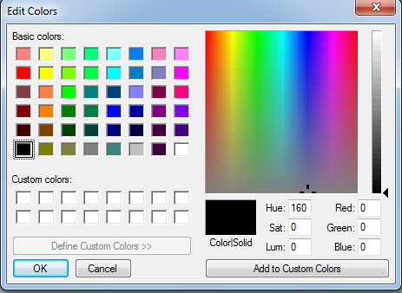

Characteristics of monitors
Color
Monitor Construction
Graphic adapter
256 x 256 x 256
= 16,777,216
Notes:
Monitors have certain characteristics that you need to know, to distinguish between good and better monitors.
Number of colors represented and displayed in a monitor, which depends mainly on the monitor construction and the graphic adapter, which is a special device added to the computer system that controls the colors displayed on the screen.
Old monitors used to display low number of colors, mainly the basic colors and one degree of each one.
But, with the development of new types of monitors, a wider range of colors can be displayed. See here, the basic three colors are Red, green and blue. Each of these colors, you can choose 256 degrees of them, and when creating all the combinations between these three letters, this large number of colors will result.
Yes, this is the number of colors that can be displayed using modern monitors.

Slide 27
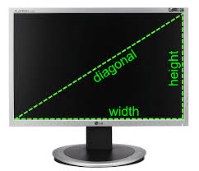
Characteristics of monitors
Size
Measured in inch (diagonally)
15-17 inch, 19-21 inch
, and more.
Notes:
Another important characteristic of a monitor, is its size.
A monitor size is measured in inch, and diagonally.
Meaning that, you measure this line, from one corner of the monitor to the other.
Small monitors usually range between 15-17 inch, while larger monitors may reach 19 to 21 inch. Of course, the larger the monitor is the clearer the displayed image will be.
By the way, modern TV screens (more than 30 inch) can also be used as monitors for a computer.

Slide 28
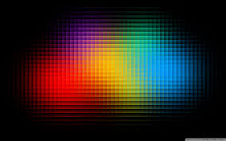

Characteristics of monitors
Resolution
Number of displayed pixels
Width X Height
VGA : 640 x 480 SVGA : 800 x 600 XVGA : 1024 x 768
Notes:
Resolution is defined as, number of displayed pixels on the screen.
A pixel, is a small unit (a square-shaped) that display certain color, and combination of all pixels on the screen form the displayed image.
A monitor resolution is measured by multiplying number of pixels in the width and in the height of the screen.
And as larger the two number are, the better the resolution.
These are the most common resolutions used for most monitors.
When more pixels are used to form an image, the image becomes clearer.

Slide 29
Kinds of printers
Laser
Lase beam
High quality
High speed
High cost
Black and white
/ Colored
Notes:
Laser printers use Laser beam source to print documents.
It is of a high quality, high speed and thus high cost
It can print black and white documents and images, and can print colored, according to the printers.
Laser printers are the most common and preferable to use, because of its quality and speed.

Slide 30
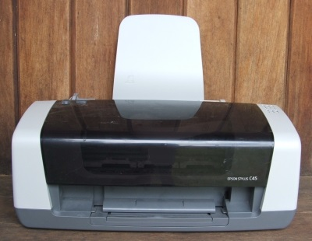
Kinds of printers
Inkjet
Spray colors
High speed
Less quality
Less cost
Notes:
It sprays one or more colors of small droplets of ink at high speed onto paper, but slower and with less quality than the laser. Sometimes it is preferable because of its lower cost.

Slide 31
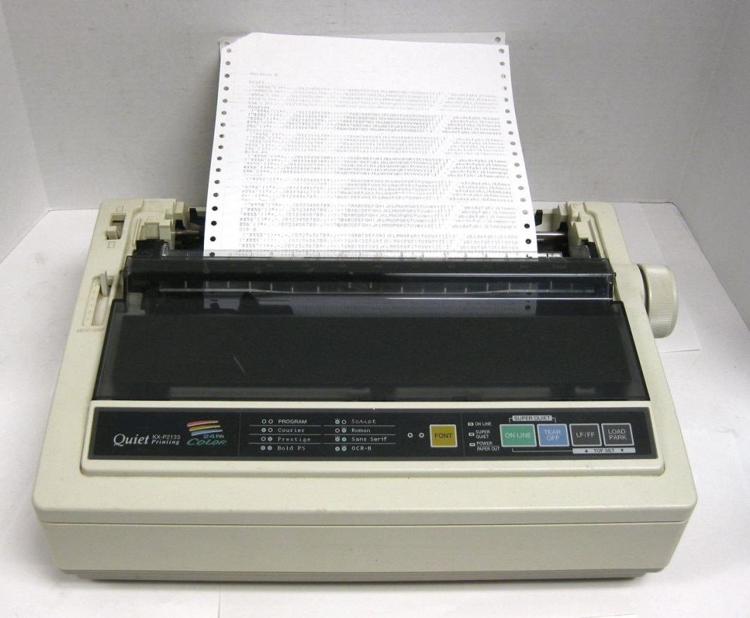
Kinds of printers
Dot Matrix
Old
Use pins
Low quality
Low speed
Low cost
Notes:
It is a very old types of printers.
It Uses pins to strike on an inked ribbon against paper.
It has low quality, speed and cost than other types of printers.

Slide 32
Computer performance
Factors that affect the speed of the CPU processing:
Clock Speed:
- Represents CPU processing speed.
- Number of times the CPU can process data or instructions per second.
- Affects computer efficiency.
- Measured by Megahertz (MHz).
Notes:
Computer performance means, the factors that affect the speed of the CPU processing.
The first factor is “Clock speed”
The processing speed of a CPU is represented by its clock speed, which is related to the number of times the CPU can process data or instructions per second.
The faster the clock speed is, the more efficient the computer will be.
The clock speed is measured by Megahertz (MHz).

Slide 33
Computer performance
RAM memory capacity:
The more RAM capacity
➔ Higher performance
Notes:
larger number of RAMs means Faster computer. Because if the memory does not have enough space, the computer will have to use a part of hard disk instead, and you remember that hard disk is slower than RAM, so it will slow down the processing operations in the computer.

Slide 34
Computer performance
Hard Disk Speed:
- Less access speed to the Hard disk
➔ Faster storage.
➔ Faster retrieval of data.
➔ Higher performance
Notes:
The hard disk speed is the access speed at which the content can be read and written on a hard disk.

Slide 35
Computer performance
Free Hard Disk Space:
More Free Hard Disk
➔ Higher Performance
Notes:
Free space on hard disk should be available when running programs. Since, Windows needs to create what is called “Temporary Files” on the hard disk to help in operating these programs.
If there is no enough space, Windows will not be able to load these programs, or they won’t perform efficiently.
When a program is shut down, these temporary files are deleted.

Slide 36
Computer performance
Defragmenting Files
Collecting files stored in separated places into proper space.
➔ Increases Performance
Notes:
When you delete files from your hard disk, spaces will result between other existent files. And when new files are stored, they fill the available spaces, even if the system needed to divide a file into several spaces. So, when you need a certain file, the system may need to retrieve it from separate places, which takes time.
So, From now and then, a defragmentation process is adviseable, so that files are stored in a more proper way.
We will discuss this in more details in the next chapter, when we talk about windows tools.

Slide 37
Computer performance
CPU Speed
The most important factor, since it determines the speed of processing data.
More CPU Speed
➔ Higher performance
Notes:
The CPU speed determines how fast your computer will run. The higher the value of the CPU speed the faster the CPU will operate.

Slide 38
Computer performance
Number of Running Applications (Multitasking):
More running applications
➔ Less Performance.
Notes:
Which is also called Multitasking.
Many times you need to run several programs at the same time. For example, internet explorer, along with Microsoft Excel or word. As we discussed earlier, windows create temporary files for each opened program. So, the more programs you run on your computer, the more temporary files are created, and thus less free space on the Hard disk is available, and as a consequence less computer performance.

Slide 39
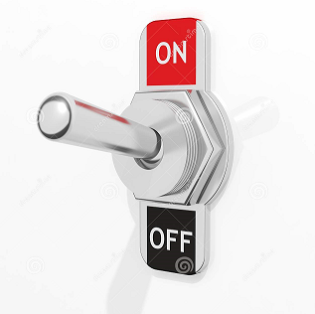
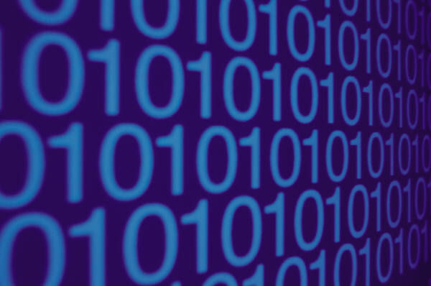
Data representation in the memory
Electronic Signals
Either ON or OFF
ON ➔ 1 and OFF ➔ 0
Binary System (Machine Language)
Notes:
How data is represented in the computer memory?
When you deal with data, you as a human, can understand words in a certain language, or decimal numbers from 0 to 9. But, they are not stored exactly as you see them on the screen, or as you input them into the computer using keyboard, for example.
Since the computer is an electrical machine, that uses electrical circuits that deals with electronic signals. So it only understands two values ON and OFF.
ON is represented by 1, and OFF by 0. These two values form the Binary system that is used by the computer, or in other words, they form the machine language.
Of course, these signals are transformed into an understandable form using ordinary computer programs.

Slide 40
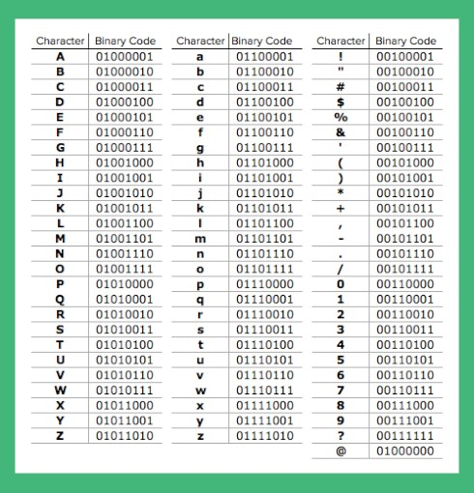


Memory capacity measurement
Bit
Byte
Represents one character.
Notes:
Memory is one of the most important parts of the computer. If the memory has enough space, the computer will be fast.
So, we need to learn how to represent the memory capacity using measurement units.
Bit, is the smallest unit in memory, which contains either 0 or 1. But you need 8 bits to represent one character in a computer system, for example the letter A is represented this way.
All letters, numbers and symbols on the keyboard is represented in binary code. As you can see in this table.

Slide 41
Memory capacity measurement
Unit | Size
Kilobyte (KB) | 2¹⁰ bytes = 1024 bytes
Megabyte (MB) | 2²⁰ bytes = 1024 X 1024 bytes (about 1 million bytes)
Gigabyte (GB) | 2³⁰ bytes = 1024 X 1024 X 1024 bytes (about 1 billion bytes)
Terabyte (TB) | 240 bytes = 1024 X 1024 X 1024 X 1024 bytes (about 1 trillion bytes)
Notes:
Byte is the main unit memory capacity is measured by, but other larger units are used.
Kilobytes(KB):about 1000 byte exactly it is1024 Bytes.
Megabyte(MB):about 1 million byte exactly it is1024x1024 Bytes.
Gigabyte(GB): about 1 billion byte exactly it is1024x1024x1024 Bytes.
Terabyte(TB): about 1 trillion byte exactly it is 1024x1024x1024x1024 Bytes.

Slide 42
The end
Notes:
Let’s wrap everything up,…
Today, we distinguished between hardware and software
Then, we talked about some Hardware components, Motherboard, CPU, and memory.
We divided memory into two groups, primary and secondary.
And then described several types of each group.
And finally, ordered the speed of the most used types of memory.
That’s all for today, thank you for watching and see you next lecture.

