Slide 1

Working with windows 7, Part i
0750099 Pre-Computer Skills
Notes:
Hello, and welcome back!
Today we will talk about Computers, their main operations, and the most common types of computers.

Slide 2
Lecture outline
Using Mouse in Windows 7
File Management
Operations on Files and Folders (View, Create, open, …etc.)
Windows Explorer
Notes:
In this lecture, we will talk about …

Slide 3
Learning outcomes
Learn how to use a mouse in Windows 7
Learn how to manage your files and folders
Be able to apply several operations on files and folders.
Be able to open and work with Windows Explorer.
Notes:
After you attend this lecture, you should know the following:

Slide 4

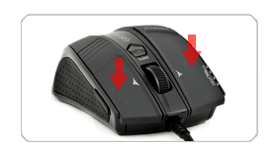
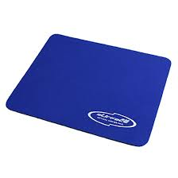
Using Mouse
What is a Mouse?
A mouse: is a hand held input device that is rolled over a small flat surface, called a Mouse Pad.
Notes:
If you remember, when we first talked about the characteristics of Windows 7, we said that this operating system is user friendly, meaning; it is easy to use by users. And using mouse in dealing with windows makes work easier.
Of course you also remember that mouse is an input device, meaning that using mouse you can give commands to the computer system.
In windows, Mouse is the main input device used for entering commands.
In this lecture, we will discuss how mouse is used for this purpose.
So, What is a Mouse?
A mouse is a hand held input device that is rolled over a small flat surface, called a Mouse Pad.
Of course you can move the mouse on any flat surface, a book or a table, but the Mouse pad is designed to maintain the smooth movement of a mouse.
(This part will be described to the students on real mouse and mouse pad)

Slide 5
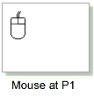
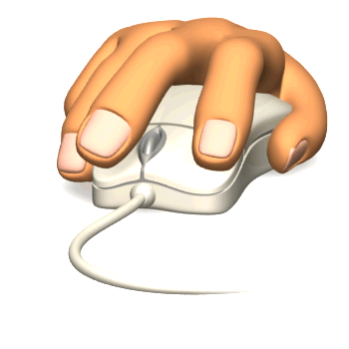
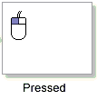
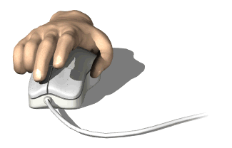
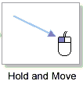
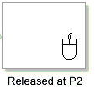
Using a Mouse
Mouse Operations
Click
Double Click
Drag
Notes:
How do we use a mouse to input commands?
Note that there are 2 buttons on the mouse (left and right), some older ones have 3 buttons (left, middle and right).
When you press with your Index finger on any of these buttons, this is called clicking.
But, your click should be pointed to something on the screen. So clicking means, to position the mouse pointer on an object then quickly press and release the button (either left or right).
So, what is there a difference between a left-click and a right-click? Of course there is.
A left click, selects a certain object (a file or a folder) on the screen. You need to select files and folders to perform certain operations on them, as we will see later in this lecture when we talk about file management.
You can select only one object with a left-click. If you need to select more than an object, you can use the Ctrl or Shift key from the keyboard. Remember Keyboard is also an input device, so it shares the mouse with this task.
When you use the Ctrl key along with the left-click, that should select more than one icon in separated places.
When you use the shift key along with the left-click, that should select several successive icons.
The Right-click, performs a totally different task. When you right-click on an icon a pop-up menu will appear with certain commands that you can choose from. These commands differ whether you are right-clicking a folder, a file or a program icon. Also, when you right-click on the desktop, or on the screen in general, another different pup-up menu with different commands will appear.
Another operation is Double-click:
Double clicking means pressing and releasing the mouse button twice in a rapid succession. This operation is only done by the left button. It is used to open a folder, a file or start a program.
The last operation is Drag.
Dragging means, is to change the location of an object by holding it down (keep pressing on the mouse left button, while moving it to the desired location) then let go of the button.
(This part will be described practically on the computer without passing the slide)

Slide 6

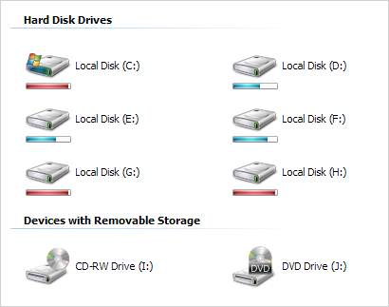
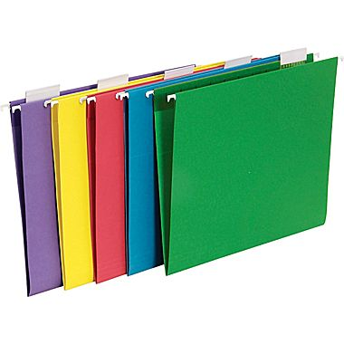
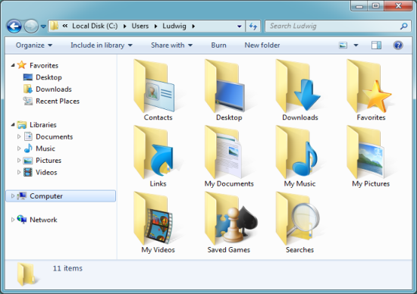

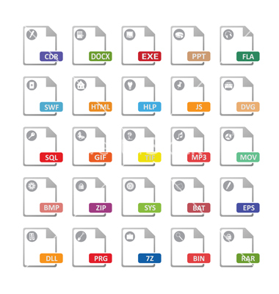
File Management
Cabinet
Drive
Folders
Folders
Papers
Files
Notes:
(The comparison between File Management in Real lift and File Management on Computers are done using this slide, then the drives, folders and files are displayed practically on the PC)
In the real life we have a lot of data and information that we need to gather and arrange in a manner that helps us to use them when needed.
Papers hold our data… Papers are arranged in Folders, these folders usually have tags to give indication about their contents. Folders are arranged in Alphabetical order in Cabinet Drawers.
With the emerge of technology, our data has transformed from “hard” data printed on papers, into “soft” data stored in computers. Data are stored on “Files”, that are arranged in “Folders” with names that indicates the contents, and these Folders are saved in “Drives”.
Let’s take a closer look!
(The following is discussed with a real windows folders and files)
We have discussed before that a computer system has a hard desk that is considered a storage device. The hard desk is usually partitioned into at lease two partitions named “Drives”. Usually one of these drives is dedicated for windows system files, to keep the system as efficient as possible. The other drive or drives are used to arrange the user’s data. Drives are given letters as (C:, D:, E:, …etc). Whenever you connect an external storage, such as a USB flash, an external hard desk, a digital camera, …etc, a new drive will be created for this new device. {Here, I will add a flash into the computer to display the new drive}
In each drive you can find Folders. Are places where you hold any number of files.
To create a folder, … (show folder creation and renaming in practice).
In each folder, you can create new files, or drag or copy files from other folders on your computer (Also, practice).

Slide 7
Operations on Files and Folders
View Files (in a folder/window)
Create (New folder, New file)
Select (Icon, several icons)
Copy, Cut and Paste (Ctrl + C, Ctrl + X, Ctrl + V)
Move (Drag and Drop)
Rename (F2)
Delete ➔ Recycle Bin
Notes:
All Practical

Slide 8
Windows Explorer
A program that gives you more comprehensive view of computer contents, provided by Windows.
Notes:
You can manage your files using a program named Windows Explorer.
This program is provided by Windows, and allows you to manage your files and folders in a more comprehensive view.
Start Windows Explorer (Start Menu ➔ All Programs ➔ Accessories ➔ and then click Windows Explorer)
{Here Windows explorer is started and viewed practically, and mentioning the hierarchy (tree) view used to display the contents, and how the tree is expanded and collapsed using mouse}.

Slide 9


Windows Explorer
Click the white arrow next to a folder to display its contents. (Expand).
Click the black arrow next to an open folder to close it. (Collapse).
Notes:
You can manage your files using a program named Windows Explorer.
This program is provided by Windows, and allows you to manage your files and folders in a more comprehensive view.
{Here Windows explorer is started and viewed practically, and mentioning the hierarchy (tree) view used to display the contents, and how the tree is expanded and collapsed using mouse}.

Slide 10
The end
Notes:
That’s all for today, thank you for watching and see you next lecture.

