Slide 1

Working with windows 7
Part iI
0750099 Pre-Computer Skills
Notes:
Hello and welcome back!
In todays lecture we will continue working with windows 7. We will learn about some important tools of this operating system, and some miscellaneous topics that you will need when you use Windows.

Slide 2

Lecture outline
Windows Tools
  My Computer
  Control Panel
  Accessories
Notes:
In this lecture, we will talk about …

Slide 3
Lecture outline
Files and Folders
  Display
  Sorting
  File Compression
  Searching
  Creating Shortcuts

Slide 4
Lecture outline
Formatting
Defragmentation
Common File Types
Important key shortcuts (Abbreviations)

Slide 5
Learning outcomes
Learn how to work on some common tools of Windows 7, such as Control Panel and Accessories.
Learn how to apply extra operations on Files and folders, such as displaying them in several ways, sorting them, compressing them, …etc.
Notes:
At the end of the lecture, you will learn the following:

Slide 6
Learning outcomes
Learn how to apply formatting and defragmentation of a certain drive.
Learn some common file types used in a computer system, and some most frequently used key shortcuts.

Slide 7
Control panel
You can change the settings of your computer from the Control Panel.
  Desktop Background
  Screen Saver
  Date / Time
  Region Settings
Notes:
(This part is explained practically using Windows 7)
We will start talking about one of the most important tool provided by Windows, which is the Control Panel.
The control panel is full with options and tools that are used to change the way Windows looks and works. Meaning that you can change the setting of your computer system using the Control Panel.
To view Control panel categories, do the following:
1. click the Start button, and then click “control panel”. The control panel window will appear. The displayed view enables you to select the items according to category. For example, if you want to control your printer, select the “Hardware and sound” category.
2. To change the way the items are displayed, you can change them from the arrow next to “View by”, where you can either choose, Large icons or small icons. These are used to view a list of all items in the Control panel.
Click, category again, to return back to the main categories view.
Let’s take a look about some important settings that can be changed using the Control Panel.
First, the Desktop Background. Note the desktop on the computer I am using, this blue background is the original background set by Window. If you want to change it, Go to control panel, and select the “Appearance and Personalization” category.
From “Personalization”, click on “Change desktop background”. From Picture location, you can view several locations, where pictures are stored. Or, you can select solid colors, to have one color in the background.
I will choose this picture, and then from Picture Position you can change the way the background is viewed. For example, fill means, that the selected picture will be resized to fill the whole screen. Tile, means that the picture will be repeated with its original size until the screen is covered. Center, means that the picture will keep its original size and will be fitted in the center of the screen.
To return back to the original background, just select it again and save the changes.
-----
Now, from Control panel, you can also set a screen saver. A screen saver replaces the display on the screen with an animated graphic after a time interval set by the user, and when the computer is left unattended.
To set a screen server, go to the control panel, Select “Appearance and Personalization” category, and then from “Personalization” select “change screen server” option.
From this dialog, you can select the appropriate screen server as desired, from this list. Note that when selecting any of these screen severs, it will be displayed in this screen, so that you will know in advance how it will look like.
From “wait” box, you can specify number of minutes that your computer should stand still until the screen server is appeared. If I entered 2, it means when I leave the computer without working on it, using the keyboard or the mouse, it will count 2 minutes, then the screen sever will start. Press “Preview” button to display the screen server. Now, when you move the mouse, you will return back to the original screen.
Now, note that you have returned back directly, but if you check this checkbox, “On resume, display logon screen”, it will return you back to the logon screen, so that you will have to enter your password to logon again.
Press “Apply” button, so that the settings entered take effect.
-----
Another change you can apply using the control panel, is the Date and Time. From Control panel, select “Clock, Language and region” Category. Select “Set time and date” option, and this dialog will appear.
From this dialog, you can select the time zone, according to Greenwich timing. Also, from here, you can select this option, “Automatically adjust clock for daylight saving time”, which will change the computer clock automatically when summer timing is used.
From “change date and time” button, you can set the date and time of your computer system.
From these arrows, you can change the month and year. And from this box, you can change the time (hour, minute and second) and whether the time is AM or PM (day or night).
When OK is pressed, the new date and time is set. But, I will press cancel, so that I don’t change the correct time of my computer.
You can also, change date and time, from outside the control panel, from the Date and Time icon in the taskbar.
-----
Let’s return back to the control panel, and also from “Clock, language and Region” category, you can change “Region Settings”. From this dialog, you can change the way the dates, the numbers are displayed on your computer. For example, when you enter a date in Excel program, the dated will be formatted in a special way. From this dialog, the formats are displayed here. See here, formats for dates and times are already set. But, you can change them from “Additional Settings” button.
In this dialog, you have several tabs, where you can change the format of numbers, currency, time and date.
From number, you can change the symbol used for decimal point, for example. From “Currency” tab, you can change the symbol that represents your currency, from here you can select between dollar sign, or Euro. But, let’s return back to the original dialog, and check this list. From this list, you can change your location and language, to Arabic (Jordan) for example. First, the days are changed as you can see from here. Press ”Additional Settings” again, and go to “Currency” tab, you can find the Jordanian Dinar is added to the list. In time tab, you can change the format of time displayed in the system’s application. In date tab, date format can be changed, also you can choose the type of calendar from this list.

Slide 8
Control panel
Keyboard Languages
Volume Settings
Resolution Settings
Screen Colors.
Notes:
(This part is explained practically using Windows 7)
Also from this category “Clock, language and region”, you can change the keyboard language. Click on this category, and from there choose "Region and Language", a dialog will appear. From this dialog, go to tab "Keyboard and Languages".
Press on "Change Keyboard" button, another dialog "Text Services and Input Languages" will appear. You can find here the default language, in this computer "English" is the default language, suppose you need to add other languages, from "Add" button, another dialog will list all available languages on Windows, where you can select a new one. When it is selected, press OK, and you will find it in the "Installed Services" list here.
----
Another possible setting is the Volume settings, where you can change from the Volume icon in the task bar, where you can increase or decrease the sound volume, or you can mute it entirely. Also, from Control Panel, "Hardware and Sound" category, you can change the sound volume from "Adjust System Volume".
------
You can also change the Resolution Settings from Control Panel. Remember when we have discussed the screen resolution, which are the number of pixels that are used to display images. Resolution can be changed to certain amount according to the screen type.
Go to Control Panel, "Appearances and Personalization" category, click on "Adjust Screen Resolution". From the Resolution drop-down menu, you can select the desired amount.
-----
Press OK, to check the changes, see the screen display has be enlarged. To return it back, repeat the steps again.
From "Control Panel" you can change the screen color as well. From "Appearance and Personalization" category, click "Adjust Screen Resolution", and from "Advanced Settings" a dialog will appear. Select the "Monitor" tab, and change the color setting. From this list, you can decide how high the quality of colors displayed on the monitor.

Slide 9
accessories
Calculator
Note Pad
WordPad
Notes:
(This part is explained practically using Windows 7)
Accessories, is a folder provided by Windows and it includes several useful programs for users.
To access this folder, go to the Start Menu, and from All Programs, search for "Accessories". Click on it, you will find several programs, such as Windows Explorer, which we have discussed earlier in a previous lecture. Also, other programs such as calculator, note pad and Word pad.
Calculator, is a program that allows you to perform certain calculations that are presented by simple calculator, or scientific calculator. Open the program, and you will find the standard calculator, that provides simple mathematical operations, such as addition, subtraction, multiplication, division and others.
From this menu, you can change the calculator type into "Scientific" where other more complex operations can be performed, such as the triangular functions (sine, cosine …etc.).
Note pad, is a very simple word processing program, that enables you to enter text, and format it is a simple manner. Click on the program icon, to open the note pad. From this editor, you can enter any text you need. For example "Hello World!", then from "Format" menu, select Font and change the font format as desired.
WordPad, on the other hand, is another word processing program, that allows you to enter text and format it in more complex manner, besides adding images and simple objects to the file.
Of course, Microsoft Word is more efficient and professional Word Processing program, that will be discussed in details in Chapter 6.

Slide 10
computer
The “ computer” icon is the main icon in any computer it is used to organize files and folders inside your computer.
My computer window contains:
  Hard Disk Drivers
  Devices with removable Storage
  Network Drivers
Notes:
(This part is explained practically using Windows 7)
Computer Icon, where you either find on the desktop, or on the start menu. When you click this icon, a window will be displayed to enable you to access all files, folders and programs on your PC.
In this folder, you can find the main drives of the hard desk, given letters to indicate them, as we described earlier.
Also, you can find drives for any other devices connected to your computer, DVD or CD drive. And If you have attached a USB flash, a digital camera or a smart phone, a new drive will be displayed to enable you view all files of this device.
You can also find network drivers, where you can access other computers connected to the same network you are working on, if any, and enables you to share and exchange data with these computers.

Slide 11
files
Sorting
Create Shortcut
File Compression
Formatting
Disk Defragmentation
Print Screen
Notes:
(This part is explained practically using Windows 7)
Now, we will talk more about files and folders. We have already discussed some operations that can be applied on them, such as creating a folder or a file, selecting, copying, moving, ..etc.
Today, we will apply more operations on files and folders.
-------
Open a folder on your computer that contains several files and folders. You may need to sort these files. But first, you have to display them using the Details View. And from the header buttons here, you can sort the files, by Name, either from A to Z or Z to A. Or by Size, from smallest to largest or largest to smallest. The type, note here that all folders are gathered, all Excel files are together too. And Finally, you can sort your files by the date modified. From oldest to newest and vise versa.
-------
You can create shortcuts for a certain file or a program. Suppose that you have this file in a certain folder, but you use it more frequently, so, you can create a shortcut for this file, so that whenever you click on it, it will open the original file.
To create a shortcut, Right-click the required file, and select "Create Shortcut" command. This will create another file with this arrow beside the icon, indicating that this is a shortcut to the file, not the original one.
Cut the shortcut and paste it on the desktop, to be more accessible. Now, whenever you double click on this shortcut, the original file will be opened.
Now, return to the shortcut, and right-click on it. Select "Properties", and check the "Target". In this box, you will find the path to the
original file that this shortcut is related to.
Try to delete the original file, and return back to the shortcut. Double-click on it, a warning message will be displayed indicating that no file resides in the target specified in the shortcut properties.
-------
Another important operation that you can apply on files is compression. Some files may have large sizes that you need to compress to take less space on your PC, or sometimes, you need to compress more than one file to become one file, and send it by Email for example to another person. Compressing such files, will make the uploading process faster.
Let’s Open a folder that contains several files. For example, this folder.
I have several folders and files, that I want to compress (make them smaller in size), and also convert them in one file that is easier to copy or send to other people.
Special Programs are used to apply this operation, one of them is WinRar. You can install this program on your computer, and then use it for compression. When you install this program, you can find it among All programs in the start menu. Check the icon of this program, since we will refer to it again.
Now, select the desired folders and files, then Right-click on them, you can find several operations, along with the same icon of Winrar, which means that you can apply them using this program.
Select, Add to archive, which will open a folder that allows you to enter the name of the new compressed file, with the extension, .rar.
Press OK, and the new file is created here in the same folder.
Double click the file again, the Winrar program is opened, and all compressed files are displayed here. Now, you can decompress your file, into the original files, by selecting “Extract To”, enter a path and a name of a new folder, that should contained all extracted files, then press ok.
Here, the new folder is created, and the files are decompressed.
-----
Now, let’s talk about other operations that can be done in Windows, which are formatting and defragmentation.
First, formatting. In many cases, you will need to format your PC drives, or removable drives, to prepare them for using.
Formatting means, preparing the sectors in a drive to be ready for storing files in them.
Sometimes, you may be forced to format a USB flash, for example, if it has viruses that can’t be deleted in other way.
Formatting a drive, will erase all files stored in it, including viruses files, other harmful files, and also the normal files.
To apply a format on a USB flash, Attach the USB flash to your computer. Then go to the Computer folder, Open the folder to check the files inside. Now, right-click on the USB flash drive icon. From the drop-down menu, select “Format” command. A dialog will appear. Make sure that “Quick Format” is checked, then press “Start” button. A warning message will be displayed, to warn you that all files in this drive will be erased permanently. Press Ok, and the format will start. When finished, a message will appear to inform you about that. Close the dialog, and return back to the USB flash drive. See, no files are there anymore, they are all erased.
-----
Now, defragmentation. We have already mentioned defragmentation when we talked about the factors that affect the speed of your computer. Then, we discussed how defragmentation rearranges the files on a drive, so that empty spaces are gathered in a way to store complete files, and thus they will be easier and faster to retrieve.
From now and then, apply defragmentation, to maintain the high performance of your PC.
To apply defragmentation on a certain drive, let’s try it on D drive for example. Go to Start Menu, then All programs, click on “Accessories” folder, then open “System Tools” folder. And then click on, “Disk Defragmenter”.
“Disk Defragmenter” dialog will appear. Select the drive that you need to apply defragmentation on it. Note, that you can apply this on any drive on your hard desk, and also on any external storage device, such as a USB flash.
You can first, Analyze the desired disk, to find out whither it has fragmented files in it or not. It 0% is displayed, then you don’t need to defragment your disk.
Suppose you have decided to defragment a disk, just select it, and then click on “Defragment Disk”. This operation may take minutes, or even hours if you have so much files on the selected drive. But, you can continue your work on the computer while this operation is running.
---------

Slide 12
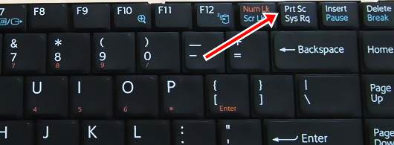
Print screen
Notes:
(This part is explained practically using Windows 7)
Another important operation that you may need when working on computer is print screen.
You may need to capture a snapshot of the current screen, for a certain program you are working on for example, and save it as an image.
To apply this, use the Print screen key on the keyboard. It is usually located on this side of the keyboard, but may differ on some keyboards. You can find the print screen command along with another command in the key, in this case you may have to use the Alt key with it. But, if the key has only the print screen command, you can just press it without the Alt key.
Let’s try it. Suppose I want to take a snapshot of my desktop with an opened window on it. I just press the print screen key. This will capture the whole image currently displayed on the screen, and then, go to any folder, create an image file.
For example, I want to create it on the desktop, right-click, and select bitmap image, an empty file will be created, right-click on it, and select Edit.
Now, you can paste the copied snapshot. By either pressing the paste button from here, or by using the short cut keys (Ctrl + V). See the captured snapshot is pasted, and you can save your file.

Slide 13
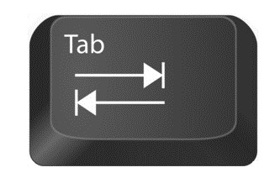
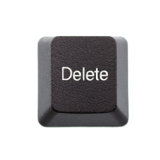

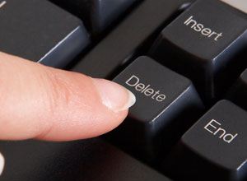
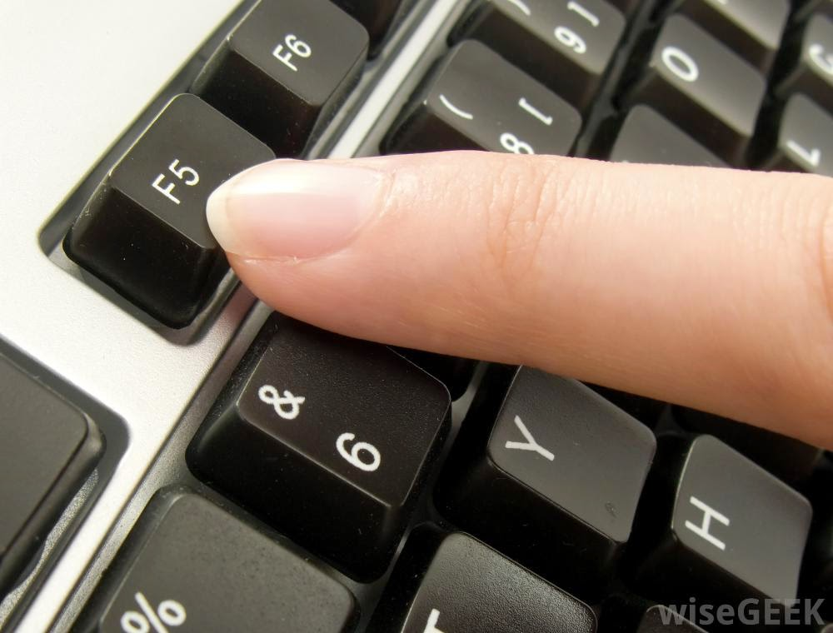

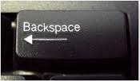
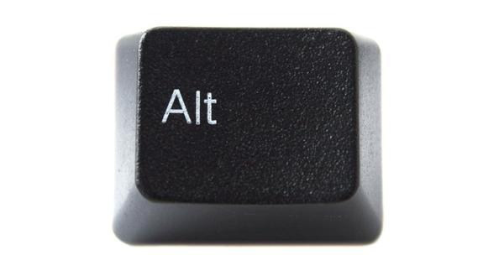
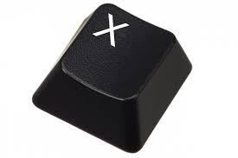
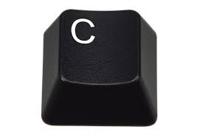
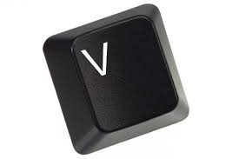
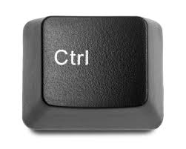
Keyboard shortcuts
Notes:
Now, let’s review the shortcut keys that you can press on keyboard, to perform some frequent operations.
Press F1: to open a Help screen related to the currently used application.
F5: is used to refresh a screen, in Internet explorer for example, and to execute certain types of files, such as power point slides.
Delete key: is used to delete the character next to the cursor pointer on an editor, or to delete a selected item.
Backspace key: is used to delete a character previous to the cursor pointer, and also, can be used to delete a selected item.
Ctrl and A letter pressed together, will select all files in a folder, all words in a word document, …etc.
Ctrl and C, copy selected items, and prepare them to be pasted.
Ctrl and X, cut selected items, and prepare them to be pasted.
Ctrl and V, paste copied or cut items.
Alt with Tab keys together, switch between opened applications, as was described in earlier lectures.
Ctrl, Alt and Delete keys together, will reboot your computer. They are usually used when your computer is hanged, and you need to force its restart.

Slide 14
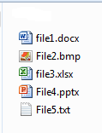
Common file types
Notes:
Finally, let’s review some common file types that can be created and used. But, first let’s talk about extensions. An extension is a 3 or 4-letter word that comes after a file name and indicates the program that has created this file.

Slide 15







Common file types
Notes:
Some of the most common file types are:
Docx: a document created using Microsoft Word
Xlsx: a spreadsheet created using Microsoft Excel
Pptx: a presentation created using Microsoft PowerPoint
Accdb: a database created using Microsoft Access
Txt: a text file created using Notepad
Pdf: a file created and can be opened using Adobe Reader.
Html or htm: a web page that can be displayed by any web browser. The shape of the icon may differ according to the default browser on your computer.

Slide 16





Common file types
Notes:
Images, have several extensions, that differ according to their specifications such as resolution and color. Most common image extensions are: gif, bmp and jpg or jpeg.
Rar: is a compressed file created using Winrar program, other compressed file extensions may be found, with extension zip.
Finally, tmp, which are temporary files that are generated by running programs on your computer, these files usually are erased when the creating programs are closed, but sometimes, some files are left undeleted, so you have to clean your hard disk from now and then from temporary files.

Slide 17
The end
Notes:
We are done with chapter 2. In this chapter, we have worked closely with Windows 7, and have learnt several important operations and tools that can be used in it.
That is all for today, thank you for watching and see you next lecture.

