Slide 1

General concepts of internet
0750099 Pre-Computer Skills
Notes:
Hello and welcome back!
Today we will start chapter 3, which is The Internet.
In today’s lecture, we will start discussing some general concepts that you may need to know when starting using the Internet.

Slide 2

Lecture outline
General Concepts
Internet, Intranet and Extranet
www, Web browsers, web site and home page
Hyperlink, URL, Protocol, HTML, …etc.
Web Address
Notes:
In this lecture, we will talk about …

Slide 3
Learning outcomes
Know and understand the most important concepts about the Internet.
Understand some common abbreviations in the Internet, such as: www, URL, HTTP, HTML, …etc.
Understand how a web address is formed, and know its main parts.
Notes:
At the end of the lecture, you will learn the following:

Slide 4
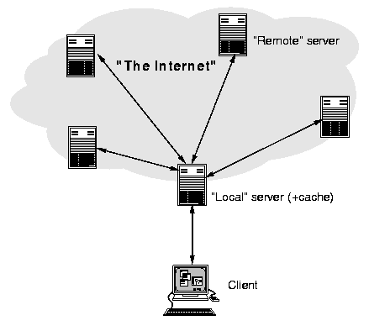

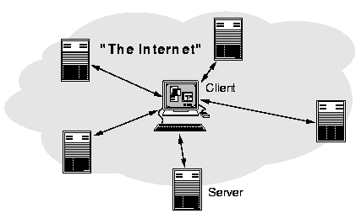
General concepts
The Internet
Notes:
The Internet:
Is a system of connected computers that allows your computer to exchange data, messages and files with any of the millions of other connected computers all over the world.
The Internet, is a type of a Client/Server Network, Where a sever resides in an organization, and includes all web pages to be viewed by clients. Sometimes, clients could be other servers that have their own clients.
Also, a client can view web pages from more than one server.

Slide 5

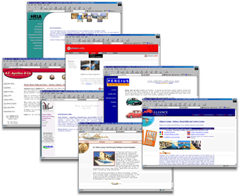
General concepts
WWW: World Wide Web
Notes:
www, stands for: World Wide Web
Which is a collection of web pages and related resources which are linked together across the Internet, using what is called a Hyperlink, which we will discuss shortly.
Also, these three letters, www, are used at the beginning of any web address, as you can see.

Slide 6
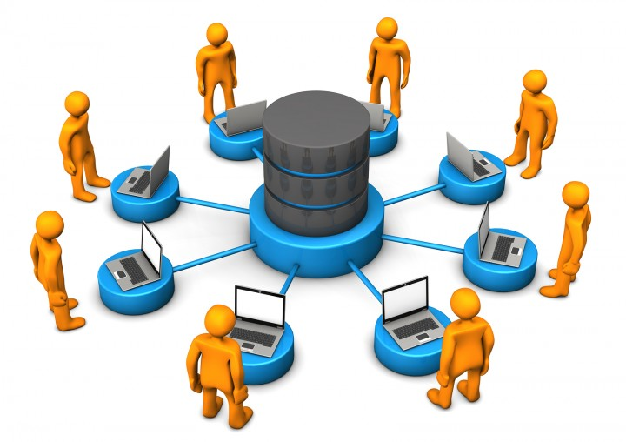
General concepts
Intranet
Notes:
Intranet: is a private network that is contained within an enterprise, and used to share company information among employees.

Slide 7
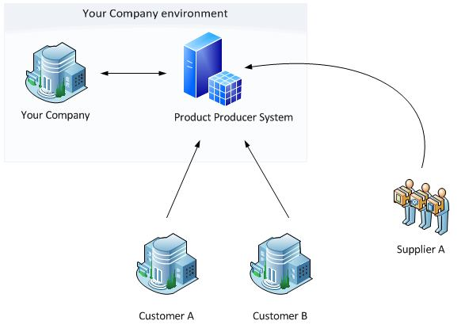
General concepts
Extranet
Notes:
Extranet: is a private network that uses Internet technology to share part of business information with suppliers, partners, customers or other businesses.

Slide 8
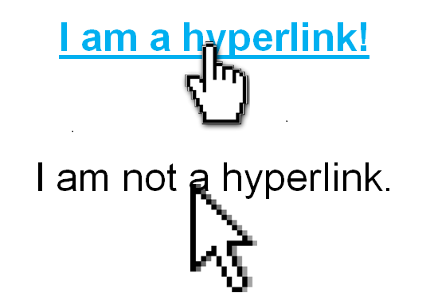

General concepts
Hyperlink
Notes:
A Hyperlink: is a piece of text that can perform an action when the users clicks on it, it is used mainly to connect web pages together over the Internet.
Check here the difference between a text with a hyperlink, and text without a hyperlink. When you move the cursor over a hyper link it will be changed into a hand shape, while in the other case, it stays the same.

Slide 9
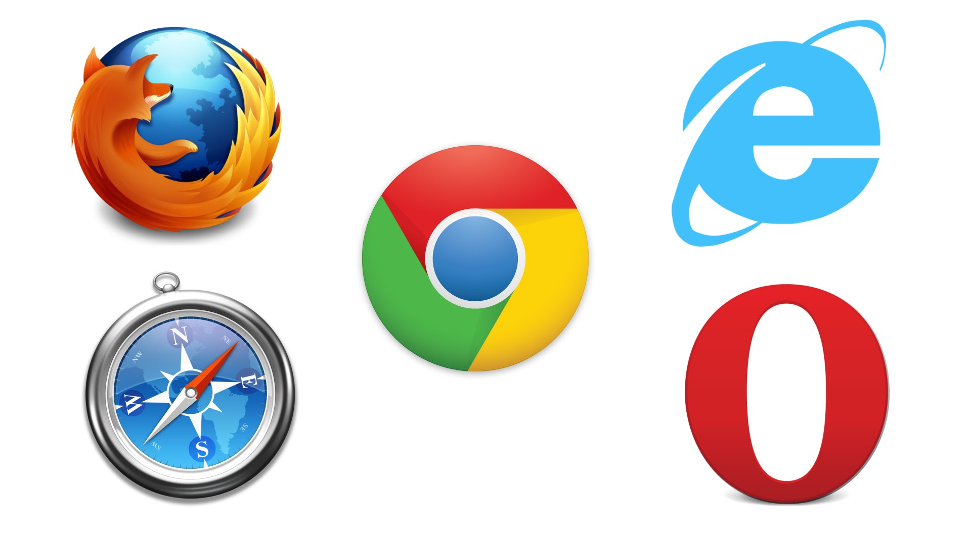
General concepts
Web Browsers
Notes:
Web Browsers: are computer programs that allow people to access information, view images, hear sounds and watch videos on the World Wide Web. Examples of some famous web browsers are: Google chrome, Internet Explorer, Firefox, Opera and Safari.

Slide 10
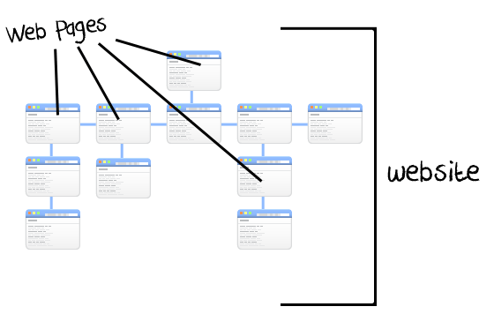
General concepts
Website
Notes:
A Web site is a computer storage area that contains one or more Web pages. When a web site is created, a storage area is reserved on special servers specially used for the Internet.

Slide 11
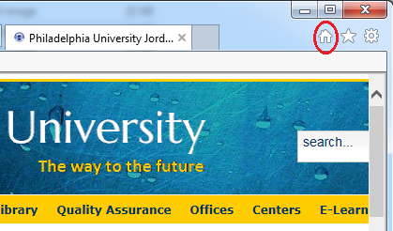
General concepts
Home Page
Notes:
A home page is the first Web page you see when you launch a web browser. You can change the home page for your browser, using the browser settings. And whenever you want to go to the Home page, just click on the Home-shaped icon in the toolbar. This is the shape of home icon in Internet Explorer.

Slide 12
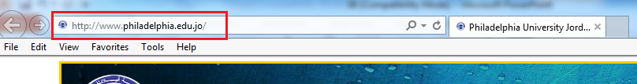
General concepts
URL: Uniform Resource Location
Notes:
A URL, which stands for Uniform Resource Location, is A unique address given to every web page. This address should be unique to navigate you to the correct web page. Any URL contains standard parts, that we will discuss later in this lectures. For example, this is the URL of our university web site.

Slide 13
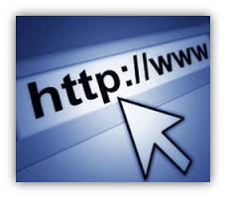
General concepts
Protocol
Hyper Text Transfer Protocol
Notes:
A Protocol is a set of instructions for transferring data between computers over the network. One of the most used protocol over the internet is http, which is used for most web addresses. http stands for Hyper text transfer protocol.

Slide 14
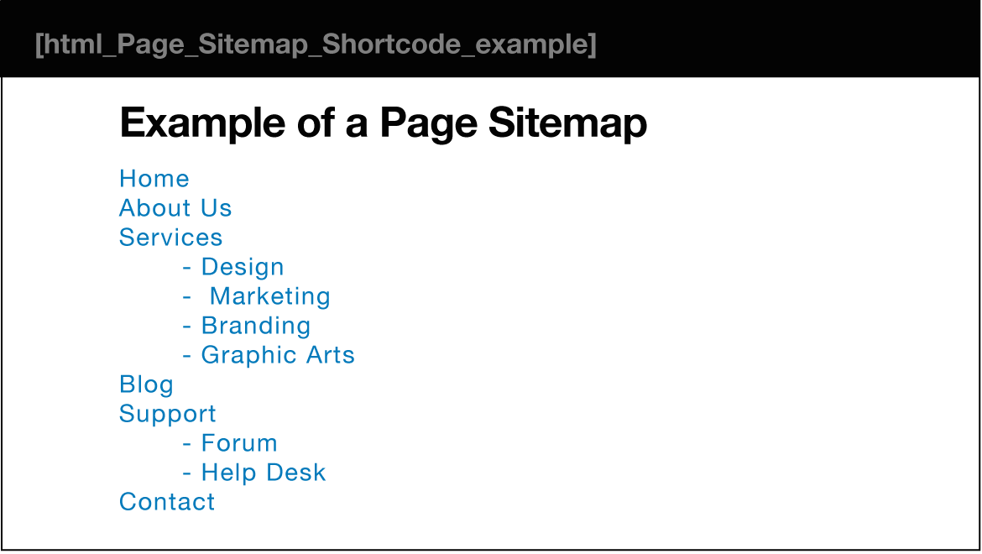
General concepts
Site Map or Index Map
Notes:
A Site Map or Index Map is similar to a table of contents in a book, it tells you where you can find information by category. Meaning, it tells you the correct path to reach a certain web page, starting from the home page of a site, using hyperlinks.

Slide 15

General concepts
ISP: Internet Service Provider
Notes:
ISP, Internet service provider, is a company that offers their customers access to the Internet. There are several types of Internet services, that we will discuss in coming lectures. In Jordan, the National Information Technology Center is the main Internet service provider for all governmental institutions.

Slide 16

General concepts
HTML: Hyper Text Markup Language
Notes:
HTML, stands for Hyper Text Markup Language, is a set of formatting commands that you place around a text or pictures to create a Web page. It is the main language used for designing web pages.

Slide 17
The end
Notes:
We are done with chapter 2. In this chapter, we have worked closely with Windows 7, and have learnt several important operations and tools that can be used in it.
That is all for today, thank you for watching and see you next lecture.

