Slide 1

Internet Connections and Introduction to Internet Security
0750099 Pre-Computer Skills
Notes:
Hello and welcome back!
Today we will discuss how to connect to the Internet, and view several options of Internet connections and Internet services.
We will also discuss some security issues that we have to consider when using the internet.

Slide 2

Lecture outline
Internet Connection Services
Dial-up Connection
BroadBand Connection
Options for Internet Connections
(Phone Line, Mobile Phone, Satellite and Wireless Hot Spots)
Notes:
In this lecture, we will talk about …

Slide 3
Lecture outline
Security Consideration
Identity / Authentication
Data Security
Notes:
In this lecture, we will talk about …

Slide 4
Learning outcomes
Know about the common Internet connection services and options.
Learn some Internet security considerations, such as Identification and Password.
Learn some data security techniques, such as Backups and Firewalls.
Notes:
At the end of the lecture, you will learn the following:

Slide 5
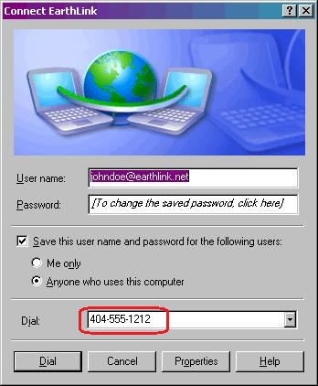

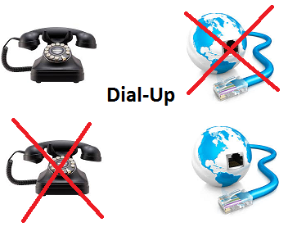
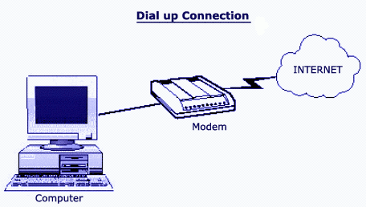
Internet connection services
Dial-Up Connection
Notes:
In the early days of the Internet, people used to plug a device called modem into the computer, which in turn was plugged into a phone line.
Each time they wanted to connect to the Internet they had to dial up their Internet service provider. See, here we used to enter the phone number of the ISP server, and make a phone call.
The disadvantages of using this type of connection is that it was very slow, and so it wasn’t easy to watch movies on the Internet or download large files. Also, when a person needed to make a phone call, they would have to disconnect the Internet. Which means no phone can be used during connecting to the Internet, and vice versa.

Slide 6
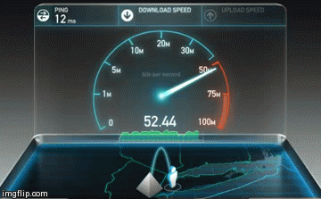
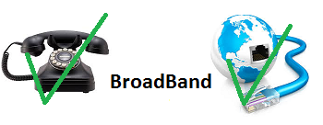
Internet connection services
BroadBand Connection
Notes:
BroadBand connection: In this case, you are permanently connected to the Internet. You can send and receive emails immediately when they are sent as you can make your phone calls while connected to the Internet.
And the most important is the fast speed of this connection, which enables you to download large files in short times, and watch movies or listen to music.
The fees of such services are paid on monthly basis not by seconds as in dial-up services. And Internet service provider companies compete by presenting good offers for Internet users.

Slide 7
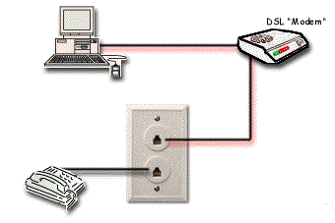
Options for Internet connection (Broadband)
Phone Line
Notes:
There are several options that enable you to connect to the Internet using Broadband connection.
One of the most common option is the phone line. And it is also called DSL (Digital Subscriber Line). This type of connection uses your phone to establish an Internet connection. But, it doesn’t affect the phone calls.
It needs a computer, a modem, a phone and an account with an ISP that provides the Internet service.

Slide 8
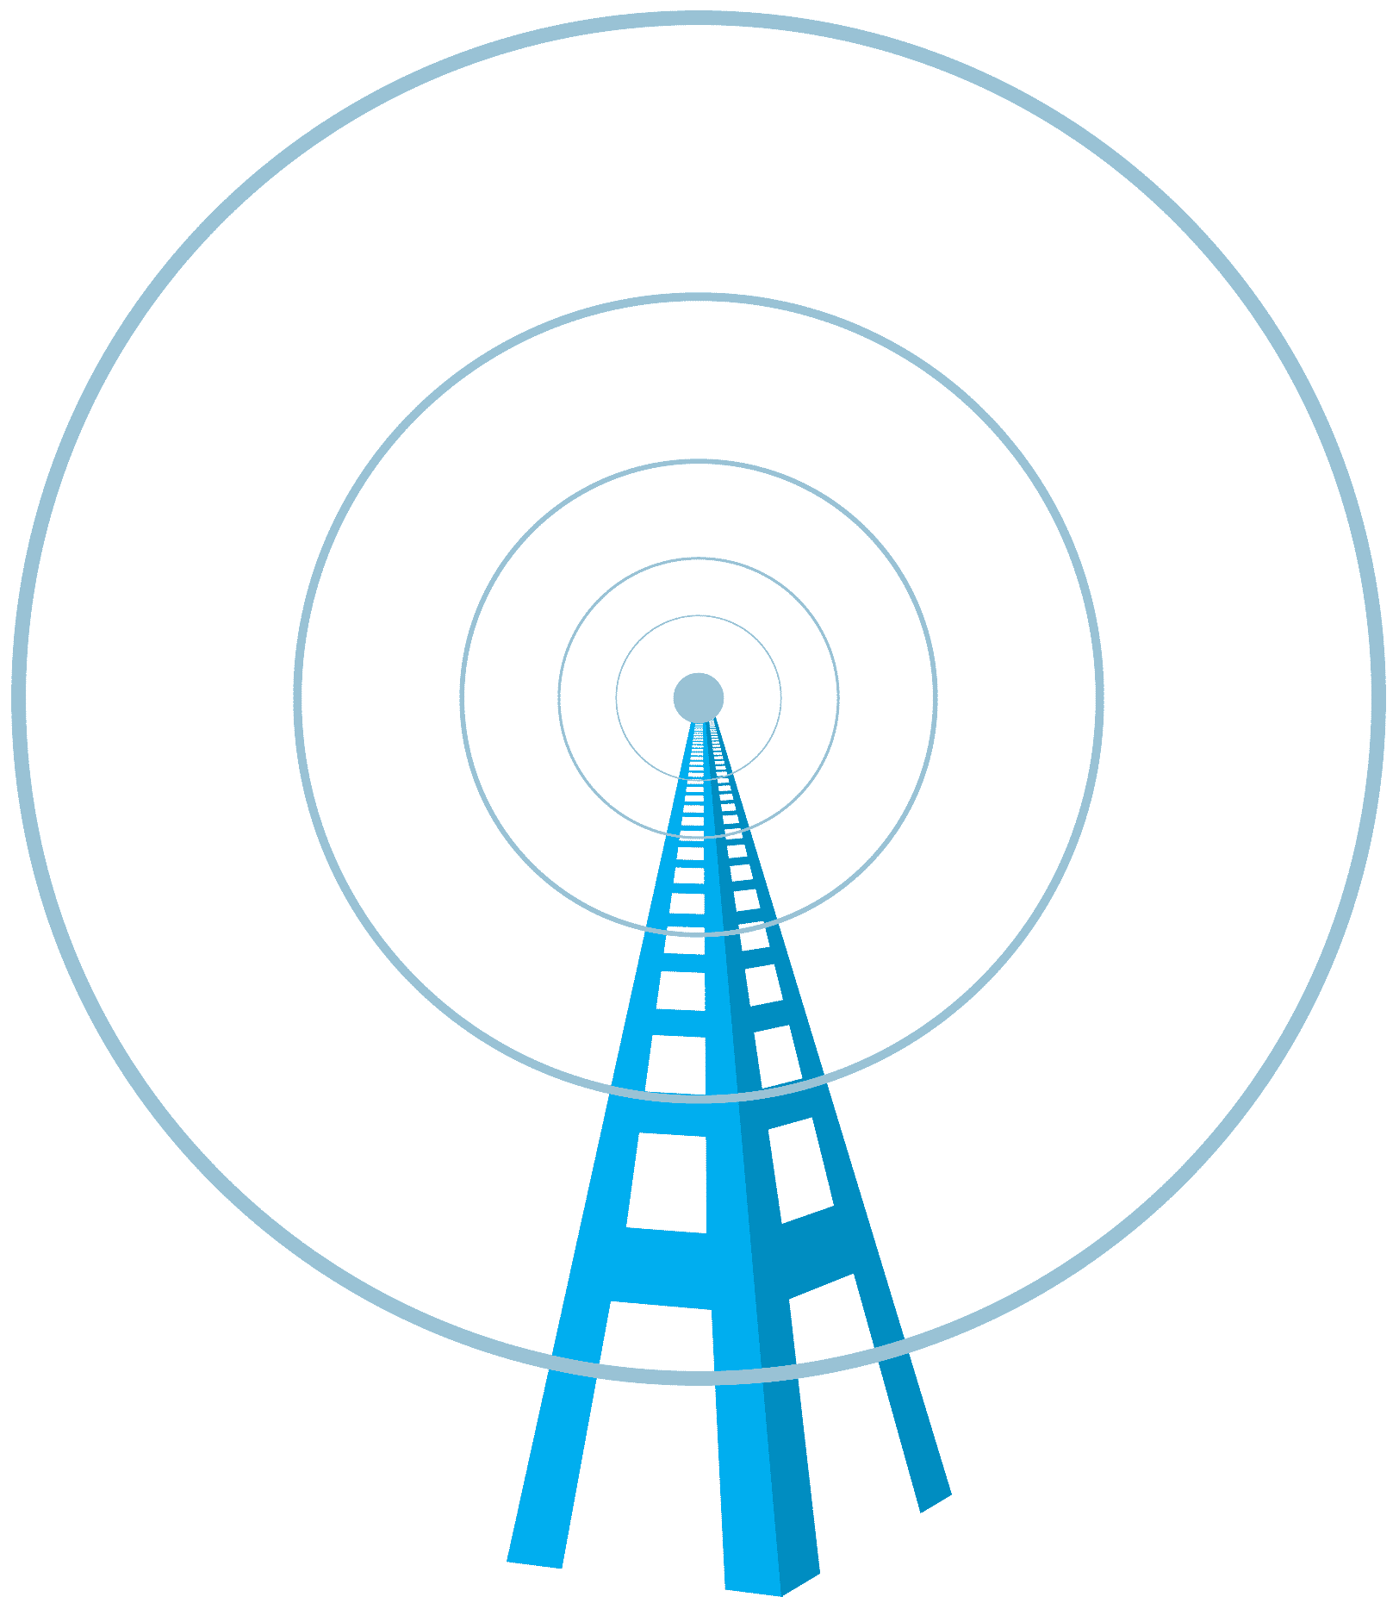
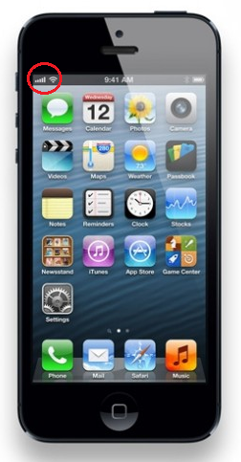
Options for Internet connection
The Mobile Phone
Notes:
The Mobile Phone is a wireless technology which uses the existing cellular telephone networks.
Speeds differ depending on the provider and the technology used.
It is available anywhere there is a cellular coverage and is portable and perfect for traveling.

Slide 9
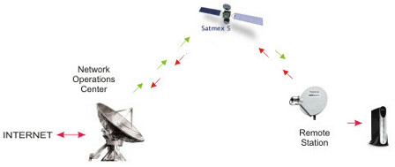
Options for Internet connection
Satellite
Notes:
The Satellite delivers the Internet via a satellite dish.
Speeds can actually range quite high.
It is available anywhere you can point a dish at a provider’s satellite and
is often faster than other types of connections.
It requires special equipment and
the cost of the Internet connection is high.

Slide 10
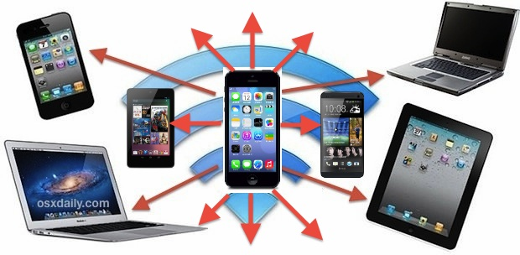
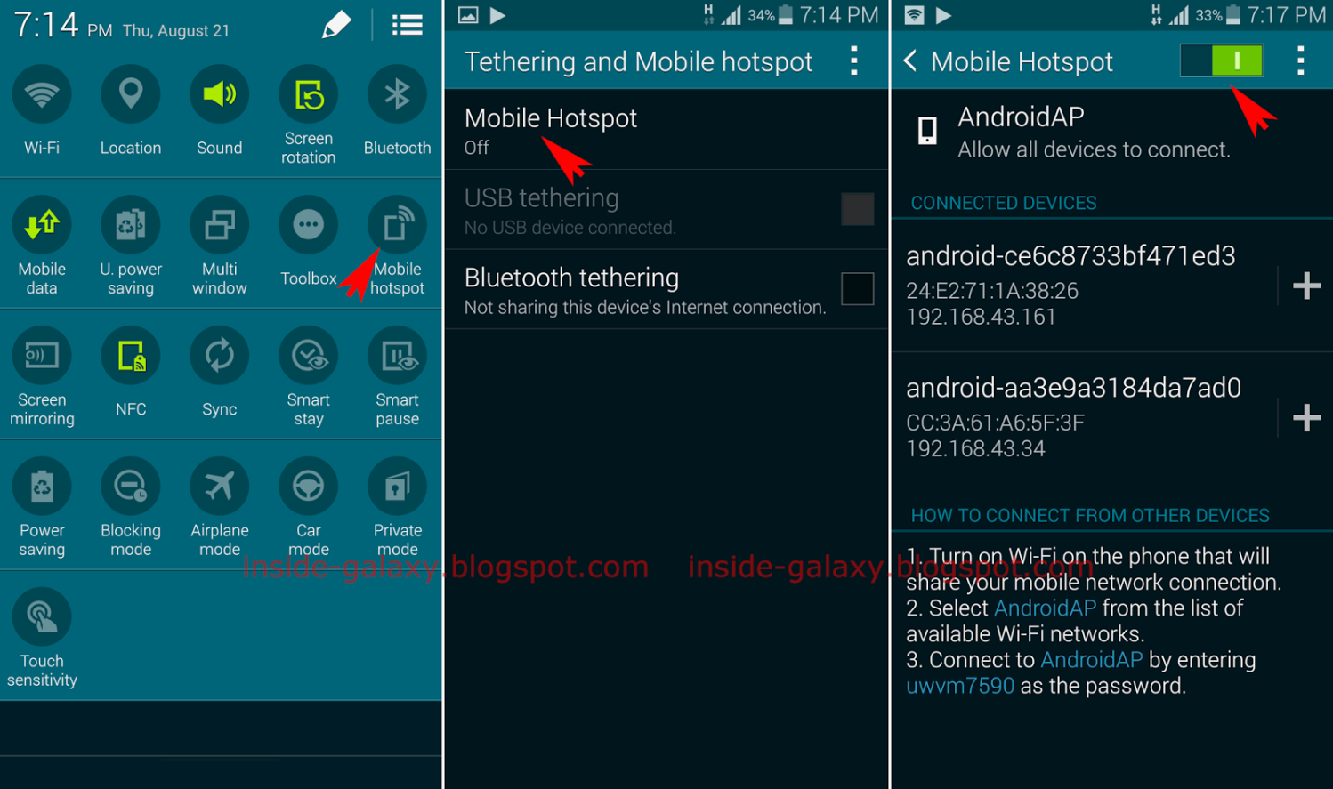
Options for Internet connection
Wireless Hot Spots
Notes:
Wireless hot spots, use radio waves to provide wireless high speed Internet and Network connections. They often appear in airports, hotels, cafes, shopping malls, and restaurants.
It is normally free for web browsing, or viewing email, but not for downloading material.
Smart phones connected to internet, can provide hot spots for other devices nearby. Just provide your friends with the password for your phone hot spot, and they can connect to your Internet.

Slide 11

Characteristics of broadband
Fast connection to the Internet
An always-on connection
Flat Fee Payment
Risk of Intruder Attack
Notes:
Characteristics of BroadBand Conenction:
Fast connection to the Internet
It provides rapid loading of web pages and e-mail,
fast downloading of files, programs and computer updates.
more efficient delivery of photos and other large e-mail attachments
and the ability to talk to others and attend video conferences in real time.
2. An Always-on connection
It is available 24 hours a day, so there is no delay while waiting for a dial up connection.
3. Flat Fee Payment
the cost of your broadband connection will be determined by the speed of the service you require, and the amount of material you send and receive. In other words, you decide how much to pay to the Internet service provider, according to the speed and amount of download you agree with them on.
4. Risk of Intruder Attack
As your computer is in constant contact with the Internet, hackers will try to invade your computer connection.
you should always update your anti-virus programs and you may also need firewall programs to prevent unauthorized external users from accessing your system.
We will discuss some security considerations considering these matters.

Slide 12
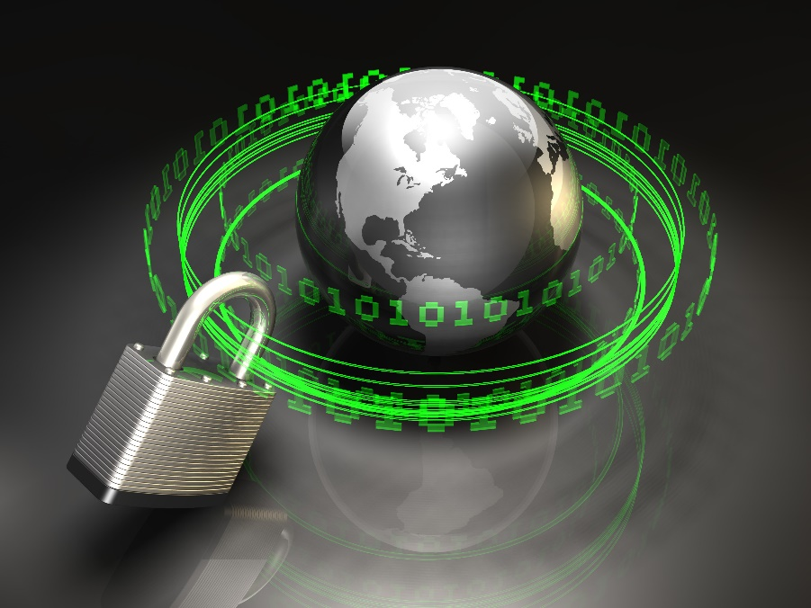
Security consideration
Notes:
When using the Internet, you have to take some security considerations to protect your files and data.
So, access to stored files should be restricted only to those who have a legal right to access them.
Security experts usually protect computer systems from access by unauthorized persons through:

Slide 13
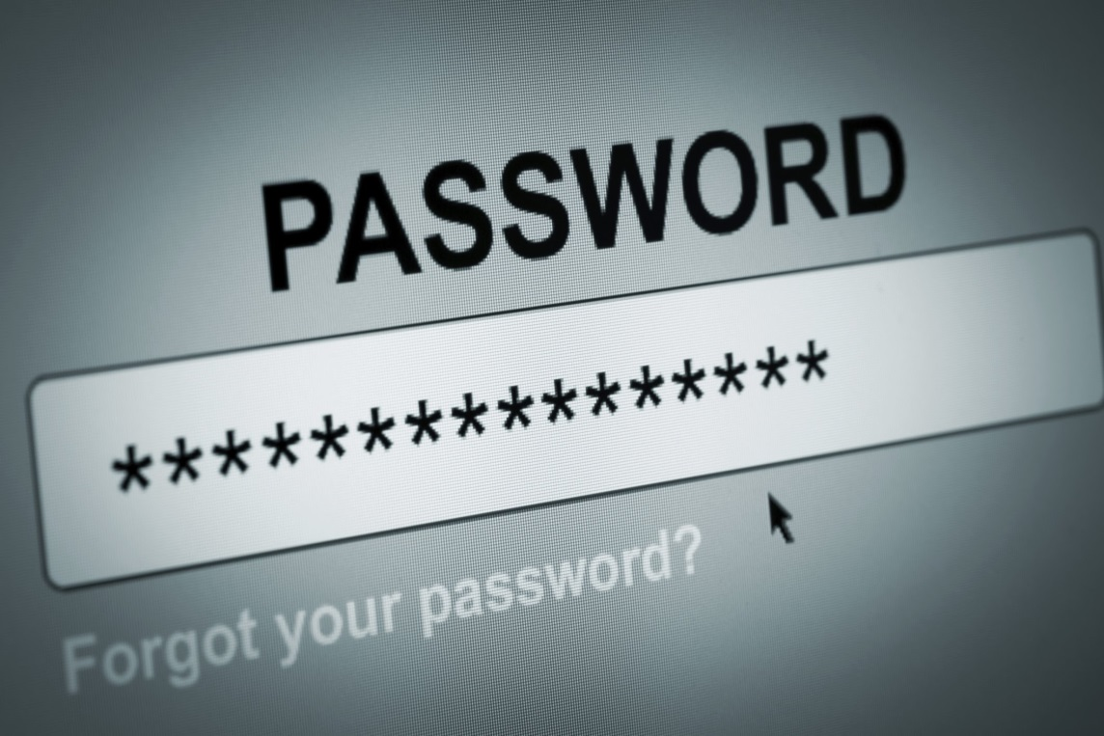
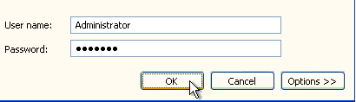
Security consideration
Identification
Authorization
Authentication
Notes:
Identification:
A User ID is used to logon to a computer or computer network. It uniquely identifies you to the network.
Authorization:
Which protects computer resources by only allowing those resources to be used by certain users that can have these permissions. And to make sure that this user is authorized, a password or a signature should be presented to use such resources.
Authentication:
Means that these users that already have accessed the computer system with valid user Id and password, are allowed to certain actions only. A Network administrator should grant privileges for each user ID according to the needed actions. For example, some users are only allowed to display files, others are allowed to update or delete them.

Slide 14
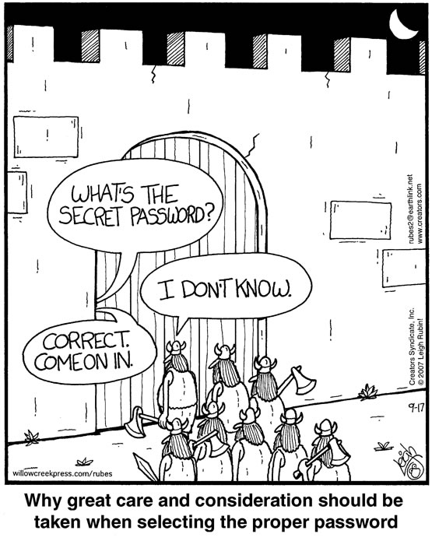
password
Notes:
Since Passwords are the proof that a certain user can access certain data or files, then we have to consider using valid and strong passwords to protect such data.
But, first let’s define passwords:
Passwords are secret combination of letters, number and symbols that are used to prove that a user can access certain data.
You have password for your computer system, password for email account, password for Facebook or Twitter account. A password is as important as your house key. You have to keep eye on this key so that no one other than you, or a member from your family can access your home.
When creating and using passwords some policies should be taken into consideration so that no one else can access your data.

Slide 15
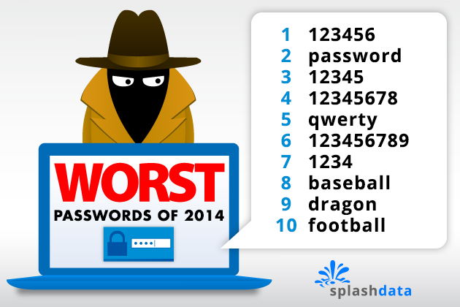
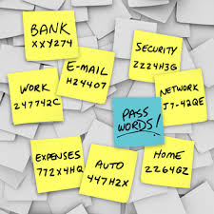
password
DON’T SHARE !!!
Notes:
First of all, Don’t share your passwords with anyone, unless you really need to.
Don’t Write it down, memorize it in your head, and change it in regular basis.
Try to choose difficult passwords using combination of capital letters, small letters, numbers and special characters. So, that guessing your password would be difficult.
Some examples of weak passwords:
Serial numbers without letters.
The word “Password”
Qwerty, which are successive letters on the keyboard.
Baseball or football, may be hobbies of yours that your close friends know about.
And of course your user id and your name are so weak passwords.

Slide 16
Password cracking
Guessing Password
Gain unauthorized access to a system.
Advantages:
Legal password recovery
Check system passwords strength
Notes:
One important threat you may face is Password cracking.
Which is: the process of recovering passwords from data that has been stored in a computer system.
And a common approach used for this, is guessing the password.
The main purpose of password cracking is to Gain unauthorized access to a system.
On the other hand, it may have some advantages ,such as
Helping a user to recover a forgotten password
Or checking the strength of passwords used in the system, usually this is done by the Network administrator.

Slide 17
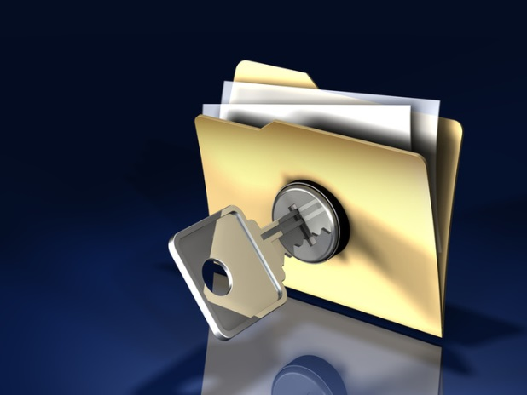
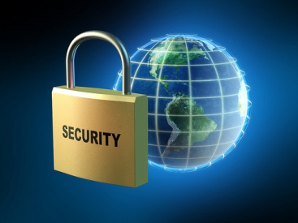
Security considerations Data security
Notes:
Data Security is a system of safeguards for protecting information technology against disasters, system failure, or unauthorized access through the Internet that can result in damage or loss.
Security involves not only the physical security of the computer equipment, but also the security of the data contained on the storage media.

Slide 18
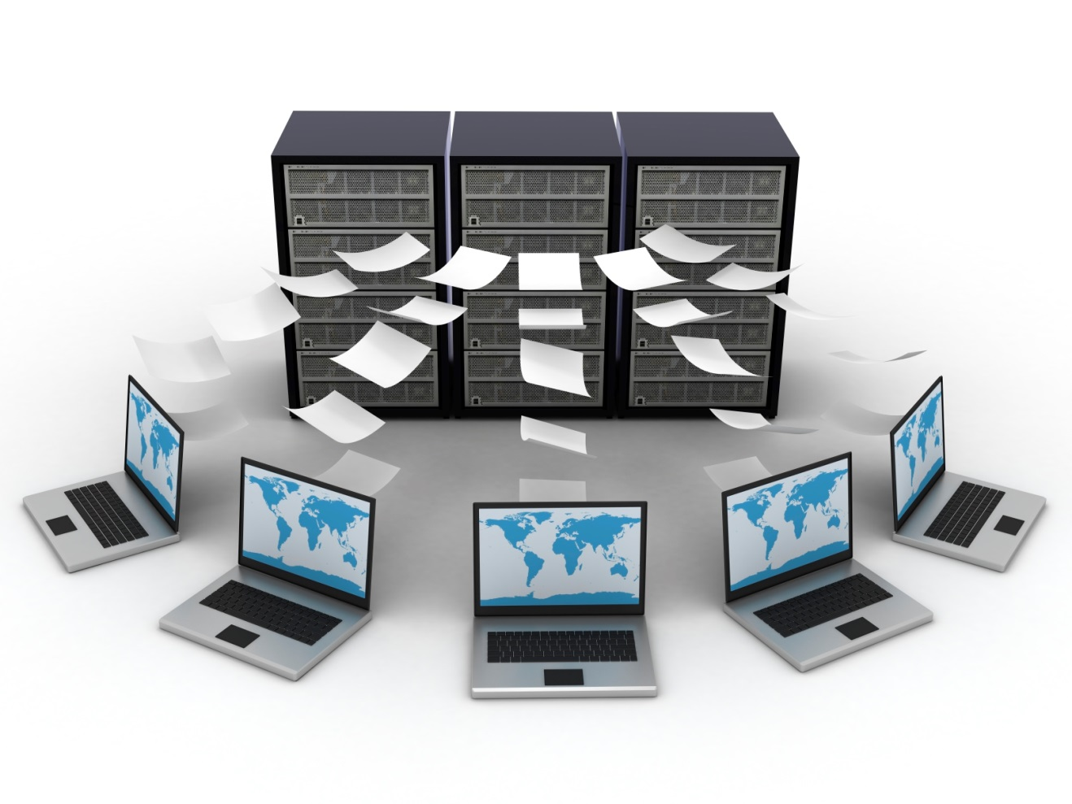
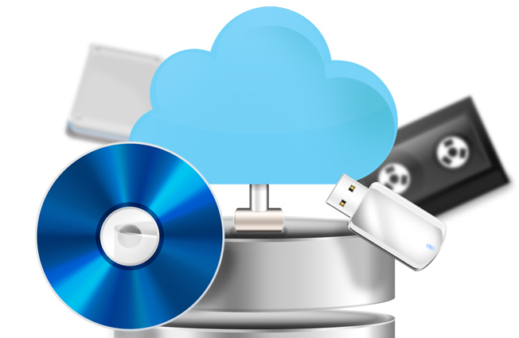
Security considerations Backups
Notes:
Backups are copies of all software, files and information which you have in your computer systems. You can use those copies when the original copies are damaged because of physical failure, user errors, accidents or carelessness.
Backups usually are taken on external storage devices such as: removable hard desks, CDs, tapes, USB flashes, … etc.

Slide 19
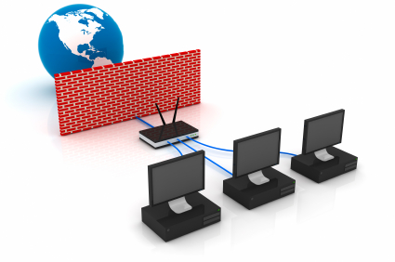
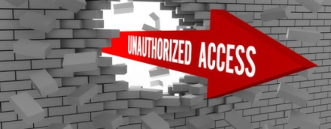
Security consideration Firewall
Notes:
Unauthorized access is a threat raised from using the Internet. A Firewall, is used to protect data from theft or unauthorized access.
A Firewall, is a set of related programs located at a network server that protects the resources of a private network from users from other networks.

Slide 20
The end
Notes:
In Next lecture, we will continue discussing other security considerations, such as Viruses, Hacking, and how to protect our data from such dangers.
That’s all for today, thank you for watching and see you next lecture.

