Slide 1

Advanced Internet Security Considerations
0750099 Pre-Computer Skills
Notes:
Hello and welcome back!

Slide 2

Lecture outline
Internet Security Threats
Viruses
What is a Virus?
Virus indicators
Protection against a virus
Notes:
In this lecture, we will talk about …

Slide 3
Lecture outline
Illegal Access
Hacking
Security threats from websites
Malware
Spyware
Fraud
Spam
Notes:
In this lecture, we will talk about …

Slide 4
Lecture outline
Other Security Considerations
Encryption and Decryption
Secure and unsecure websites
Notes:
In this lecture, we will talk about …

Slide 5
Learning outcomes
Learn more about Viruses, and how to protect your data from them.
Recognize some security threats such as, illegal access or also called hacking.
Notes:
At the end of the lecture, you will learn the following:

Slide 6
Learning outcomes
Recognize security threats that comes from the Internet, such as: Malware, spyware, fraud, …etc.
Learn some other security considerations, such as: encryption and decryption, secure and unsecure website.
Notes:
At the end of the lecture, you will learn the following:

Slide 7
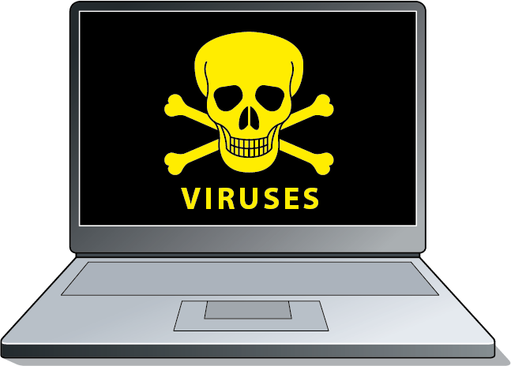
Security considerations viruses
Notes:
Viruses are software programs which are written with the intention of causing inconvenience and disruption or serious damage in a computer system. Files on floppies can spread viruses across a network or via email and the internet.
There are several types of viruses, some targets specific types of files, others targets the main memory, and others effect the booting of the computer system.

Slide 8

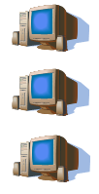


Security considerations viruses
Notes:
Viruses hide on disks.
When you access the disk, the virus will infect your computer.
It then can spread from one computer to another.
When you connect to Internet, the chance of your computer catching a virus increases, so you have to protect your system by using software called Anti-Virus.

Slide 9
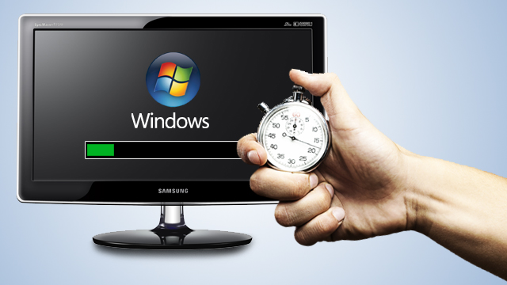
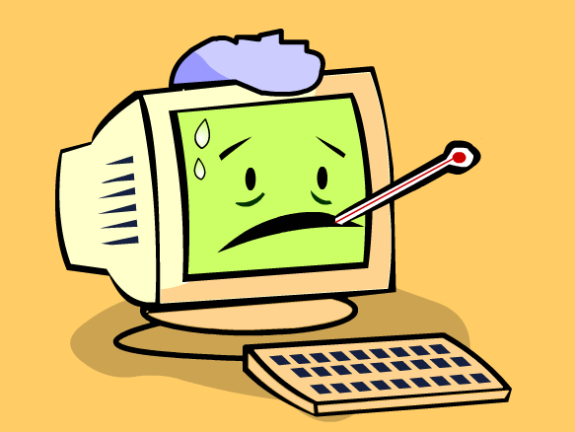
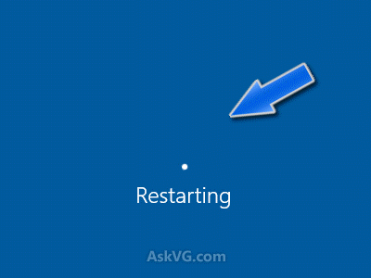
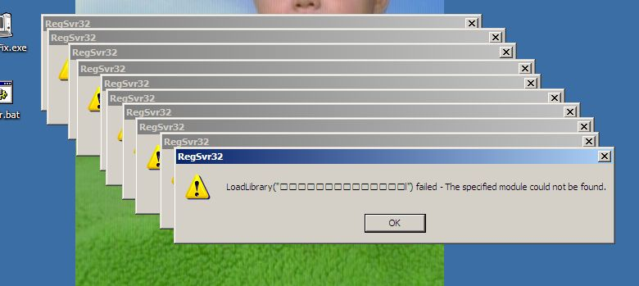
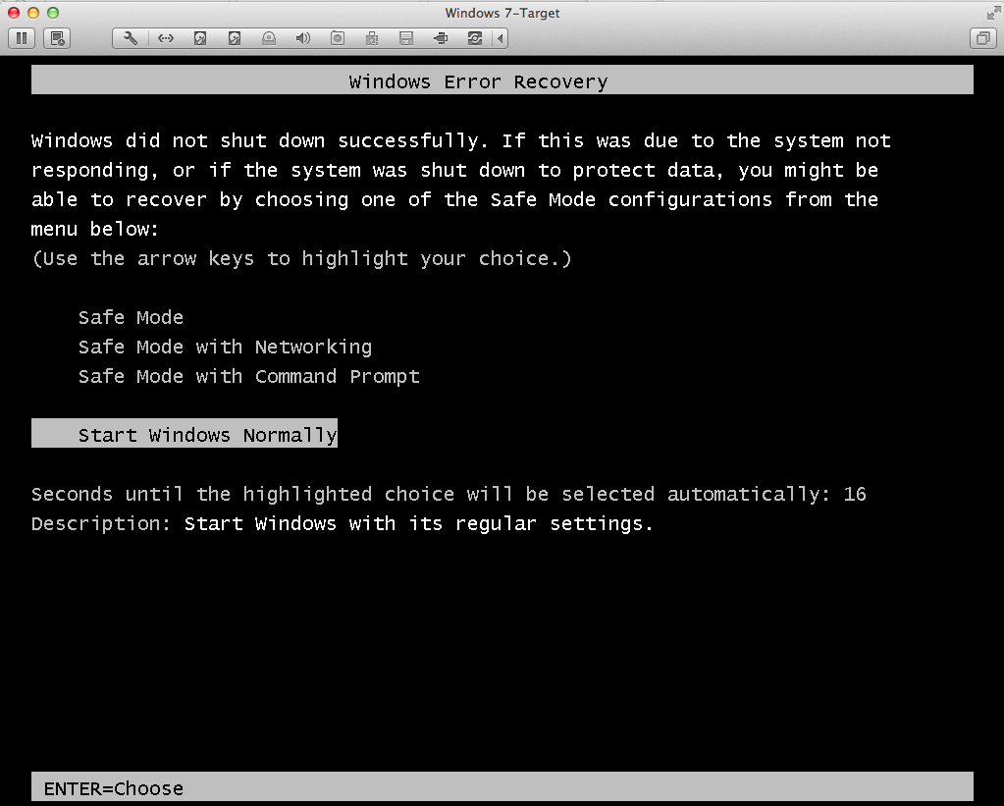
Security considerations viruses - Indicators
Notes:
As any disease, Computer virus has symptoms, or you can say indicators that show you that your computer might be infected by a virus,
Such as:
1. When it runs slower than normal
2. When it crashes and restarts every few minutes,
3. or restarts on its own and then fails to run normally.
4. When you see unusual error messages

Slide 10
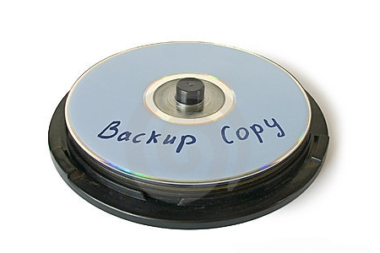
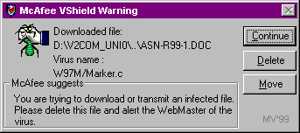
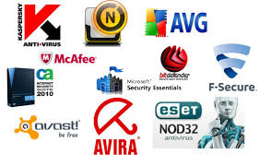

Security considerations viruses - protection
Notes:
Since viruses can corrupt your files or your entire computer system, you have to protect your computer against viruses.
How?
First of all, you need to use a high-quality anti-virus program, and be sure to update it regularly.
there are many anti-virus programs that you can purchase, or even use freely but with limited capabilities, such as (Norton, McAfee, AVG and many others).
Always scan your disks and files after using them on other computers, to catch any viruses and remove them from infected files.
And if course Always scan the files you download from the Internet. The same applies to attachments downloaded from e-mails
4. In regular basis, make backup copies of important documents or files and store them on separate disk

Slide 11
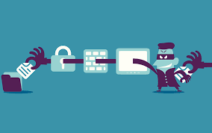
Internet security threats illegal access - hacking
Notes:
Illegal access to the computer information includes copying, modification and locking of the data on the single computer, computer systems and networks.
The main objective of the illegal access to a computer information is to reach the owner’s information and invading his or her privacy right.

Slide 12
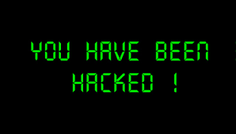
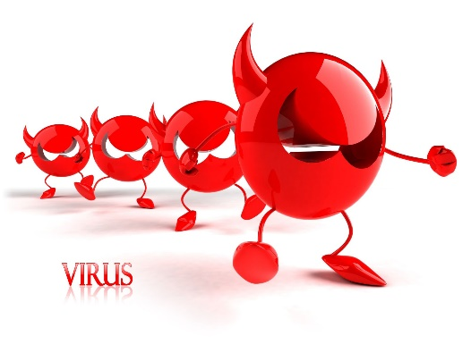
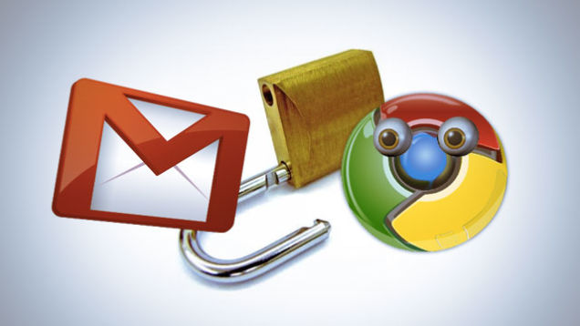
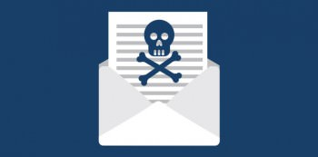
Internet security threats hacking effects
Notes:
Illegal access may cause the following:
The web site is deleted, modified or corrupted
Corporate networks will end up experiencing virus attacks
You will receive email threats
Your mail will become available to an unauthorized party,
Others will own your private information,
And Modifications or corruption of the databases and documents

Slide 13
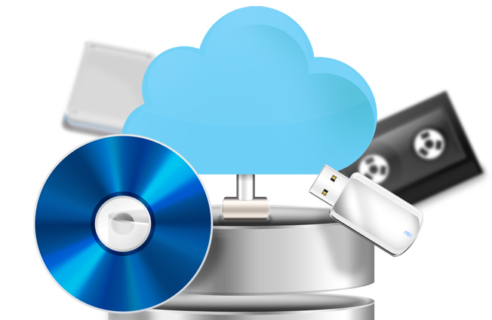

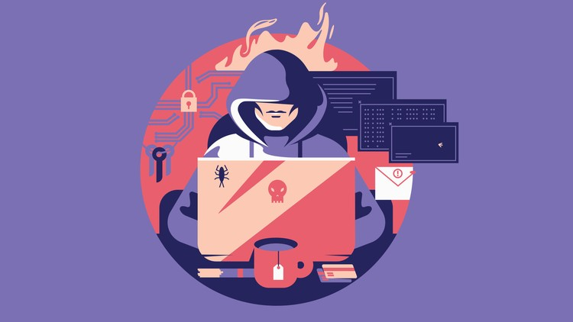
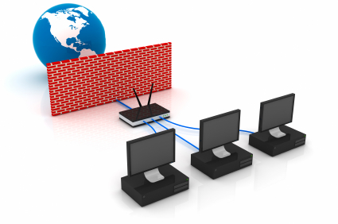
Internet security threats hackers
Notes:
Hackers are the people who create or improve programs and share them with fellow hackers to gain unauthorized access to computer systems.
So, how to protect our systems and data from hacking,
As we discussed in the previous lecture, by applying Data security, having external backups of important data, and using firewalls.

Slide 14
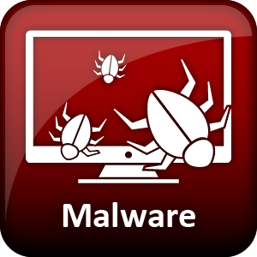
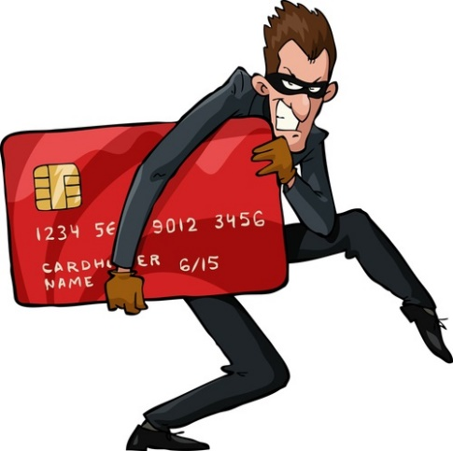
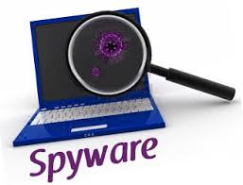
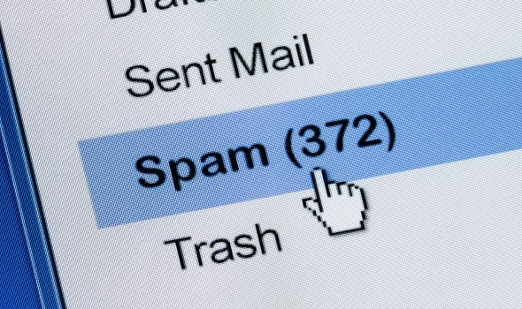
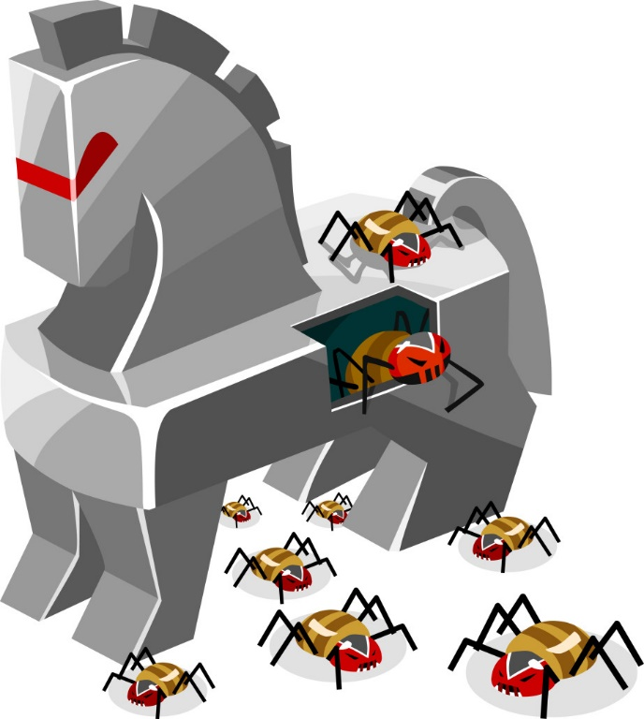
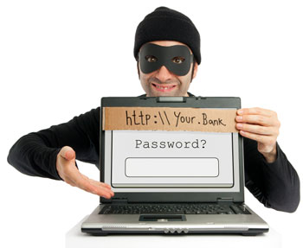
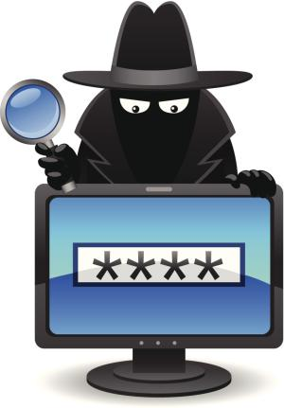
Internet security threats
Notes:
We have other security threats that we may face when using the Internet.
Malware, short of Malicious Software, is a software designed to sneak in a computer system without the owner’s awareness or approval.
Spyware, is a program that is installed secretly on a personal computer to spy or take partial control over the user’s interaction with the computer without the user being informed or approved.
These programs can collect various types of personal information, such as Internet Surfing habits and sites that have been visited, but also can interfere with the user’s control of the computer in other ways, such as installing additional software or even change the computer settings.
Fraud, is another threat that you may face, especially what is related to payments via the Internet. be aware of the possibility of being subject to fraud when using a credit card on the Internet.
You can never guarantee that the person sells products online is the original seller. You may pay the price of a product and never have it.
Even the bank accounts can be hacked so that you enter a faked site, and enter your account password, and this password is stolen and used by the hacker.
Another threat is Spam. Spam is a term used to describe unwanted and undesired e-mail sent to your mail box. Spam e-mails may contain things for sale or hoax virus alerts. Spam e-mails may also consist of attachments with viruses, which can damage your computer files. Usually, an e-mail system can recognize Spam e-mails, and also you can specify e-mail addresses as spammers.

Slide 15
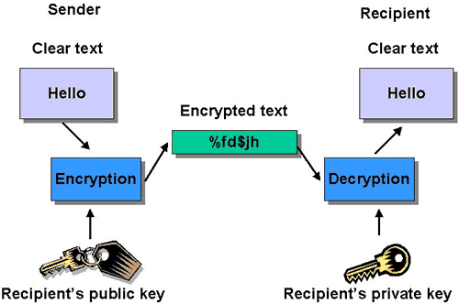
Other security considerations encryption and decryption
Notes:
Encryption: is the conversion of data into a form that cannot be easily understood by unauthorized people.
Decryption: is the process of converting encrypted data back into its original form, so it can be understood. In order to do that, a correct decryption key is required.

Slide 16
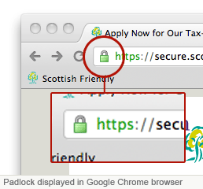
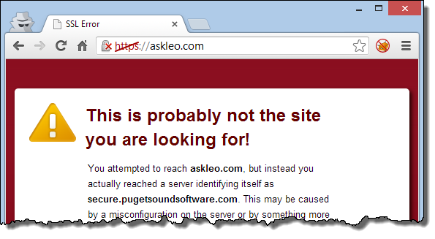
Other security considerations Secure & unsecure websites
Notes:
Encryption is used now in websites to guarantee the security of data transferred through them. To make sure that a website is secured, note the logo of secured website, along with the protocol https.
Other unsecured websites, will give you an alert to warn you before starting using them.

Slide 17
The end
Notes:
In Next lecture, we will continue discussing other security considerations, such as Viruses, Hacking, and how to protect our data from such dangers.
That’s all for today, thank you for watching and see you next lecture.

