Slide 1

Introduction to e-mail
0750099 Pre-Computer Skills
Notes:
Hello and welcome back!

Slide 2

Lecture outline
What is an E-mail?
Advantages of an E-mail
E-mail Address
Creating an E-mail Account
What is a Spam E-mail?
Notes:
In this lecture, we will talk about …

Slide 3
Learning outcomes
Understand the definition of e-mail and its advantage.
Learn the main parts of an e-mail address.
Learn how to create a new account using google.

Slide 4
Learning outcomes
Know the main parts of an email screen.
Understand the definition of a spam e-mail and spammers.

Slide 5
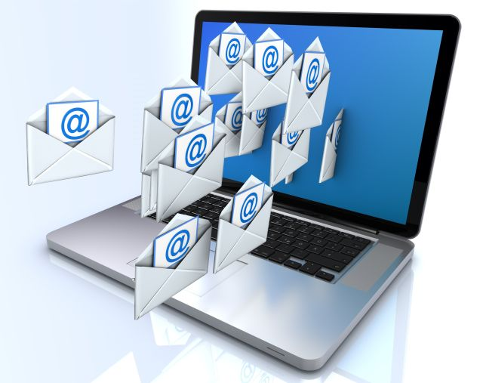
E-mail
Notes:
E-mail: is an electronic message that is sent by a computer user to another, via a certain network. It could be a local network within a certain institution, or a global network which is the Internet.
There are several email applications that are used to correspond electronic messages, such as microsoft outlook for example. But there are many companies that provide free e-mail accounts using their servers, such as goolge, yahoo, hotmail and others.

Slide 6
Advantages of E-Mail System
Speed of Delivery
Low cost
Easy to deliver, reaches you where ever you are

Slide 7
Advantages of E-Mail System
Can be sent to an individual or a group
You can create mailing lists and send the same message to a number of people.
You can send text, sound, images and spreadsheets files as attachments.

Slide 8
Spam e-mail
Spam: is the term used to describe unwanted, unsolicited e-mail sent to your mail box.
Spam e-mails may contain things for sale, chain letters, and hoax virus alerts.

Slide 9
Spam e-mail
Spam mails may also contain attachments with viruses, which can damage your computer files.
While Spam is basically impossible to stop, there are ways to limit your exposure to spam mail.

Slide 10
spammers
Spammers: people who send you spam e-mail.
They use different ways to deliver Spam e-mail. The most common method is to use a free email address from a large e-mail provider, like Hotmail and Yahoo.

Slide 11
The end
Notes:
12.5:
We will discuss now some tools in internet explorer, such as History, which is used to help you browse old web pages that you have visited before, in earlier days, weeks or even months.
Also, favorite tool will be discussed, which will enable you to specify certain web pages that you frequently visit, as your favorites, so that you can access more easily.
12.8:
That’s all for today, don’t forget the self-test assessmnet.
Thank you for watching and see you next lecture.

