Slide 1

English 99

Slide 2
Adverbs of frequency
Always 100%
Usually
Often
Sometimes 50%
Rarely
Seldom
Never 0%

Slide 3
He never is on time
He is never on time √
He usually wakes up at 7 √
He wakes up usually at 7
You can always depend on me √
You always can depend on me

Slide 4
How Often
I sometimes do crossword puzzles
I usually go for a long walk
I always read a book
I often play computer games
I rarely run marathons
I seldom watch TV

Slide 5
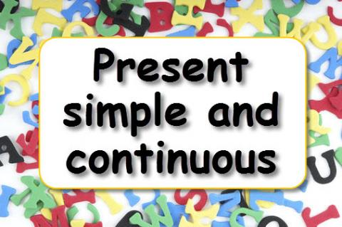

Slide 6
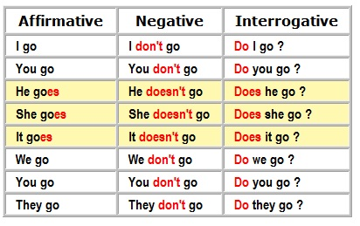

Slide 7
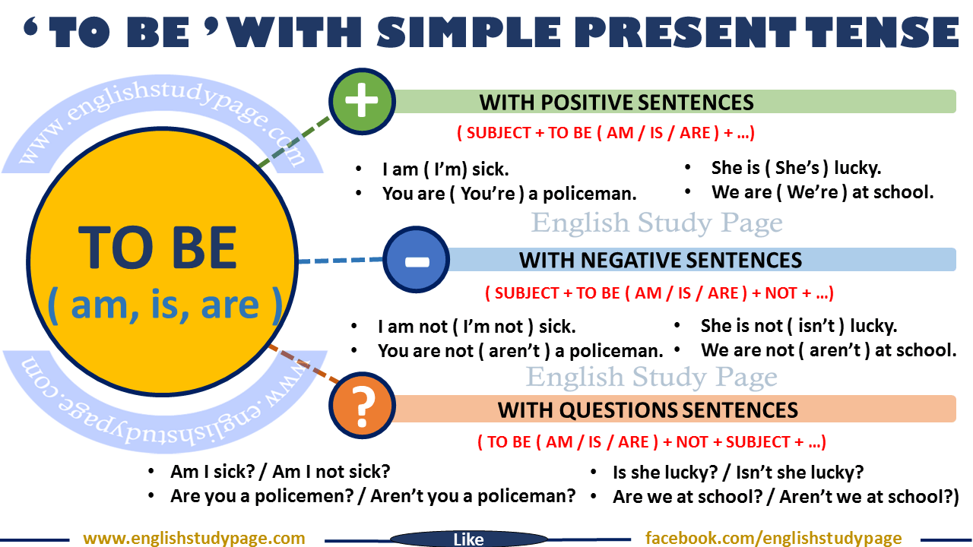

Slide 8
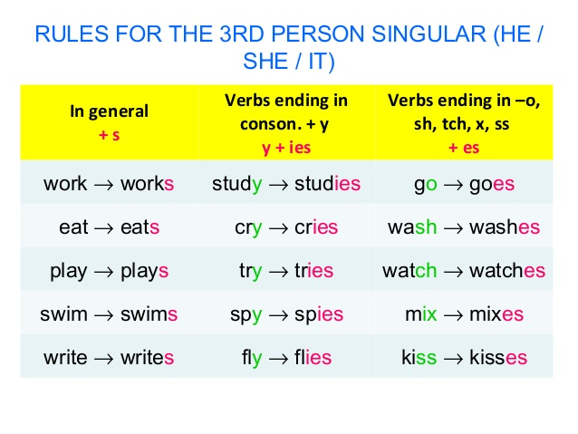

Slide 9
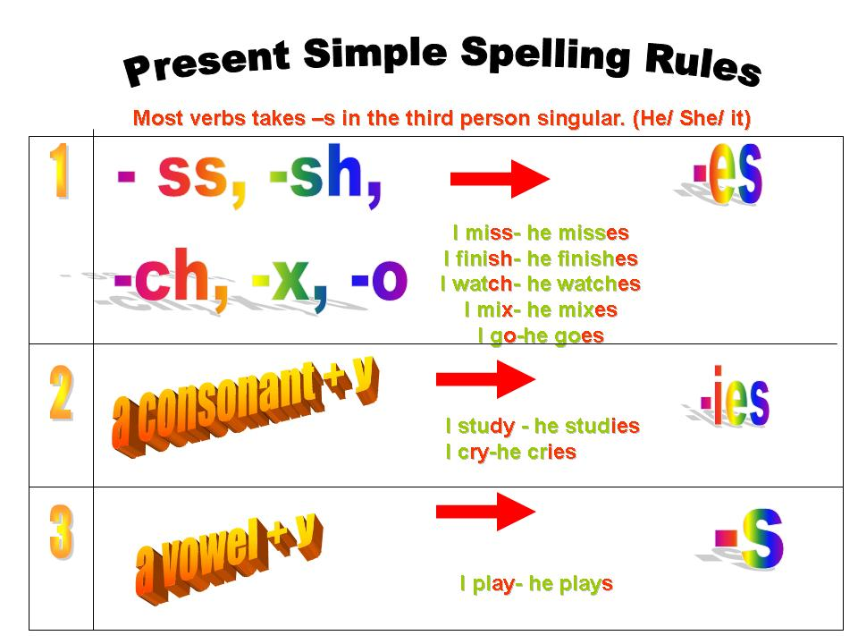

Slide 10
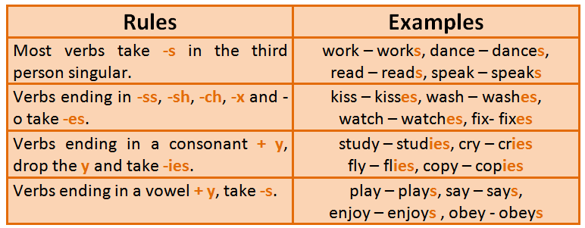

Slide 11
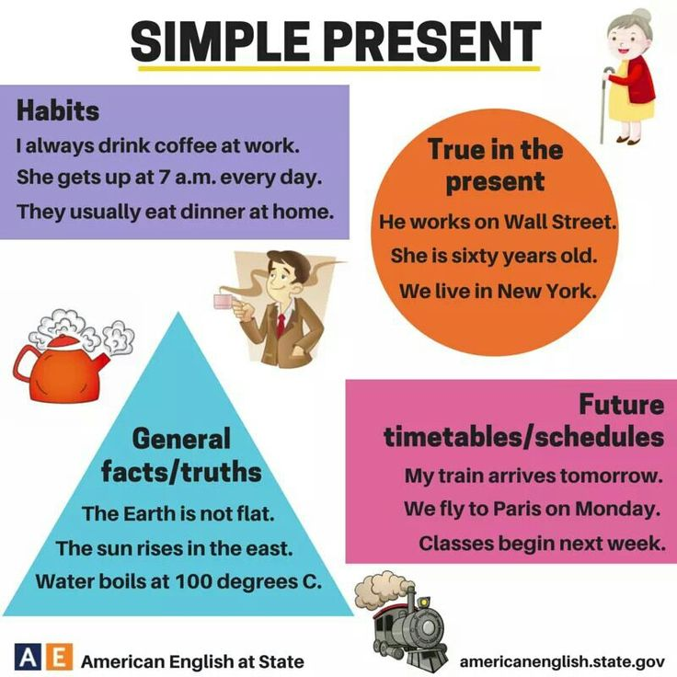

Slide 12
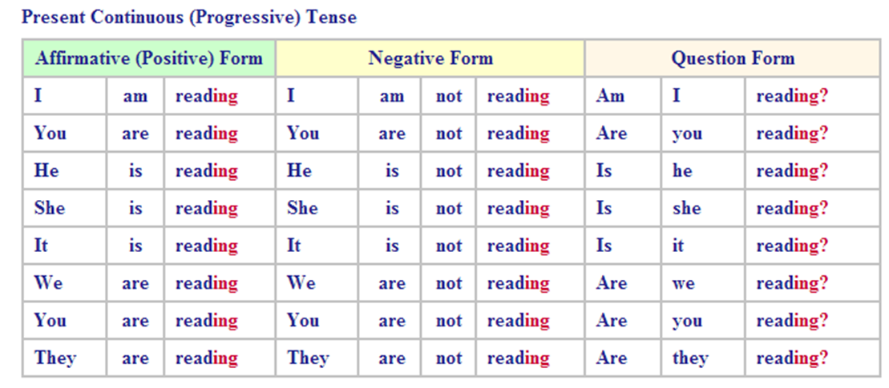

Slide 13
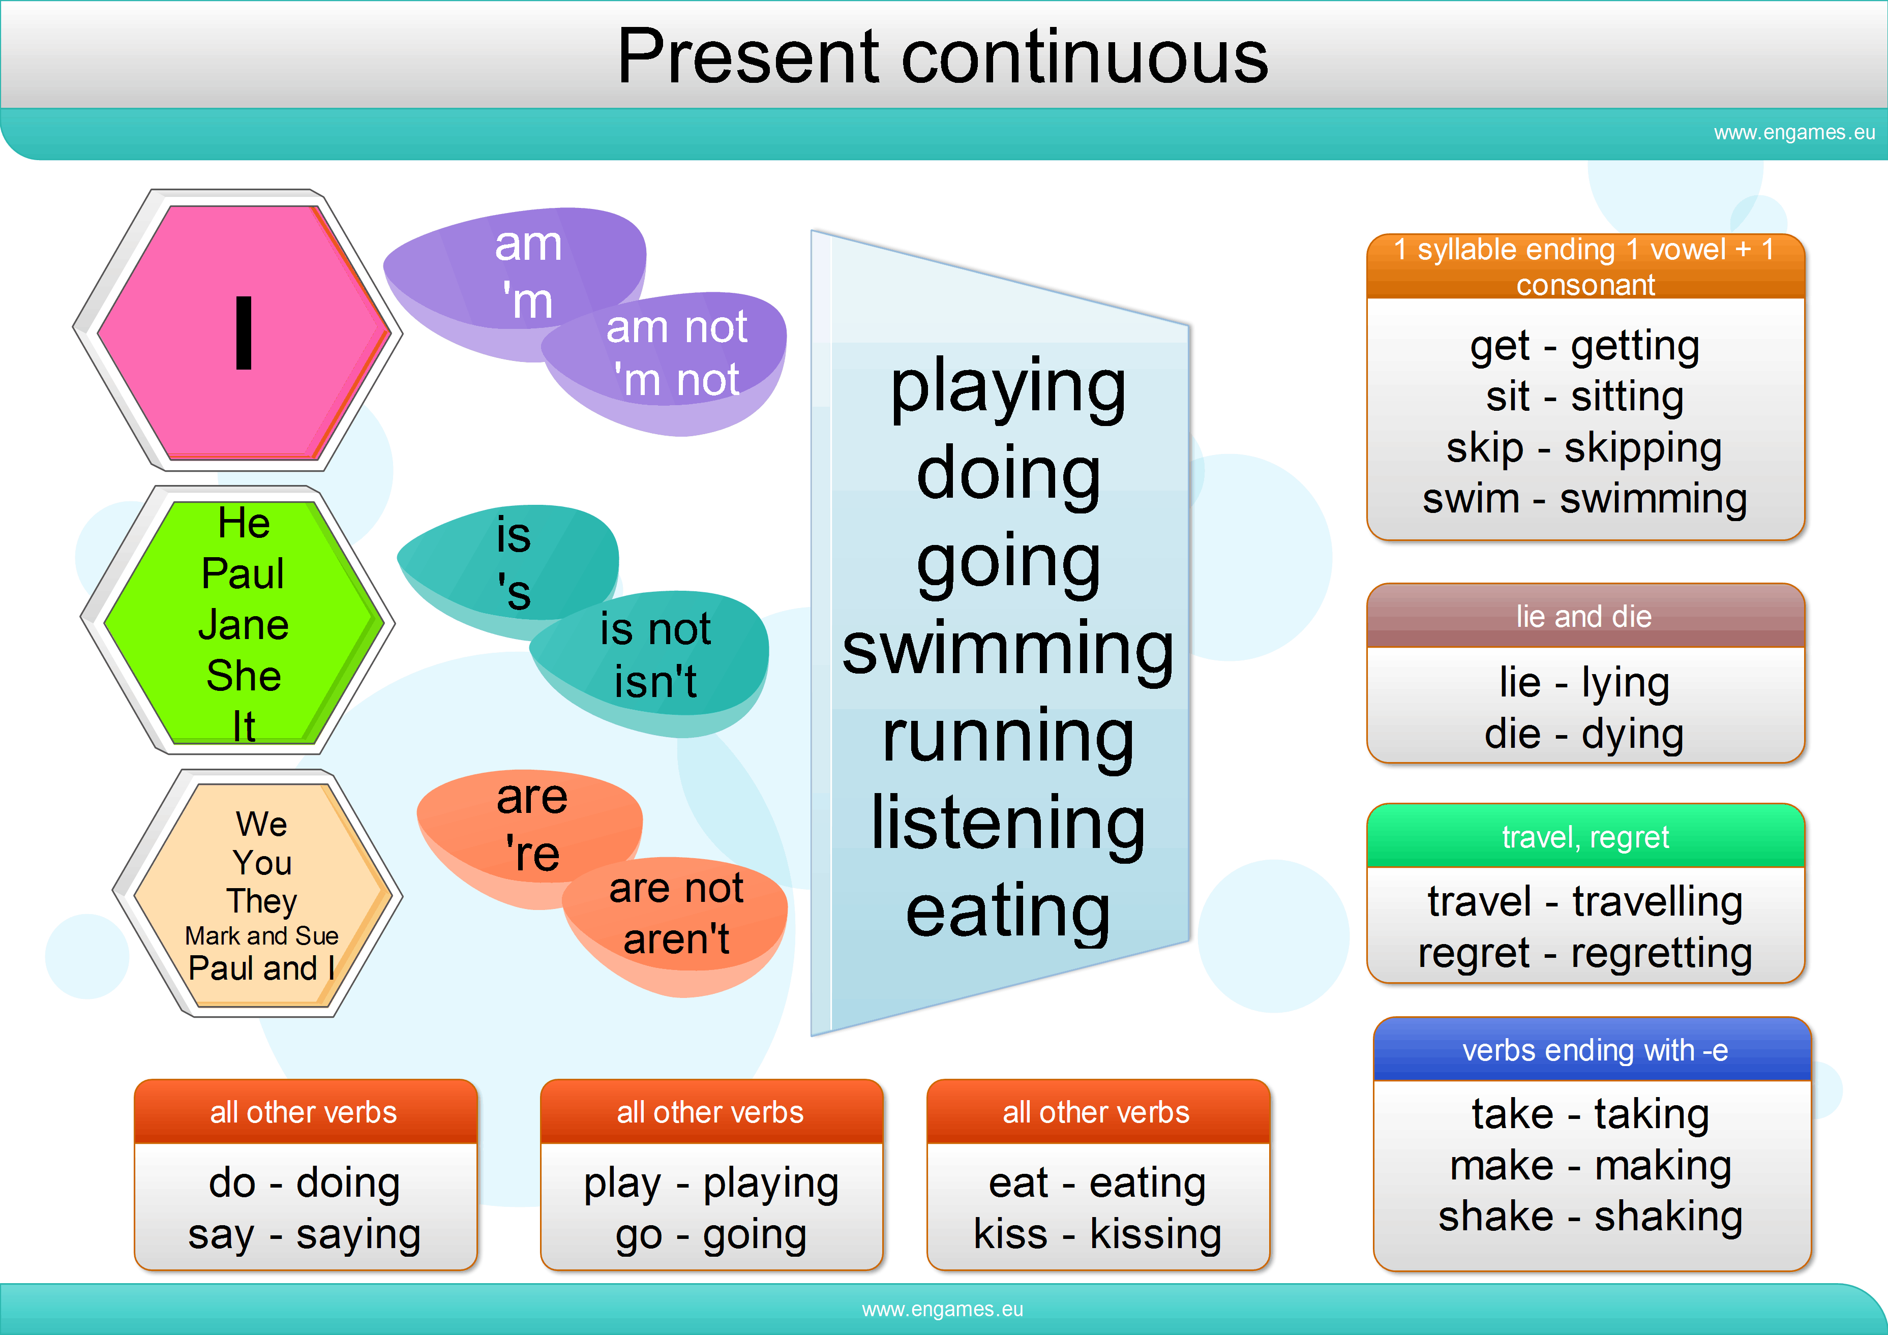

Slide 14
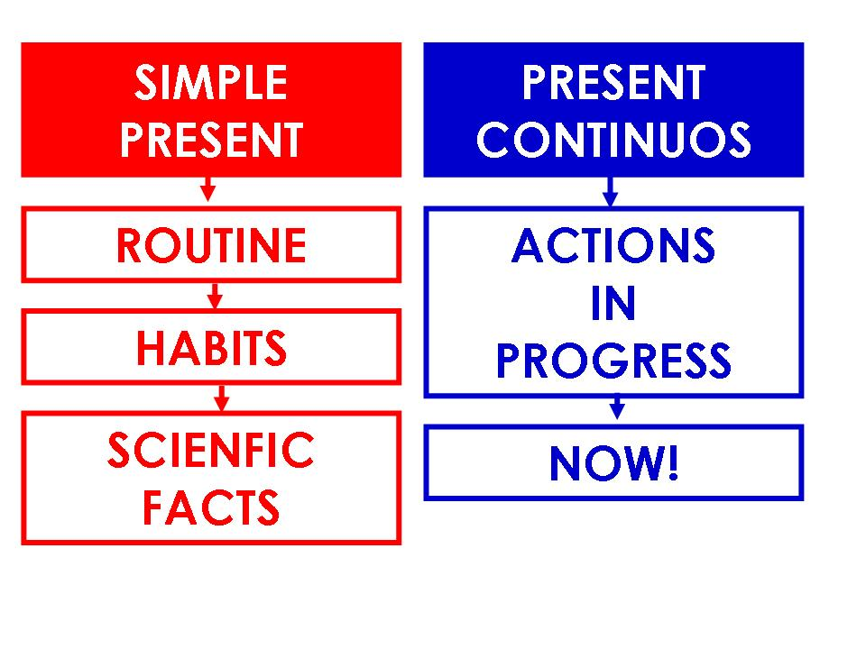

Slide 15
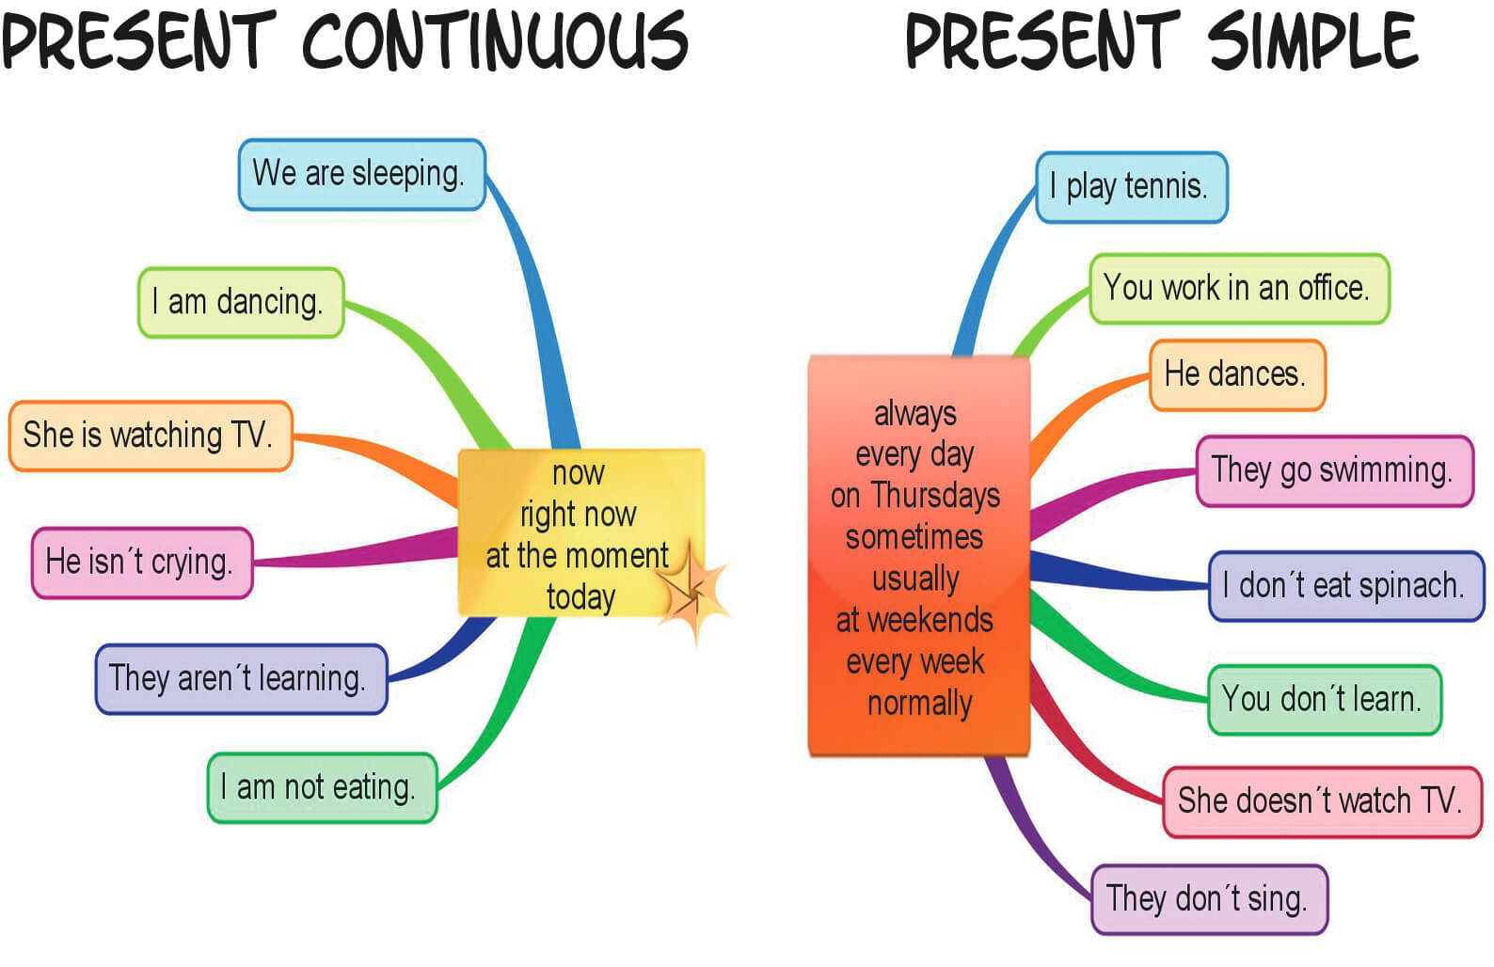

Slide 16
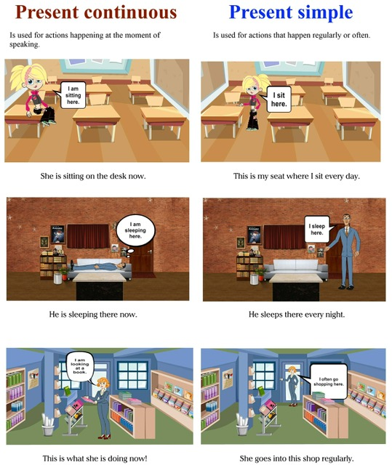

Slide 17
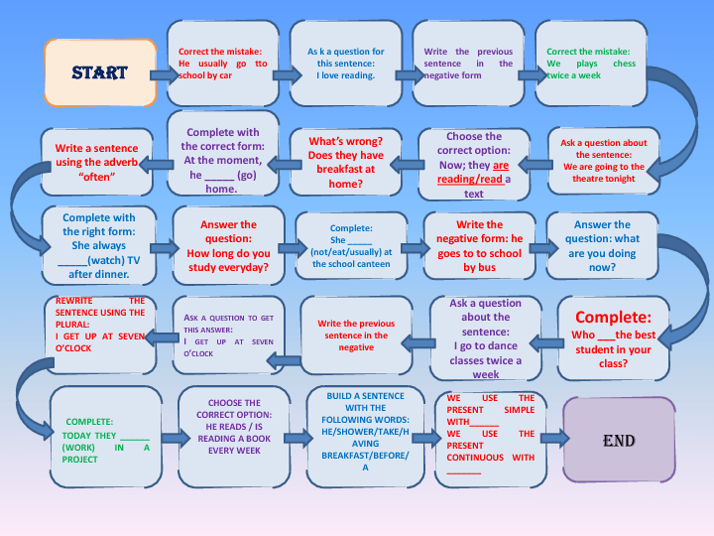

Slide 18
Thank you

