Slide 1

English 99 Introduction

Slide 2
Physical Health
Mental Health
Regular exercise
Healthy diet
Avoid smoking
Avoid stress
Sleep well
Mental exercise
Forget your problems
Hangout with friends
Have a hobby
Be happy
Sleep well

Slide 3


Slide 4


Slide 5


Slide 6
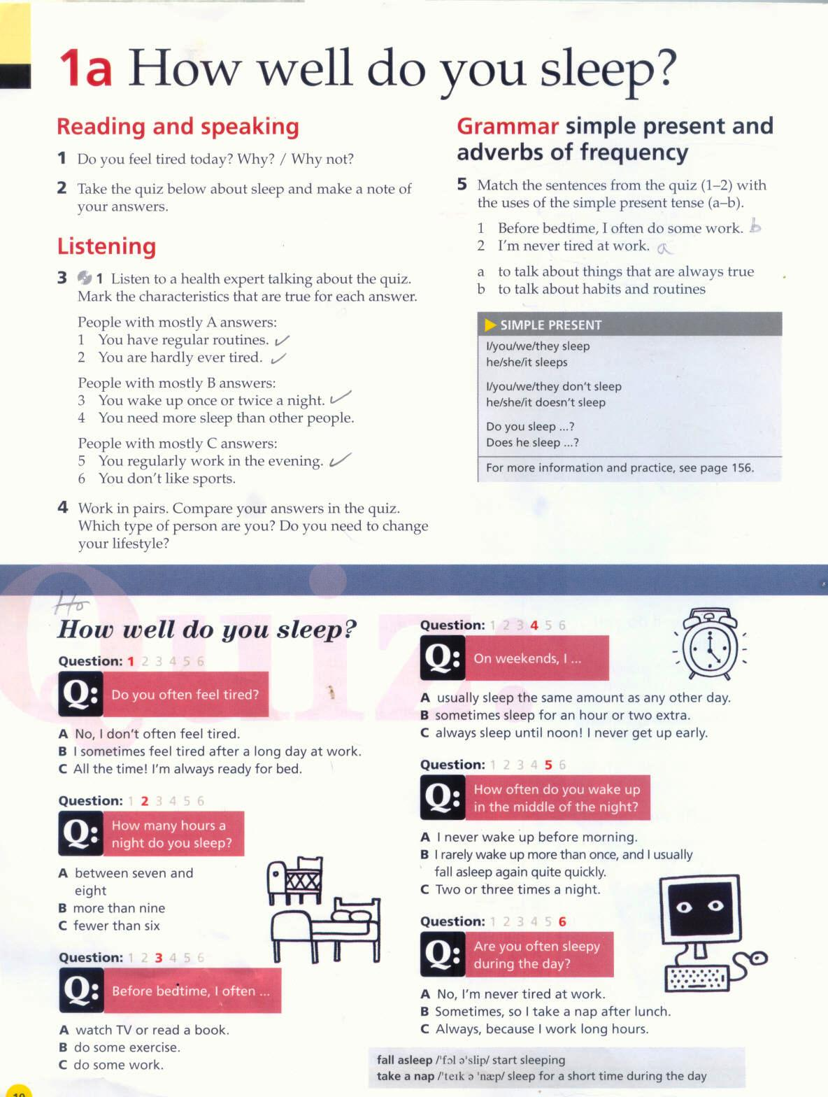

Slide 7
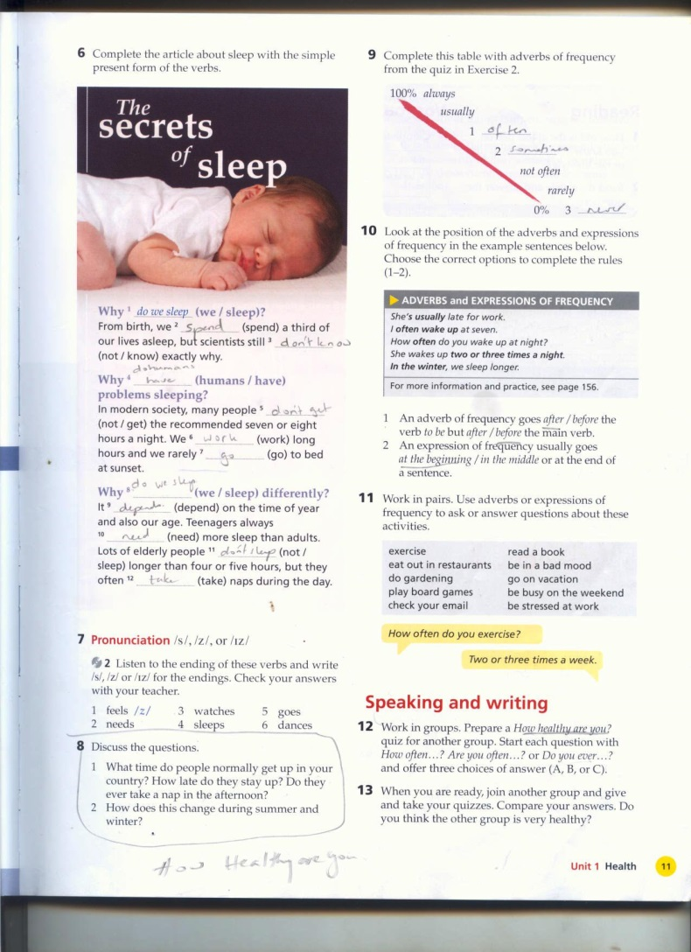

Slide 9


Slide 10
Thank you for watching

