Slide 1

English 99

Slide 2
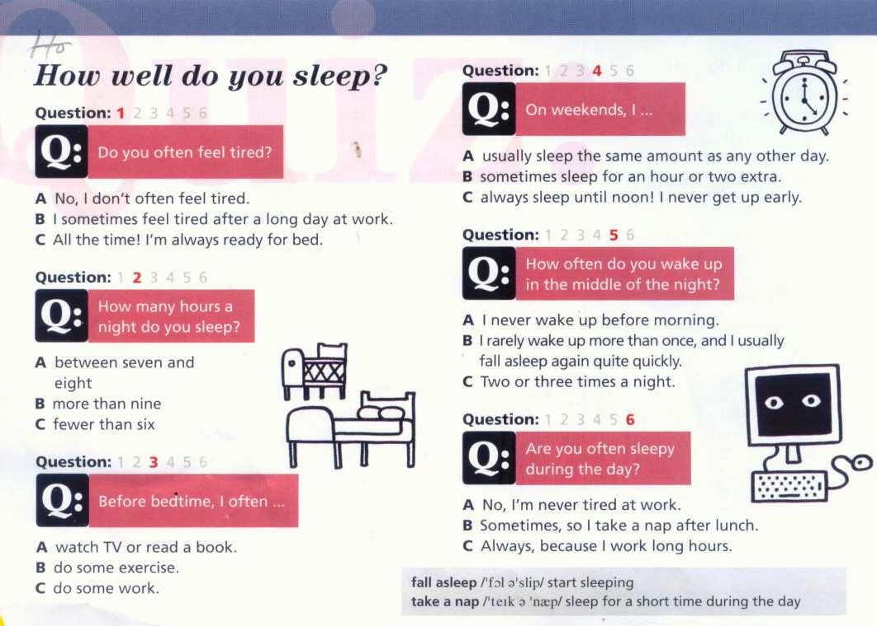


Slide 3
An adverb of frequency goes after/before the verb to be but after/before the main verb.
An expression of frequency usually goes at the beginning /in the middle or at the end of a sentence

Slide 4
How often do you exercise ?
How often do you eat out in restaurants?
How often do you do gardening?
How often do you play board games ?
How often do you check your email?
How often do you read a book?
How often are you in a bad mood?
How often do you go on vacation?
How often are you busy on the weekend?
How often are you stressed at work?

Slide 5
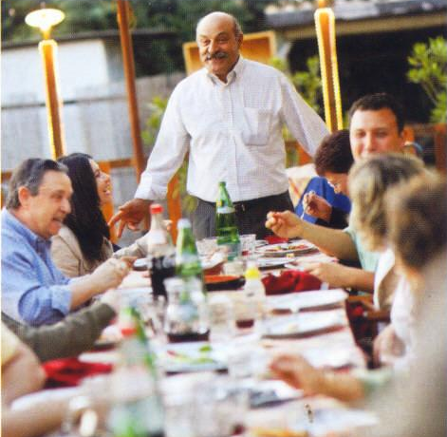

Slide 7
Currently
Explorer
journalist
Regions
healthy
authority
Explanation
stress
generation
traditional

Slide 8
Before bedtime, I often do some work
I’m never tired at work.
To talk about things that are always true
To talk about habits and routines

Slide 9
He’s currently traveling to places and regions.
He’s speaking to us right now on the phone.
Men live as long as women
Every Sunday the whole family meets and they eat a huge meal together.
Young people are moving to the city so they are doing less exercise because of their lifestyle.

Slide 10
We are learning a new language now
We often spend time together
Give me a minute !I am checking my email.,
How often do you go to the gym?
Right now I am reading a really interesting book
Currently, a friend of mine isn’t eating any candy and he says he feels healthier.
I am nearly eighty but I don’t do any exercise !
Which video game are you playing ? It looks like fun .

Slide 11
Talking about sickness

Slide 12
I have a sore throat .
You should take this medicine .
It’s good for a sore throat.
You need a box of tissues .
If you still feel sick in a few days ,see a doctor.
Let me have a look.
Do you feel sick?
Let me check your temperature.

Slide 13
Thank you for watching

