Slide 1

English 99

Slide 2
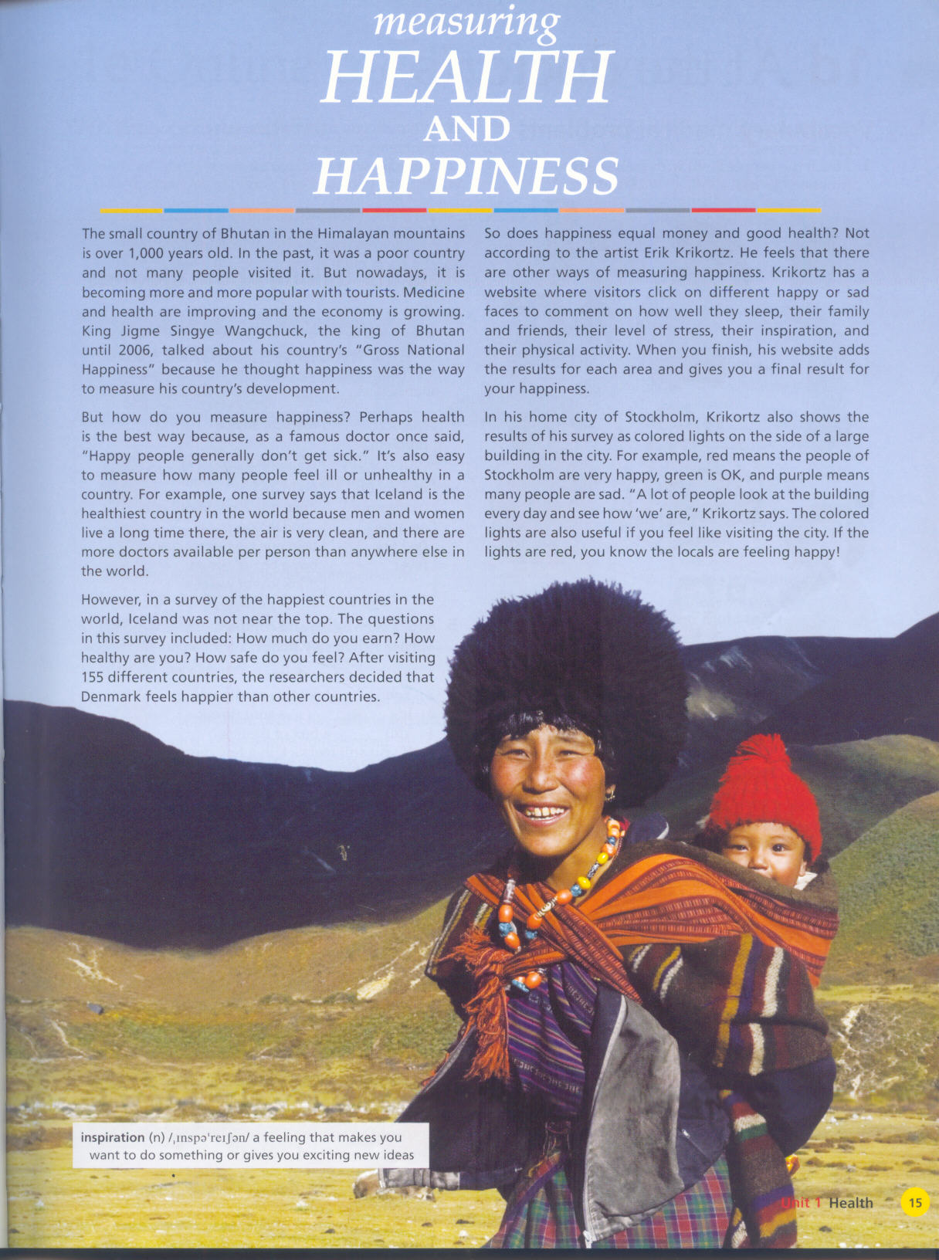
Word

Slide 3
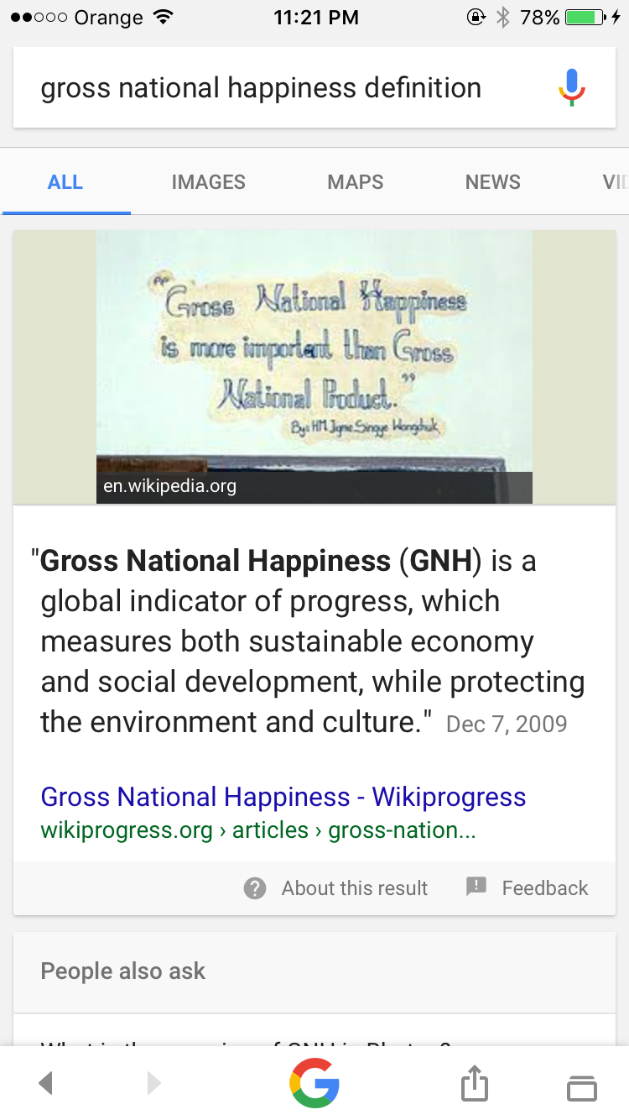

Slide 4
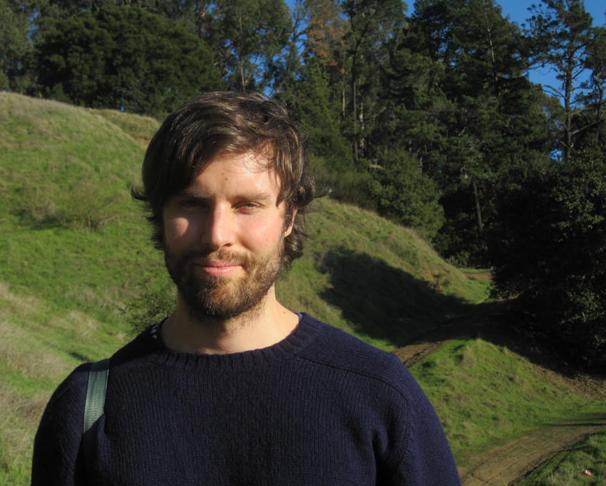

Slide 5
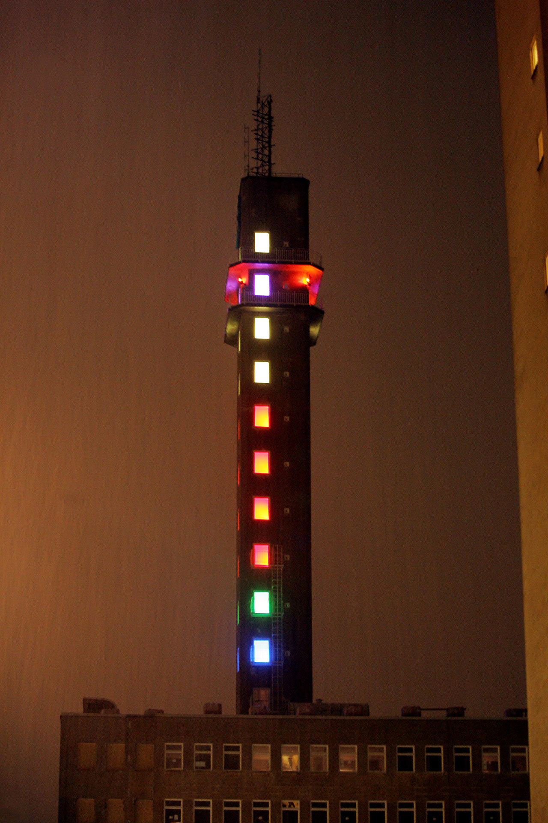

Slide 6
Word
Popular:
Measure:
Development :
Survey :
Earn :
Locals :
Inspiration:

Slide 7
Word | Meaning
Popular | well-known ,famous
Measure | discover the value of
Development | progress
Survey | Questionnaire
Earn | How much money one gets
Locals | people who live in a particular place
Inspiration | a feeling that makes you want to do something

Slide 8
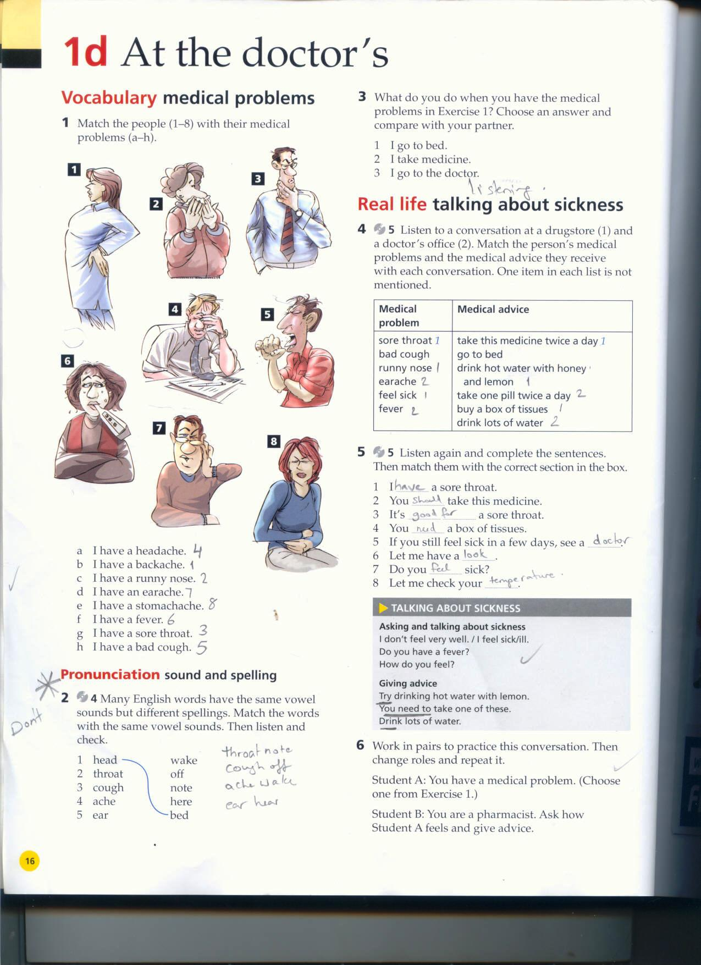
-

Slide 9
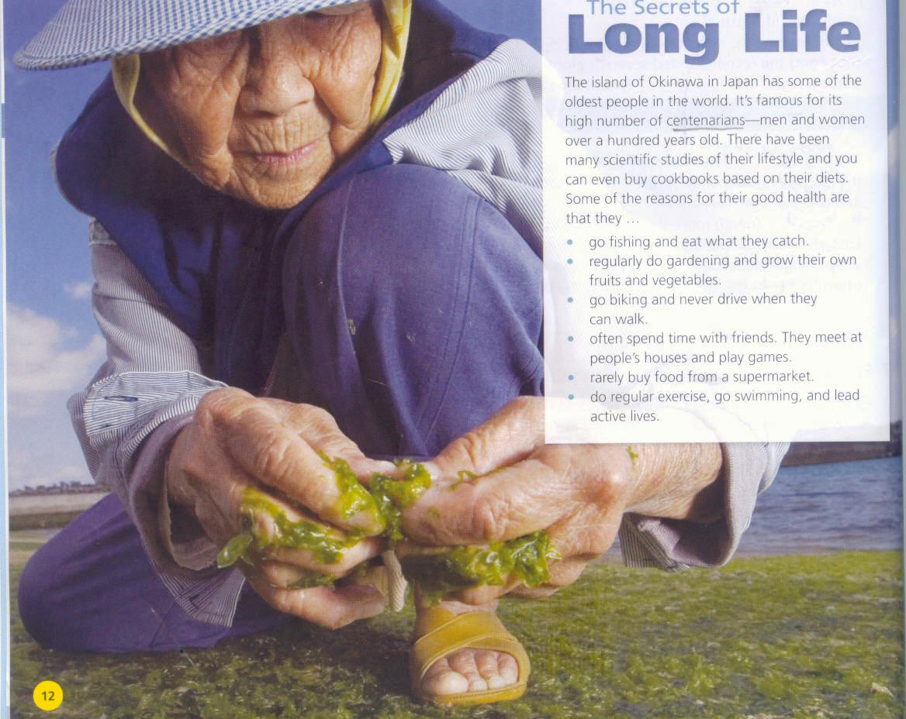

Slide 10
Do
Go
Play

Slide 11
Thank you

