Slide 1

English 99

Slide 2
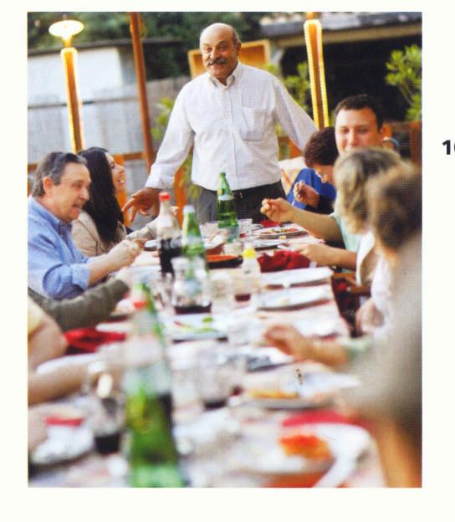

Slide 3
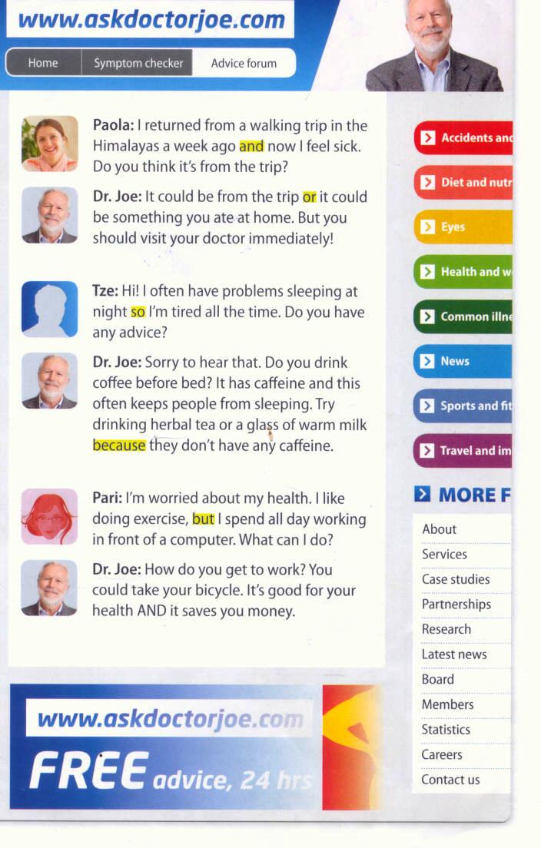

Slide 4
Mary came in. Mary greeted everyone.
He is tall. His friend is short.
Do you want tea ? Do you want coffee?
He was absent. He was sick.
He didn’t study. He failed .

