Slide 1

English 99

Slide 2
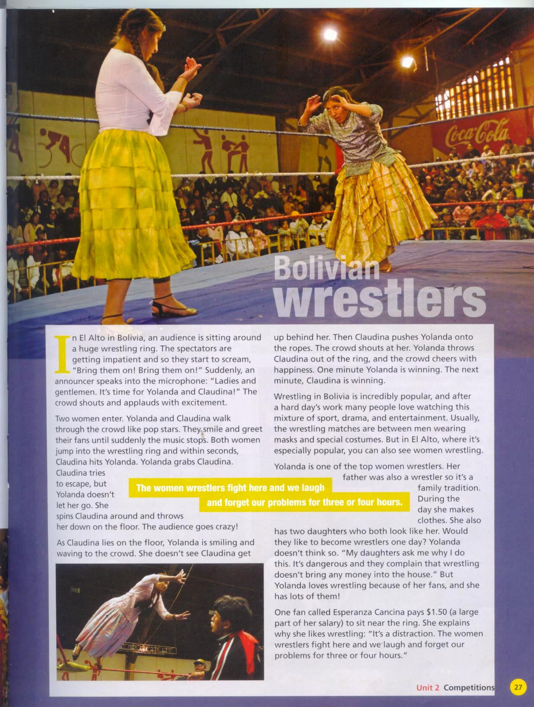

Slide 3
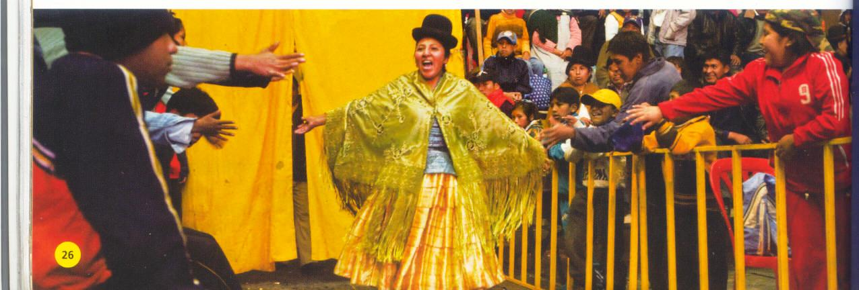

Slide 4
Audience: spectators
Applaud: show approval by clapping
Impatient: nervous, irritated
Fans:
Grab: seize
Escape: runaway
Let go:
Spin : turn around
Cheers: shout for joy

Slide 5
Mixture: a combination of
Mask: a cover
Costume: clothes of a particular country
Complain: express dissatisfaction
Distraction: prevent from concentration
Go crazy:
Wrestler:
Wrestling:
Wave : move the hand

Slide 6
Wrestling is popular in Bolivia.
True
Only men can wrestle in public.
False
People earn a lot of money doing it.
False

Slide 7
The two wrestlers before the fight? paragraph2
The popularity of male and female wrestling in Bolivia? paragraph4
The moments before the wrestlers enter? paragraph1
Yolanda’s family life? paragraph5
The reason why a fan watches it ? paragraph6
The fight between the two women wrestlers? paragraph3

Slide 8
Three words meaning a large group of people at a performance or sporting event: audience ,spectators, crowd
Two verbs meaning to speak loudly and make a lot of noise: scream, shout
To clap your hands together: applaud
People who support someone famous: fans
To get away from someone or something :escape
Three verbs to describe fast movements: jump, spin, throw

Slide 9
Yolanda: I get a wonderful feeling every time I go out there.
One of Yolanda’s daughters: I don’t like the days when there is wrestling
Esperanza: Life can be hard for people like me

Slide 10
Would they like to become wrestlers one
day ?( want to do in the future)
Yolanda and Claudina walk through the crowds like pop stars.( behave in a similar way)
Esperanza explains why she likes watching wrestling .(enjoy in general)
She also has two daughters who both look like her ( have a similar appearance)

Slide 11
What does he like?
He likes swimming.
What does he look like?
He is tall and thin.
What is he like?
He is very friendly.

Slide 12
What is your opinion about women taking part in sports like wrestling?

Slide 13
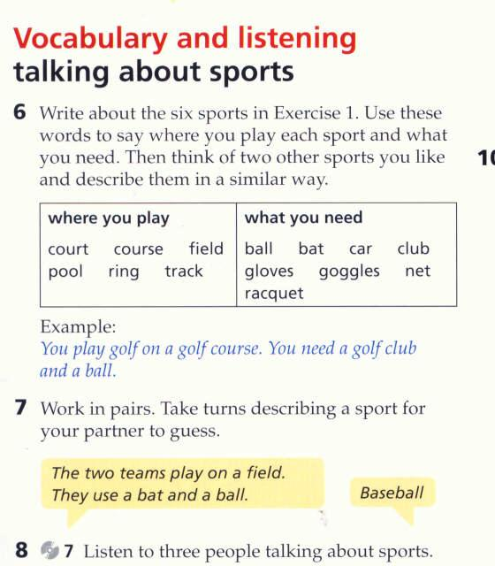

Slide 14
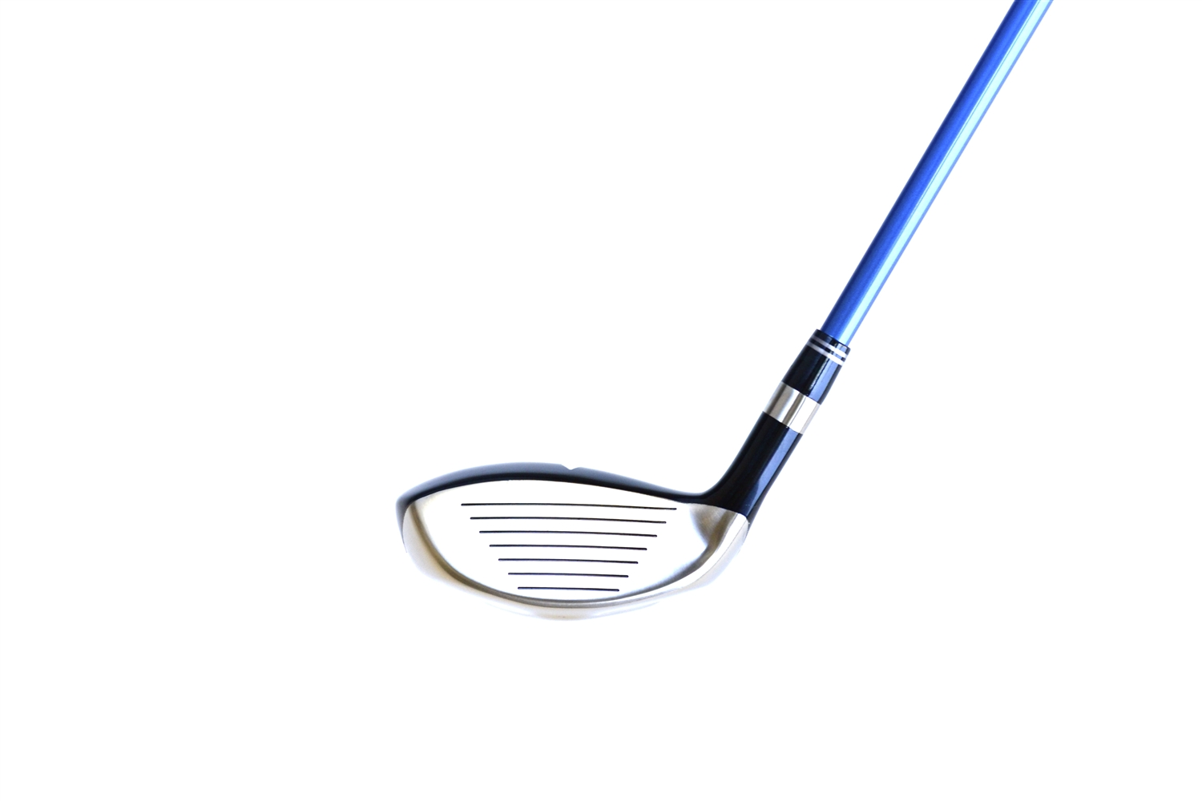
A golf club

Slide 15
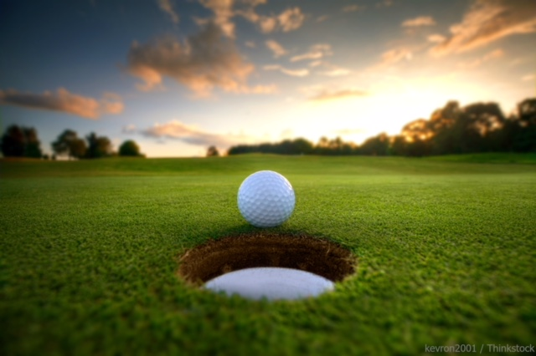
A golf course

Slide 16
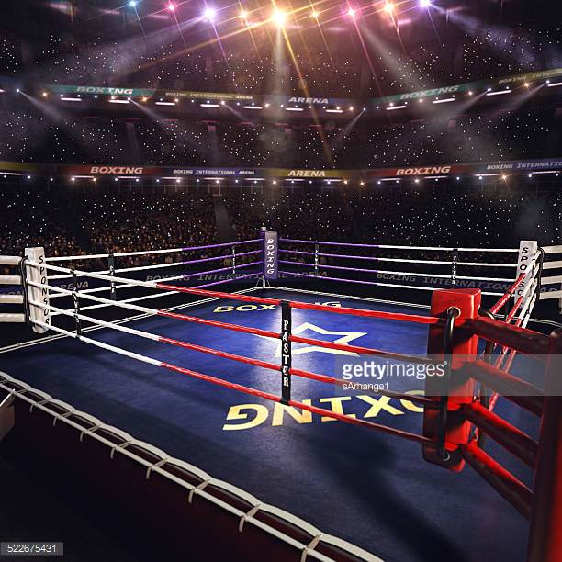
A boxing ring

Slide 17
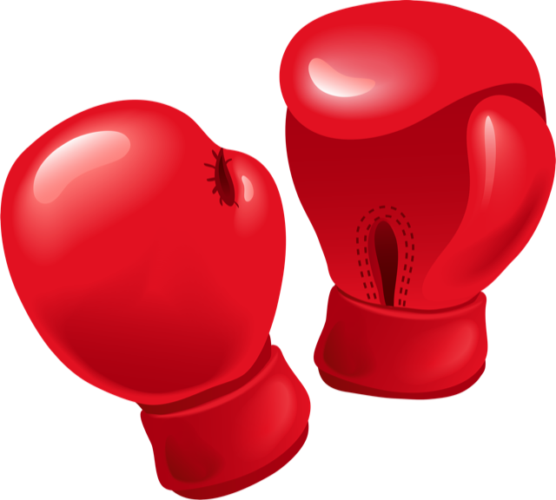
Boxing gloves

Slide 18
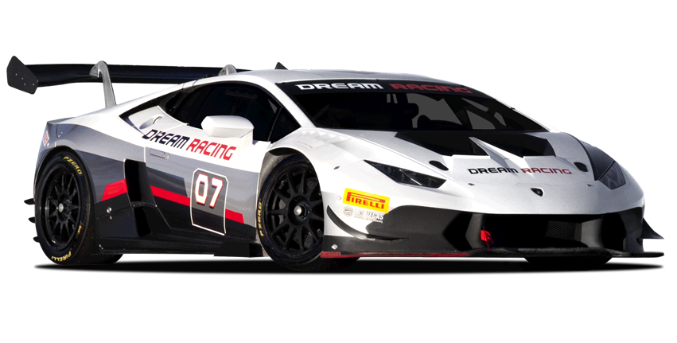
A race Car

Slide 19
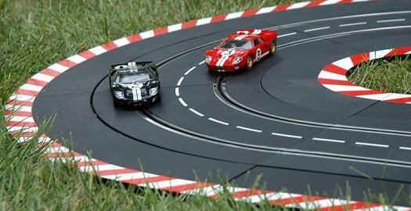
A car race track

Slide 20
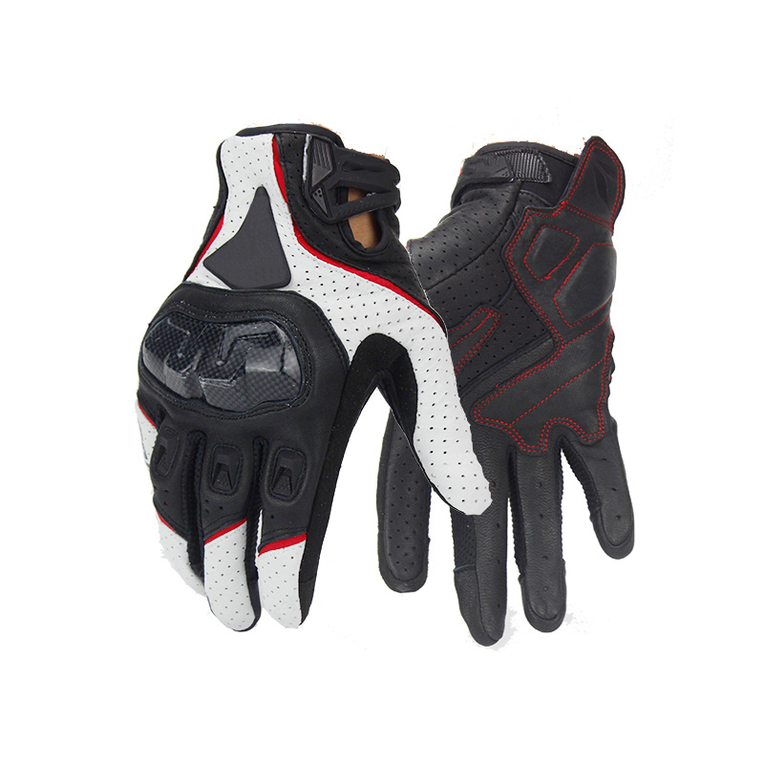
Gloves

Slide 21
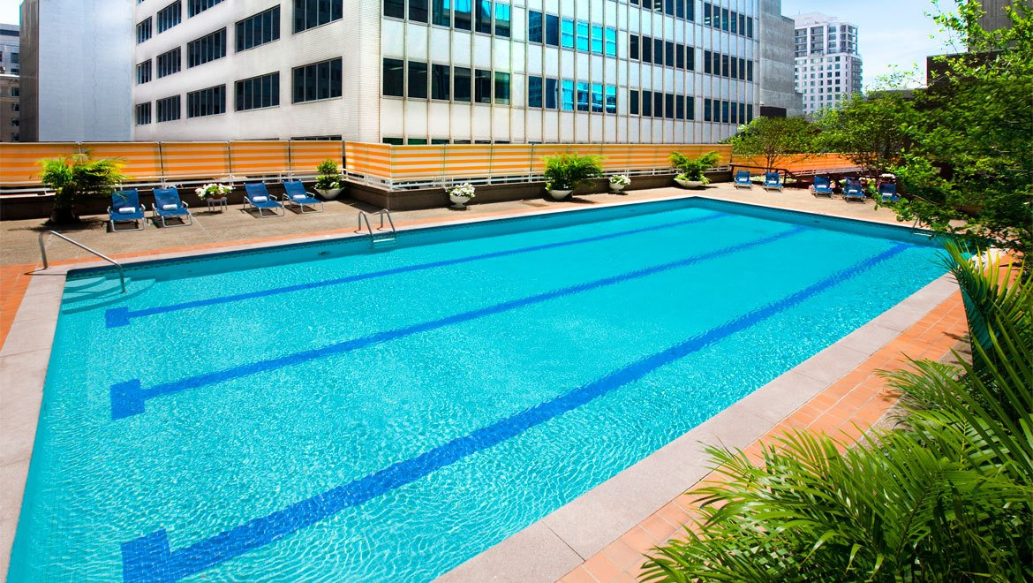
A swimming pool

Slide 22
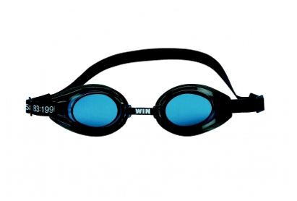
goggles

Slide 23
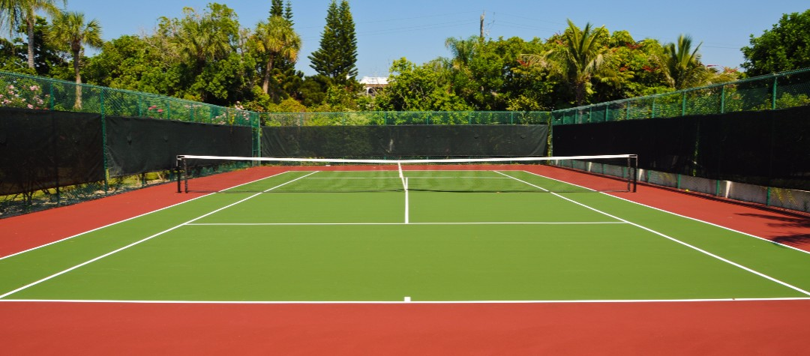
A tennis court

Slide 24
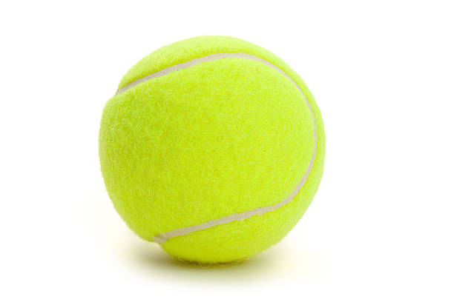
A tennis ball

Slide 25
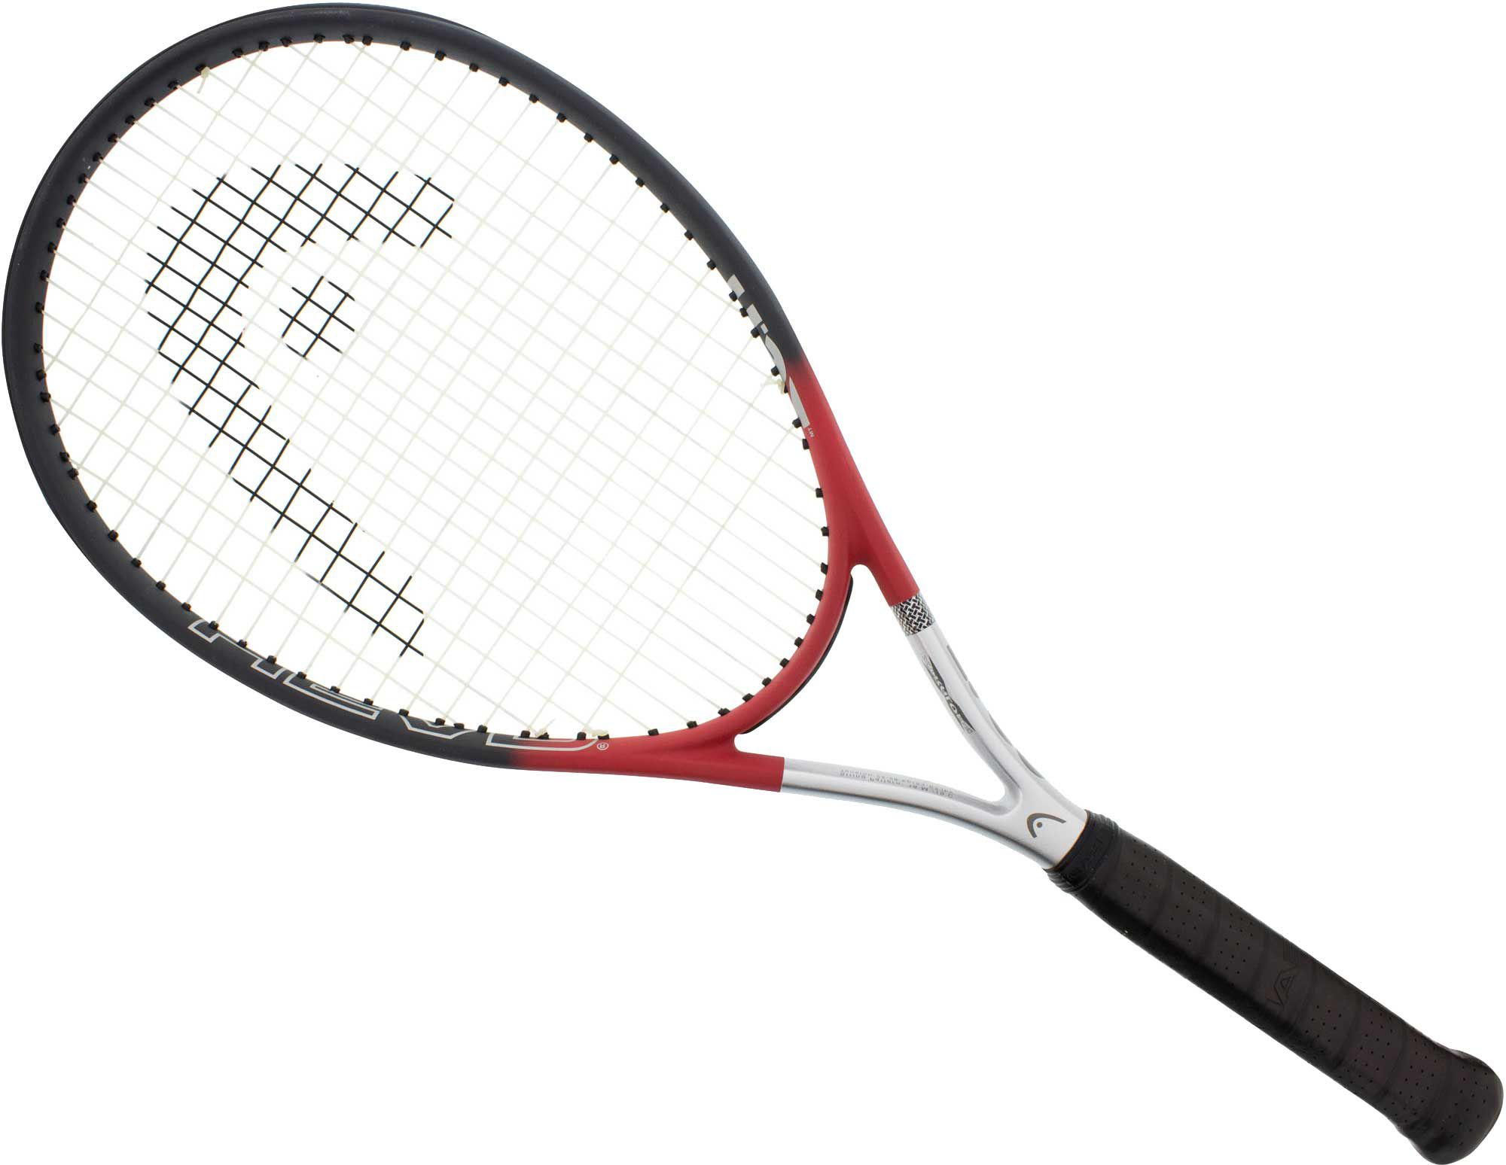
A tennis racquet

Slide 26

A bat

Slide 27
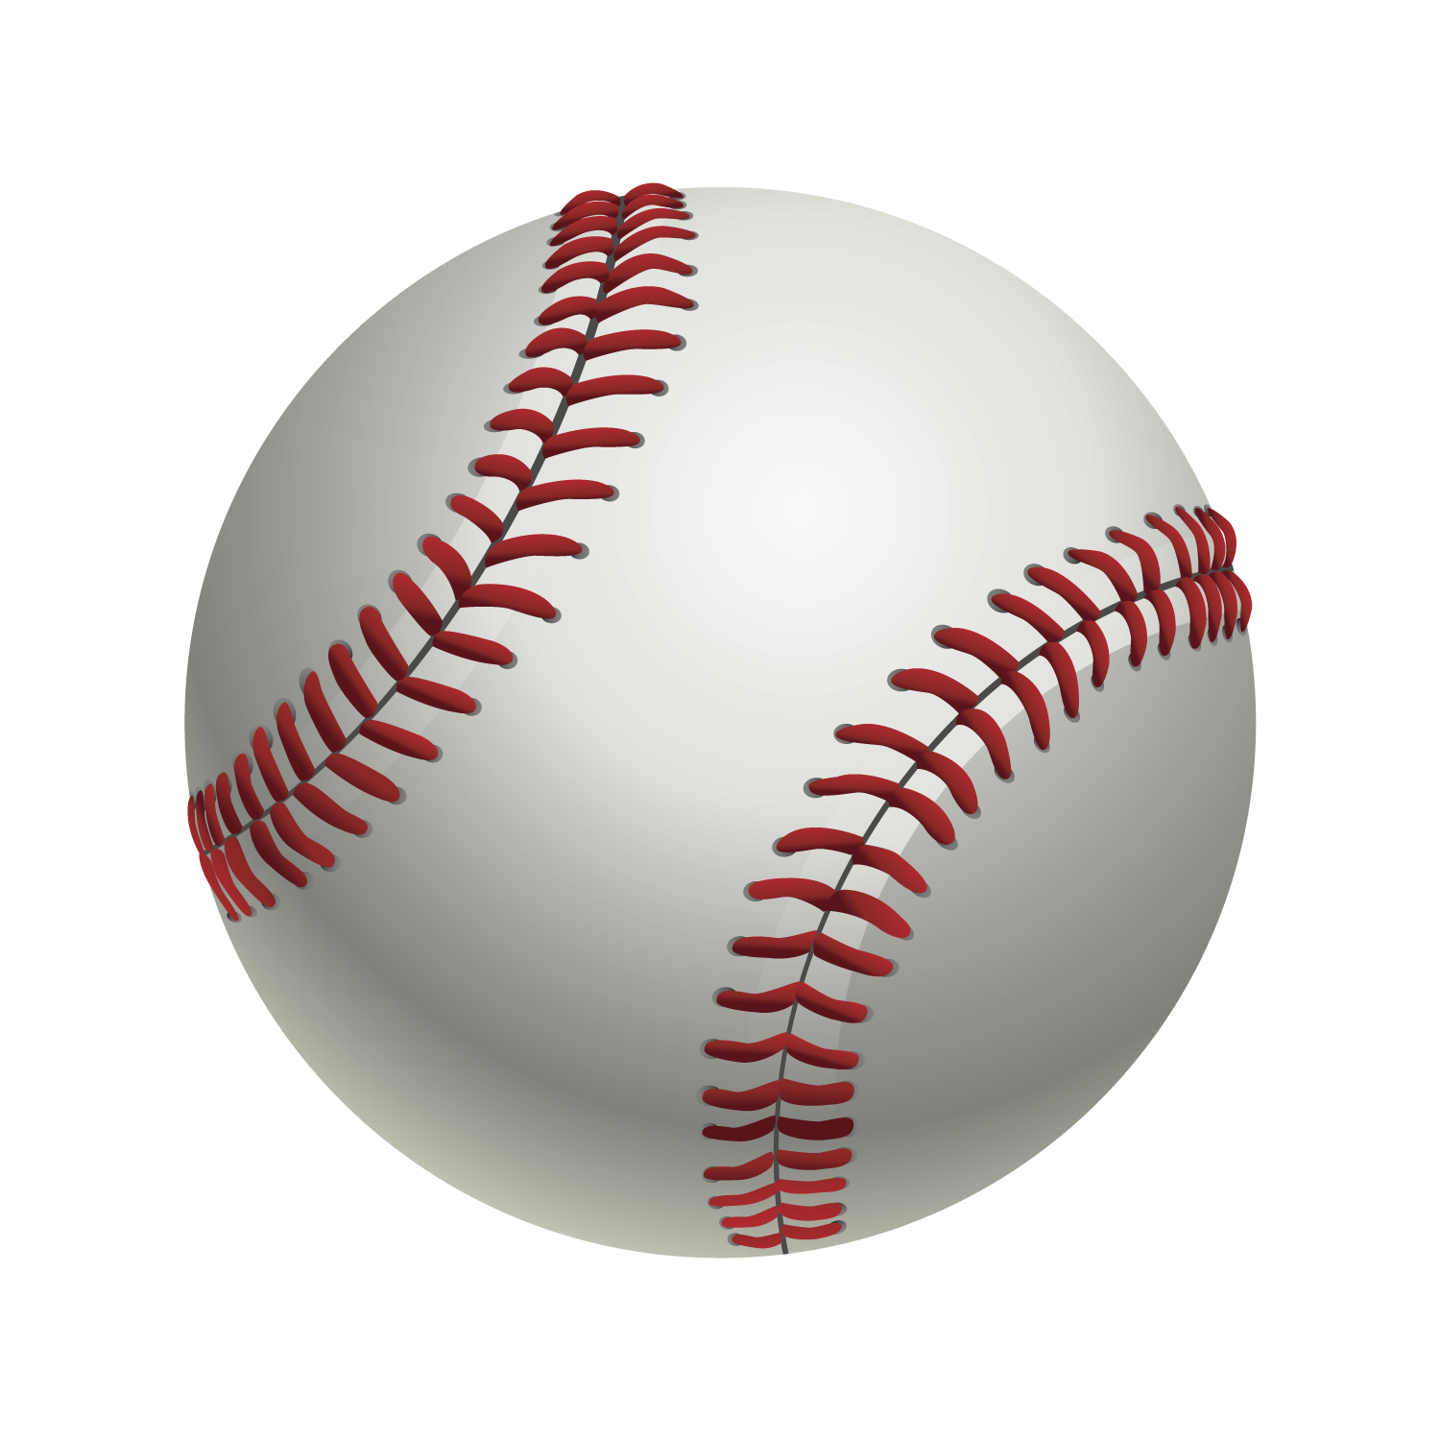
A baseball ball

Slide 28
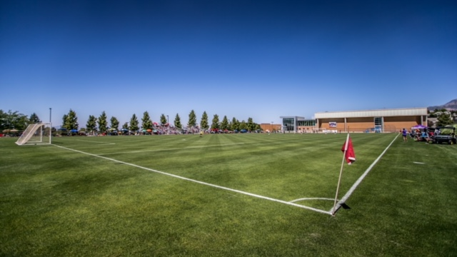
A soccer field

Slide 29
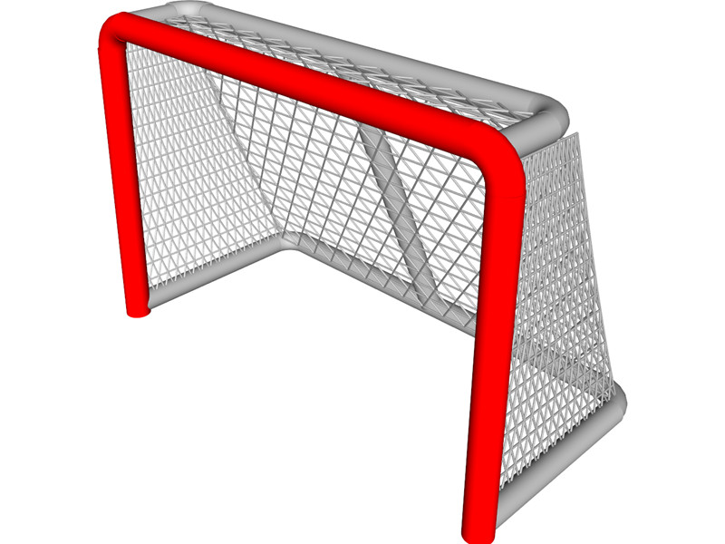
A net

Slide 30
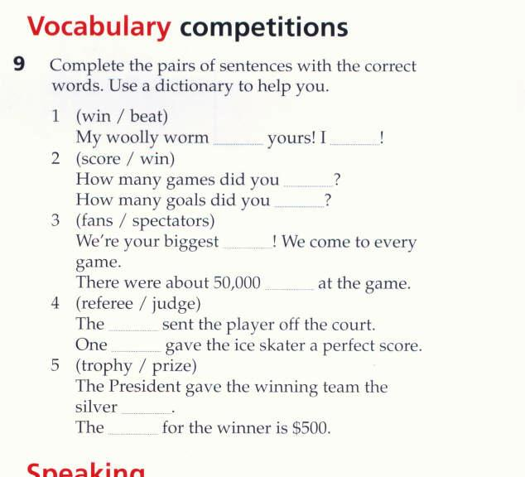

Slide 31
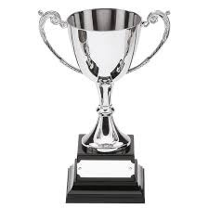

Slide 32
Thank you for watching

