Slide 1

English 99

Slide 2
Compete (verb)
Competitive(adjective)
Competition (noun)
Competitor( noun/person)
Spectator

Slide 3
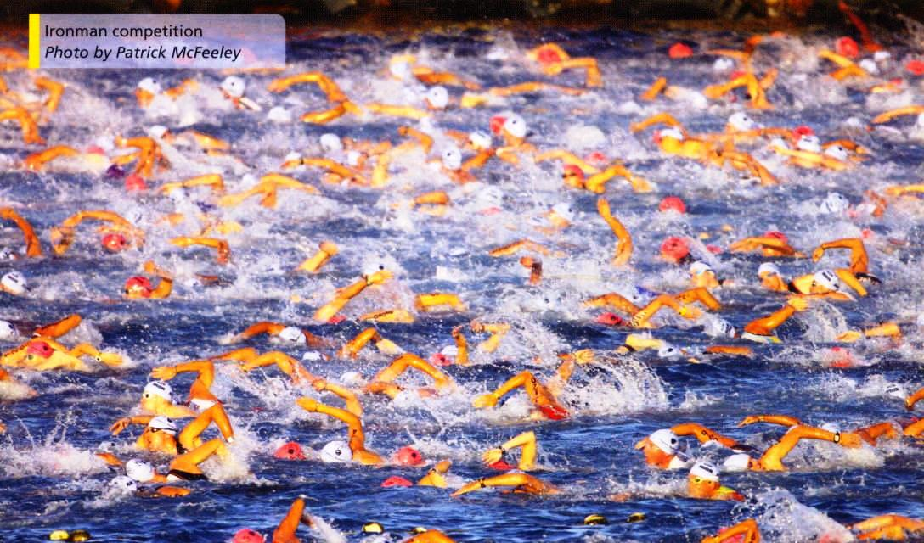

Slide 4
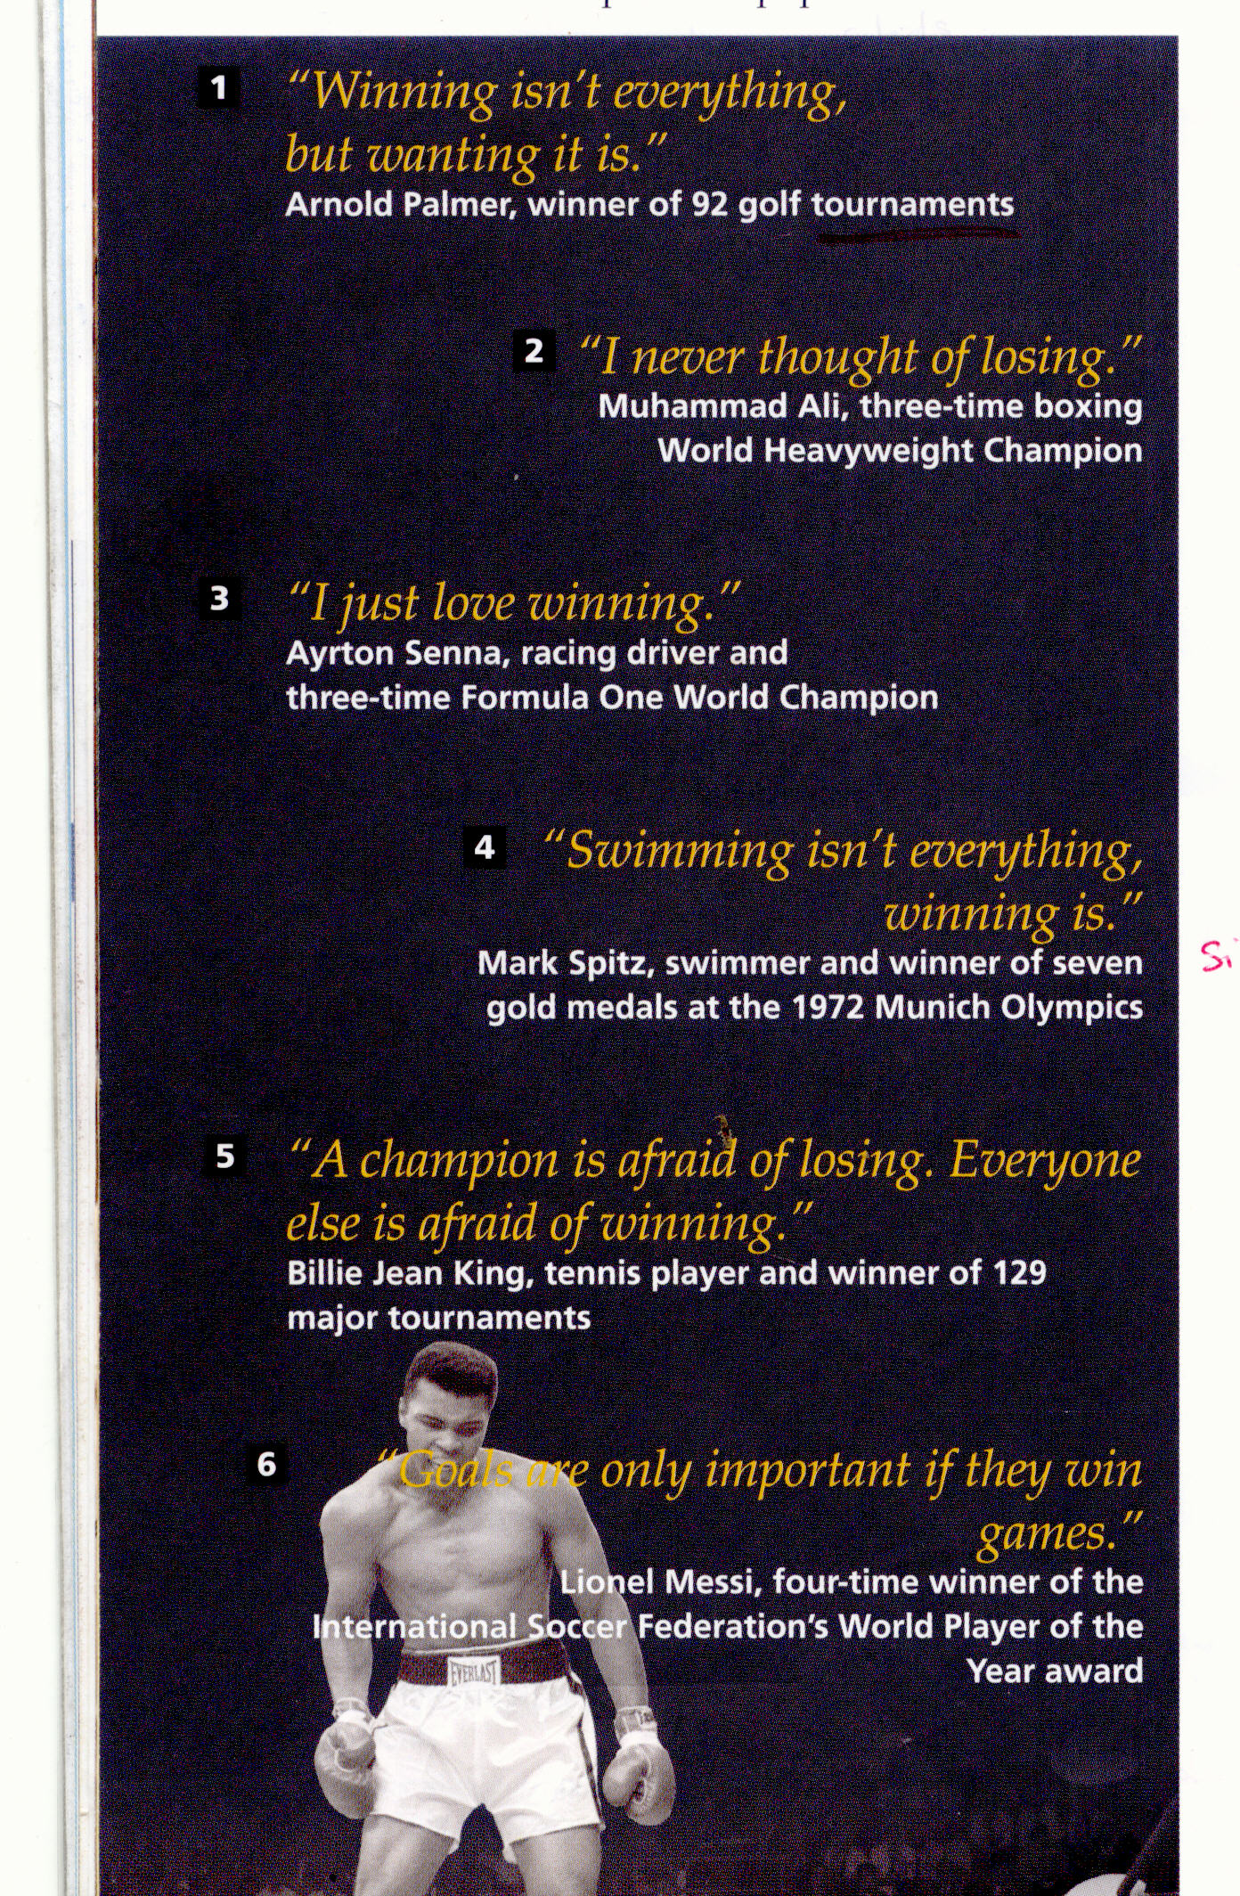

Slide 5
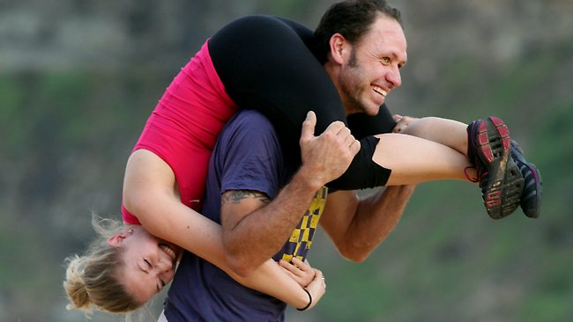

Slide 6
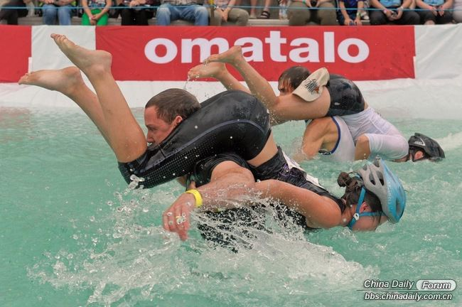

Slide 7
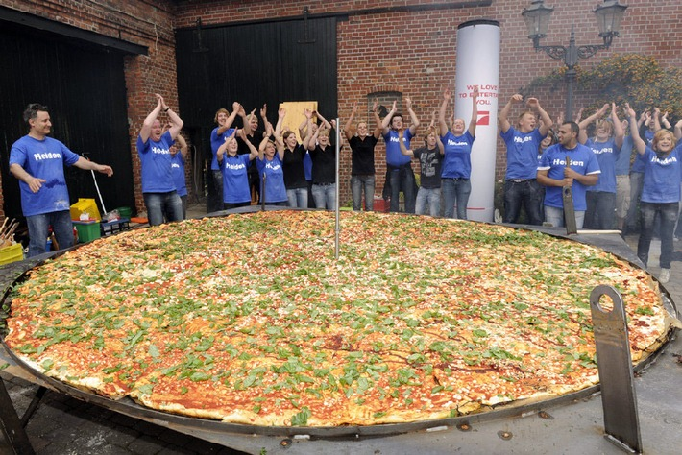

Slide 8
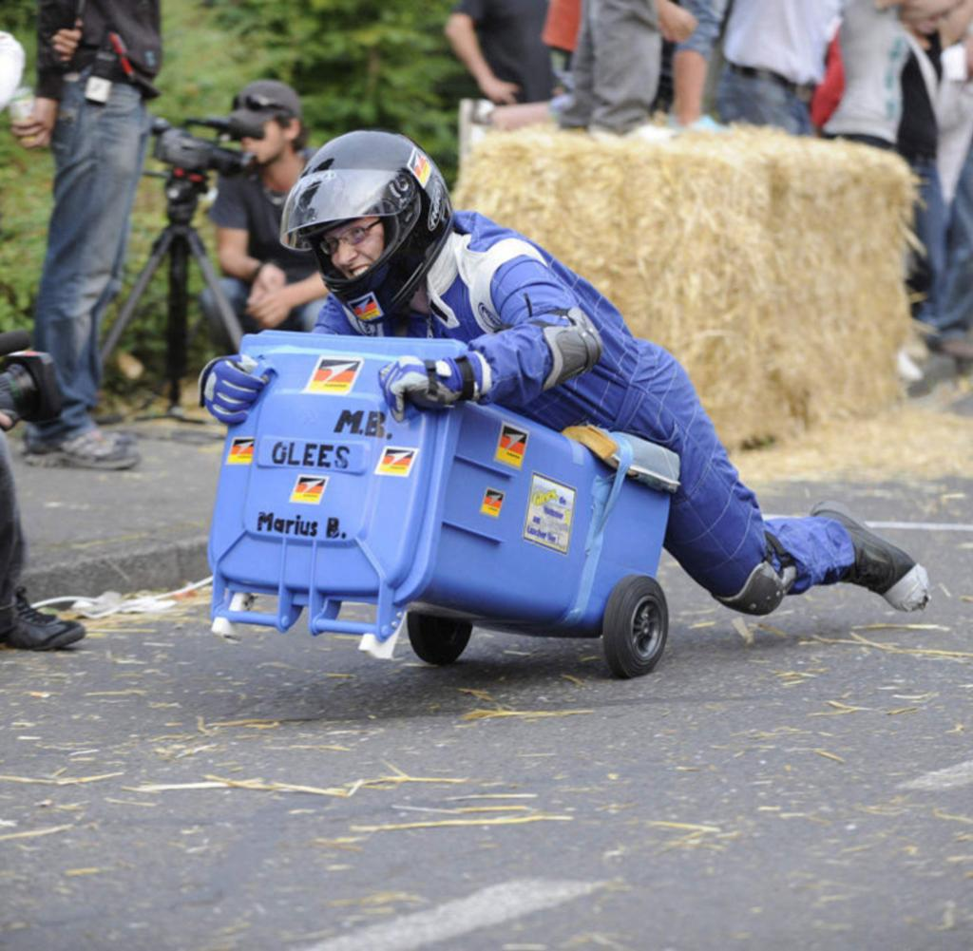

Slide 9
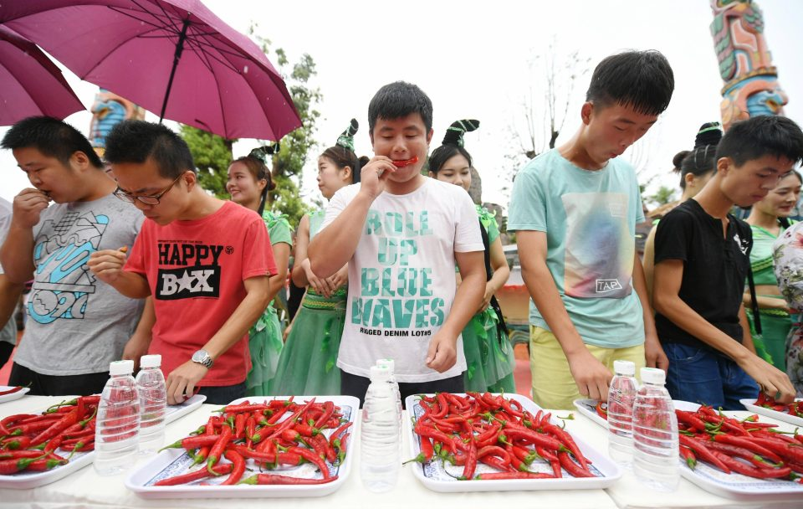

Slide 10
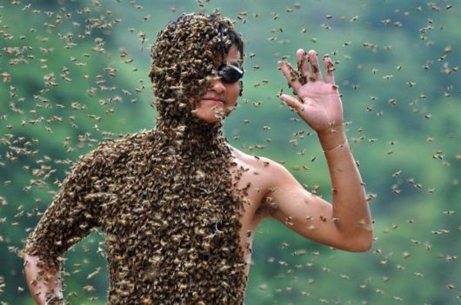

Slide 11
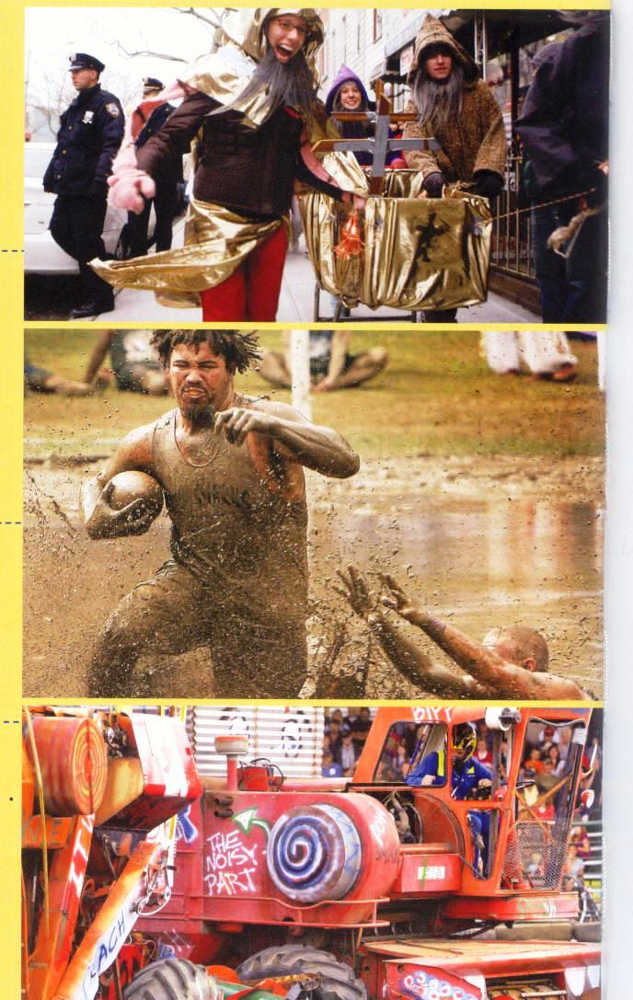

Slide 12
Blog about:
Annual:
Route:
Championship:
Giant:
Combine:
Shopping cart :
Mud: soil mixed with water

Slide 13
Blog about:
Annual:
Route: a way of getting from one place to another
Referee :the person who makes sure that the players follow the rules
Championship: a contest
Harvest the process of gathering in crops
Giant:
Combine:
Shopping cart ; used for carrying groceries
Mud: soil mixed with water

Slide 14
Thank you for watching

