Slide 1

English 99

Slide 2
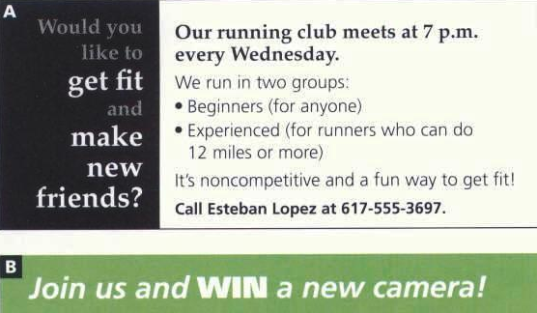

Slide 3
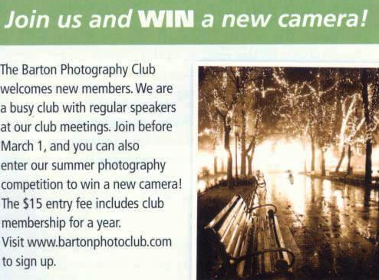

Slide 4
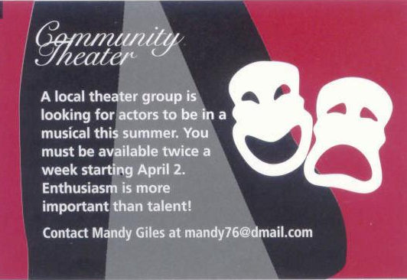

Slide 5
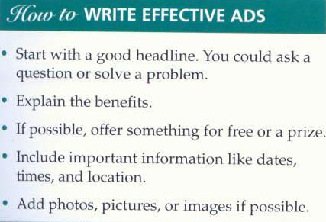

Slide 6
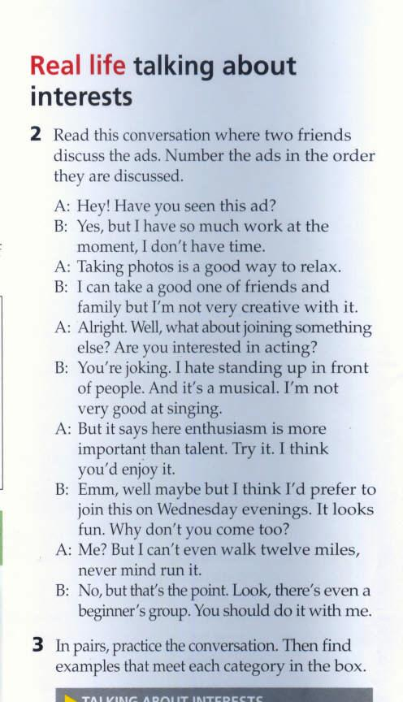

Slide 7
Asking about interests
Do you like taking photographs?
Talking about interests ( And likes /Dislikes)
I’d like/prefer to join a running club
I am good at acting
I wouldn’t like it
I am not interested in photography
Recommending and encouraging
It looks interesting
I think you’d enjoy it
You should do it with me

Slide 8
Suggestions
We could go
How about going
Why don’t we go
Accepting a suggestion
That’s a good idea
Refusing a suggestion
I am not sure that’s a good idea because

Slide 9
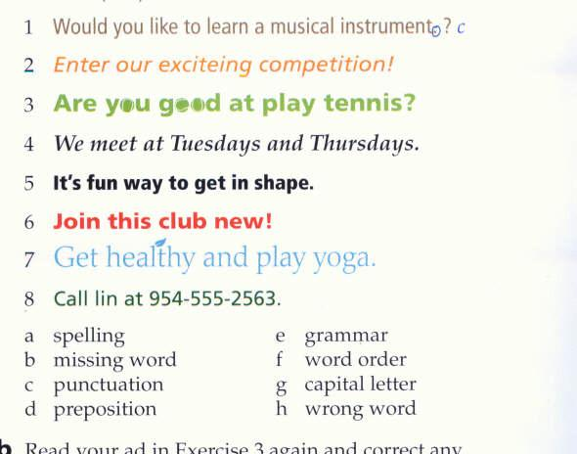

Slide 10
What type of club is it ?
Who is the club for ?
Are there any rules for members?
Is there a membership fee? How much is it ?
How often will you meet?

Slide 11
Thank you for watching

