Slide 1

English 99

Slide 2
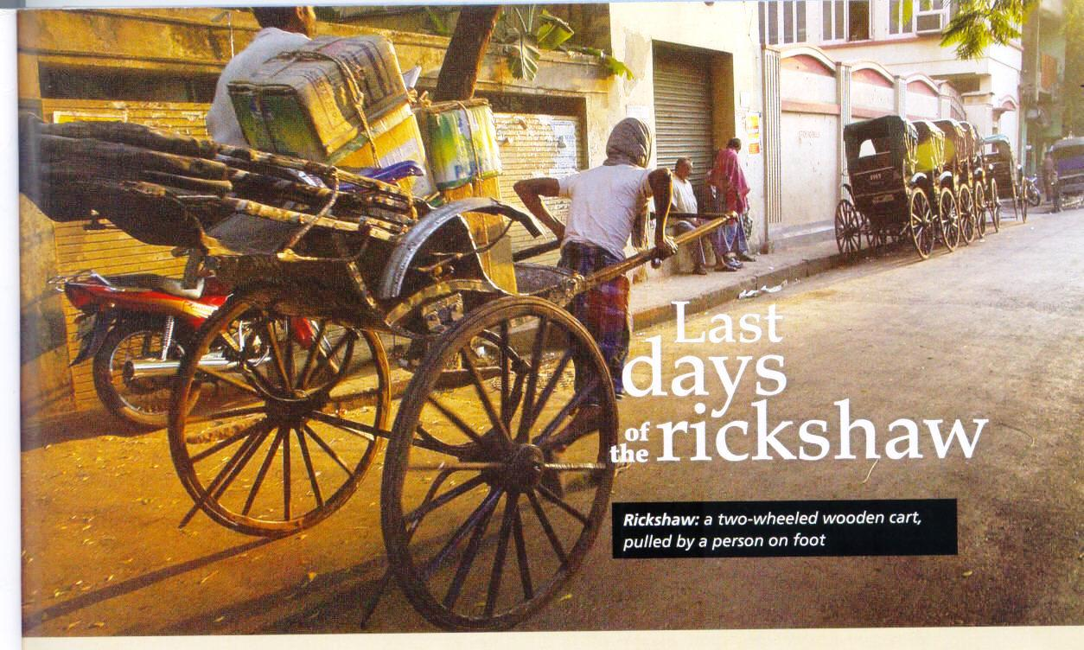
------------------------------------------------------------------------------------------------------------------------------------------------------------------------------------------------------------------------------------------------------------------------------------------------------------------------------------------------------------------------------------------------------------------------------------------------------------------------------------------------------------------------------------------------------------------------------------------------------------------------------------------------------------------------------------------------------------------------------------------------------------------------------------------------------------------------------------------------------------------------------------------------------------------------------------------------------------------------------------------------------------------------------------------------------------------------------------------------------------------------------------------------------------------------------------------------------------------------------------------------------------------------------------------------------------------------------------------------------------------------------------------------------------------------------------------------------------------------------------------------------------------------------------------------------------------------------------------------------------------------------------------------------------------------------------------------------------------------------------------------------------------------------------------------------------------------------------------------------------------------------------------------------------------------------------------------------------------------------------------------------------------------------------------------------------------------------------------------------------------------------------------------------------------------------------------------

Slide 3
Reading
Which of these words and expressions describe Kolkata?
Busy-highly –populated-noisy-polluted-quiet-safe for pedestrians

Slide 4
Reading
Which arguments in favor of rickshaws does it mention ?
1. they are better in traffic jams.
2.they can travel down small streets.
3. they don’t produce pollution.
4. they are good for shopping.
5. they are cheaper than other public transportation.
6.They always travel during the monsoons.

Slide 5
Reading
Choose the reason that local officials and politicians don’t ban rickshaws
1. There isn’t much other employment for the drivers.
2. The tourists want them.
3.The drivers don’t want to go back to the countryside.

Slide 6
Reading
Which of these statements do you think people in Kolkata often say about rickshaws?
1.“Rickshaw drivers always blow their horns so loudly.”
2.“ They represent our city.”
3.“They shouldn’t be on the roads “
4.“They are very useful”.

Slide 7
Reading
“ you can never find a rickshaw when you need one”.
“Rickshaws are cruel”.

Slide 8
Raeding
previously :
fumes : smoke and gases from an engine
scooters :
Pedi cabs: a type of taxi with no engine
alternative:
on foot:
pedestrians:
horns:

Slide 9
Reading
tiny: very small
symbol: sign of
advantage:
miss :not to catch a bus/plane you intended to catch
popular: famous
purchase: buy

Slide 10
Reading
unload :
drop off: to take somebody to a place and leave them there
get on/ off: to walk into or out of a bus/train
Monsoon season:
flood: when water covers an area
ban : to stop or make illegal
official: someone in a position of authority

Slide 11
Reading
income:
rickshaw : a two-wheeled wooden cart pulled by a person on foot
pick up :to get a passenger from one place and transport them to another

Slide 12
Thank you for watching

