Slide 1

English 99

Slide 2
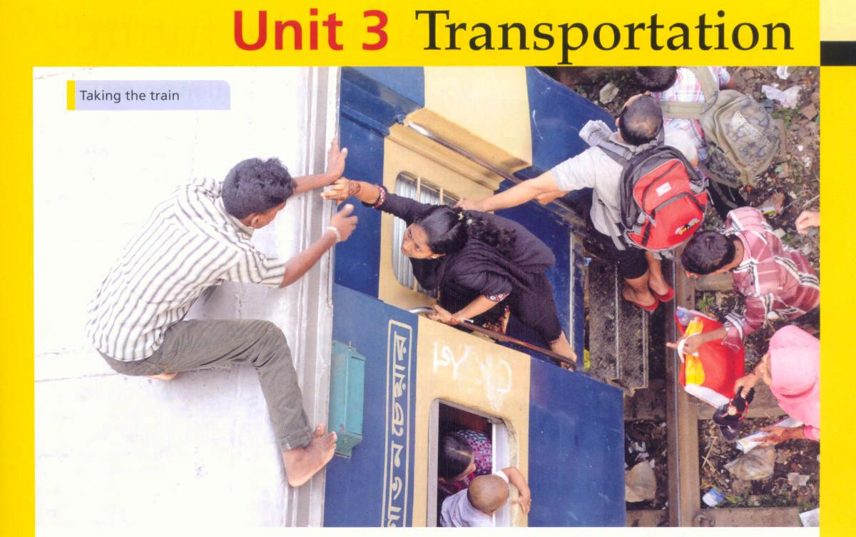

Slide 3
1. visit relatives: by walking ,by bus, by train, by car
2. move house and furniture: by truck
Get to the airport :by taxi, by bus, by car, by train
See the countryside for pleasure: by car ,by bus, on a motorcycle, by bicycle
Cross a river :by ferry
Get to the train station : by bus, by car, on a motor cycle, by taxi, by walking
Go out in the evening to a party or restaurant: by car , by taxi , by bus by walking

Slide 4
Take children to school: by bus ,by car,
by walking ,by bicycle
Cross the ocean :on a ship, by ferry, by plane
Go shopping :by car, by walking ,by bus ,
by train

Slide 5
Homework :
Write about a journey you made using different forms of transportation

Slide 6
Vocabulary: Transportation Nouns
Machines with engines for transporting people. Vehicles
People who travel to work everyday. commuters
Period in a day when lots of people travel to and from work. rush hour
Long lined of vehicles on the road . traffic jam
Road construction or maintenance .road work
Place to fill your car with. gas station
The maximum speed you can drive legally. speed limit
People walking in a town or city .pedestrians

Slide 7
Vocabulary : Transportation Verbs
Replace the verbs in bold in the sentences with a verb of similar meaning

Slide 8
Do you want me to get the children from school? Pick up
We need to leave the train at the next station. get off
I was late and I nearly didn’t get on my flight. catch
Go! You don’t want to not catch your flight. miss
I should travel by a taxi .It ‘s much quicker. take
Ask the driver to leave the children at school. drop off

Slide 9
Writing notes and messages
Read the notes and messages and match them with the reasons for writing
Thanking 5
Apologizing 2,8
Giving travel information 4,6
Suggesting a time and place 1,7
Giving a message from someone else. 3

Slide 10
Articles: (1) the airport (2) the bus
(4) the train
Pronouns: (1) me (2)I
Auxiliary verbs : (7) will see
Polite forms::
(1) would you meet me
(3) can you call

Slide 11
I am sorry but I am stuck in a traffic jam. I’ll see you in half an hour
Sorry, stuck in traffic, see you in 30 mins
Thank you for booking the train tickets. I’ll pay you when we meet at the station.
thanks for booking train tickets, pay you at station
Take the subway to Palermo Street and the Luna café is at the end of platform one.
Take subway to Palermo st Luna café and platform 1

Slide 12
Peter wants to come with us in the taxi Can you call him and tell him where to meet us ?
Peter wants to come in taxi call and tell him where to meet
My flight is an hour late. Meet me in the arrivals terminal at five o’clock .
Flight 1 hr late meet at arrivals at 5

Slide 13
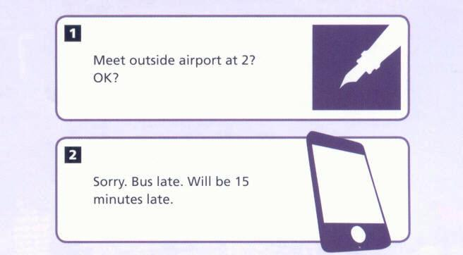

Slide 14
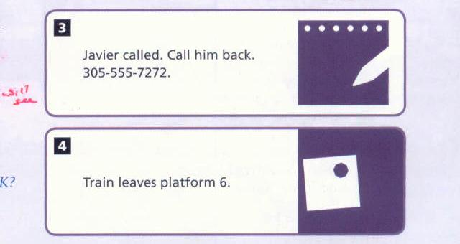

Slide 15
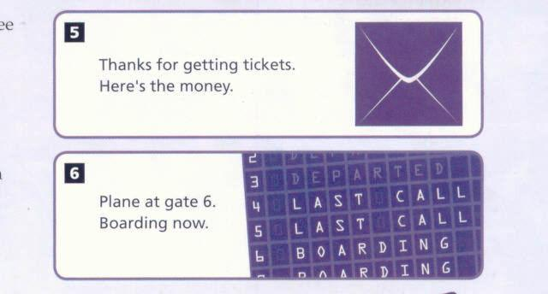

Slide 16
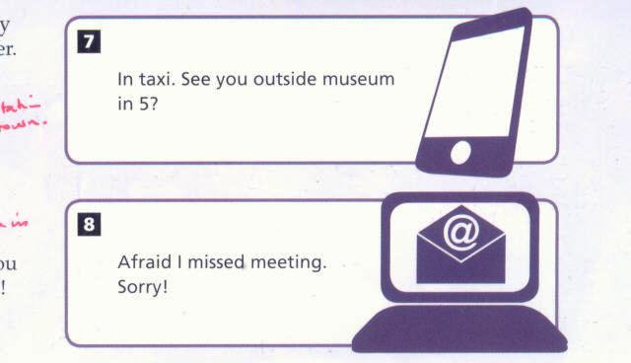

Slide 17
Comparatives and superlatives
Regular adjectives:
Clean cleaner cleanest
Big bigger biggest
happy happier happiest
Expensive more expensive most expensive
Irregular adjectives
good better best
bad worse worst

Slide 18
Spelling rules for comparative superlative adjectives
1.For regular short adjectives ,add er/est:
long longer longest
2.For adjectives ending in e add r /st:
Large larger largest
3.For adjectives ending in y after a consonant change the y to i :
happy happier happiest
For adjectives ending in consonant –vowel-consonant , double the final consonant:
Big bigger biggest
Hot hotter hottest

Slide 19
Grammar
India is ( hot ) than Norway
Cars are ( dangerous) than bikes
James is the ( friendly)person in our class
Helen is the ( good ) athlete in the country.
Cheetahs are (fast)than Tigers
She is the (happy) person in the office
Skiing is the(exciting) sport in the world
Sports cars are (difficult) to drive than family cars

Slide 20
Grammar
What letters do you add to regular short adjectives to form comparative and superlative adjectives?
er est
How do you form the comparative and superlative forms with longer adjectives?
more the most

Slide 21
Grammar
Which are examples of irregular comparative and superlative adjectives ?
Better best worst
Which word usually comes after a comparative adjective ? Which word usually comes before a superlative adjective ?than the
What word adds emphasis to a comparative adjective ? Much

Slide 22
Comparative and superlatives
Use comparative to compare between two things :
Cars are faster than buses
Use superlative to compare three or more things :
Blue whales are the biggest animals in the world
New newer newest
My bicycle is newer than yours
It is the quickest way to get to the station
Interesting more interesting most interesting
Gas cars are much more expensive than electric cars ( emphasis)

Slide 23
Grammar
Complete the paragraph with the comparative or superlative form of the adjectives
Your views on transportation
For commuting and daytime travel, the most popular ( popular) form of public transport is the bus .The largest ( large) number of people in the survey use buses everyday to get to work or school .However, taking the bus isn’t the fastest ( fast) form of transportation .Everyone said that parking downtown is still the biggest ( big)

Slide 24
As ......As
Form
Affirmative : An elephant is as heavy as a car
Negative : A bus isn’t as comfortable as a car
Question: Is a horse as strong as an elephant?
Use : we use as +adjective +as to compare two things and say they are the same or equal
He is as tall as his brother

Slide 25
Grammar
Problem so they don’t often drive their car. The situation is much better ( good) in the evenings
Than during the day. as a result ,taxis are more popular ( popular) than private cars but they are the most expensive ( expensive) form of transportation .So many people want buses to run later ( late ) in the evenings .

Slide 26
As ..........As Grammar
Use as +adjective +as to compare something and say they are the same or equal
Use not as +adjective +as to compare two things that are different or not equal
Elephants are as heavy as cars but they aren’t as fast
Are elephants and cars the same weight ?
Do they travel at the same speed ?

Slide 27
As …….As
We use not as +adjective +as to compare two things and say they are different or not equal
John is not as clever as Ann

Slide 28
Grammar
Write comparative sentences and questions using as …as or not as ..as
1.Rosa/old/Maria (+)
2.Alaska/cold/ Canada(+)
3.Cars /cheap/bicycles (-)
4.Horseback riding/ healthy/ running(?)
Buses/quiet/trams( –)
Books/exciting /movies (?)
China/hot /Brazil (?)

Slide 29
Grammar
4. Eight o’clock in the morning is the best /worst time of the day for commuting.
5. The town needs better /faster public transportation

Slide 30
Grammar
Complete each second sentence so that it has the same meaning as the first sentence
Most people think cars are more comfortable than elephants .
Most people think elephants aren’t as comfortable
2. Elephants have the same importance now as they did in the past
Elephants are as important as ever
3. Lester believes horses are better than modern machines
Lester doesn’t believe modern machines are as good as horses

Slide 31
Grammar
4.Trucks are stronger than horses.
Horses aren’t as strong as trucks.
5. Trucks are noisier than horses.
Horses aren’t as noisy as trucks.

Slide 32
Grammar
Make sentences using each adjectives to compare these animals
Use comparative and superlative adjectives and not as +adjective +as
1. strong ; lion , mouse, horse
2.fast: snail, cheetah, elephant
3.comfortable:car,camel,plane
4. heavy : hippopotamus ,blue whale, elephant
5.dangerous: shark, alligator ,snake

Slide 33
Grammar
Homework
Compare yourself with a member of your family or with a friend using as ....as and
not as ....as

Slide 34
Thank you for watching

