Slide 1

English 99

Slide 2


Slide 3
Listening
What reasons do they give for and against this kind of transportation ?
Cleaner ,efficient engine
expensive

Slide 4
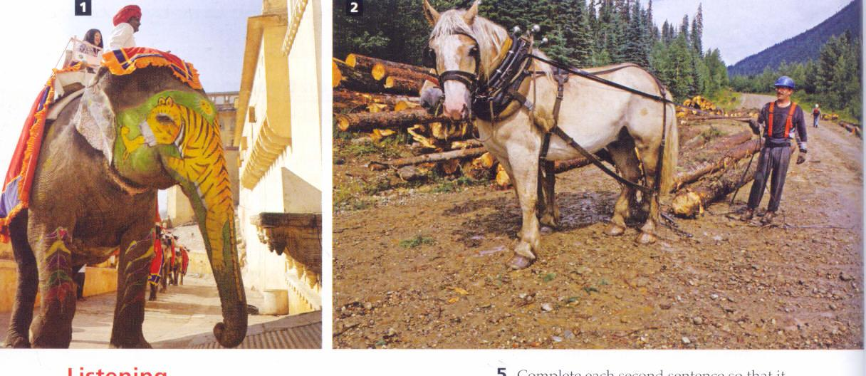

Slide 6
Listening
Documentary 1
What special event is happening ? Wedding
What jobs did the Asian elephant do in the past?
Transported soldiers and carried wood
What kind of people do they transport now?
Tourists and people on special occasions

Slide 7
Listening
Documentary 2
Lester Courtney is a logger what do loggers do? Cut trees
Why does Lester prefer to use horses ?
Because they are not as heavy and noisy as trucks

Slide 8
Listening
Thai : adjective
domestic :
guests: a person who is invited to visit someone’s home
transported: take or carry from one place to another
soldiers: people who serve in the army
forest: a large area covered with trees
Leisure:
loggers

Slide 9
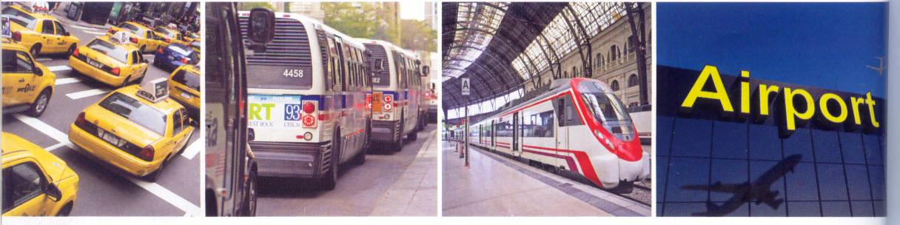

Slide 11
Listening
Change:
Receipt: a piece of paper that proves that money has been received
Terminal: a transport route
One way ticket:
A round ticket: a ticket for travel to a place and back again
Book: reserve
It is a long story

Slide 12
Listening
1. At the taxi stand: where does Javier want to go? Train station
2. In the taxi: How much is the fare ?16.30
Does Javier want a receipt ? No
3. At the bus stop: where does Suri want to go0 ? North Terminal
What type of ticket does she buy ?One way

Slide 13
Listening
4.At the train station : How much is the ticket? 30.50
Which platform does the train leave from? Platform 6
5.At the airport : where did Suri book her plane ticket ? Online
Does she check any bags ? No she has a carry on

Slide 14
Real life : Going on a journey
Mark the expressions that you hear
In a taxi
I’d like to go to the station, please. √
You can drop me off here . √
How much is it ? √
Do you have change ? √
Do you want a receipt ? √

Slide 15
On a bus
Do you stop at the airport? √
One –way or round trip? √
Please stop at the next one √
That’s two dollars √

Slide 16
At the train station
A round-trip ticket to the airport ,please .√
First or second class? √
Can I pay by credit card?
Which platform is it ? √

Slide 17
At the airport
May I see your passport? √
How many bags are you checking? √
I only have this carry-on . √
Window or aisle? √
Can I have a seat next to my friend? √

Slide 18
Thank you for watching

