Slide 1

English 99

Slide 2
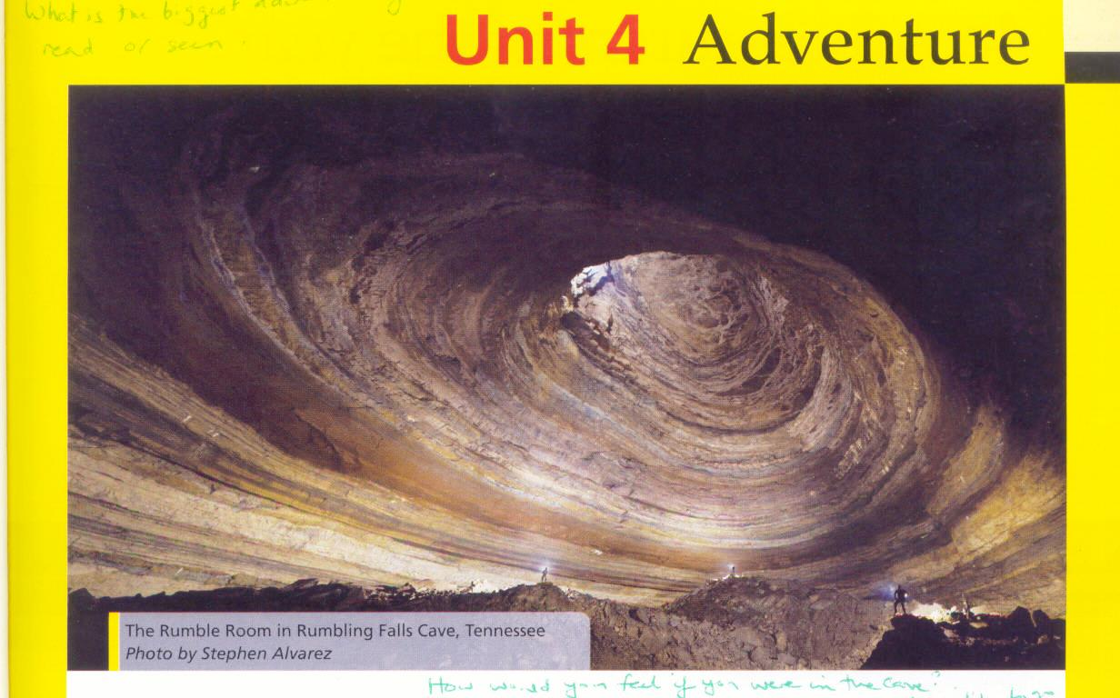

Slide 3
Cave: natural hole in the ground
Caver : a person who explores caves for a hobby
To go caving: explore systems of caves

Slide 4
Complete each sentence with one of the words
risk challenge achievement
1. You take a ……when you go caving.
2.Discovering a new cave is a great ……….
3. Adventurers like a tough ………..

Slide 5
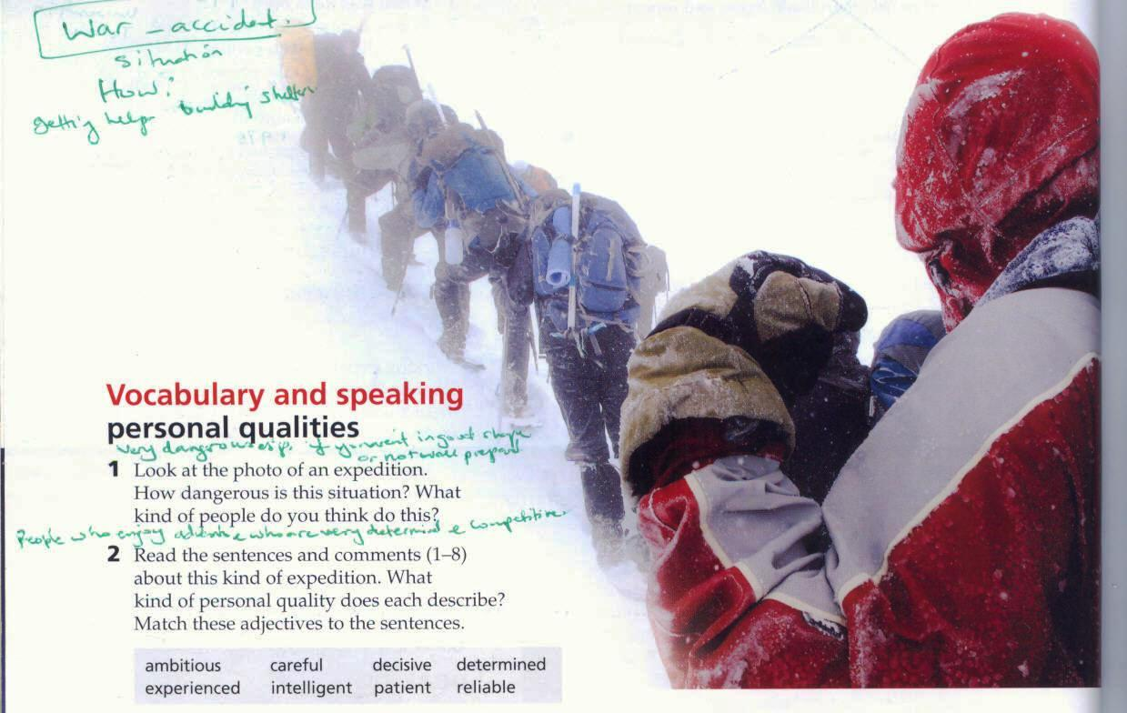

Slide 6
How dangerous is this situation ?
It is very dangerous especially if you were not in good shape or not well prepared
What kind of people do you think do this ?
People who enjoy adventure and who are very determined and competitive

Slide 7
Expedition :
an excursion, journey, or voyage made for some specific purpose, as of war or exploration
Survivor: a person who continues to live, despite nearly dying:

Slide 8
Personal qualities
Match these adjectives to the sentences :
ambitious careful decisive determined experienced intelligent patient reliable
1.” The leader of our team has worked for thirty years as a mountaineer .”experienced
2.” Whatever the risk, we always achieved our goal. Nothing stopped us”. determined
3. “Even as a child, I wanted to be the best” ambitious

Slide 9
1.
4. “It is important to plan before any expedition .”careful
5.”When the weather is really bad, you have to wait. There ‘s no point in taking stupid risks”. patient
6. “We all have to be there for each other .We won’t survive without each other’s help and support “.reliable
7.” He has a quick brain and you need that for this kind of expedition “. intelligent

Slide 10
8. “ The leader is the person who makes the final decision and everyone has to agree.” decisive

Slide 11
What personal qualities do these people need?
A teacher : is patient because the students need time to learn
A close friend: reliable ,you will always have their help and support .
A news photographer: decisive need to move quickly to get important photos
An athlete : determined to do well
A language learner: patient and determined because it takes time to learn a language well
A president: ambitious and determined to get to such an important position .

Slide 12
A TV presenter : decisive make quick decisions

Slide 13
You can make some adjectives for personal qualities negative by adding a prefix :
unambitious
Indecisive
Impatient

Slide 14
In , on , or at for time expressions
1. We use in with months, years , seasons, decades ,centuries ,and some parts of the day such as the morning ,the evening .
2. We use on with days ,dates and special days such as her birthday ,New Year’s Day , the weekend.
3. We use at with times and special expressions such as night ,the final moment .
4. We don’t use in ,on , or at with time expressions such as yesterday ,last week ,two days later .

Slide 15
A lake : a large area of water surrounded by land and not connected to the sea except by rivers or streams
A ridge: a long, narrow raised part of a surface, especially a high edge along a mountain
Glacier : a large mass of ice that moves slowly
Cliff : a high area of rock with a very steep side, often on a coast

Slide 16
Summit : the highest point of a mountain.
Crevasse: a very deep crack in the thick ice of a glacier (= moving mass of ice)
North face :
Mountain : a raised part of the earth's surface, much larger than a hill, the top of which might be covered in snow.

Slide 17
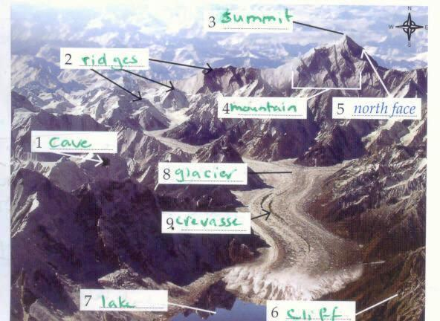
Geographical features

Slide 18
Thank you for watching

