Slide 1

English 99

Slide 2
Complete the text with the simple past form of the verbs
Reza ( be born)in Tabriz,Iran,in 1952. He
( study) architecture at the university in Tehran but he ( not ,become) an architect .When he was a teenager ,Reza ( love ) photography and ,after college ,he ( get ) a job with a local newspaper as a photographer .But he ( not ,want) to take photos of local news and in 1978 he ( go) abroad and he ( take ) photos of wars these days he works for National Geographic magazine

Slide 3
1. When was Reza born ?1952
2. Where did he study architecture? Tehran
3.What did he do after college?
He worked as a photographer for a local newspaper
4. Did he want to take photos of local news ?
No, he didn’t
When did he go abroad?1976

Slide 4
Speaking
Write eight to ten questions to ask your partner about his or her past
Where /born? Where /live?
What subjects/like/at school?
Go/college ?
What job/want?
What /do after that ?

Slide 5
Speaking
Tell your partner which of these events happened to you in the past
Explain :
1. When they happened
2. what you were doing at the time
Broke a bone got your first job
Felt scared
Fell off your bicycle
Example : I was climbing on a wall when I was eight . I fell and broke my arm.

Slide 6
Ambitious : wanting to achieve great things
Careful : not doing any thing risky or dangerous
Decisive : making decisions and acting on them.
Determined : wanting to do somethi9ng strongly
Experienced : having had a lot of practice of something

Slide 7
Intelligent :: able to think an d learn easily
Patient : talking things slowly ready to wait being calm
Reliable : always ready to help whatever the situation

Slide 8
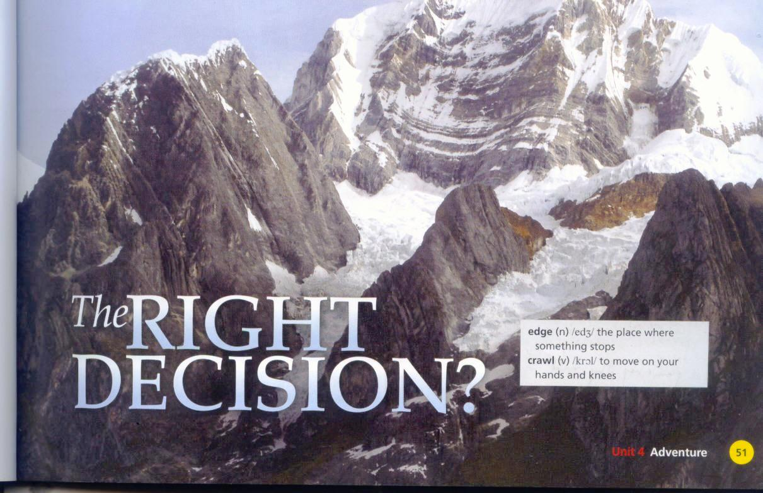

Slide 9
Reading : The Right decision ?
Talk about the best and worst decisions you have ever made
How do you make big decisions in your life ?

Slide 10
What decision did Yates make ?
He cut the rope letting Simpson fall in order to save himself
What decision did Simpson make ?
He lowered himself to the bottom of the crevasse and tried to find a way out

Slide 11
Mark the sentences true or false
1. The accident happened while Simpson and Yates were climbing up the mountain .False
2. They didn’t reach the top of Siula Grande. False
3.Yartes cut the rope because he wanted to survive . True
4. Yates didn’t look for Simpson afterwards. False
Simpson managed to get to the base camp on his own. True

Slide 12
Do the following people think that Yates made the right decision or not ?
Some climbers No
Simpson Yes
The author of the article Yes

Slide 13
edge : the place where something stops
crawl : to move on your hands and knees
incredible:unbelievable
physically fit: to be in a state of health and well being
unfortunately: unluckily
disaster: a sudden accident oer a natural catastrophe that causes great damage or loss of life
slipped :to slide without intending to
hanging :suspended in the air
realized :understand clearly , become fully aware of
managed to: succeeded in achieving something
defended : protect from harm or danger

Slide 14
Practice telling another story with your partner
Student A biked to work and these events happened
You had a terrible journey to work
You were biking and it started raining
A car hit your bicycle
You weren’t hurt
The driver was very nice He owned a bicycle
He gave you a new bike ! It is much better than the old one
Tell your story to student B Student B listens and responds

Slide 15
Speaking
Speaking Match the following time expressions
in May 1985
Three days later
At 4:00 in the afternoon
In the middle of the night
On day 1
At the last second
In 1988
to these events from the story Then tell the main parts of the story using the time expressions
Stood at the top of the mountain
Cut the rope
Wrote a book
Heard his name
Crawled back to base camp
Started climbing Siula Grande

Slide 16
Writing
When you read the news, is it always bad news? Are there ever any news stories with good news or happy endings?
Do you recall any recent world or local news stories about accidents or natural disasters ?Were people killed injured or survived?

Slide 17
Writing
Which of this information is included
The location
The weather
The people
Why they were there
Any unusual details
How the situation ended

Slide 18
Eventually :finally
Dehydrated: losing a large amount of water
Immediately: at once

Slide 19
Underline the adverbs in the story
Suddenly
Immediately
sadly
Eventually
Safely
Badly
Surprisingly
Happily

Slide 20
Match the adverbs with the rules
we often use ly adverbs to
Comment on the whole clause or sentence
Eventually, they saw another ship .
Immediately /eventually/ sadly
Describe the verb how someone did something or how it happened
He slowly swam towards the island
Safely/ suddenly
Describe an adjective
The three survivors were amazingly healthy.
Badly /surprisingly
Many adverbs are adjectives +ly: suddenly

Slide 21
Make these sentences more interesting using the adverbs
1. The climb was **dangerous ( incredibly )
2. The sun was **shining ( brightly)
The man** jumped into the car ( quickly )
They were nearly art the top of the mountain when one of them **slipped
( suddenly )

Slide 22
It started raining** Riu had an umbrella
( fortunately)
The Amazon river was **long and they were lost for days ( amazingly)
They **walked back ( slowly)
They were lost in the forest for hours but** they found the road again( eventually )

Slide 23
Write a true story from your own life or the newspaper
Where it happened
What the weather was like
Who was there and what they were doing
What unexpected event happened
What happened next
The ending happy or sad

Slide 24


Slide 25
Listening
Match the survivors to their stories
Maria Garza
Escaped from a burning airplane
Bethany Hamilton
Surfing when attacked by a shark
Mr. and Mrs.Carlson
Lost at sea for thirty –one day

Slide 26
1.The aim of the program is to talk about
A. recent survival stories
B. the best survival stories
C. the personal qualities of survivors
2. Dr. Weisz says all survivors
A. are decisive
B. need determination
C are decisive and need determination

Slide 27
3. Unlike Bethany ,the Carlsons
a. were at sea for a long time
b. were in the water
c. didn’t have experience
  4. Most survivors
  a. don’t take risks
  b. often take risks
  c. aren’t very careful

Slide 28
Are there any situations when you need to be decisive or careful?

Slide 30
Listening
1. Was the start of the weekend good or bad?bad
2. When did Mark and the others leave ?
Early Saturday morning
Where did the car break down? Who fixed it ?
Near a garage
Why couldn’t they find the campsite at first ?
It was getting dark
What happened after they found the campsite ?
It started to rain
Where did they go instead ?
To a hotel down the road

Slide 31
Complete the conversation
A: Hi Mark .How was your camping trip?
B: It was great in the end but we had a terrible time at the beginning
Why
First we left the house early on Saturday morning but after only half an hour the car broke down
Oh no
Fortunately there was a garage nearby and the mechanic fixed the problem But when we arrived at the forest it was getting dark after we drove around for about an hour we finally found the campsite we but it was completely dark by then unfortunately it started raining so we found a nice hotel down the road
That was lucky
Yes it was a great hotel and in the end we stayed there for the whole weekend
Sounds great

Slide 32
Think of a bad trip you had. Did it have a happy ending ? Make a list of the events and tell your partner the story

Slide 33
Exit :the door through which you might leave a building or large vehicle.
Pregnant :having a baby or babies developing inside the womb.
Psychology: the scientific study of the way the human mind works and how it influences behaviour, or the influence of a particular person's character on their behaviour
Sank: fall to the bottom
Take risk

Slide 34
Seat belt: a belt that fastens around you when you are travelling in a vehicle or aircraft and holds you in your seat, in order to reduce the risk of being injured in an accident.
Surfing :the sport of riding on a wave on a special board

Slide 35
Camping :the activity of staying in a tent on holiday

Slide 36
Which survival story do you think is the most amazing ? Why?

Slide 37
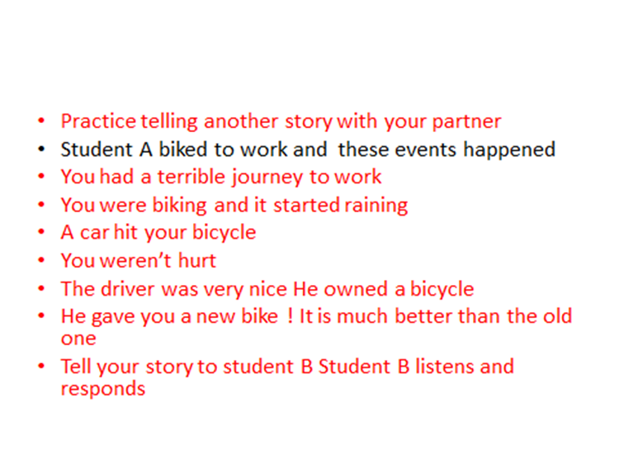

Slide 38
Thank you for watching

