Slide 1

English 99

Slide 2
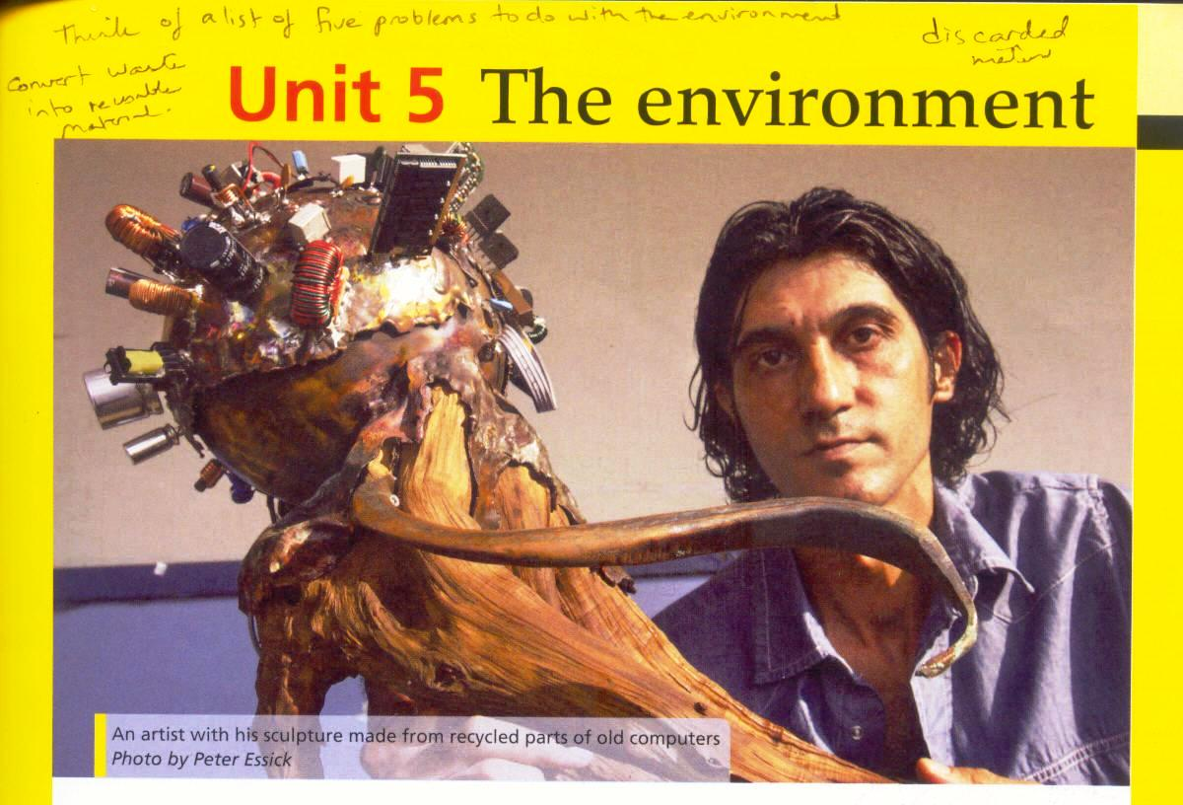

Slide 3
Unit Five : The environment
Which of these materials did he use in the sculpture shown in the photo ?
cardboard glass leather
metal paper plastic wood

Slide 4
1.What everyday objects does Sabra use in his sculptures?
He uses drift wood, computer parts and metal matrix.
2.What do you think he does with these objects? He uses them in new ways.
3.What do you think he wants us to think
about ?
He wants us to think about the environment and recycling .

Slide 5
Make sentences about these everyday objects
A dictionary is made of paper. You use it for looking up words.
A cell phone is made of plastic and metal.
We use it for calling people and sending text messages.
A pen is made of plastic and metal.We use it for writing .

Slide 6
Scissors are made of metal. We use them for cutting paper.
A tin can is made of metal. We use it to protect food.

Slide 7
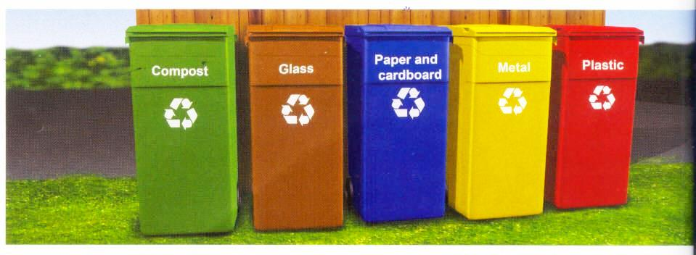

Slide 8
Match each object with the correct recycling container above
Aluminum foil :a thin aluminum sheeting used for cooking or covering food
Plastic bag:
Vegetable peel: the skin of vegetable such as potatoes which you cut off and peel before cooking
Tin can:
Carton :
Coffee:
Jar :a glass container that holds jam and other food
Envelope :
Newspaper:
Eggshell:
yogurt cup: the plastic container used for yogurt
Bottle
Compost: decaying plant material often used on gardens as a fertilizer

Slide 9
take
Match the expressions with take with the correct category
Transportation:
Take a taxi
Took the boat through
Daily routines :take a walk/Take a shower
Lengths of time :
take a few days
took 129 days
Idioms:
take time to
take a break
take care

Slide 10
Write sentences about yourself using take.

Slide 11
Complete the sentences with take and these phrases
1. Most people take a plane from San Francisco
to Sydney.
2.The journey across the great garbage patch took many days
3. The journey was tiring and the crew needed to take regular breaks

Slide 12
4. For this kind of project, it’s important to take time and plan everything before you leave.
5.The Pacific Ocean can be dangerous so everyone on the ship had to take care.

Slide 13
How much do you recycle or reuse items at home or at work ?How easy is it to recycle where you live ?

Slide 14
What words and expressions you can think of using the root cycle
Bicycle
Water cycle
The life cycle of a butterfly

Slide 15
Thank you for watching

