Slide 1

English 99

Slide 2
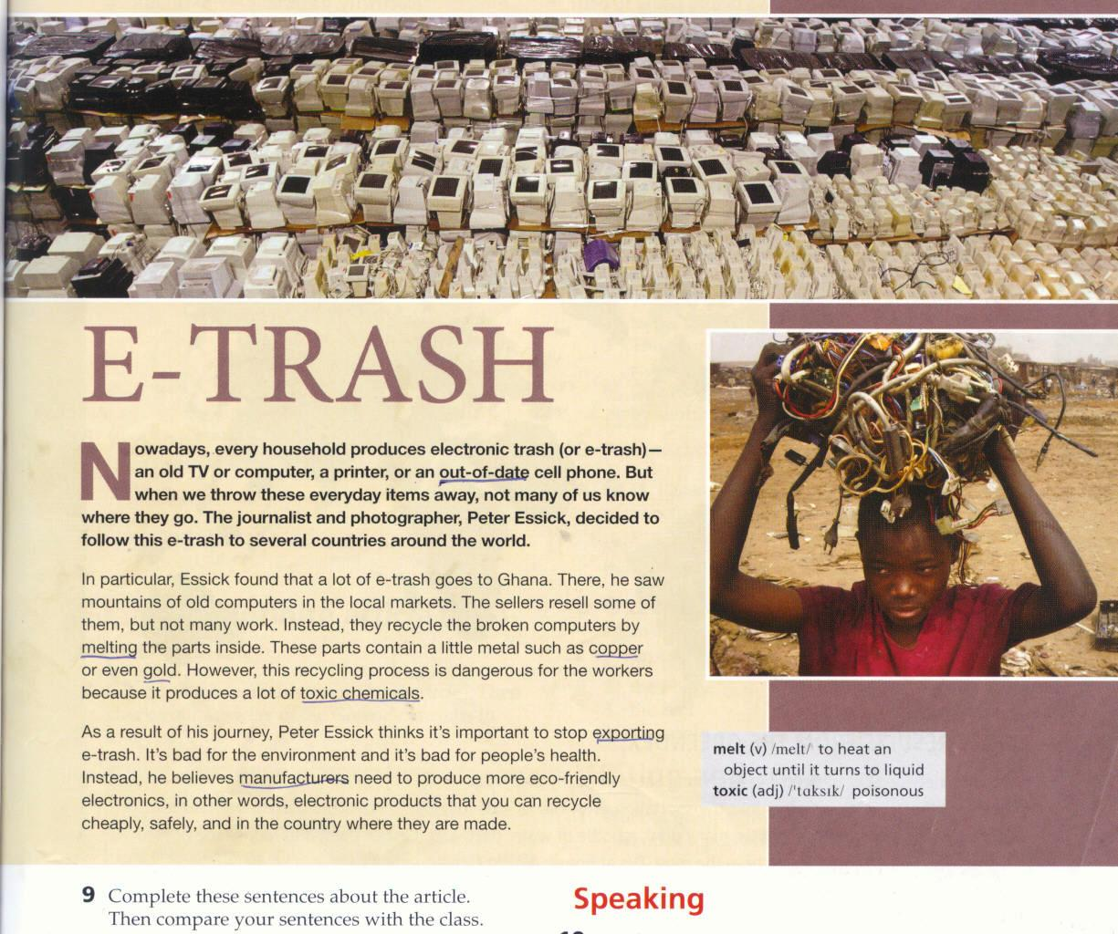
Reading : E-Trash

Slide 3
We often join words or parts of other words with a hyphen to make new words
E-trash
Out-of-date
Eco-friendly

Slide 4
1. How many of us know where our e-trash goes ?
Not many of us know
2. Did Peter Essick follow the trash to lots of countries?
To a lot of countries
How many of the computers do sellers resell?
Some of them
4. How much metal do the parts of the computers contain?
A little metal
5. Why is the process of recycling these parts so dangerous?
A lot of toxic chemicals
6. How much e-trash does Peter Essick think we should export? Why?
we shouldn’t export any e-trash

Slide 5
Out-of-date
Melt: to heat an object until it turns to liquid
Copper:
Toxic :poisonous
Export:
Manufacturers:

Slide 6
Complete these sentences
I knew a little /a lot about this topic before reading this
This article is /isn’t surprising for me because
I agree /don’t agree with Essick because

Slide 7
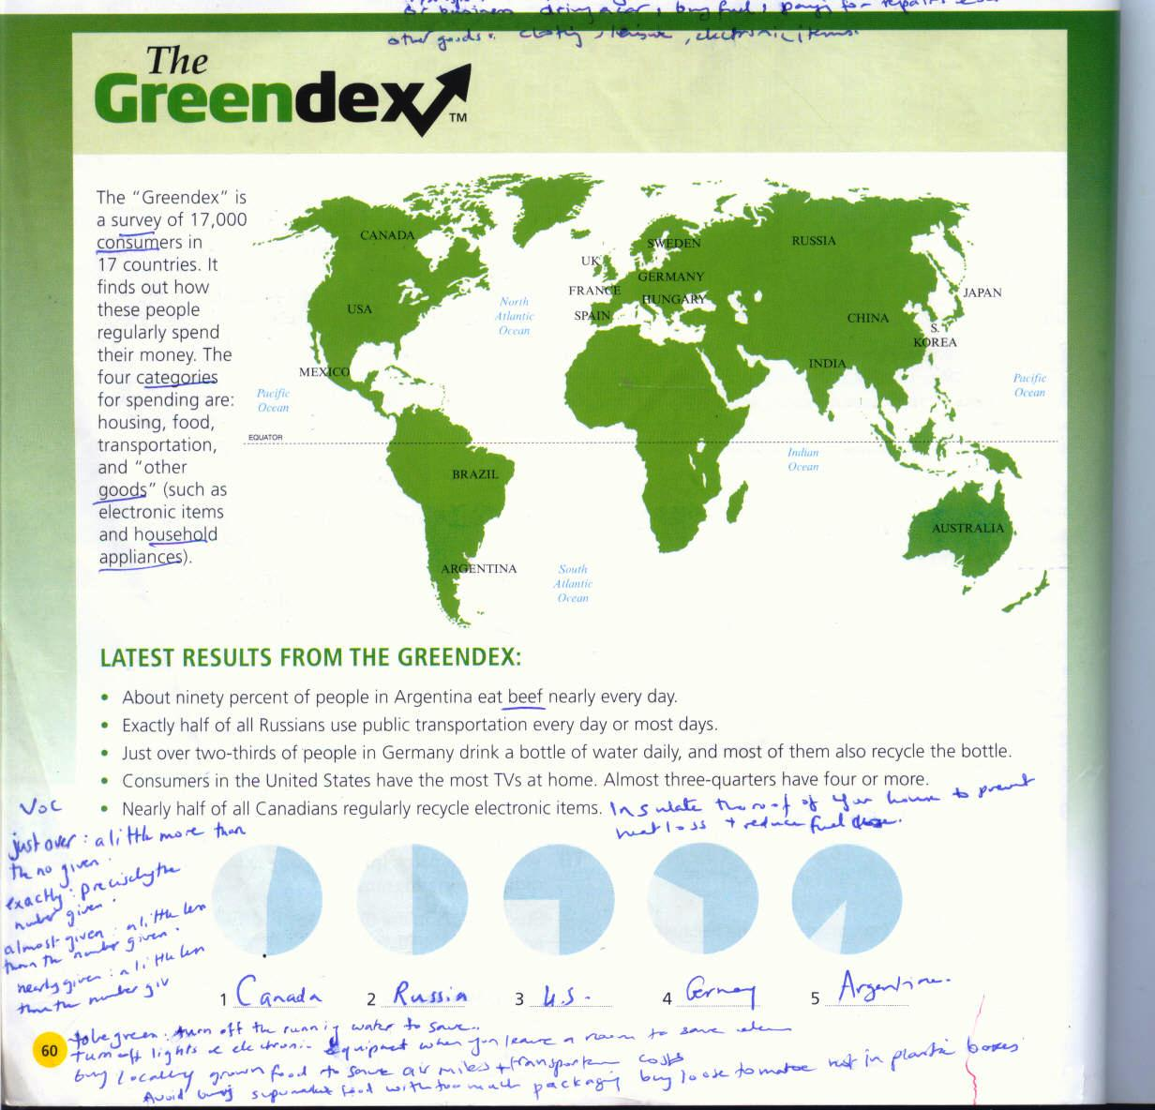

Slide 8
Speaking
Imagine you are taking on a radio call –in program
Student A you are the radio host
Student B you are a caller

Slide 9
Reading : The Greendex
Are you green? Do you
Recycle your trash
Ever buy second hand goods
Turn off computers and TVs before going to bed
Use public transportation or car pools
Can you think of more ways to be green

Slide 10
1. what is the purpose of the greendex
2./ is your country in the survey
What kinds of cost do you think each of the four categories includes

Slide 11
Label; the picture chart with the correct country

Slide 12
Facts and figures
Choose the correct percentage
1. about ninety percent
A.89%
B. 90%
C.99%
2/ exactly half
A. 49%
B. 50%
C.51%
1

Slide 13
Just over two-thirds
A.64%
B.66%
C.69%
4.almost three-quarters
A.66%
B.69%
C.74%

Slide 14
Consumer
Categories
Goods
Household appliances
Beef
Just over a little more than the one given
Exactly precisely the number given

Slide 15
Nearly half
a.48%
b.50%
c.52%

Slide 16
You are going to prepare a Greendex report about the class
follow these steps
1. write Eight to ten questions
To find out How Green everybody is
2. Each group member meets students from the Other Groups and interview them using the questions
Working with your first group again collect the information from your questions and summarize the results
Present your conclusions to the class using pie charts to help your presentations

Slide 17
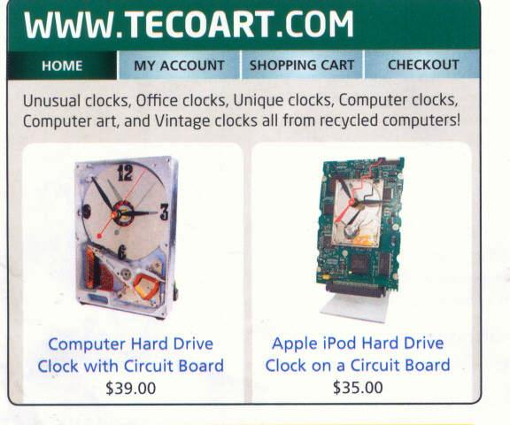

Slide 18
Unique : there is only one like it
Vintage : old
Hard drive : the part of computer that holds all the information
Circuit board : used to hold and connect small electronic parts

Slide 19
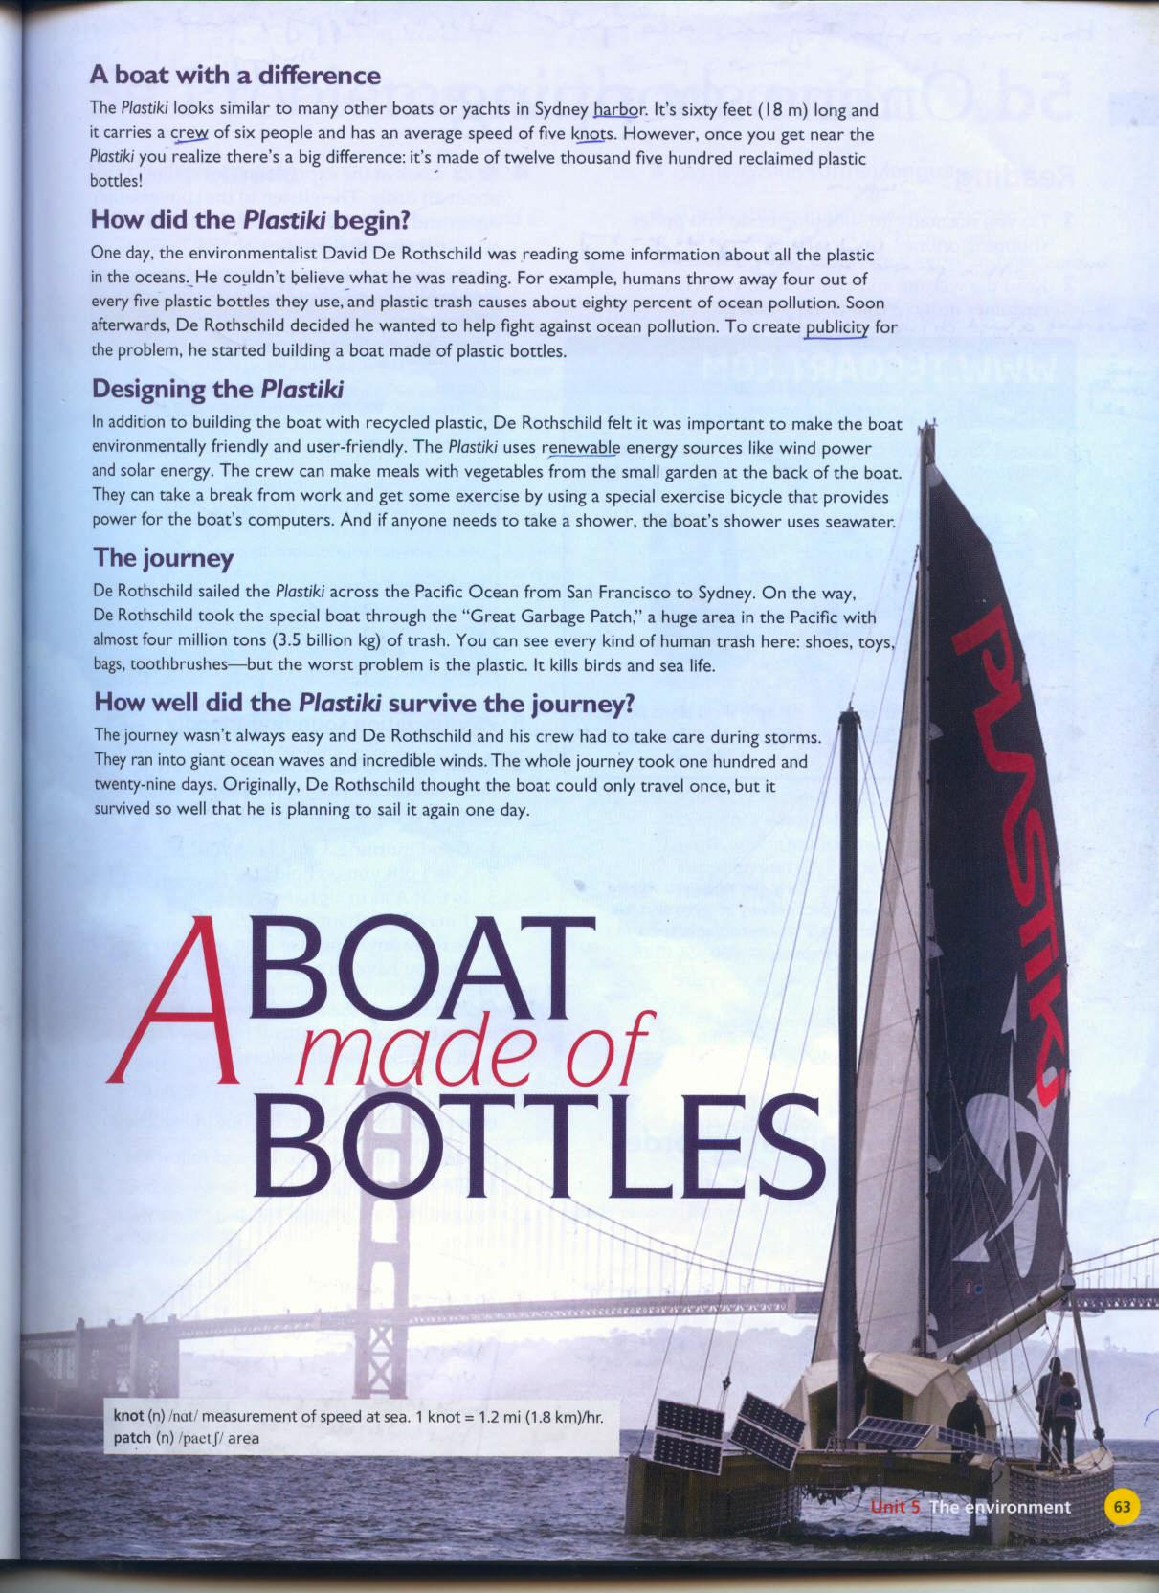

Slide 20
Knot :measurement of speed at sea
Patch :area
Harbor :
Reclaimed:
Crew:
Publicity

Slide 21
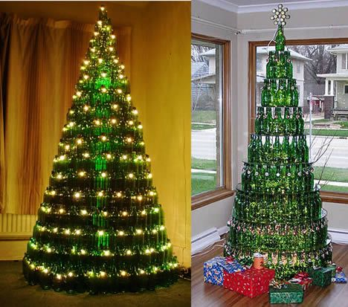

Slide 22


Slide 23
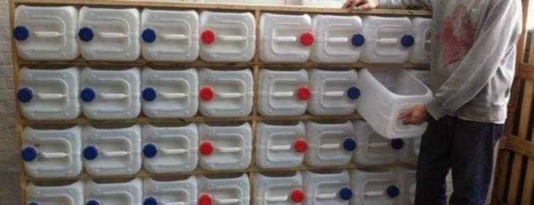

Slide 24
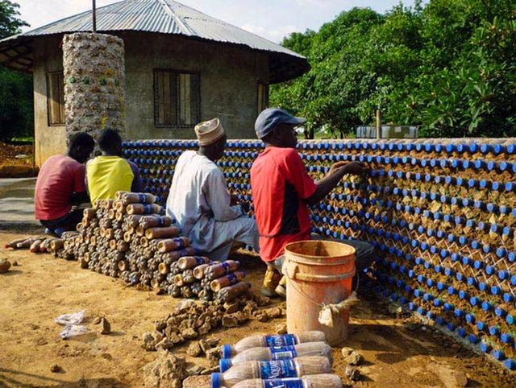

Slide 25
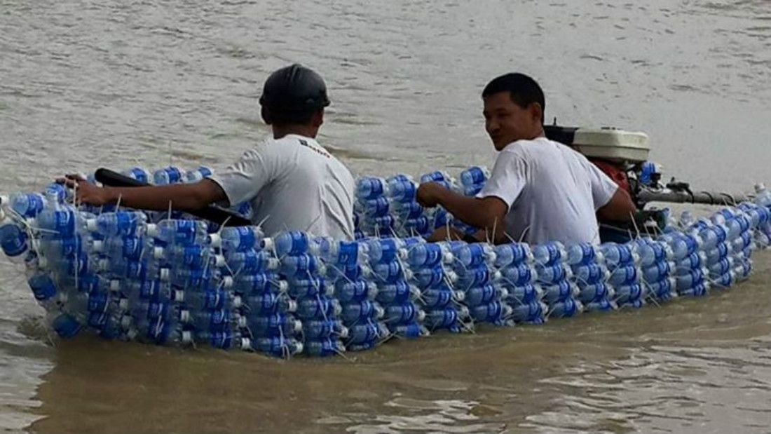

Slide 27
Thank you for watching

