Slide 1



Engineering Mechanics
Statics
Eng. Laith Batarseh

Slide 2
Introduction to Mechanics
In this class
1. Definition of statics
2. Examples on static and dynamic situations
3. Cartesian coordinate system

Slide 3
Introduction to Mechanics
is the body changes its volume parameters when the load is applied on it.
is the body that has the same volume parameters before and after applying the load
Mechanics
Statics
Is the filed of mechanics that describes the behavior of rigid bodies when it is subjected to load and have a constant velocity
Rigid body mechanics
Deformable body mechanics
Statics
Dynamics
Fluid mechanics
Constant
Velocity
Variable
Velocity
Liquids and gasses

Slide 4



Introduction to Mechanics
Examples:
Rigid body
Deformable body
Fluids

Slide 5
Introduction to Mechanics
Definitions:
Static Cases:
Dynamic Case:
P
Velocity = 0
P
P
Velocity = Constant
A
B
P
Velocity is changeable
Acceleration or Deceleration
A
B

Slide 6
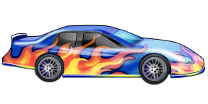
Introduction to Mechanics
Example:
Start
End
P
At rest
Acceleration
Constant velocity
Deceleration
Statics
Dynamics

Slide 7
Introduction to Mechanics
z
Cartesian coordinate system
y
y-z plane
x-y plane
x-z plane
y
x-y plane
x
x

Slide 8
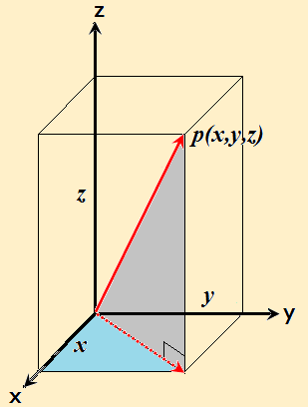
Introduction to Mechanics
Cartesian coordinate system
y
P(x,y)
z
y
x
x
(0,0)
x
y

Slide 9
Introduction to Mechanics
Summary
Mechanics is divided into: rigid-body, deformable- body and fluid mechanics
Rigid-body mechanics deals with static and dynamic situations of a rigid body
Static is the field of science that deals with bodies and particles that have a constant or zero velocity.
Dynamics is the field of science that deals with bodies and particles that have changeable velocity.
P

Slide 10
Introduction to Mechanics
Summary ^{cont}
Cartesian coordinate system is a system define the location of a point as coordinates
In Cartesian coordinate system, the coordinates represent the perpendicular distances from the axes: x, y and z
P

Slide 11
Introduction to Mechanics
End of lecture
See you in the next lecture
Don’t forget to answer the quiz
P

