Slide 1


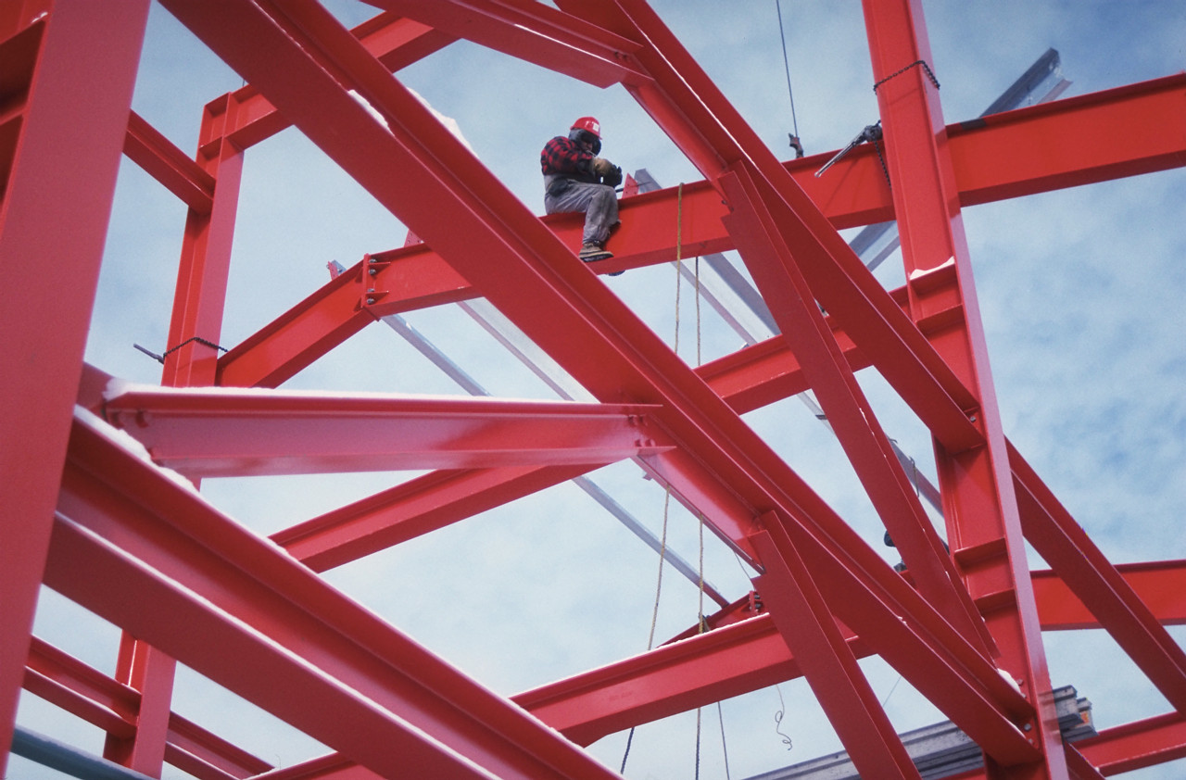
Statics
General
Concepts
Eng. Laith Batarseh

Slide 2
General Concepts
In this lecture
1. Some general concepts
2. Newton’s laws of motion
3. Units of measurements

Slide 3
General Concepts
is a measure used to define the position or size of body. (Units: Meter or Feet)
is a force acts on a line or surface on the body
is a measure of how mush matter in object and it could be defined as the measure of body resistance to accelerate. (Units: kg or lbm or slug)
General concepts
Length
Mass
Particle
Rigid body
Time
Force
Concentrated force
Distributed force
is a force acting on a single point on the body
P
is a collection of particles that have a fixed distance between each other before and after applying load (ie. Force).
is interaction between two bodies represented as a pull or push with direct contact (eg. Pushing a car) or indirect contact (eg. Electrical, gravitational and magnetic forces). (Units: Newtown or lbf)
is a mass with negligible size comparing with other object . (eg. Electron to nucleus, Pluto planet to its orbit, …,etc).
is considered as the fourth dimension where a sequence of events is arranged from the past to present to future. (Units: second)

Slide 4
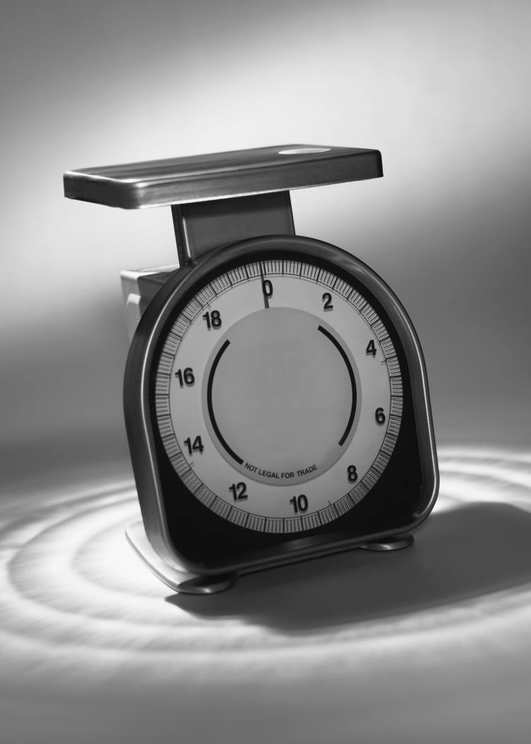

General Concepts
Examples:
Length:
Eiffel Tower length is approximately:
320 m
Mass:
Earth mass is approximately:
5.97219 × 10²⁴ kg
P
320 m
5.97219 × 10²⁴ kg

Slide 5


General Concepts
Examples ^{(cont)}:
Forces :
Time:
If an ambulance transports a patient from his house which is 5 km far from the hospital and the ambulance velocity was 100 km/hr then the ambulance will be in the hospital after leaving patient house by 5/100 =0.05 hr or 3 minutes.
Attraction force
+
-
P
Positive
charge
Negative
charge
Repulsion force
+
+
Positive
charge
Positive
charge
Note: static is time independent

Slide 6

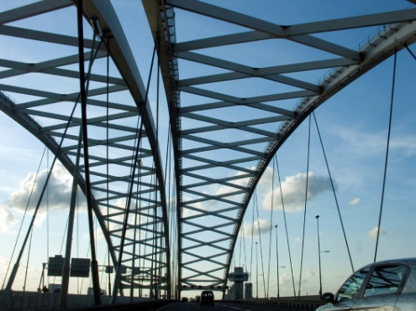
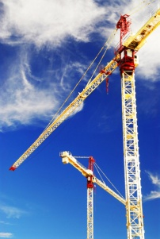

General Concepts
Examples ^{(cont)}:
Particles:
Rigid Body
1
Bridge
1
P
Atom
2
A satellite moving around earth
Crane
2

Slide 7
General Concepts
Newtown's Laws of Motion
First Law: a particle at rest or moves in constant velocity will remain on its state
unless it is subjected to unbalance force.
F₂
P
F₁
F₃
F₄
Second Law: a particle subjected to unbalance force will move at acceleration has the same direction of the force.
F
Third Law: each acting force has a reaction equal in magnitude and opposite in direction
Action: Force of A acting on B
A
B
Reaction: Force of B acting on A

Slide 8
General Concepts
Newtown proved his most famous law at all in the 17th centaury and called it Law of Universal Gravitation.
Statement: any two objects have a masses (M₁ and M₂ )and far away from each other by a distance (R) will have attraction force (gravitational) related proportionally with the objects masses product (M₁ M₂ ) and inversely with the square of the distance between them (R²). Mathematically:
Where: G = 66.73 x 10⁻¹² m³/(kg.s²)
Weight: according to Newtown's Law of Gravity, weight is the gravitational force acting between the body has a mass (m) and the earth (of mass M_{e}) and is given as: W=mg. g is the gravitational acceleration and equal to GM_{e}/R².
Newtown's Law of Gravity

Slide 9
General Concepts
According to Newton's 2nd law, the unit of force is a combination of the other three quantities: mass, length and time. So, the force units N (Newtown) and lbf can be written as:
Units of Measurements
Length
(m or ft)
Mass
(kg or lbm)
Time
(sec)
Force
(N or lbf)
SI
m
Kg
N
English
ft
lbm
lbf

Slide 10
General Concepts
Summary
Length, mass, force and time are all parameters have it own units.
Particle is a mass with negligible size.
Rigid body has a constant mass and shape.
Concentrated force acts on a single point while the distributed force acts on a line or surface of the body.
Newtown derived three laws of motion:
First Law: a particle at rest or moves in constant velocity will remain on its state unless it is subjected to unbalance force.
Second Law: a particle subjected to unbalance force will move at acceleration has the same direction of the force.
Third Law: each acting force has a reaction equal in magnitude and opposite in direction
P

Slide 11
General Concepts
Summary ^{cont}
Beside the three laws, Newtown derived the law of universal gravitation.
According to Newtown law of universal gravitation, body weight is the gravity force applied from the earth on the body.
Units are measures of parameters .
P

Slide 12
General Concepts
End of lecture
See you in the next lecture
Don’t forget to answer the quiz
P

