Slide 1


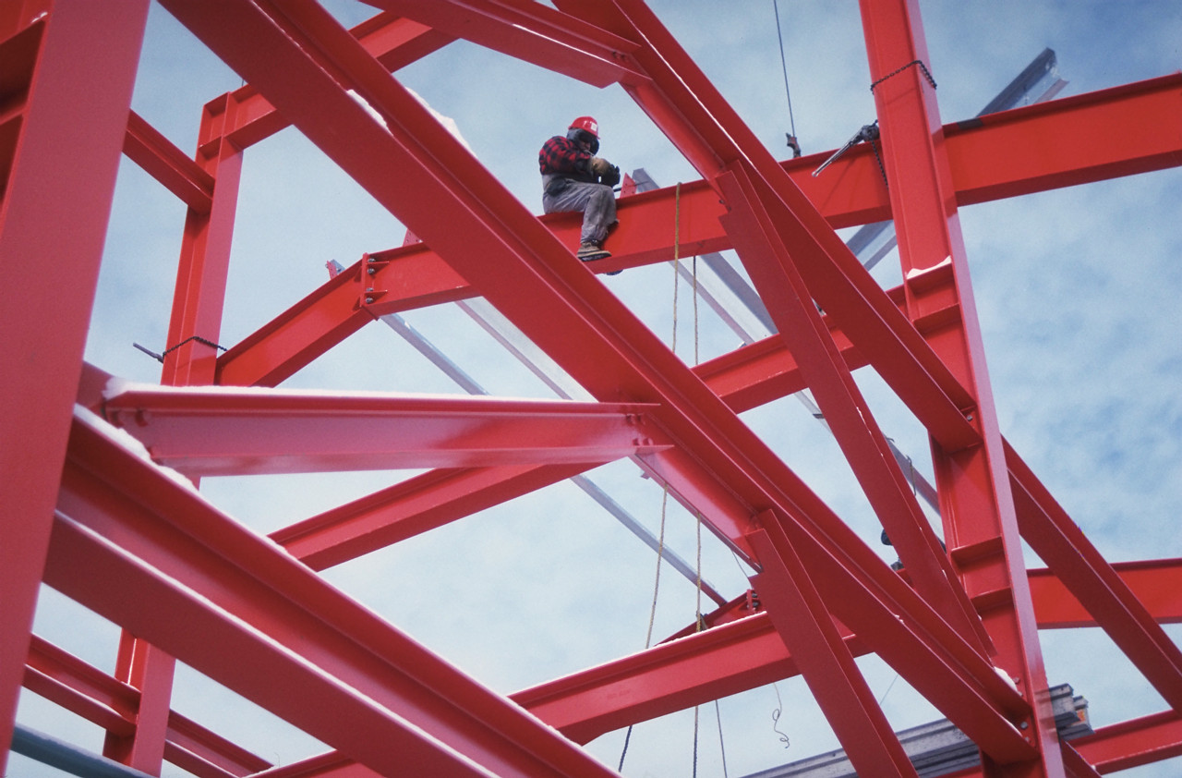
Statics
Force
Vectors
Eng. Laith Batarseh

Slide 2
Force Vectors
In this lecture
1. Scalar and vector quantities
2. Vector operations

Slide 3
Force Vectors
Physical
Quantity
Scalar
Vector
Is any physical quantity can be described fully by a magnitude only.
Is any physical quantity needs both magnitude and direction to be fully described.
Examples: mass, length and time.
Examples: force, position and moment.

Slide 4
Force Vectors
Vector presentation
Example
Magnitude (M)
Vector
5 units
Sense of Direction
Direction (θ)
Fixed axis
30º
Sense of Direction
Vector notations:
A
V = M∟θ
This vector has a magnitude of 5 units and it tilted from the horizontal axis by +30º

Slide 5
Force Vectors
Vector Operations
Multiplication by a scalar
Example
A=5∟30º
A
2A
30º
0.5A
-A
2A =10∟30º
0.5A =2.5∟30º
-A =-5∟30º = 5∟180+30º

Slide 6
Force Vectors
Vector Operations
Vector addition (A+B)
Vector subtraction (A-B)
A
R=A+B
A
A
B
B
-B
A
-B
A
OR
A
R=A+B
R=A-B
R=A-B
B
-B

Slide 7
Force Vectors
Vector Operations
Example:
Assume the following vectors: A = 10∟30º and B = 7∟-20 º
Find:
A+B
A-B
Solution:
-B
B
A
A-B
A
A+B

Slide 8
Force Vectors
Vector Operations
Special cases:
Collinear vectors:
Multiple addition:
A+B+C+…: in such case, the addition can be in successive order or in multiple steps.
A + B
A + B
A
B
B-A
B - A
A
B

Slide 9
Force Vectors
Vector Operations
Example:
Assume the following vectors: A = 10∟30º ,B = 7∟-20 º and C = 6∟135º .
Find:
A+B+(A+C)
Solution:
A+B+(A+C)
C
B
A+B
A
A+C
A+C
A+B
A

Slide 10
Force Vectors
Vector Operations
Example ^{(cont)}: Find A+B+(A-C)
B
A+B
A
A
A+B
A+B+A
A+B+A-C
-C
A+B+A

Slide 11
Force Vectors
Summary
Physical quantity can be scalar or vector
Scalar quantity has a magnitude only.
Vector quantity has both magnitude and direction.
Vector is represented by an arrow. The arrow length indicates the vector magnitude and its head indicates the vector sense
Scalar multiplication of vector means scaling of vector magnitude only.
Parallelogram method is used to determine vectors addition.
Multiple vector addition is a successive processes of adding two vectors
P

Slide 12
Force Vectors
End of lecture
See you in the next lecture
Don’t forget to answer the quiz
P

