Slide 1


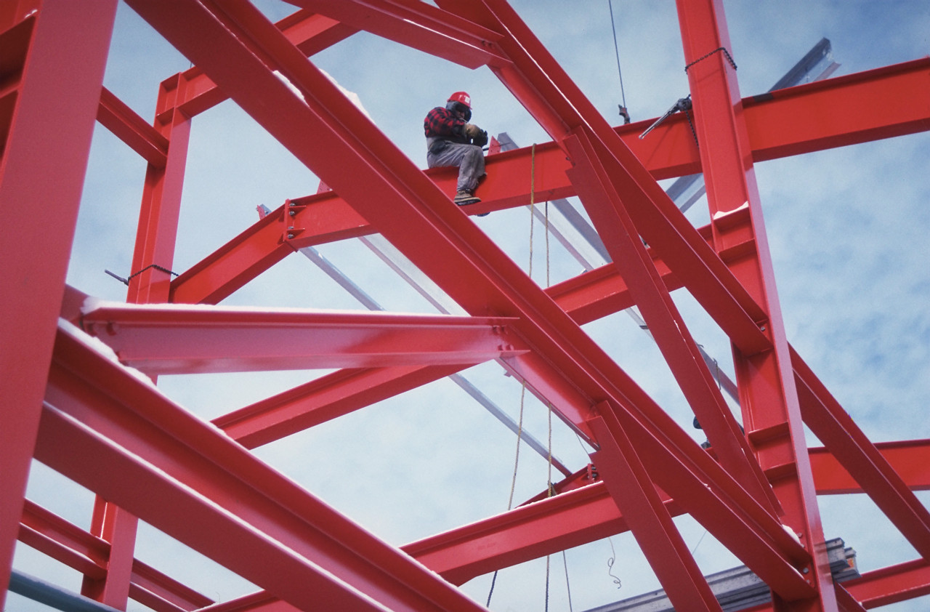
Statics
Vectors
Addition
Of
Force
Eng. Laith Batarseh

Slide 2
Vectors Addition Of Force
In this lecture
1. Representing force by vector
2. Examples on forces
3. Resultant force
4. Force components

Slide 3
Vectors Addition Of Force
Representing forces by vectors
Because force has both magnitude and direction, it can be represented as a vector.
Examples:
m₁ = ½ m₂ so w₂ = 2w₁
both w₁ and w₂ are downward
the vector w₂ must be twice the length of the vector w₁
w₁=m₁g
W₂ =m₂g

Slide 4
Vectors Addition Of Force
Examples on forces
Spring
1
2
Friction
Compression
Tension
3
Ropes and wires are always experience tension forces

Slide 5
Vectors Addition Of Force
Finding a resultant force
Resultant force is an equivalent force for a grope of concentrated forces acting on the same point.
To find the resultant force, all the forces must be represented as vectors and then must be all added together.
One of the most powerful method to add forces, specially when its number is large, is to add their components.

Slide 6
Vectors Addition Of Force
Force components
Resolving several forces
v
v
F
F
F_{v}
u
u
F_{u}
v
v
u
u

Slide 7
Vectors Addition Of Force
Analysis procedures
Parallelogram Law:
Triangle method
F_{u}
v
F_{v}
F_{v}
F
F_{u}
F_{v}
u
F_{u}
Cosine law:
Sine Law:
F_{u}
F_{v}
θ
b
a
F

Slide 8
Vectors Addition Of Force
Example [1]:
Question:
The hook shown in the figure is subjected to two tension forces F1 and F2. determine the magnitude and direction of the resultant force.
Solution:
Given: F1 =200∟250º and F2 =100∟-30º
Required: find the resultant force F
Plan:
We can select the triangle method.
Find the magnitude by using
Find the direction by using
^{y}
^{x}
20º
30º
F1= 200 N
F2=100 N

Slide 9
Vectors Addition Of Force
Example [1]^{cont}:
Solution:
Note that θ = 50º
Cosine Law:
Sine Law:
So: F = 156∟109º
20º
130º
30º
200 N
50º
100 N
50º
130º
Θ
20º
30º
200 N
100 N
F
ϕ
50º
20º

Slide 10
Vectors Addition Of Force
Example [2]:
Question:
Resolve 100 N force shown in the figure to its components along the bars.
Solution:
Given: F1 =100∟-30º
Required: resolve the force F
Plan:
Define the axes
Resolve the force by sine law
30º
100 N

Slide 11
Vectors Addition Of Force
Example [2]:
Solution:
2
F1
1
F2
100N
F1
3
F2
30º
F1
100N
30º
F2
100 N
4
F1 = 50 N and F2=86.6 N

Slide 12
Vectors Addition Of Force
Summary
Force has both magnitude and direction and so it can be represented as vector
Resultant force is an equivalent force for a grope of concentrated forces acting on the same point.
Resultant force can be obtained by either the parallelogram method or the triangle method
Parallelogram or the triangle method can be used to determine the force components
Force components are the projection of this force on selected axes system
P

Slide 13
Vectors Addition Of Force
End of lecture
See you in the next lecture
Don’t forget to answer the quiz
P

