Slide 1


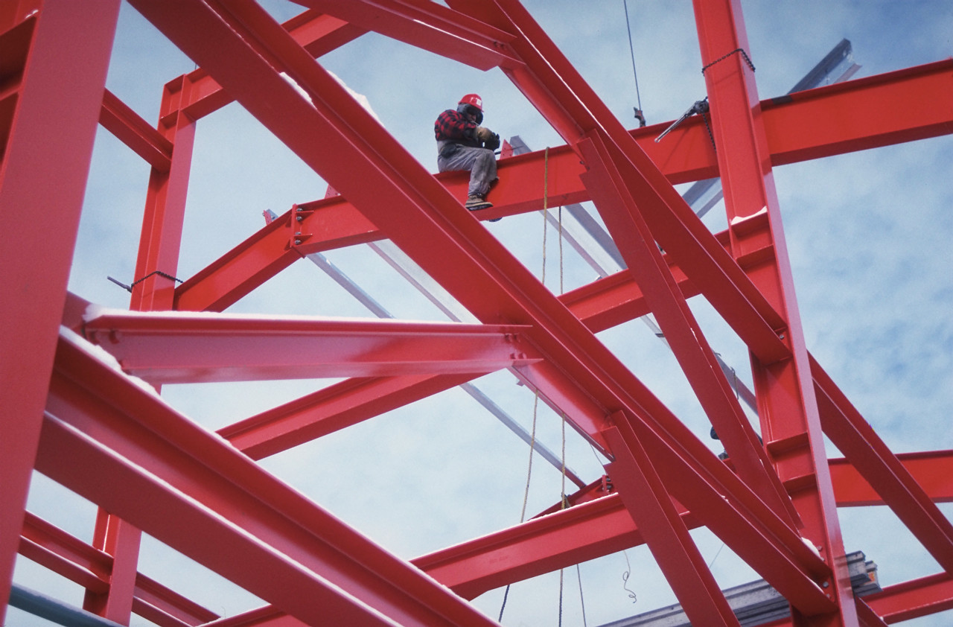
Statics
Coplanar Forces
Eng. Laith Batarseh

Slide 2
Coplanar Forces
In this lecture
We will
Define the concept of coplanar forces
Study the cases of scalar notation
Study the cases of Cartesian notation
Learn how to sum forces

Slide 3
Coplanar Forces
Coplanar forces
Coplanar forces are the forces that share the same plane.
These forces can be represented by their components on x and y axes which are called the rectangular components.
The components can be represented by scalar and Cartesian notations.
Scalar notation
Cartesian notation
y
F_{x} = F cos(θ)
F_{y}= F sin(θ)
F_{y}
F
θ
F_{x}
x
y
j
F = F_{x} i + F_{y} j
F_{y}
F
x
F_{x}
i

Slide 4
Coplanar Forces
Scalar notation cases
1
2
y
y
c
F_{y}
F
F
b
F_{y}
θ
a
F_{x}
x
F_{x}
x
F_{x} = F cos(θ)
F_{x} /F= a/c
F_{y}= F sin(θ)
F_{y} /F= b/c

Slide 5
Coplanar Forces
Cartesian notation cases
F ₂ = -F₂,_{x} i + F₂,_{y} j
y
y
j
F_{2,y}
F ₁= F₁,_{x} i + F₁,_{y} j
F_{1,y}
F₂
F₁
F_{y}
F
F_{2,x}
F_{1,x}
x
x
F_{3,x}
F₃
F_{4,x}
F_{x}
F₄
i
F_{4,y}
F ₃= -F₃,_{x} i - F₃,_{y} j
F_{3,y}
F ₄= F₄,_{x} i - F₄,_{y} j

Slide 6
Coplanar Forces
Force summation
For both cases of notations, the magnitude of the resultant force is found by:
And the direction is found by:
F_{R,x} =∑F_{x}
+ve
F_{R,y}
F_{R,y} =∑F_{y}
F_{R}
+ve
θ
F_{R,x}

Slide 7
Coplanar Forces
Example [1]:
Question:
The hook shown in the figure is subjected to two tension forces F1 and F2. determine the magnitude and direction of the resultant force.
Solution:
Given: F1 =200∟200º and F1 =100∟-30º
Required: find the resultant force F_{R}
Plan:
Find the resultant force by the scalar notation
Find the resultant force by the Cartesian notation
20º
30º
F1= 200 N
F2=100 N

Slide 8
Coplanar Forces
Example [1]^{cont}:
Solution:
Scalar notation
x – components: F_{1,x} = - F1 cos(20) = - 188 N
F_{2,x} = F2 cos(30) = 86.6 N
∑Fx = 86.6 – 188 = -101.4 N
y – components: F_{1,y} = - F1 sin(20) = -68.4 N
F_{2,y} = -F2 sin(30) = - 50 N
∑Fy = – 68.4 – 50 = – 118.4 N
Magnitude : F_{R} = [(-104.4)² + (-118.4)²] ^{½} = 157.9 N
Direction : θ = tan-1 |-118.4/-104.4| = 48.6º
y
x
20º
30º
200 N
100 N
-104.4N
θ
-118.4 N

Slide 9
Coplanar Forces
Example [1]^{cont}:
Solution:
Cartesian notation
Forces : F₁ ={ - 188 i – 68.4 j} N
F₂ = {86.6 i – 50 j} N
∑Fx = 86.6 – 188 = -101.4 i N
∑Fy = – 68.4 – 50 = – 118.4 j N
Magnitude : F_{R} = [(-104.4)² + (-118.4)²] ^{½} = 157.9 N
Direction : θ = tan⁻¹ |-118.4/-104.4| = 48.6º
20º
30º
200 N
100 N
-104.4N
θ
-118.4 N

Slide 10
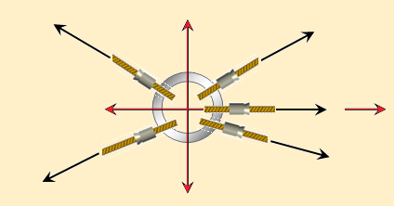
Coplanar Forces
Example [2]:
Question:
There are 5 forces acting on the ring shown in the following figure. determine the magnitude and direction of the resultant force.
Solution:
Given: the magnitudes and directions for all forces
Required: find the resultant force F
Plan:
use the Cartesian notation to find the resultant force.
150 N
y
200 N
45º
45º
100 N
x
30º
20º
60 N
50N

Slide 11
Coplanar Forces
Example [2]^{cont}:
Solution:
Forces:
F₁ = 200 cos(45) i + 200 sin(45) j
F₁ ={ 141.42 i +141.42 j} N
F₂ = 100 i + 0 j N
F₃ = -150cos(45) i + 150sin(45) j ={ -106.06 i + 106.06 j} N
F₄ = - 50 cos(30) i – 50 sin(30) j ={- 43.3 i - 25 j} N
F₅ = 60 cos(20) i - 60 sin(20) j ={ 56.4 i - 20.52 j} N
Magnitude : F_{x} = 141.42+100 – 106.06 – 43.3 +56.4 = 148.46 N
F_{y} = 141.42 +0 +106.06 – 25 – 20.52 = 201.96 N
F = {148.46 i + 201.96 j} N
|F| = [ (148.46)² + (201.96)²]^{½} = 250.66 N
Direction: θ = tan⁻¹ |201.96/148.46| = 53.7º
150 N
y
200 N
45º
45º
100 N
x
30º
20º
60 N
50N
y
250.66 N
53.7º
x

Slide 12
Coplanar Forces
Summary
Coplanar forces are the forces that share the same plane.
These forces can be represented by their components on x and y axes which are called the rectangular components.
The components can be represented by either scalar or Cartesian notations.
Resultant force can be found as:
P
F_{R,x} =∑F_{x}
F_{R,y} =∑F_{y}

Slide 13
Coplanar Forces
End of lecture
See you in the next lecture
Don’t forget to answer the quiz
P

