Slide 1



Statics
Cartesian Vectors
Part I
Eng. Laith Batarseh

Slide 2
Cartesian Vectors
In this lecture
We will
Introduce the 3-dimensional (3-D) problems
Learn the right – hand method to define 3-D Cartesian coordinate system
Learn how to find the magnitude and direction of 3-D vector

Slide 3
Cartesian Vectors
Forces
One dimension
Two dimensions
Three dimensions

Slide 4

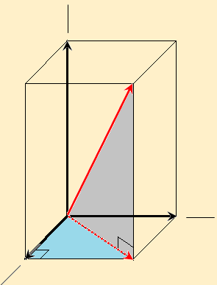
Cartesian Vectors
In three dimensions system, new component appeared (A_{z}).
The new dimension direction is represented by unit vector (k)
The position of the vector has to be located by three angles one from each axis
The projection of vector on x-y plane represent a new vector called A’
Note that
z
A_{z}
A
A_{y}
A_{x}
y
A’
x

Slide 5
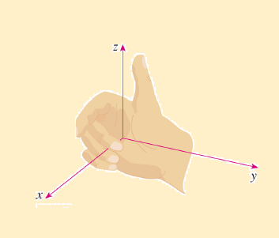
Cartesian Vectors
Right hand coordinate system
This method is used to describe the rectangular coordinate system.
The system is said to be right handed if the thumb points to the positive z-axis and the fingers are curled about this axis and points from the positive x-axis to the positive y-axis.

Slide 6
Cartesian Vectors
Notation
To find the components of a vector oriented in three dimensions, two successive applications of the parallel-ogram must be done.
One of the parallelogram applications is to resolve A to A’ and A_{z} and the other is used to resolve A’ into A_{x} and A_{y}.
A = A’ + A_{z} = A_{x} + A_{y} + A_{z}
z
A_{z}
A
A _{y}
A_{x}
y
A’
x

Slide 7
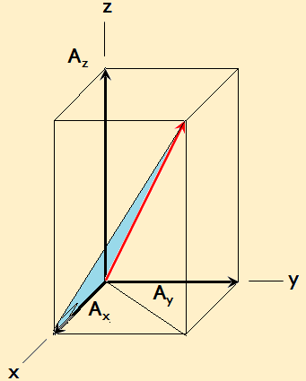
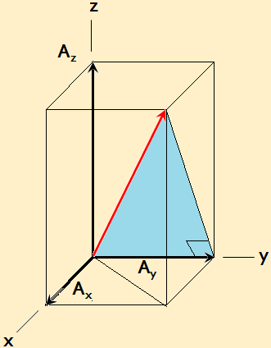
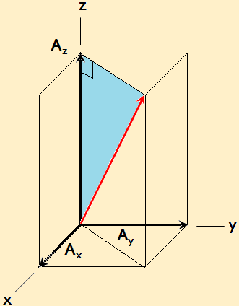
Cartesian Vectors
Angles
α is the angle between the vector and x-axis
β is the angle between the vector and y-axis
γ is the angle between the vector and z-axis
γ
α
β

Slide 8
Cartesian Vectors
Cartesian unit vectors
k
A = A_{x} i + A_{y} j + A_{z} k
j
A_{x} = Acos(α)
A_{y} = Acos(β)
A_{z} = Acos(γ)
i

Slide 9
Cartesian Vectors
Magnitude and Direction
Magnitude
Direction

Slide 10
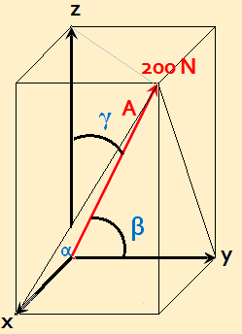
Cartesian Vectors
Example [1]:
Question: find the rectangular components of force
F in x,y and z axes where: α = 60º, β = 45º and γ = 60º
Solution:
Given: F = 200 N, α = 60º, β = 45º and γ = 60º
Required: find F_{x}, F_{y} and F_{z}
Plan:
use the following relations:

Slide 11
Cartesian Vectors
Example [1]^{cont}:
Solution:
F_{x} = F cos(α) = 200 cos(60) = 100 N
F_{y} = F cos(β) = 200 cos(45) = 141.42N
F_{z} = F cos(γ) = 200 cos(60) = 100 N
Verification:
F = [100² +141.42² + 100²] ^{½} = 200 N

Slide 12
Cartesian Vectors
Summary
Force can be one, two or three dimensional
Right hand side method is used to described the Cartesian coordinate system
Three dimensional force has three angles: α, β and γ with axes: x, y and z respectively and the representation of this force can be as follows:
P
A_{x} = Acos(α)
A_{y} = Acos(β)
A_{z} = Acos(γ)
A = A_{x} i + A_{y} j + A_{z} k

Slide 13
Cartesian Vectors
End of lecture
See you in the next lecture
Don’t forget to answer the quiz
P

