Slide 1


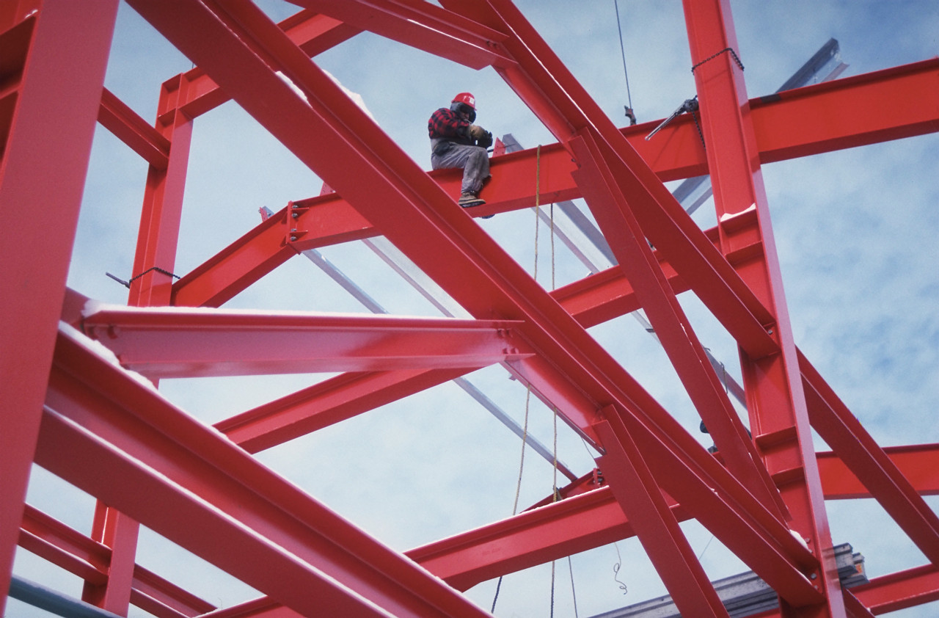
Statics
Cartesian Vectors
Part 2
Eng. Laith Batarseh

Slide 2
Cartesian Vectors
In this lecture
We will
Learn new direction definition
Learn how to add Cartesian Vectors
Define the position vector

Slide 3
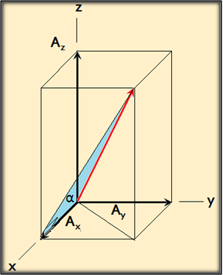
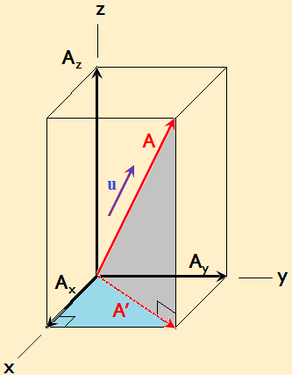
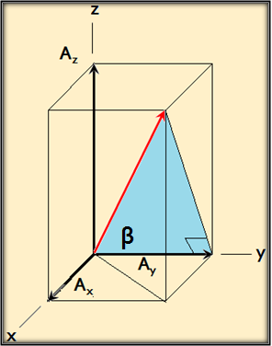
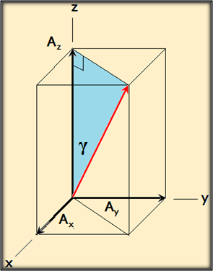
Cartesian Vectors
Other direction definition
A = A_{x} i + A_{y} j + A_{z} k
u_{A} = cos(α) i + cos(β) j + cos(γ) k
A = |A| u_{A}
= |A| cos(α) i + |A| cos(β) j + |A| cos(γ) k
= A_{x} i + A_{y} j + A_{z} k

Slide 4
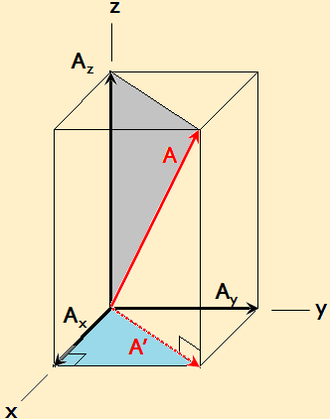
Cartesian Vectors
Other direction definition ^{cont}
A_{z} = A cos(ϕ)
A’ = A sin(ϕ)
ϕ
A_{x} = A’ cos(θ) = A sin(ϕ) cos(θ)
A_{y} = A’ sin(θ) = A sin(ϕ) sin(θ)
θ

Slide 5
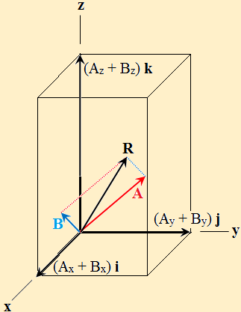
Cartesian Vectors
Cartesian Vectors Addition
A = A_{x} i + A_{y} j + A_{z} k
B = B_{x} i + B_{y} j + B_{z} k
R = A+ B
= (A_{x} + B_{x} ) i + (A_{y} + B_{y}) j +(A_{z} + B_{z} ) k
General rule:
F_{R} = ∑F = ∑F_{x} i + ∑F_{y} j + ∑F_{z} k

Slide 6
Cartesian Vectors
Example [1]:
Question: assume the following forces:
F₁ = 5 i + 6j -4k
F₂ = -3i +3j +3k
F₃=7i-12j+2k
Find the resultant force F = F1 + F2 +F3 and represent it in both Cartesian and scalar notations
Solution:
Given: F1, F2 and F3
Required: find resultant force F and represent it in both Cartesian and scalar notation

Slide 7
Cartesian Vectors
Example [1]:
Solution:
F = (5-3+7)i + (6+3-2)j +(-4+3+2)k = 9i +7j +10k (Cartesian notation)
Scalar notation:
Magnitude:
Unit vector u:

Slide 8
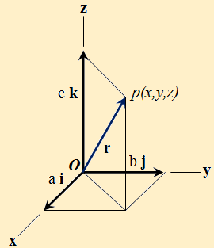
Cartesian Vectors
Position vector
Assume: r = ai + bj + ck
At this point, r is called position vector.
Position vector is a vector locates a point in space with respect to other point.
in this case, vector r is a position vector relates point P to point O.

Slide 9
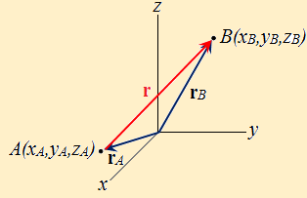
Cartesian Vectors
Position vector
Assume vectors r_{A} and r_{B} are used to locate points A and B from the origin (ie. Point 0,0,0).
Define a position vector r to relate point A to point B.
r_{B} = r + r_{A} → r = r_{B} – r_{A}
r = (x_{B} – x_{A})i + (y_{B} – y_{A})j + (z_{B} – z_{A})k

Slide 10
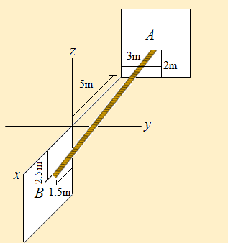
Cartesian Vectors
Example [2]:
Question: if the robe shown in the figure extend from point A to point B. Find its length and direction measured from point A towards point B.
Solution:
Given: A(-5,3,2) and B(1.5,0,-2.5)
Required:
|r|
α, β and γ

Slide 11
Cartesian Vectors
Example [2]^{cont}:
Solution:
1. Position vector
A(-5,3,2) and B(1.5,0,-2.5)
r = (x_{B} – x_{A})i + (y_{B} – y_{A})j + (z_{B} – z_{A})k
r = (1.5 – (-5))i + (0– 3)j + (-2.5– 2)k
r ={ 6.5i + – 3j + -4.5k} m
2. Robe length
3. Direction

Slide 12
Cartesian Vectors
Summary
Position vector is a vector locates a point in space with respect to other point.
A = |A| cos(α) i + |A| cos(β) j + |A| cos(γ) k
F_{R} = ∑F = ∑F_{x} i + ∑F_{y} j + ∑F_{z} k

Slide 13
Cartesian Vectors
End of lecture
See you in the next lecture
Don’t forget to answer the quiz

