Slide 1

Statics
Chapter Ten
Work principle
By
Laith Batarseh
Home
Next
Previous
End

Slide 2
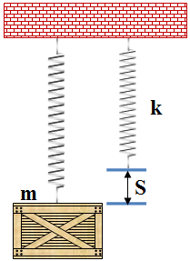
Work principle
Statics
Example: work done by spring
dU = F.dr
= kS.dS
→ integrate with respect to S
W = ½ kS²

Slide 3
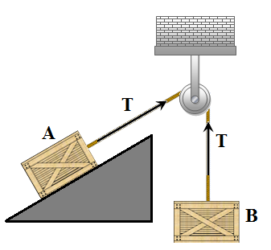
Potential and Kinetics Energy
Statics
Example work done in cords
@ A: T.dS
@ B: -T.dS
So the resultant work equal zero

Slide 4
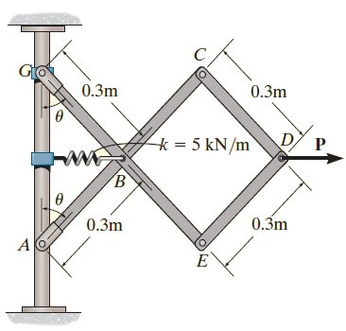
Work principle
Statics
Example 11.2
Determine the required force P in Figure, needed to maintain equilibrium of the scissors linkage when θ=60º. The spring is un-stretched when θ=30º . Neglect the mass of the links
Engineering mechanics: static, 12th edition in SI units, R.C. Hibbeler, 2010

Slide 5
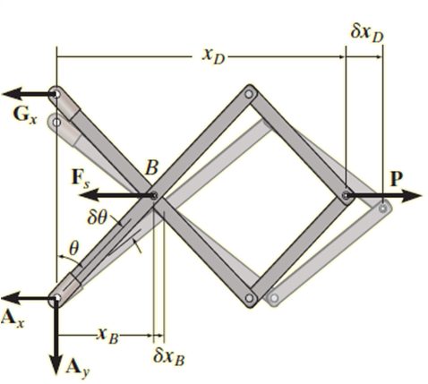
Work principle
Statics
Example 11.2
Solution
F.B.D
Engineering mechanics: static, 12th edition in SI units, R.C. Hibbeler, 2010

Slide 6
Work principle
Statics
Example 11.2
Solution
Spring force
F_{s} = k.s= 5000 [(0.3 ) sin (θ - (0.3 ) sin 30°] = (1500 sin (θ)- 750) N
Virtual Displacements.
x_{D} = 3[(0.3 m) sin (θ)] = (0.9 m) sin (θ)
x_{B} = (0.3 m) sin (θ)

Slide 7
Work principle
Statics
Example 11.2
Solution
Differential elements
dU = 0 → P δ(x_{D})– F_{s} δ(x_{B})= 0
P (0.9 cos(θ) δ(θ)) – [1500 sin(θ) – 750] (0.3 cos(θ) δ(θ)) = 0
{0.9P +225 – 450 sin(θ)} cos (θ) δ(θ) = 0
Because cos(θ) δ(θ) ≠ 0
{0.9P +225 – 450 sin(θ)= 0 → P = 500 sin(θ) – 250
θ = 60º
P = 500 sin(60) – 250 = 183

Slide 8
Work principle
Statics
End of lecture
See you in the next lecture
Don’t forget to answer the quiz
Home
Next
Previous
End

