Slide 1

Statics
Chapter Ten
Work principle
By
Laith Batarseh
Home
Next
Previous
End

Slide 2
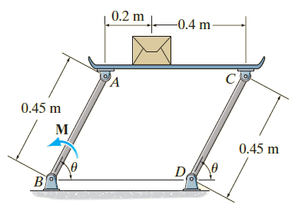
Work principle
Statics
Example 11.3
If the box in Figure has a mass of 10 kg, determine the couple moment M needed to maintain equilibrium when θ=60º. Neglect the mass of the members.
Engineering mechanics: static, 12th edition in SI units, R.C. Hibbeler, 2010

Slide 3
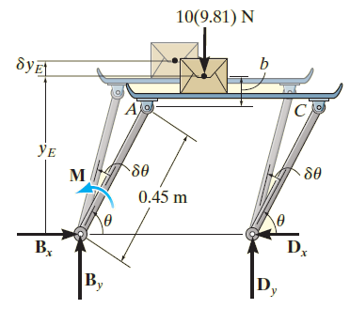
Work principle
Statics
Example 11.2
Solution
F.B.D
Engineering mechanics: static, 12th edition in SI units, R.C. Hibbeler, 2010

Slide 4
Work principle
Statics
Example 11.2
Solution
Virtual Displacements.
y_{E} = 0.45 sin(θ)+ b
Differential elements
δy_{E} = 0.45 cos(θ) δ(θ)
Virtual work equation
dU = 0 → M δ(θ)– [10(9.81)] δy_{E} = 0

Slide 5
Work principle
Statics
Example 11.2
Solution
Mδ(θ) - 10(9.81) (0.45 cos(θ) δ(θ)) = 0
→ {M- 44.145 cos(θ)} δ(θ)=0
Because δ(θ) ≠ 0
M- 44.145 cos(θ)=0
θ = 60º
M= 44.145 cos(60)=22.1 N.m

Slide 6
Work principle
Statics
End of lecture
See you in the next lecture
Don’t forget to answer the quiz
Home
Next
Previous
End

