Slide 1

Statics
Chapter Ten
Potential and Kinetic Energy
By
Laith Batarseh
Home
Next
Previous
End

Slide 2
Potential Energy
Statics
Definition
Potential energy is capacity to do work
Potential energy
elastic effect
gravitational effect

Slide 3
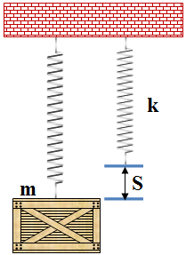
Potential Energy
Statics
Elastic effect
The most common example on elastic effect is the spring
Because potential energy represents the work capacity, it can be determined directly from the work equation for springs:
V_{e} = ½ kS²
Example
Assume k=1000N/m and S=100mm
V_{e} = ½ (1000N/m)(0.1m)² =5 Joule

Slide 4
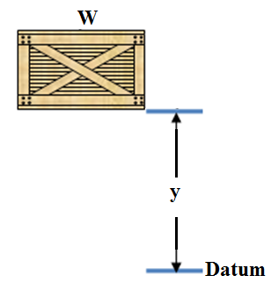
Potential Energy
Statics
Elastic effect
The work done by gravity on a body is calculated as : W.y (force . distance) and this equation is applicable to represent the potential energy
V_{g} = W . y
Example
Assume w=100N and y= 5m
V_{e} = (100N/m)(5m)² =2500 Joule

Slide 5
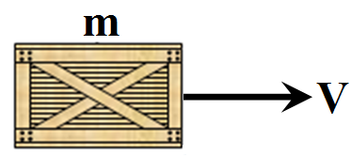
Kinetic energy
Statics
Definition
Kinetic energy is the energy is the energy of motion. The value of kinetic energy depends on body mass and velocity
K.E= ½ m.V²
Example
Assume m =5kg and V=2m/s
K.E= ½ (5)(2)² =10 Joule

Slide 6
Potential and Kinetics Energy
Statics
We reached the end of this course. I hope this course add new knowledge to you. See you in next courses

