Slide 1


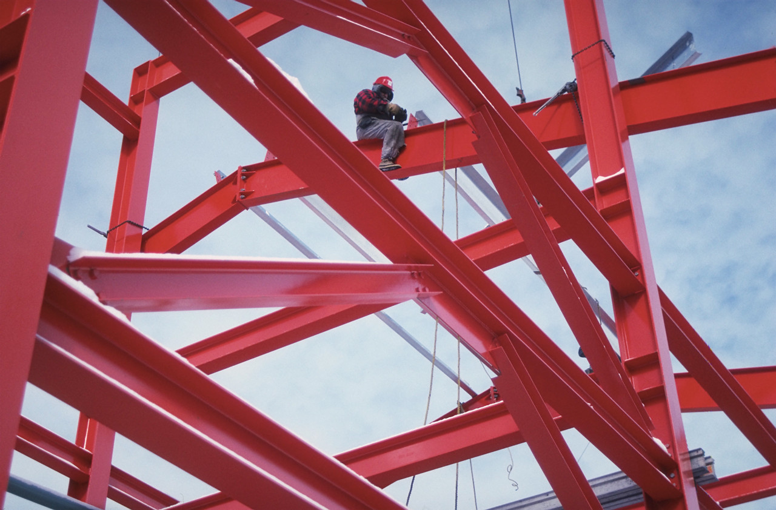
Statics
Condition
For
Equilibrium
Eng. Laith Batarseh

Slide 2
Condition For Equilibrium
In this lecture
We will
  Define the concept of equilibrium
  Learn the concept of free body diagram
  Learn the connection types

Slide 3
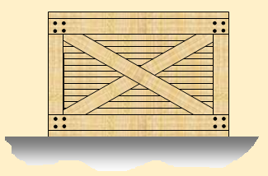

Condition For Equilibrium
Equilibrium
At rest
V = 0
Moves at constant velocity
V =C
Constant Velocity

Slide 4
Condition For Equilibrium
Equilibrium condition
Satisfying Newtown’s 1st Law of Motion: ∑ F = 0
This condition implies that ma = 0. here m could not equal zero and so a = 0 (i.e. not accelerating or decelerating)

Slide 5
Condition For Equilibrium
Free Body Diagram (FBD)
Definition:
Is a diagram for a particle or a body isolated from its surrounding.
It shows all the forces acting on the particle

Slide 6
Condition For Equilibrium
Procedures to draw FBD
Drawing outlined shapes
Show all the forces
Identify each force

Slide 7
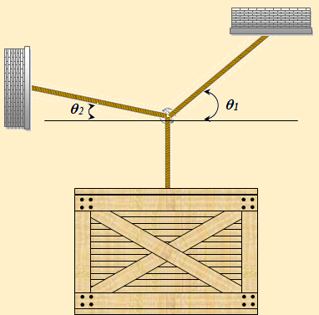
Condition For Equilibrium
Example[1]
F1
F2
M
Mg

Slide 8
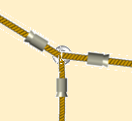
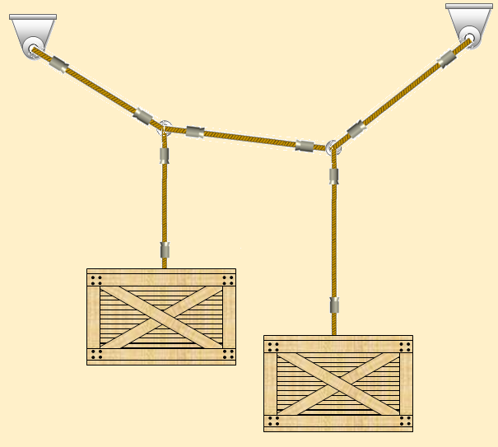
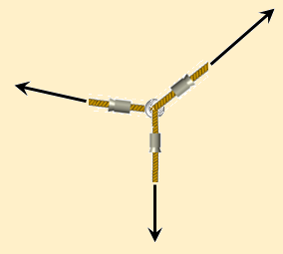
Condition For Equilibrium
T1
Example[2]
B
T2
D
A
B
C
M1g
T3
T2
C
M1
M2
M2g

Slide 9
Condition For Equilibrium
Connection types: linear springs
deflection (δ) = L – L_{o}
F = K δ where K is the spring stiffness
increasing K makes the spring stiffer.
Stiffer springs needs more force to deflect it
Applying
Load
L_{o}
L_{o}
L
δ
F

Slide 10
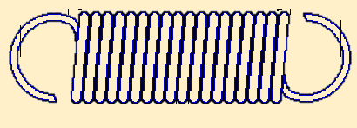
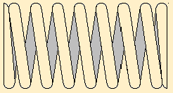
Condition For Equilibrium
Forces in Linear Springs
As the load affects the spring, an internal resistance load creates.
The relation between the external load and the internal force of the spring is proportional and the proportional factor is the stiffness (K)
Linear springs could be:
tension spring compression springs

Slide 11
Condition For Equilibrium
Equivalent of Linear Springs (parallel)
K1
K2
K3
Keq = K1 + K2 + …. + Kn
Force
Force
Kn

Slide 12
Condition For Equilibrium
Equivalent of Linear Springs (series)
K1
K2
Kn
Force
Force

Slide 13
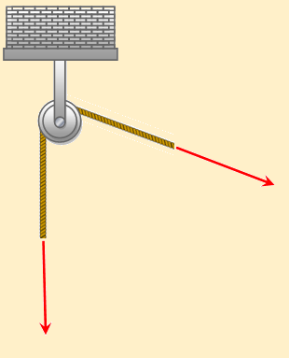
Condition For Equilibrium
Connection types: cables and pulleys
it has always tension force in the direction of the cable.
In most of engineering problems, cables are assumed massless and unable to stretch.
T
T

Slide 14
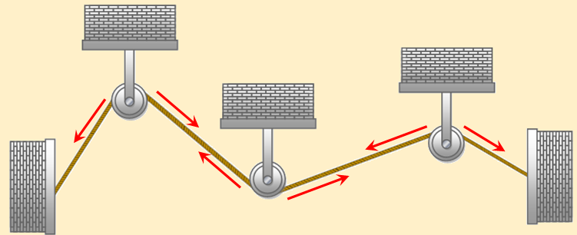
Condition For Equilibrium
Example[3]
T

Slide 15
Condition For Equilibrium
Summary
Equilibrium condition ∑ F = 0
F.B.D is a diagram for a particle or a body isolated from its surrounding and shows all the forces acting on the particle
The relation between the external load and the internal force of the spring is proportional and the proportional factor is the stiffness (K)
P

Slide 16
Condition For Equilibrium
Summary ^{cont}
For parallel connected springs
For series connected springs
In most of engineering problems, cables are assumed massless and unable to stretch.
Keq = K1 + K2 + …. + Kn
P

Slide 17
Condition For Equilibrium
End of lecture
See you in the next lecture
Don’t forget to answer the quiz
P

