Slide 1
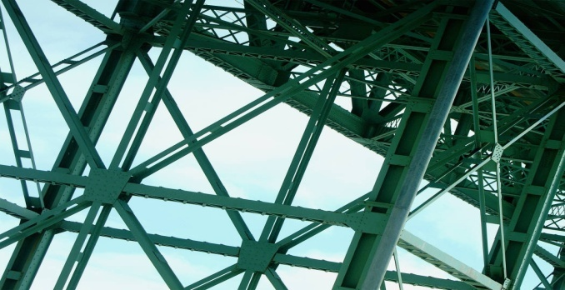

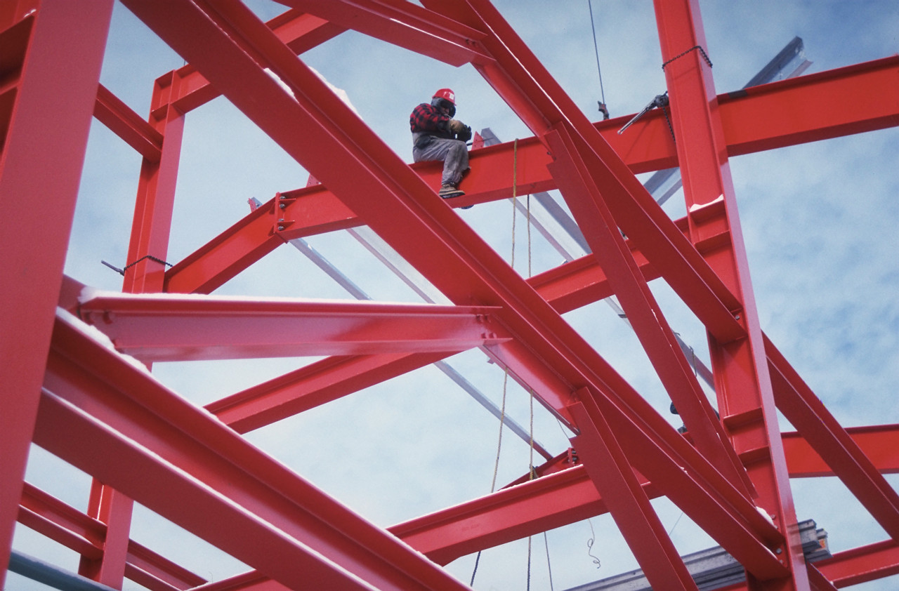
Statics
Coplanar
Forces
Eng. Laith Batarseh

Slide 2
Coplanar Forces
In this lecture
We will
Use equilibrium conditions to find unknown forces in given configuration

Slide 3
Coplanar Forces
Equilibrium conditions:
∑F = 0
∑F_{x} i + ∑F_{y} j = 0
∑F_{x} = 0
∑F_{y} = 0

Slide 4
Coplanar Forces
Procedures for analysis
FBD
Coordinate system (x and y axes)
Force Labeling (magnitude and direction)
Assuming the sense of the unknown forces
Equilibrium equations
∑ F_{x} = 0 and ∑ F_{y} = 0
Positive and negative assigning
Define the direction of the solution

Slide 5
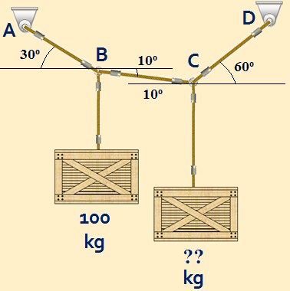
Coplanar Forces
Example[1]
Question:
Find the mass of the 2nd box needed to make this config-uration in equilibrium state.
Given: 1. one load
2. the directions of tension forces in cables
3. equilibrium condition
Solution: decompose the forces to its components and apply the equilibrium equations at points A and B

Slide 6
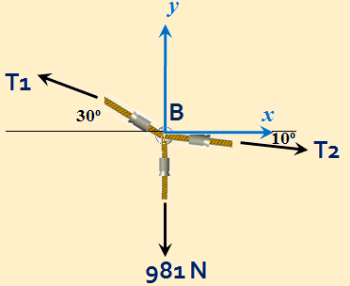


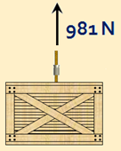
Coplanar Forces
Example[1] ^{cont}
∑F_{x} = 0
-T₁cos(30)+T₂cos(10) = 0
F_{y} = 0
T₁sin(30)-T₂sin(10)-981 = 0 --- Eq.2
Substitute Eq.1 in Eq.2 and solve for T₁
T₁ = 3031N
Back to Eq.1→ T₂ = 2665 N

Slide 7
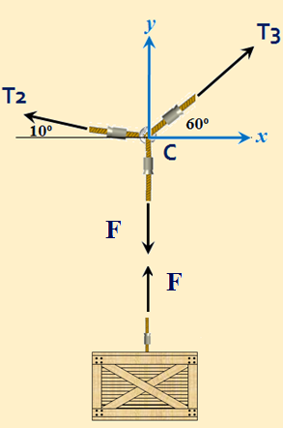
Coplanar Forces
Example[1] ^{cont}
∑F_{x} = 0
-T₂cos(10)+T₃cos(60) = 0
T₃ =5250N
F_{y} = 0
T₃sin(60)+T₂sin(10)-F= 0 --- Eq.2
Substitute the obtained values for T₂ and T₃ to find F
F=5009N → 511 kg

Slide 8

Coplanar Forces
Example[2]
8m
3m
C
Question: find the tensile forces generated in members AB and AC when the 50 kg load is applied knowing that this configuration is in equilibrium state.
Given:
The load
Equilibrium state
Solution:
1.Drawing FBD
2. Apply equilibrium equations
6m
B
4m
A
50 kg

Slide 9
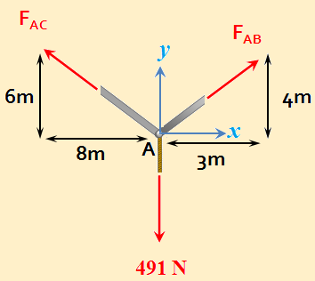
Coplanar Forces
Example[2]^{cont}
Solve Eqs 1 and 2 to find F_{AC} and F_{AB}

Slide 10
Coplanar Forces
Example[3]
8m
3m
Question: determine the stretch in springs AB and AC when the 50 kg load is applied knowing that this configuration is in equilibrium state.
Given:
The load
Equilibrium state
Solution:
1.Drawing FBD
2. Apply equilibrium equations
C
K_{AC} = 300N/m
B
6m
K_{AB} = 500 N/m
4m
A
50 kg

Slide 11
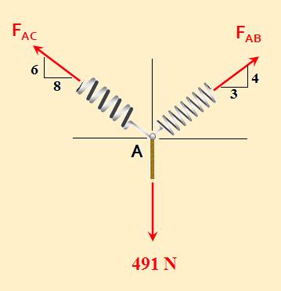
Coplanar Forces
Example[3]^{cont}
Solve Eqs 1 and 2 to find F_{AC} and F_{AB}

Slide 12
Coplanar Forces
Example[4]
Question: The box held the given configuration in equilibrium and the unstretched length of spring AC is 8m. Determine the mass of the wooden box.
Given:
Spring AC unstreched length
Equilibrium state
Solution:
1.Drawing FBD
2. Find the force in spring AC
3. Apply equilibrium equations
8m
3m
C
K_{AC} = 300N/m
6m
B
K_{AB} = 500 N/m
4m
A
M=??

Slide 13
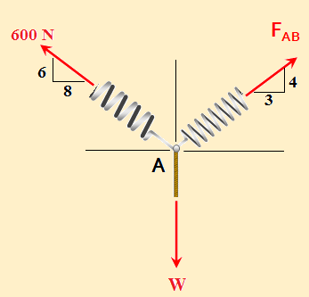
Coplanar Forces
Example[4]^{cont}
F_{AC} = k_{AC} x_{AC} = 300*(10-8) = 600N
M = 1000/9.81 = 102 kg

Slide 14
Coplanar Forces
Summary
∑F = 0
∑F_{x} i + ∑F_{y} j = 0
∑F_{x} = 0
∑F_{y} = 0

Slide 15
Coplanar Forces
End of lecture
See you in the next lecture
Don’t forget to answer the quiz

