Slide 1


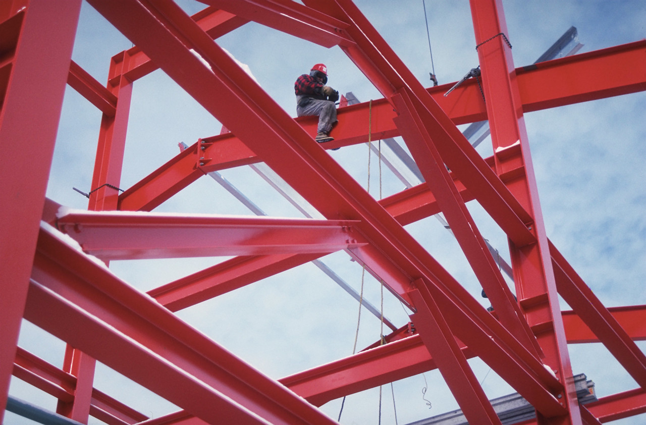
Statics
Statics .
Three dimensional
Forces
Eng. Laith Batarseh

Slide 2
Three dimensional Forces
In this lecture
We will
  Use equilibrium conditions to solve 3D problems

Slide 3
Three dimensional Forces
Statics .
Equilibrium conditions:
∑F = 0
∑F_{x} i + ∑F_{y} j + ∑F_{z} k= 0
∑F_{x} = 0
∑F_{y} = 0
∑F_{z} = 0

Slide 4
Three dimensional Forces
Statics .
Procedures for analysis
FBD
Coordinate system (x, y and z axes)
Force Labeling (magnitude and direction)
Assuming the sense of the unknown forces
Equilibrium equations
∑ F_{x} = 0, ∑ F_{y} = 0 and ∑ F_{z} = 0
Positive and negative assigning
Define the direction of the solution

Slide 5
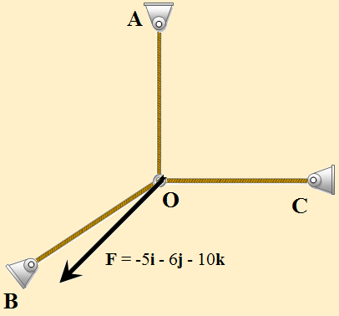
Three dimensional Forces
Statics .
Example[1]
Question:
Find the tension forces in each cable
Given: 1. the load
2. equilibrium condition
Solution: decompose the forces to its components and apply the equilibrium equations to find the tension forces in cables OA, OB and OC

Slide 6
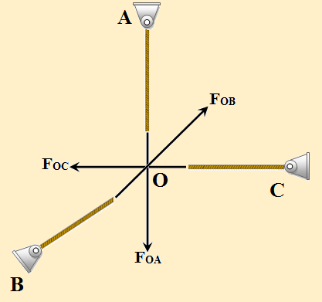
Three dimensional Forces
Statics .
Example[1]
Solution:
∑F_{x} = 0 → F_{OB} = 5i
∑F_{y} = 0 → F_{OC} = 6j
∑F_{z} = 0 → F_{OB} = 10k

Slide 7

Three dimensional Forces
Statics .
Example[2]
Question:
Find the tension forces in each cable shown in the figure
Given: 1. the load
2. equilibrium condition
Solution: decompose the forces to its components and apply the equilibrium equations to find the tension forces in cables OA, OB and OC
3000 N
Z
O
8 m
2 m
C
3 m
y
1.5 m
A
3 m
4 m
4 m
B
x

Slide 8
Three dimensional Forces
Statics .
Example[2]
Solution:
Using the Cartesian vector notation
First : F_{OA}
O
z
8 m
y
1.5 m
A
4m
x

Slide 9
Three dimensional Forces
Statics .
Example[2]
Second : F_{OB}
Third: F_{OC}
O
z
8 m
y
3 m
x
4 m
B
O
8 m
C
2 m
3 m

Slide 10
Three dimensional Forces
Statics .
Example[2]
1. The forces
2. Equilibrium equations
3 equations
3unknowns

Slide 11
Three dimensional Forces
Statics .
Example[2]
Solution strategy
Eliminate F_{OA}
Eliminate F_{OB}

Slide 12
Three dimensional Forces
Statics .
Example[2]
Solution strategy
Solve for Eq.4 F_{OB}
Solve for Eq.1 F_{OC}

Slide 13
Three dimensional Forces
Statics .
Summary
Three dimensional problems are preferred to be solved by the Cartesian notation
Equilibrium equations
∑F_{x} = 0
∑F_{y} = 0
∑F_{z} = 0

Slide 14
Three dimensional Forces
Statics .
Summary
Solving strategy:
FBD
Coordinate system (x, y and z axes)
Force Labeling (magnitude and direction)
Assuming the sense of the unknown forces
Equilibrium equations
∑ F_{x} = 0, ∑ F_{y} = 0 and ∑ F_{z} = 0
Positive and negative assigning
Define the direction of the solution

Slide 15
Three dimensional Forces
Statics .
End of lecture
See you in the next lecture
Don’t forget to answer the quiz

