Slide 1
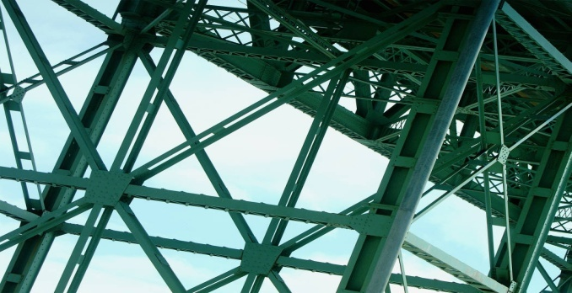

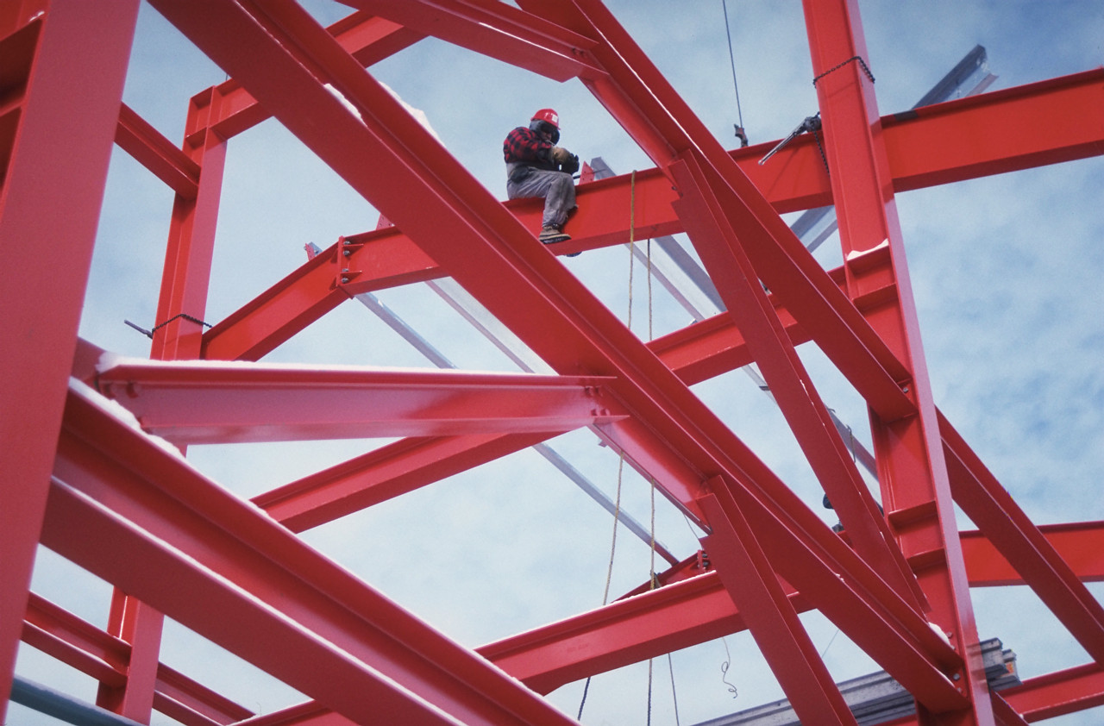
Statics
Statics .
Three dimensional
Forces
Eng. Laith Batarseh

Slide 2
Three dimensional Forces
In this lecture
We will
Use equilibrium conditions and matrices operations to solve 3D problems

Slide 3
Three dimensional Forces
Statics .
Mattresses operations
Note: three dimensional problem produce three equations with three unknowns. To solve these equations we can use mattresses operations
Collect the three equations in the following form:
These methods are:
Cramer's rule
Gauss elimination method
LU decomposition method
Arrange the above equations in mattresses form :
Use one of the mattresses operation method to find x₁, x₂ and x₃

Slide 4
Three dimensional Forces
Statics .
Cramer's rule
The three equations are arranged in matrix form
Solution is found as:

Slide 5

Three dimensional Forces
C
Statics .
Example[2]
Question:
Find the tension forces in each cable shown in the figure using matrix notation
Given: 1. the load
2. equilibrium condition
Solution: decompose the forces to its components and apply the equilibrium equations to find the tension forces in cables OA, OB and OC
3000 N
Z
O
8 m
2 m
C
3 m
y
1.5 m
A
3 m
4 m
4 m
B
x

Slide 6
Three dimensional Forces
Statics .
Example[1]
1.Equilibrium equations
2. Matrix notation
3 equations
3unknowns

Slide 7
Three dimensional Forces
Statics .
Example[1]
3. Cramer's rule

Slide 8
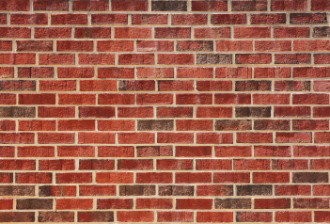
Three dimensional Forces
Statics .
Example[2]
Question:
Find the tension forces in each cable shown in the figure using matrix notation
Given: 1. the load
2. equilibrium condition
Solution: decompose the forces to its components and apply the equilibrium equations to find the tension forces in cables OA, OB and OC
z
3m
3m
A
B
3m
6m
x
9 m
O
C
y
100 kg

Slide 9
Three dimensional Forces
Statics .
Example[2]
Solution:

Slide 10
Three dimensional Forces
Statics .
Example[2]
Solution:
1.Equilibrium equations
2. Matrix notation

Slide 11
Three dimensional Forces
Statics .
Example[1]
3. Cramer's rule

Slide 12
Three dimensional Forces
Statics .
Summary
Matrix notation can be used to solved equilibrium three dimensional problems
There are many methods you can use it such as:
Cramer's rule
Elimination methods

Slide 13
Three dimensional Forces
Statics .
End of lecture
See you in the next lecture
Don’t forget to answer the quiz

