Slide 1

Statics
Chapter Three
7.2 distributed loads
By
Laith Batarseh

Slide 2
Distributed Loads
Statics
Combined distributed loads
In this lecture we will learn how find the resultant force for a combined distributed forces
If you have a several disturbed loads , you can find the resultant force for the whole combination by finding the resultant force from each distributed force and then sum the resultant forces to obtain a single equivalent force

Slide 3
Distributed Loads
Statics
Example 1:
Determine the magnitude and the location of the equivalent resultant force acting on the beam shown in the figure.
400N/m
w
300N/m
x
2m
4m
2m

Slide 4
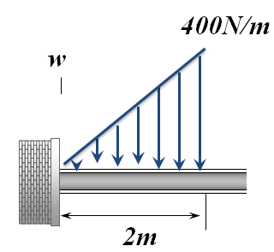
Distributed Loads
Statics
Example 1:
Solution: first load
F_{R} = area under the loading diagram
F_{R} = (0.5)(400 N/m) (2m) = 400 N
(x’) at the centroid of triangle load
x‘ = (1/3)(2) = 2/3m
w
400N
x
2/3 m

Slide 5
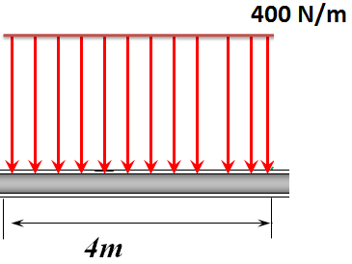
Distributed Loads
Statics
Example 1:
Solution: second load
F_{R} = area under the loading diagram
F_{R} = (400 N/m) (4m) = 1600 N
(x’) at the centroid of load area
x‘ = 2+(0.5)(4)= 4m
w
1600N
x
4m

Slide 6
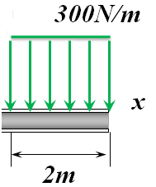
Distributed Loads
Statics
Example 1:
Solution: third load
F_{R} = area under the loading diagram
F_{R} = (300 N/m) (2m) = 600 N
(x’) at the centroid of load area
x‘ = 2+4+(0.5)(2)= 7m
w
600N
x
7m

Slide 7
Distributed Loads
Statics
Example 1:
Solution: representing all forces
w
400N
1600N
600N
2/3m
4m
7m

Slide 8
Distributed Loads
Statics
Example 1:
Solution: representing all forces
F_{R} =∑F = 400 + 1600 + 600 = 2600 N
w
2600N
To find the location of this force we must use the technique of simplifying of a force and couple moment you learn previously
x’=4.2m
M_{R} = F_{R} * x’ → x’ = M_{R}/F_{R}
M_{R} =(400)(2/3) + (1600)(4) + (600)(7) = 10867 N.m
x‘ = 10867/2600 = 4.2 m
Try to solve the same problem if the second load (400N/m) acts on the lower surface of the body. Be aware to the sum of forces and the direction of resultant moment

Slide 9
Distributed Loads
Statics
Example 2:
Determine the magnitude and the location of the equivalent resultant force acting on the beam shown in the figure.
250 N/m
400 N/m
200 N/m
5m
10m
5m
60º
45º

Slide 10
Distributed Loads
Statics
Example 2:
1250 N
4000 N
1000 N
5m
10m
5m
60º
45º
∑Fx = -(4000)(cos45) + (1000)(cos30) = -2198 N
∑Fy = -1250 – (4000)(sin45) – (1000)(sin30) = -4578 N
F_{R} = {(-2198)² + (-4578)²}^{1/2} = 5078 N
Ө = tan⁻¹(-4578/-2198) = 64º

Slide 11
Distributed Loads
Statics
Example 2:
to find the location of the resultant force, we can take the moment about a certain point in the body. Let us take point O.
∑Mo = -(1000)(cos30)(0.5)(5sin60) – (1000)(sin30)(0.5)(5cos60)
– (1250)(2.5+5cos60) – (4000)(sin45)(5cos60+5+(0.5)10cos45)
+ (4000)(cos45)(0.5)(10sin45) = -29963 N.m
x‘ = Mo/F_{R} = 29963 /5078 = 5.9 m from point O
1250 N
(4000)(sin45)
4000 N
1000 N
(1000)(sin30)
5m
10m
5m
(4000)(cos45)
(1000)(cos30)
60º
45º
O

Slide 12
Distributed Loads
Statics
End of lecture
See you in the next lecture
Don’t forget to answer the quiz

