Slide 1

Statics
Chapter Three
1. Moment Scalar
By
Laith Batarseh
Home
Next
Previous
End

Slide 2
Moment Scalar
Statics
In this lecture
  Define the concept of moment
  Learn how to sum moments
Home
Next
Previous
End

Slide 3
Moment Scalar
Statics
Definition
  Moment is defined as the tendency of a body lies under force to rotate about a point not on the line of the action of that force (i.e. there is a distance between the force and the rotation point )
  Moment is a vector quantity
Description
Moment depends on two variables:
  The acting force
Home
  Moment arm
Next
Previous
End

Slide 4

Moment Scalar
Statics
Description
Arm
Force
Tendency to rotate
Home
Next
Previous
End

Slide 5
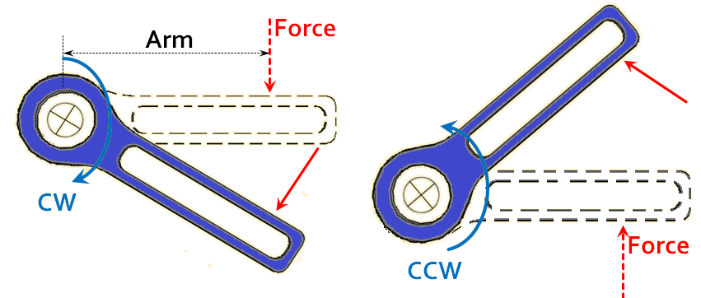
Moment Scalar
Statics
Tendency for rotation
Home
Next
Previous
End

Slide 6

Moment Scalar
Statics
Magnitude
D
F
Moment magnitude (M) = F.D
Home
Next
Previous
End

Slide 7
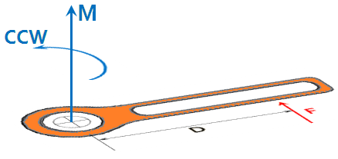
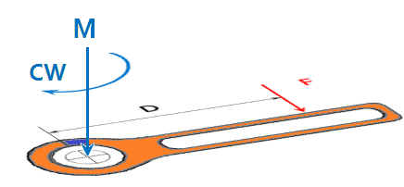
Moment Scalar
Statics
Direction
Home
Next
Previous
End

Slide 8
Moment Scalar
Statics
Solving procedures
1. Define the magnitudes of force (F) and arm (D)
2. Assume the positive direction (eg. Counter clock wise)
3. Find the magnitude of moment (M) as F.D
4. Give the moment the correct sign according to the tendency for rotation
Home
Next
Previous
End

Slide 9

Moment Scalar
Statics
Example [1]
  Find the moment caused by the following forces about point O
2m
2m
O
0.5m
O
0.5m
100 N
(a)
(b)
100 N
Home
Next
Previous
End

Slide 10
Moment Scalar
Statics
Example [1]
Assume the CCW direction is the positive direction.
2m
2m
O
0.5m
O
0.5m
100 N
(a)
(b)
100 N
Branch (a)
Mo = F.d = -(100N)(0.5m)
Mo=-50 N.m=50N.m CW
+
Branch (b)
Mo=F.d = (100N)(2m)
Mo=200 N.m CCW
Home
+
Next
Previous
End

Slide 11
Moment Scalar
Statics
Moment resultant
F1
d1
M1
O
M2
d2
M3
d3
F3
F2
Mo = ∑Mo = M₁ + M₂ – M₃ = F₁d₁+F₂d₂ – F₃d₃
+
Home
Next
Previous
End

Slide 12
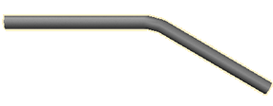
Moment Scalar
Statics
Example [2]
  Find the moment caused by the following forces about point O
100 N
2m
50 N
O
75 N
1m
3m
30º
60 N
5m
Home
Next
Previous
End

Slide 13
Moment Scalar
Statics
Example [2]
100 N
2m
50 N
O
75 N
1m
3m
30º
60 N
5m
+
Home
Next
Previous
End

Slide 14
Moment Scalar
Statics
Exercise
  Find the moment caused by the following forces about point O
100 N
5m
O
30º
0.3m
2m
45º
300 N
Home
Next
Previous
End

Slide 15
Moment Scalar
Statics
Exercise
100 N
100sin (30)N
5m
O
100cos (30)N
0.3m
2m
300 cos (45)N
300 sin (45)N
300 N
+
Home
Next
Previous
End

Slide 16
Moment Scalar
Statics
Summary
Moment is the tendency to rotate produced by a force
Moment is vector quantity
The scalar magnitude of the moment equal to : F.d
The direction of the moment will be in a direction perpendicular to the plane which contains the vectors of the F and d
Home
Next
Previous
End

Slide 17
Moment Scalar
Statics
End of lecture
See you in the next lecture
Don’t forget to answer the quiz
Home
Next
Previous
End

