Slide 1

Statics
Chapter Three
2. Moment vector
By
Laith Batarseh
Home
Next
Previous
End

Slide 2
Moment vector
Statics
In this lecture
  Find the moment using cross product
Home
Next
Previous
End

Slide 3
Moment vector
Statics
Cross product
Cross product is a mathematical operation can be done on vectors
Cross product for one time is done for two vectors
The cross product of two vectors is a vector perpendicular to the plane of A and B
The notation of vector A cross vector B is: C = AxB where C is the resultant vector from the cross product
the vector C can be represented as : C =CUc where Uc is a unit vector in a direction perpendicular to the plane that contains both A and B.
The value of the scalar quantity C is given as : C=A.B.sin(ϕ)
where ϕ is the angle between A and B.
The cross product is controlled by the right-hand rule
Home
Next
Previous
End

Slide 4
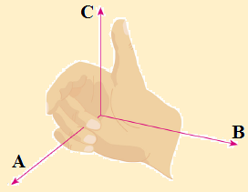
Moment vector
Statics
Graphical representation
Uc
ϕ
Home
Next
Previous
End

Slide 5
Moment vector
Statics
Laws of operation
Commutative Law is not valid: AxB ≠ BxA. AxB = -BxA
Multiple by scalar: s(AXB)= (sA)xB = Ax(sB)= (AXB)s
Addition: Ax(B+D) = (AxB) + (AxD)
Home
Next
Previous
End

Slide 6
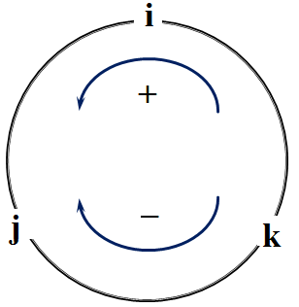
Moment vector
Statics
Cartesian vector formulation
z
K=ixj
j=kxi
y
i=jxk
Home
x
Next
Previous
End

Slide 7
Moment vector
Statics
Cartesian vector formulation
A = A_{x} i + A_{y} j + A_{z} k
B = B_{x} i + B_{y} j + B_{z} k
AxB=(A_{y} B_{z} -A_{z} B_{y} )i-(A_{x} B_{z} - A_{z} B_{x} )j + (A_{x} B_{y} - A_{y} B_{x} )k
Home
Next
Previous
End

Slide 8

Moment vector
Statics
Moment – vector formulation
M
Mo = rxF
Magnitude: Mo = rFsin(θ) = Fd
Direction: perpendicular to x-y plane (z-direction)
Matrix notation:
Resultant moment:M_{Ro} = ∑(rxF)
d
x
θ
r
O
y
F
Best for three dimensional problems
Home
Next
Previous
End

Slide 9
Moment vector
Statics
Example [1]
  Find the moment caused by the following forces about point O
z
F = [5i + 10j + 6k]N
O
y
3m
1m
2m
x
Home
Next
Previous
End

Slide 10
Moment vector
Statics
Example [1]
1. Formulate the position vector (r) : r = 3i+2j+1k
2. Find the moment vector (M_{o}) by matrix notation
r = 3i+2j+1k
F = [5i + 10j + 6k]N
Home
Next
Previous
End

Slide 11
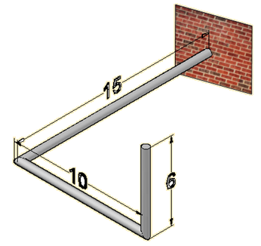
Moment vector
Statics
Example [2]
  Find the moment caused by the following forces about point O
z
O
y
x
F = [-5i + 5j -5k]N
Home
Next
Previous
End

Slide 12
Moment vector
Statics
Example [2]
1. Formulate the position vector (r) : r= 15i + 10j +6k
2. Find the moment vector (M_{o}) by matrix notation
Home
Next
Previous
End

Slide 13
Moment vector
Statics
Summary
Moment is a vector can be found by cross product and matrix notation
Matrix notation:
Home
Next
Previous
End

Slide 14
Moment vector
Statics
End of lecture
See you in the next lecture
Don’t forget to answer the quiz
Home
Next
Previous
End

