Slide 1

Statics
Chapter Three
3. Principle Of Moments
By
Laith Batarseh
Home
Next
Previous
End

Slide 2
Principle Of Moments
Statics
In this lecture
Learn the principle moment
Home
Next
Previous
End

Slide 3
Principle Of Moments
Statics
Principle of Moments
some times called Vrigonon’s theorem (Vrigonon is French mathematician 1654-1722).
State that the moment of a force about a point equals the summation of the moments created by the force components
In two dimensional problems: the magnitude is found as M = F.d and the direction is found by the right hand rule
In three dimensional problems: the moment vector is found by M =rxf and the direction is determined by the vector notation (ie. i,j and k directions)
Home
Next
Previous
End

Slide 4
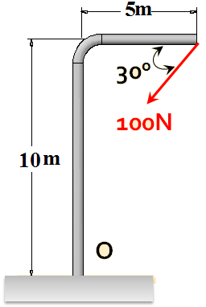
Principle Of Moments
Statics
Example [1]
Find the moment caused by the following forces about point O
Home
Next
Previous
End

Slide 5
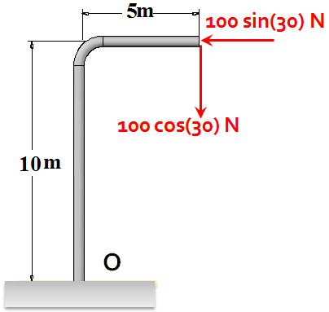
Principle Of Moments
Statics
Example [1]
+
M_{o,1} = 100 sin(30) (10) = 500 N.m
+
M_{o,2} =- 100 cos(30) (5) =- 433N.m
M = M_{o,1}+M_{o,2}=500-433=67N CCW
Home
Next
Previous
End

Slide 6

Principle Of Moments
Statics
Example [2]
The following is a gate. In which direction this gate will rotate?
100N
40º
1.2 m
60º
0.3 m
120N
Home
Next
Previous
End

Slide 7
Principle Of Moments
Statics
Example [2]
1. Force analysis
100 cos(40)
120 sin(60)
100 sin(40)
1.2 m
0.3 m
120 cos(60)
2. Moment calculations
+
∑ M = (100 cos(40))(1.5) –( 120 cos(60))(1.2) =43 N.m CCW
Home
Next
Previous
End

Slide 8
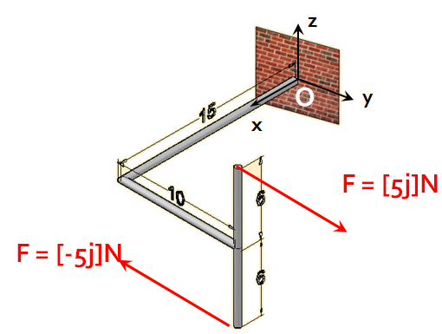
Principle Of Moments
Statics
Example [3]
Find the moment caused by the following forces about point O
Home
Next
Previous
End

Slide 9
Principle Of Moments
Statics
Example [2]
r₁= 15i + 10j +6k F₁ = [5j]N
r₂= 15i + 10j -6k F₂ = [-5j]N
Home
Next
Previous
End

Slide 10
Principle Of Moments
Statics
Summary
In two dimensional problems: the magnitude is found as M = F.d and the direction is found by the right hand rule
In three dimensional problems: the moment vector is found by M =rxf and the direction is determined by the vector notation
Home
Next
Previous
End

Slide 11
Principle Of Moments
Statics
End of lecture
See you in the next lecture
Don’t forget to answer the quiz
Home
Next
Previous
End

