Slide 1

Statics
Chapter Three
4. Moment of force about axis
By
Laith Batarseh
Home
Next
Previous
End

Slide 2
Moment of force about axis
Statics
In this lecture
Learn how to find the moment produced by a force about certain axis
Home
Next
Previous
End

Slide 3
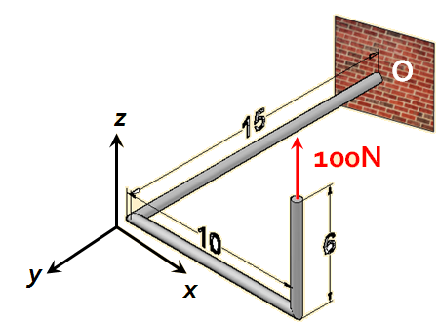
Moment of force about axis
Statics
In many real cases, the force tendency to rotate is about a specified axis.
Example :
Moment components:
M_{o,1} = (100)(10) (about y-axis)
M_{o,2} = (100)(15) (about x-axis)
M_{o,3} =0 (about z-axis)
Home
Next
Previous
End

Slide 4
Moment of force about axis
Statics
Magnitude
Scalar analysis: M = F.d
Vector analysis:
Where: u_{a} is a unit vector defining the direction of a-axis and given as
u_{a} = u_{a,x} i + u_{a,y} j + u_{a,z} k
To find the moment vector (Ma): Ma. u_{a}
Home
Next
Previous
End

Slide 5
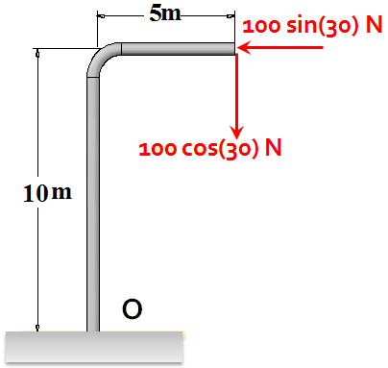
Moment of force about axis
Statics
Example [1]
+
M_{o,1} = 100 sin(30) (10) = 500 N.m
+
M_{o,2} =- 100 cos(30) (5) =- 433N.m
M = M_{o,1}+M_{o,2}=500-433=67N CCW
Home
Next
Previous
End

Slide 6
Moment of force about axis
Statics
Example [1]
Find the resultant moment produced by the following forces about axes: x, y and z.
F1=100N
z
0.5 m
0.25 m
F2=200N
O
y
0.5 m
0.5 m
F3=300N
x
Home
Next
Previous
End

Slide 7
Moment of force about axis
Statics
Example [1]
F1=100N
z
0.5 m
0.25 m
F2=200N
O
y
0.5 m
0.5 m
F3=300N
x
Home
Next
Previous
End

Slide 8
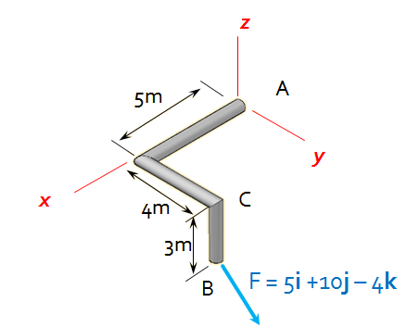
Moment of force about axis
Statics
Example [2]
Determine the magnitude of the moments of the force F about the x, y, and z axes. Solve the problem
using a Cartesian vector approach
using a scalar approach.
Home
Next
Previous
End

Slide 9
Moment of force about axis
Statics
Example [2]
using a Cartesian vector approach
r_{AB} = {5i + 4j -3k} m
For the axes: x, y and z the unit vectors are i, j and k respectively.
Mx = i . (r_{AB} x F)
My = j . (r_{AB} x F)
Mz = k . (r_{AB} x F)
Home
Next
Previous
End

Slide 10
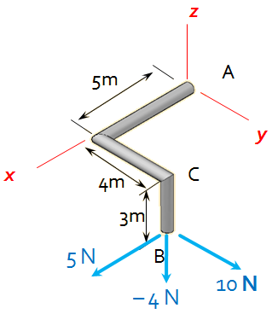
Moment of force about axis
Statics
Example [2]
using a scalar approach
Mx = ∑Mx = 10(3) – 4(4) = 14 N.m
My = ∑My = -5(3) + 4(5) = 5 N.m
Mz = ∑Mz = -5(4) + 10(5) = 30N.m
Home
Next
Previous
End

Slide 11
Moment of force about axis
Statics
End of lecture
See you in the next lecture
Don’t forget to answer the quiz
Home
Next
Previous
End

