Slide 1

Statics
Chapter Three
5.1. Moment of couple
By
Laith Batarseh
Home
Next
Previous
End

Slide 2
Moment of couple
Statics
In this lecture
  Learn how the definition of couple
Home
Next
Previous
End

Slide 3
Moment of couple
Statics
Definition
Couple is the moment generated by two forces has the same magnitude and opposite direction.
F
d
-F
Home
Next
Previous
End

Slide 4
Moment of couple
Statics
Scalar analysis
This analysis is considered for 2-D problems
The magnitude of moment is found by: M=F.d where F is the force magnitude.
the direction of couple moment is perpendicular to the plain that contain the F and d and it is found by the right hand rule.
M
F
-F
d
Home
Next
Previous
End

Slide 5
Moment of couple
Statics
Example on scalar analysis
F1
d1
F2
M1 = F1 . d1
M2 = F2 . d2
d2
-F2
-F1
Home
Next
Previous
End

Slide 6
Moment of couple
Statics
Vector analysis
This analysis is considered for 3-D problems
The moment vector is found by:
M=F x r where r is the position vector directed between the forces F and –F
Note that the moment vector is dependent on the position vector directed between the forces F and –F (r).
Derivation:
M = r_{B} x F + r_{A} x –F = (r_{B} - r_{A}) x F
But: (r_{B} - r_{A}) = r Then: M = rx F
B
r
-F
F
A
r_{B}
r_{A}
Home
O
Next
Previous
End

Slide 7
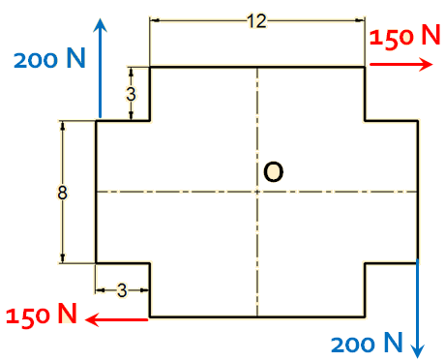
Moment of couple
Statics
Example [1]
Find the resultant moment couple produced by the following forces. All dimensions in m
Home
Next
Previous
End

Slide 8
Moment of couple
Statics
Example [1]
Solution:
1. By traditional moment analysis
∑Mo = -(150)(7)-(150)(7) – (200)(9)-(200)(9) = -5700 N.m
+
2.By cpouple moment analysis
∑Mc = -(150)(14) – (200)(18) = -5700 N.m
+
Home
Next
Previous
End

Slide 9
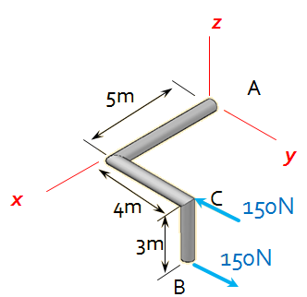
Moment of couple
Statics
Example [2]
Find the moment couple produced by the following force. All dimensions in m
Home
Next
Previous
End

Slide 10
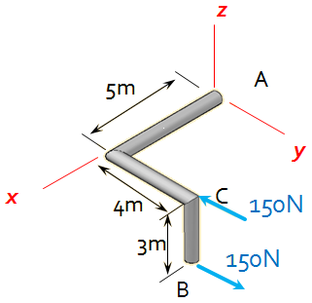
Moment of couple
Statics
Example [2]
1. F = 150 j
2. r = 3k
3. M = r x F = 150 j x 3k = {450N.m} i
Home
M
Next
Previous
End

Slide 11
Moment of couple
Statics
Summary
Couple is the moment generated by two forces has the same magnitude and opposite direction.
Scalar M=F.d
Vector M=F x r
Home
Next
Previous
End

Slide 12
Moment of couple
Statics
End of lecture
See you in the next lecture
Don’t forget to answer the quiz
Home
Next
Previous
End

