Slide 1

Statics
Chapter Three
5.2. Moment of couple
By
Laith Batarseh
Home
Next
Previous
End

Slide 2
Moment of couple
Statics
Equivalent couples
in many of life applications, an equivalent couple is required to solve some technical problems such as space and size.
Equivalent couples are the couples that have the same magnitude and same direction
As you can see, the relation between the forces and the arm distances in equivalent coupels is reverse (for example, as we reduce the moment arm, the required force for equivalent couple increases)
F₁
F₁.d₁ = F₂.d₂
F₂
=
d1
d2
-F₂
Home
-F₁
Next
Previous
End

Slide 3
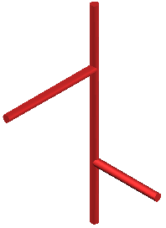
Moment of couple
Statics
Resultant couple
Resultant couple is the vectorial summation of the couples act on the body as you can see.
In simple situation as shown in the figure, the parallelogram is used to sum the moments and in more complicated cases or three dimensional problems, the Cartesian notation is used.
M1
M2
M1
M_{R}
Home
M2
Next
Previous
End

Slide 4
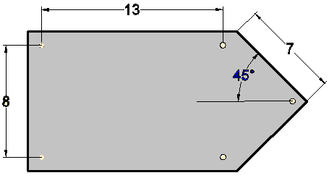
Moment of couple
Statics
Example [1]
The member shown in the figure is subjected to three coupling forces : 150, 200 and 100 N. the moment arms are shown.
If All dimensions in m, find the resultant couple moment produced by the following forces.
200N
150 N
100N
150 N
Home
100N
Next
Previous
200N
End

Slide 5
Moment of couple
Statics
Example [1]
Solution:
First, the Moment direction:
Second, the calculate the coupled moments
M₁ = -(200)(13) = -2600 N.m
M₂ = -(150)(7) = -1050 N.m
M₃ = - (100)(8) = -800 N.m
Finally, calculate the moment sum (resultant)
M_{T} = -2600-1050 -800=-4450 N.m
M_{T} = 4450 N.m (clockwise)
+
Home
Next
Previous
End

Slide 6
Moment of couple
Statics
Example [2]
The member shown in the figure is subjected to two coupling forces : 200 and 100 N. the moment arms are shown.
Find the resultant couple moment produced by the following forces.
6m
3m
200 N
45º
100 N
0.6m
45º
100 N
Home
200 N
3m
Next
Previous
End

Slide 7
Moment of couple
Statics
Example [2]
Solution:
First, the Moment direction:
Second, the calculate the coupled moments
M₁ = -(100)(0.6) = -60 N.m
M_{2,x} = (200 cos(45))(0.6) = 85 N.m
M_{2,y} = -(200 sin(45))(3) = -424 N.m
Finally, calculate the moment sum (resultant)
M_{T} = -60+85-242=-399 N.m
M_{T} =399 N.m (clockwise)
+
Home
Next
Previous
End

Slide 8
Moment of couple
Statics
3-D problems
For three dimensional problems, it is better to use the Cartesian notation (I, j and k) to represent the monuments.
The moment in a direction not one of the principle axes (x, y or z) can be represented as: M = Mu. Where u is a unit vector in the direction of the moment M.
The resultant moment can be found finally by vector addition for the moments vectors
Home
Next
Previous
End

Slide 9
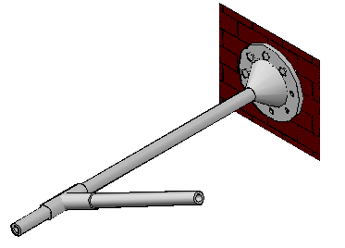
Moment of couple
Statics
3-D problems
z
Example:
The figure show an object subjected to two moments: M₁ and M₂. as you can see M₂ has an angle θ from the y-axis. The moment M₁ can be represented as: M₁= M₁i.
While the moment
M₂ can be represented as:
M₂ = M₂ (0i + cos(θ) j + sin(θ) k)
x
y
M₁
θ
M₂
Home
Next
Previous
End

Slide 10
Moment of couple
Statics
Summary
Equivalent couples are the couples that have the same magnitude and same direction
Resultant couple is the summation of the couples act on the body
In three dimensional problems, Cartesian notation is more convenient
Home
Next
Previous
End

Slide 11
Moment of couple
Statics
End of lecture
See you in the next lecture
Don’t forget to answer the quiz
Home
Next
Previous
End

