Slide 1

Statics
Chapter Three
6.1. Simplification of a force and couple system
By
Laith Batarseh
Home
Next
Previous
End

Slide 2
Simplification of a force and couple system
Statics
In many of situation where there a group of forces and moments acting on an object, it is seem more convenient to reduce the large number of forces and moments to one force and one moment.
Physical meaning: replacing a system of forces and moments by a system of one force and one moment.
Condition: the external effects produced by the forces and moments on the body for the original system are the same of the single force and moment in the new simplified system
Home
Next
Previous
End

Slide 3
Simplification of a force and couple system
Statics
Simplification conditions
F
-F
F
F
B
A
B
Note: the acting force can be transport from one position to another on its line of action (i.e. force vector)
F
F
A
B
A
B
M = F.d
Note: the force acts on a member can be transport from one position to another on a line perpendicular force vector by adding the moment generated by the original force (i.e. M=F.d)
Home
Next
Previous
End

Slide 4
Simplification of a force and couple system
Statics
Simplification conditions
Assume an object as shown in Fig.a is subjected to two forces ( F₁ and F₂) and one moment M. The forces F₁ and F₂ has a position vectors r₁ and r₂ respectively from the rotation point O to the line of action for each force.
M
F2
F1
r₂
r₁
O
Home
Next
Previous
Fig.a
End

Slide 5
Simplification of a force and couple system
Statics
Simplification conditions
To convert the previous system into one force-moment system we must:
first move each force to the point of rotation O. this step include adding the moments produced by both forces (M₁ and M₂ respectively )at the rotation point as shown in the Fig.b.
F2
M
F1
M₂ = r₂ x F₂
O
Home
M₁ = r₁ x F₁
Next
Previous
Fig.b
End

Slide 6
Simplification of a force and couple system
Statics
Simplification conditions
Then all forces and moments are summed using the following formulas:
F_{R} = ∑F
M_{R,O} = ∑M_{O} + ∑M
M_{R,o}
F_{R}
Home
O
Next
Previous
Fig.c
End

Slide 7
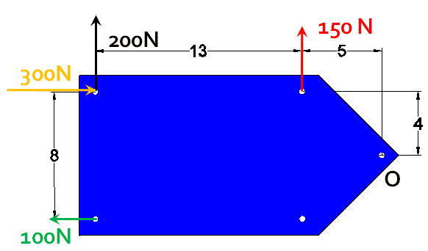
Simplification of a force and couple system
Statics
Example [1]
Figure below shows a plate a group of forces (100, 150, 200 and 300 N)
If All dimensions in m, Simplify the following force system to single force and moment system about point O
Home
Next
Previous
End

Slide 8
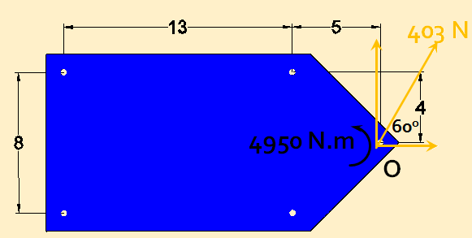
Simplification of a force and couple system
Statics
Example [1]
Solution:
First, calculate the resultant force F_{R}
∑Fx = 300 – 100 = 200 N
∑Fy = 200 + 150 = 350 N
Second, calculate the resultant moment M_{R}
M_{R} =-(200)(13) – (300)(4) –(150)(5) – (100)(4) = 4950 N.m
Finally, represent the new force and moment on the original system as shown.
Home
Next
Previous
End

Slide 9
Simplification of a force and couple system
Statics
Example [2]: couple resultant
The system shown in the figure is subjected to two coupling forces : 200 and 100 N. the moment arms are as shown.
Simplify the following force system to single force and moment system about point O
6m
3m
399 N.m
200 N
45º
100 N
0.6m
45º
100 N
Home
200 N
3m
Next
Previous
End

Slide 10
Simplification of a force and couple system
Statics
Example [2]
Solution:
First, the Moment direction:
Second, calculate the coupled moments
M₁ = -(100)(0.6) = -60 N.m
M_{2,x} = (200 cos(45))(0.6) = 85 N.m
M_{2,y} = -(200 sin(45))(3) = -424 N.m
Finally, calculate the moment sum (resultant)
M_{T} = -60+85-242=-399 N.m
M_{T} =399 N.m (clockwise)
Note that the resultant force (F_{R} ) = 0 which is true for all the coupled forces systems
+
Home
Next
Previous
End

Slide 11
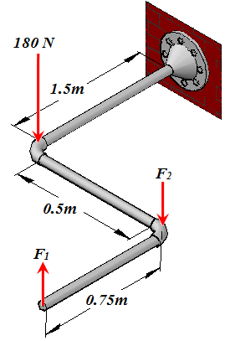
Simplification of a force and couple system
Statics
Example [3]
The three forces act on the pipe assembly. If F1 = 50 N and F2 = 80 N, replace this force system by an equivalent resultant force and couple moment acting at O. Express the results in Cartesian vector form..
Home
Next
Previous
End

Slide 12
Simplification of a force and couple system
Statics
Example [3]
Solution:
First, calculate the resultant force F_{R}
Finally, calculate the resultant moment M_{R} using cross product
Home
Next
Previous
End

Slide 13
Simplification of a force and couple system
Statics
Summary
To replace a system of forces and moments to single force and moment system, the external effects produced by the forces and moments on the body for the original system are the same of the single force and moment in the new simplified system.
The magnitude and the direction of force remain the same as it moves along its line of action
If the force produce a moment about a certain point, this moment must be compensated about that point.
Home
Next
Previous
End

Slide 14
Simplification of a force and couple system
Statics
End of lecture
See you in the next lecture
Don’t forget to answer the quiz
Home
Next
Previous
End

