Slide 1

Statics
Chapter Four
4.3. two and three forces members
By
Laith Batarseh
Home
Next
Previous
End

Slide 2
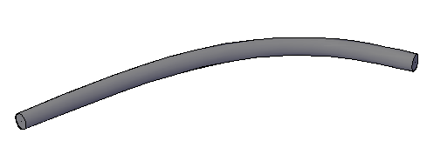
Two and three forces members
Statics
Two – forces member
Fig. 1.a shows a member loaded by two forces (i.e. two forces member). To assume that this member is under equilibrium:
The summation of forces must equal zero. Therefore, F₁=F₂.
The summation of moments produced by these forces, therefore, the lines of action for both forces must be the same.
Fig 1.b illustrates the condition of equilibrium for two forces members
F₂
F₁
(a)
F₂
F₁
(b)
Fig.1
Home
Next
Previous
End

Slide 3
Two and three forces members
Statics
Three – forces member
Similar to the two forces member, three – forces member is under equilibrium if the summation of the forces equal zero. However, to satisfy the equilibrium moment condition, the three forces must be either concurrent or parallel forces. Fig.2 illustrates two examples of concurrent and parallel forces.
Home
Next
Previous
(a)
(b)
Fig.2
End

Slide 4
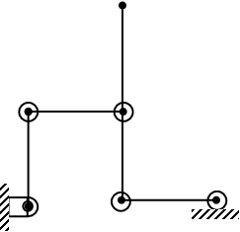
Two and three forces members
Statics
Example [1]
Fig.3 shows a member under the action of 100N force. Find the reaction forces at the supporting connections
A
100 N
0.3m
0.1m
B
0.1m
0.2m
D
Home
C
Next
Previous
Fig.3
End

Slide 5
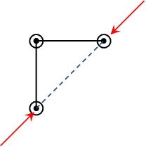
Two and three forces members
Statics
Example [1]
Solution
Let us draw F.B.D for the small member. This member is a two forces (remember, the two forces – member forces are identical). Now let us draw the F.B.D:
0.1m
F_{B}
0.1m
45º
F_{C}
You can note that we can calculate the angels of the reaction forces from the member geometry ( the line of action of these forces is the same)
Home
Next
Previous
End

Slide 6
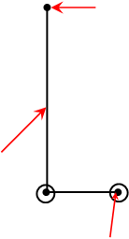
Two and three forces members
Statics
Example [1]
Solution
100 N
Now , let us draw the F.B.D for the other member
0.3 m
As you can see there is something is missing which is the direction of the reaction force F_{D}.
F_{B}
0.1 m
0.2 m
F_{D}
Home
Next
Previous
End

Slide 7
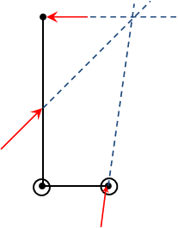
Two and three forces members
Statics
Example [1]
Solution
0.3 m
To find the reaction force Fc we can refer to the 2nd equilibrium equations which implies that these are either parallel or concurrent. As you can see these forces can not be parallel and so it must be concurrent as seen in Fig. 4. the angle Ө can be found as:
0.3 m
45º
45º
0.1 m
Ө
0.2 m
Home
Next
Previous
End

Slide 8
Two and three forces members
Statics
Example [1]
Solution
Now using the force equilibrium equations (∑Fx = ∑Fy = 0)
Rearrange Eq.2
Substitute Eq.3 into Eq.1 to have
Substitute Fc in Eq.3 to find F_{B}:
Note that you can resolve this problem by resolving the unknown reactions forces to their rectangular components and then use the ∑Fx = ∑Fy = ∑M = 0 equations

Slide 9
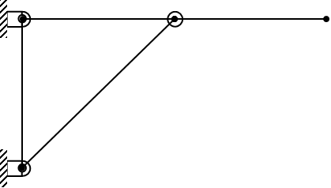
Two and three forces members
Statics
Example [2]
Fig.5 shows a member under the action of 10 kN force . Find the reaction forces at the supporting connections
10 kN
C
2 m
2 m
B
2 m
Home
A
Fig.5
Next
Previous
End

Slide 10
Equations of equilibrium
Statics
Example [1]
Solution
Let us draw F.B.D for the this system. Let us draw F.B.D for the member AB. This member is a two forces. And the F.B.D for the member CB as shown in the figure below . Note the resolving of the reaction force at point C.
F_{B}
B
10 kN
F_{C,x}
2 m
2 m
F_{B,x}
45º
F_{B}
F_{C}
F_{C,y}
F_{B,y}
F_{A}
A

Slide 11
Equations of equilibrium
Statics
Example [1]
Solution
As in the previous example, we have to find the angle of Fc. Again, we will use the equilibrium condition fro concurrent forces situation. The angle Ө can be found as:
F_{B}
B
2 m
10 kN
F_{C,x}
2 m
Ө
2 m
45º
F_{B,x}
45º
F_{C}
F_{C,y}
F_{B}
F_{B,y}
F_{A}
A

Slide 12
Equations of equilibrium
Statics
Example [1]
Solution
To find the reaction forces, we can use the equilibrium moment equation
First, we can apply the moment equation at point C:
Then , apply the moment equation at point B:
The negative value of the force mean that we must reverse the assumed sense for the component

Slide 13
Equations of equilibrium
Statics
Example [1]
Solution
The figure below show an intermediate stage of the solution where the reaction vertical components were found. To find the horizontal components, we can will use the triangle functions (sine and cosine) because the using of momentum equation will yield a trivial solution.
Verify:
2 m
10 kN
F_{C,x}
2 m
26.6º
2 m
45º
F_{B,x}
45º
F_{C}
10
F_{B}
20

Slide 14
Equations of equilibrium
Statics
Example [1]
Solution
the figure below illustrates the final solution
Note that F_{A} = F_{B} = 28.28∟45º
2 m
10 kN
20
2 m
26.6º
2 m
45º
20
45º
22.33
10
28.28
20

Slide 15
Equations of equilibrium
Statics
We reached the end of lecture
See you in the next lecture
Don’t forget to answer the quiz
Home
Next
Previous
End

