Slide 1

Statics
Chapter Four
4.4 equilibrium in 3D
By
Laith Batarseh
Home
Next
Previous
End

Slide 2
equilibrium in 3D
Statics
Supported reactions
As in two dimensional problems, :
if the support restricts the body from a translational monition, a reaction force is developed in this connection.
if the support restricts the body from a rotational motion, a reaction moment is developed in this connection
Home
Next
Previous
End

Slide 3
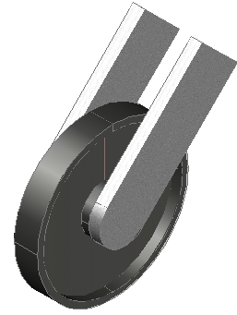

equilibrium in 3D
Statics
3D connections
Single reaction supports
Both smooth surface and 3D roller supports have a single reaction force acts on the surface of the connection
Smooth surface support
Roller support
Home
Next
Previous
End

Slide 4
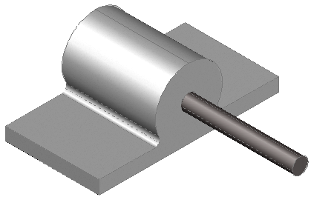
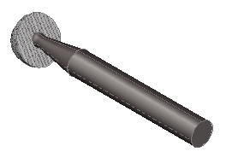
equilibrium in 3D
Statics
3D connections
Three and four reaction supports
Ball and socket connection one of the famous 3 reaction forces connection and the single journal bearing is a famous example on 4 reactions supporting. The reactions developed in journal bearing are : two forces and two couple moments
Home
Ball and socket connection
Single journal bearing
Next
Previous
End

Slide 5
equilibrium in 3D
Statics
3D connections
Five and six reactions support
This category include:
Single journal bearing with beam shaft: two forces + three couple moments
single thrust bearing: three forces + two couple moments
Single smooth pen: three forces + two couple moments
Single hinge : three forces + two couple moments
Fixed support (6 reactions): three forces + three couple moments
For more connection reactions, refer to Engineering Mechanics, Statics, 12th edition, R. C. Hibbeler, 2010, pp 238-239

Slide 6
equilibrium in 3D
Statics
Equation of equilibrium
we learn before that we can analyze a 3D problem using vector or scalar approaches
Vector analysis
In vector analysis the equation of equilibrium are written as:
∑F = 0 and ∑M = 0
where F and M are the vectors of the force and moment respectively
Scalar analysis
In scalar analysis the equation of equilibrium are written as:
∑F = ∑F_{x}i + ∑F_{y}j + ∑F_{z}k = 0
∑M= ∑M_{x}i + ∑M_{y}j + ∑M_{z}k = 0
∑F_{x} =0
∑F_{y} = 0
∑F_{z} = 0
∑M_{x} =0
∑M_{y} =0
∑M_{z} = 0

Slide 7
equilibrium in 3D
Statics
Constrains and statical determinacy
The concept of supporting a body under equilibrium is important as the satisfaction of the equilibrium equation itself.
In some cases, body may has more supports than what it needs to be in equilibrium situation while in other cases, the body will not have enough supports to keep it under equilibrium condition. In addition, in other cases, the arrangement of the supports allow the body to move.
Statically determinacy
We can say that the system is statically indeterment if the number of the unknown forces and moments are more than the equilibrium equations.
Remember: algebraically, you need a number of equation equal the number of unknowns you desire to solve.

Slide 8
equilibrium in 3D
Statics
Redundant constraints
Assume that we have the beam shown in Fig.1-a
F
The F.B.D for this beam is shown in Fig.1-b.
As you can see, the number of unknowns is 5: Ax, Ay, By, Cy and Dy and as you know, there are three equilibrium equations to use so you will failed to find all the unknown reactions using the equilibrium equations only because the number of unknowns is larger than the number of equations.
A
B
C
D
Fig.1-a
F
Ax
Ay
By
Cy
Dy
Fig.1-b
Such cases are called statically indeterment

Slide 9
equilibrium in 3D
Statics
Redundant constraints
If we go back to the same case, you can find that this system can be under equilibrium with only one roller support and so, there are two extra supports used to keep the body under equilibrium.
The case where there are extra supports to keep the body under equilibrium is called redundant constraints
F
A
B
C
D

Slide 10
equilibrium in 3D
Statics
Improper constraints
The equality between the number of unknowns and the number of equations does not guarantee in all times the equilibrium of a body, for example see the figure below. Such case is called improperly constrained because the system is able to move.
To explain that, let us go back to the figure. As you can see, we resolve the force to its rectangular components. You can note that the horizontal component (Fx) tends to move this system in the horizontal direction and so ∑Fx = 0 is not valid any more.
In general, improper constraints must be avoided in engineering practice because it shows instability in the system.
Fy
F
Fx
A
B

Slide 11

equilibrium in 3D
Statics
Example [1]
The figure show a rod supporting the 600 N box.
Find the tension forces developed in the cables B and C
Solution
z
0.4m
0.5m
We can use vector analysis
B
0.3m
C
0.2m
O
x
0.8 mm
A
y
600 N

Slide 12
equilibrium in 3D
Statics
Example [1]
Solution
Ox
Oy
F_{AB}
Let us now present the F.B.D for the connection rod
To eliminate the reactions at point O, we can apply the moment equation at this point:
F_{AC}
Oz
600
Rearrange the above equation and collect the similar Cartesian terms

Slide 13
equilibrium in 3D
Statics
Example [1]
Solution
From the concept of equilibrium in 3D:
Solve equation 1 and 2 to find F_{AB} and F_{AC}
Try this by your self.

Slide 14
equilibrium in 3D
Statics
Summary
In general, any support connection will develop a reactions when its subjected to loading configuration.
The type of reaction developed in the connection depends on the support it self. However, the minimum number of reactions is one and the maximum is six.
In two dimensional problems, the equilibrium forces and moments equations are used directly to find the unknowns
In two dimensional problems, the assumption of equilibrium is valid when the summation of forces equal zero and they are parallel or concurrent. Being concurrent means: the line of action for the reaction forces intersect at common point. This help in finding the direction of the unknown reaction forces.

Slide 15
equilibrium in 3D
Statics
Summary
In three dimensional problem, vector and scalar analysis can be used to find the unknown reactions
In vector analysis, the summation of forces vectors and moment vectors equal zero while in the scalar analysis the summation of forces components equal zero. The last method is done with the aid of Cartesian notation system
We can say that the system is statically determined if the number of unknowns equal the number of equilibrium equations
Redundant constraints are extra constraints that does not affect the state of equilibrium how ever create a case of statically in-determined
improper constraints is the case where the system is statically determined but the system is still able to move

Slide 16
equilibrium in 3D
Statics
We reached the end of lecture
See you in the next lecture
Don’t forget to answer the quiz
Home
Next
Previous
End

