Slide 1

Statics
Chapter Five
5.1 trusses
By
Laith Batarseh
Home
Next
Previous
End

Slide 2
trusses
Statics
In this lecture we will
Introduce the concept of truss and why and where we can use it
Home
Next
Previous
End

Slide 3
trusses
Statics
What is the truss
A truss is a combination of slender members (bars or beams) joined together at their ends
The main advantage of truss is hiding in it ability to distribute the acting loads among its members.
Trusses are generally used in construction field and mainly used to support a bridge or a roof weights.
If the form of truss members share the same plane we called it a planar truss

Slide 4
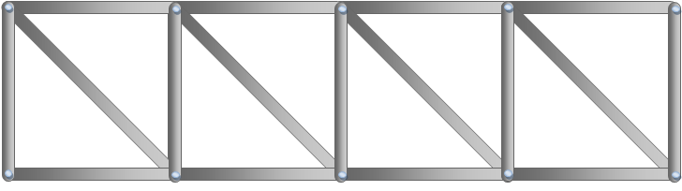
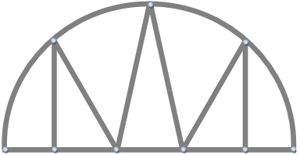
trusses
Statics
Examples on truss
Observe the member connection.

Slide 5
trusses
Statics
Examples on truss
In trusses, the forces transmit through the joints to the supporting members.
Because the trusses share the same plane, the analysis of forces in this configuration is two-dimensional.
In the large structures, a roller connection may be used to give more freedom for expansion on contraction as shown in the figure below.

Slide 6
trusses
Statics
Design criteria
To obtain a correct truss design, we must first identify the types of forces in members and joints. To do this, there are two assumption required:
All the applied loads are at the connection
The joining must be done by smooth pins

Slide 7
trusses
Statics
1st assumption
In many cases, the applied load is done at the joints. Although, in general, the weight of member is neglected because the applied loads are much larger than the member weight , in some cases the weight of member is involved in the load calculations . In such cases, the member weight is divided equally (half weight ) and each part is applied at a joint of the member.

Slide 8
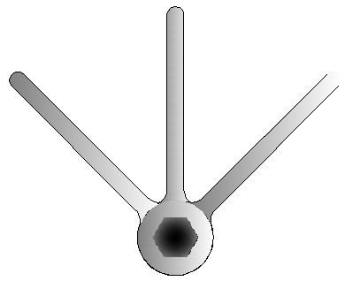
trusses
Statics
2nd assumption
Usually, the connection between the truss members is done by:
gusset plate, or
A common pin or bolt
Both kinds of connections are shown in the Figures below. For both cases, we can assume that the forces are concurrent.
Gusset plate
Common pen

Slide 9
trusses
Statics
Member force
Due to the previous two assumptions, we can that the truss member will acts as two force member. Because of this, the line of action of the force acting on a truss member is the same axis of the member.
The two type of force act on a member is either tension or compression as shown in the figure below
Tension
Compression

Slide 10
trusses
Statics
Member force
There is a simple way to recognize the type of the force in truss member. We can assume if the force try to elongate the member, then the force is a tensile and if the force try to buckle the member, then it will be a compression force. The force acting along the member define the type of stress generated inside the member. This type of analysis is discussed in a filed of engineering science called material mechanics.
It is worthy to mention that if the type of member force is compression, then the member is made thicker than the tensile member to prevent bulking.

Slide 11
trusses
Statics
Simple member
The truss is a rigid body consists from a number of connected members. To built a truss, you need at least 3 members as shown in the figure to the left
Such type of trusses that consist of three members is called simple truss
adding new members to simple truss to form new triangle as shown in the figure to the right does not change the name and we still called it simple

Slide 12
condition for equilibrium +FBD
Statics
End of lecture
See you in the next lecture
Don’t forget to answer the quiz
Home
Next
Previous
End

