Slide 1

Statics
Chapter Five
5.3 method of sections
By
Laith Batarseh
Home
Next
Previous
End

Slide 2
Method of sections
Statics
In this lecture we will
Introduce the concept of method of sections
Use this method to solve truss problems
Home
Next
Previous
End

Slide 3



Method of sections
Statics
Method of sections
Is a method used mainly to find member forces in few number of members.
it is based on the fact that if a truss is under equilibrium, then any segment in the truss is also under equilibrium. To illustrate this principle, see the figure below.
The plane used to cut the member is called section
Compression
Tension

Slide 4
Method of sections
Statics
Analysis procedures
Drawing F.B.D
First, chose appropriate section which isolate the members that you with to find there unknown forces
In most cases, we need to find the reactions at the supporting points before isolating the chosen section. This can be done easily by using equilibrium equations.
Draw F.B.D for the chopped section
Define the direction of forces using one of the methods discussed in the method of joints: by inspection or by assuming all the forces are tension and then verify this assumption using the numerical calculation

Slide 5
Method of sections
Statics
Analysis procedures
Equilibrium equations
We must be carful when select the appropriate equilibrium equation to find the unknowns. As you remember, applying the moment equation at intersecting point of lines of action for two forces eliminate them and so we can find a third unknown force. So, you may start with applying the moment equation at a common intersecting point of forces lines of actions.
In some cases we can use the principle of transmissibility and slide a force to a certain point and then resolve it into its rectangular components. This procedure insure, in many situations, eliminating one of the unknown force components. the principle of transmissibility implies that we can move the force along its line of action.

Slide 6
Method of sections
Statics
Examples [1]
Determine the force in members FE, FC, and BC of the truss shown in the figure
F
E
500 N
3m
B
C
D
A
4m
4m
4m
1000 N

Slide 7
Method of sections
Statics
Examples [1]
Solution
We can start with finding the reactions at connections A and D. the figure below shows the F.B.D for the whole truss
Now, we apply equilibrium equations to find the supports reactions:
∑Fx= 0 → 500 – Ax = 0 → Ax = 500N
∑M_{A}= 0 → -1000(8) – 500(3) + Dy(12) = 0 → Dy = 792N
∑Fy = 0 → Ay – 1000 +792 = 0 → Ay = 208 N
F
E
500 N
3m
B
C
A_{x}
A
D
4m
4m
4m
A_{y}
1000 N
D_{y}

Slide 8
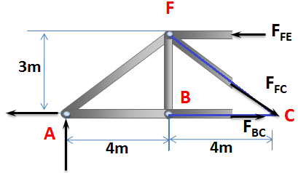
Method of sections
Statics
Examples [1]
Solution
Now let us make a section s-s as shown in figure below
500 N
208 N

Slide 9
Method of sections
Statics
Examples [1]
Solution
We can apply equilibrium equations to find the unknown member forces:
Summation of moments at point F:
∑M_{F}= 0 → F_{BC}(3) – 208(4) – 500(3)= 0 → F_{BC}= 777N
Summation of moments at point C:
∑M_{C}= 0 → F_{FE}(3) – 208(4) = 0 → F_{FE}= 277N
Summation of forces in y-direction:
∑Fy = 0 → 208 – F_{FC}(3/5) = 0 → F_{FC} = 357N
500 N
208 N

Slide 10

Method of sections
Statics
Examples [2]
Determine the force in member EB of the truss shown in the figure
500 N
1500 N
500 N
E
500 N
F
D
30º
30º
B
30º
30º
A
C
2m
2m
2m
2m
2000 N
1000 N

Slide 11
Method of sections
Statics
Examples [2]
Solution
As you can see, joint (E) connect four members and joint (B) connect five members. So, it may be more convenient to section this truss from joint (E) although this joint create statically in-determent situation due to the presence of three unknown forces.
To overcome this problem, we can make two sections, one to find one of the unknowns and the other to satisfy the requirement of this problem which is finding F_{EB}.

Slide 12
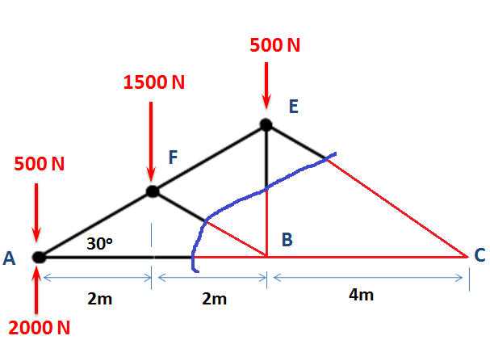
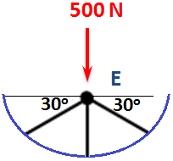
Method of sections
Statics
Examples [2]
Solution
The two chosen sections are shown in figure below. As you can see, the section b-b can be used to find F_{EB} if one of the other unknown forces is found. Our strategy is to find F_{EC} from section a-a and then go back to section b-b and with the aid of equilibrium conditions, we can find our requirement.
b
b
a
F_{BF}
F_{EC}
F_{EB}
F_{EF}
F_{ED}
F_{AB}
F_{EB}
a

Slide 13
Method of sections
Statics
Examples [2]
Solution
To find F_{EC}, we use the principle of transmissibility and slide this force to point C as shown. Then we can resolve it to its components. Apply the moment equation at point (B):
∑M_{B}= 0 →-500(4) – 1500(2) + 2000(4) – F_{EC} sin(30)(4)= 0
→ F_{EC}= 1500 N
a
F_{BF}
F_{EC,y}
F_{EB}
F_{EC}
F_{AB}
F_{EC,x}
a

Slide 14
Method of sections
Statics
Examples [2]
Solution
After finding F_{ED}, we now can take the section b-b and apply the force equilibrium equations at this point:
Summation of forces in x-direction:
∑Fx = 0 → F_{EF} cos(30) – 1500 cos(30) = 0 → F_{EF} = 1500N
Summation of forces in y-direction:
∑Fy = 0 → 1500 sin(30) + 1500 sin(30) – 500 - F_{EB}= 0
→ F_{EB} = 1000N
b
b
F_{EF}
1500
F_{EB}

Slide 15
Method of sections
Statics
End of lecture
See you in the next lecture
Don’t forget to answer the quiz
Home
Next
Previous
End

